Slide 1
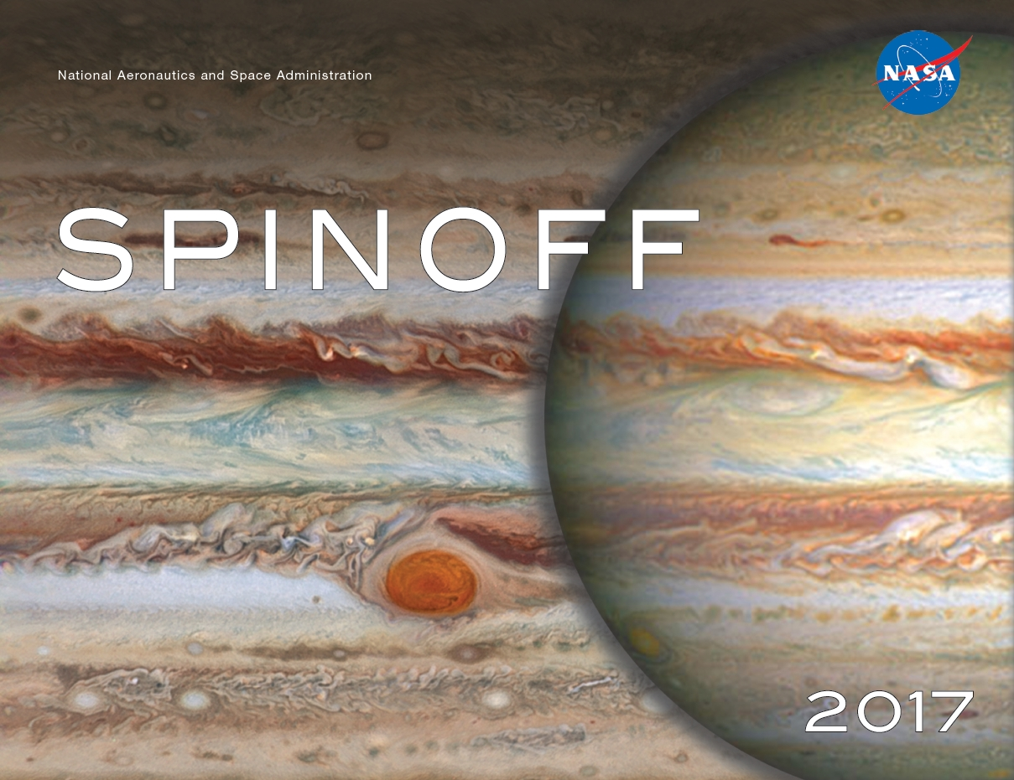

Slide 2


Slide 3
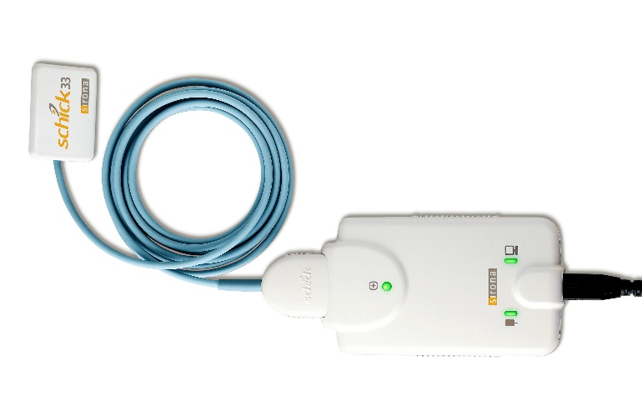
Active Pixel Sensors Lead Dental Imagery into Digital Age
Jet Propulsion Laboratory (JPL)
Schick by Sirona Dental
Long Island City, New York
NASA Technology
Complementary metal oxide semiconductor (CMOS) active pixel sensors invented at JPL allow smaller, more efficient digital imagers than those based on charge coupled device
Other camera electronics can be integrated onto chip with pixel array: first “camera on a chip”
Technology Transfer
Shick Technologies and JPL entered into Technology Cooperation Agreement to develop technology, adapt it for dental X-ray imaging
Schick obtained an exclusive license for CMOS dental imaging
Benefits
Schick, now part of Sirona Dental, enjoys energy-efficient, battery-operated X-rays and smaller, more comfortable intraoral sensors
X-rays benefit from boom in CMOS imager industry, bringing higher quality, lower costs
Spinoff 2017
Health and Medicine

Slide 4
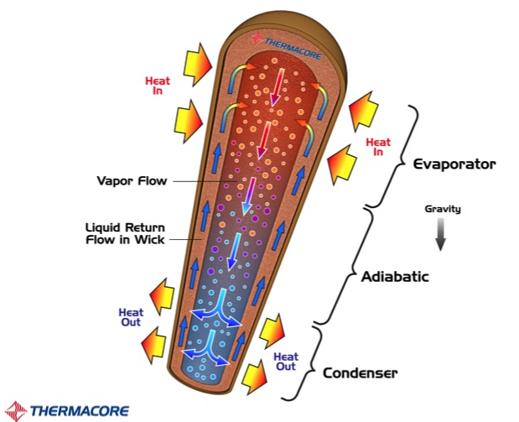
Mini-Heat Pipes Wick Away Heat in Brain Surgery
Glenn Research Center
Thermacore Inc.
Lancaster, Pennsylvania
NASA Technology
Heat pipes are “like a superhighway for heat”—they move a lot of heat quickly
NASA first became interested in the early days of spaceflight, to even out temperatures on non-rotating satellites
A recent SBIR contract funded research to passively cool fuel cells, which produce electricity
Benefits
Mini-heat pipes in bipolar forceps improve brain surgery outcomes; offer increased precision and shorten procedures
Just 2.2-mm in diameter to fit within bipolar forceps, they work with and against gravity
Heat pipes also help with blood warmers to ensure even distribution of heat, and in a number of other medical applications
Technology Transfer
Thermacore has had more than 40 SBIR contracts since the 1980s, including the fuel cell project
The ultra-thin vapor chambers designed for NASA’s fuel cells won a 2014 R&D 100 Award
SBIR contracts helped Thermacore advance heat pipe tech for many applications, including medical
Spinoff 2017
Health and Medicine

Slide 5
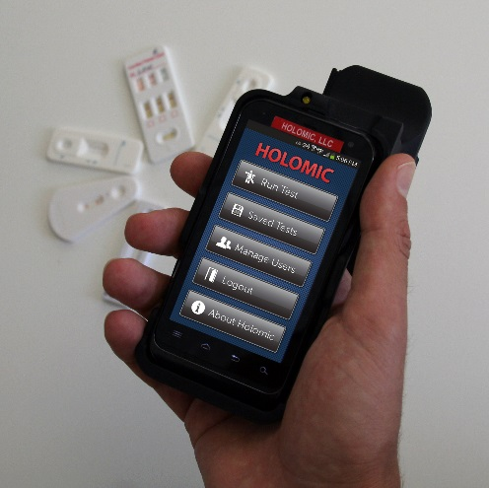
Fluorescent Diagnostic Test Readers Offer Fast, Low-Cost Results
Ames Research Center
Cellmic LLC
Los Angeles
NASA Technology
To medically diagnose astronauts in space, Ames awarded two SBIR contracts to Intelligent Optical Systems to create rapid diagnostic tests to be analyzed by a smartphone-based reader
The company subcontracted Cellmic, then known as Holomic, to build the smartphone interface
Technology Transfer
Already able to analyze lateral flow test strips in visible light, Cellmic developed reader that uses ultraviolet light for amplified results
Developed electronics, software to use phone’s microprocessor to evaluate samples
Cellmic and IOS delivered capability to rapidly detect one cardiac and three liver biomarkers
Benefits
Cellmic markets resulting HRDR-300 Fluorescent Immunoassay Reader to companies that develop their own test strips
Low cost, portability, ease of use, rapid results all benefit use in remote locations
Communications capability lets test results, locations be sent to central database
Spinoff 2017
Health and Medicine

Slide 6
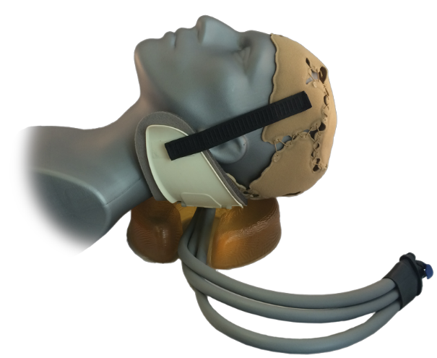
Cooling Garments Find New Medical, Athletic, and Industrial Uses
Ames Research Center
WElkins LLC
Downers Grove, Illinois
NASA Technology
In the 1960s and ’70s Bill Elkins worked on liquid cooling garments for NASA and the Air Force
Tubes threaded through suits carried water cooled by a heat exchanger
With Ames researchers, Elkins developed system of thin panels holding liquid-filled channels for cooling
Technology Transfer
Elkins founded several companies that applied liquid cooling to medical, athletic, and industrial uses
After founding WElkins LLC in the 1990s, Elkins was contacted by a doctor interested in using cooling to mitigate brain damage caused by stroke and head trauma
2004 pilot study showed strong potential
Benefits
Strokes, heart attacks, brain injury, sedation during surgery decrease oxygen flow to parts of brain; cooling diminishes need for oxygen, also decreases inflammation from injury. WElkins Cooling Headliner approved by FDA
Company also markets systems to athletes for improved performance, head trauma treatment, and to workers wearing heavy protective gear
Spinoff 2017
Health and Medicine

Slide 7
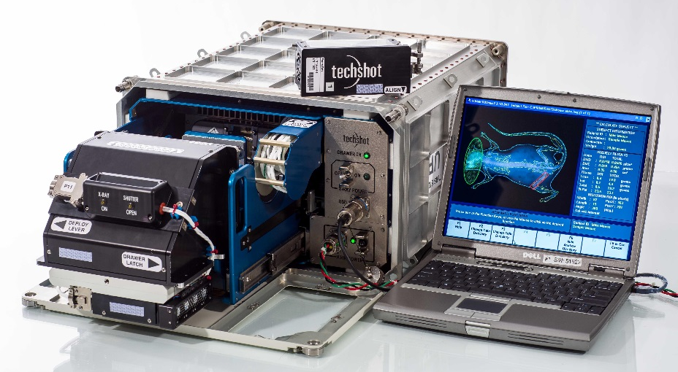
Space-Based Bone Scanner Expands Medical Research
Johnson Space Center
Techshot Inc.
Greenville, Indiana
NASA Technology
One of NASA’s ongoing areas of research is learning what happens to bones after long-term exposure to zero gravity conditions
This includes studies of astronauts as well as experiments on animals (such as mice) in space
Technology Transfer
Johnson worked with the Center for the Advancement of Science in Space (CASIS) to upgrade laboratory facilities on the space station
CASIS partnered with Techshot to develop a bone densitometer that could be deployed on the ISS and operated by astronauts without exposing them to harmful radiation
Benefits
The resulting device, dubbed Bone D, is now in commercial operation on the ISS
Companies rent the facility through Techshot, which maintains a ground-based mission control to monitor the instrument and acquire real-time data from experiments
Spinoff 2017
Health and Medicine

Slide 8
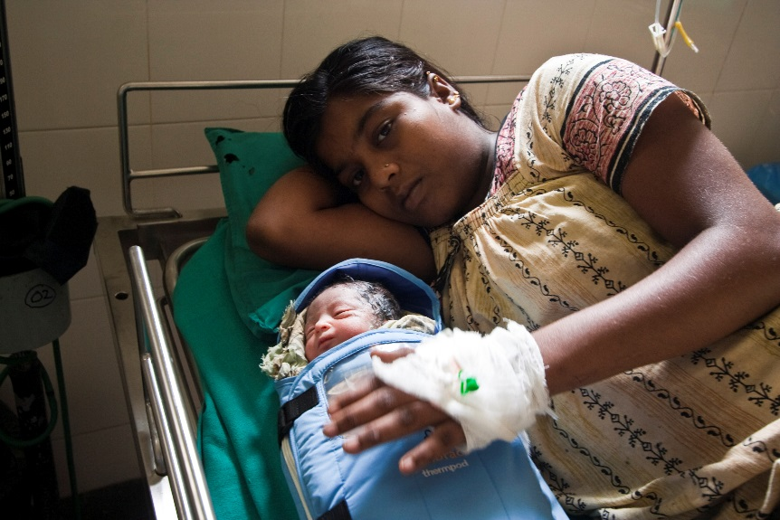
Temperature-Regulating Fabrics Keep Babies Comfortable
Johnson Space Center
Embrace Innovations
San Francisco
NASA Technology
To keep astronauts comfortable, spacesuits use active liquid cooling garments
Under Johnson SBIR contracts, Triangle Research and Development Corporation tried more passive methods, microencapsulating phase change materials and infusing them into threads and fabrics
Technology Transfer
Gateway Technologies licensed exclusive patent for incorporating temperature-regulating phase change materials into fibers and fabrics
Now known as Outlast, company supplies fabrics with phase change materials to companies that make clothes, bedding, sleeping bags, and more
Benefits
Embrace Innovations uses Outlast fabric in line of Little Lotus baby swaddles and sleeping bags
Keeps babies comfortable, reduces risk of overheating, which is linked to sudden infant death syndrome
Sales support Embrace’s nonprofit arm in efforts to save premature babies in developing world
Spinoff 2017
Health and Medicine

Slide 9


Slide 10
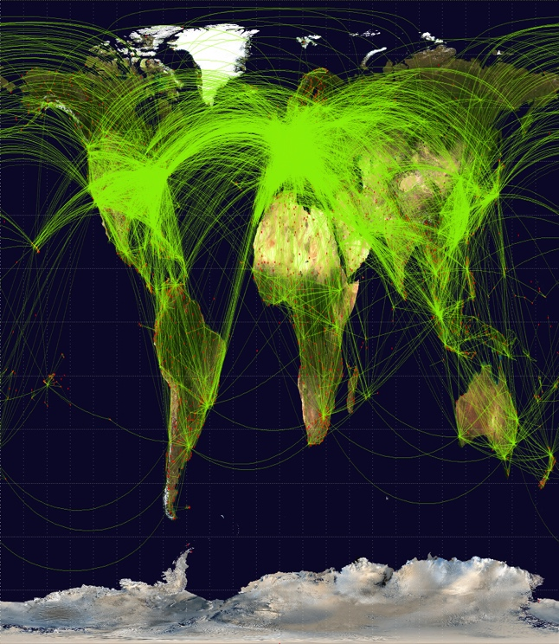
Reconfigurable Radio Tracks Flights Worldwide
Glenn Research Center
Harris Corporation
Palm Bay, Florida
NASA Technology
NASA needs powerful radios to communicate with satellites, rovers, and astronauts—to control machinery and receive data
A higher bandwidth radio will make it easier to send large packets of data more quickly
The software can also be reconfigured remotely, allowing for future updates or repairs
Benefits
Harris AppSTAR hardware and software can both be reconfigured, so it’s easy to customize.
One major client, Aireon LLC, will use the radio to track flights worldwide, filling large existing gaps over water or wilderness, allowing planes to fly more direct routes, with less space between them
Another client will use orbiting radios to track ships at sea
Technology Transfer
The radio was tested as part of the Space Communication and Navigation (SCaN) Testbed, an experimental communication system on the ISS
Developed under a 50/50 Cooperative Agreement, the radio won a 2013 R&D 100 Award
Spinoff 2017
Transportation

Slide 11
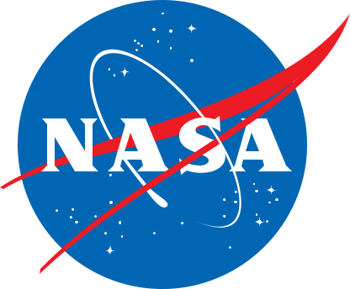
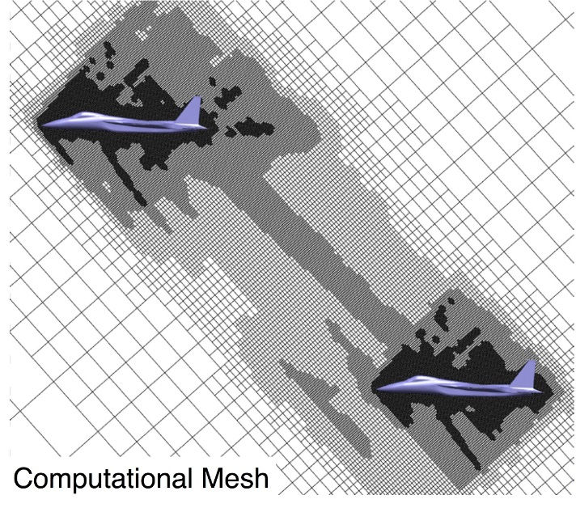
Design Software Shapes Future Sonic Booms
Ames Research Center
Aerion Technologies
Colombus, Ohio
NASA Technology
Computational Fluid Dynamics mimics wind tunnel testing to see how an air- or spacecraft will perform
Early versions of the software were very time-consuming and difficult to implement
Cart3D automates the process of mapping a grid, or “mesh,” around the vehicle in the computer model
Technology Transfer
Desktop Aeronautics, now Aerion Technologies, licensed Cart3D to use for designing a supersonic business jet and to sell the software commercially
Added a graphical user interface and other features to make it easier for non-experts to use
Also bundled other required applications so user only needs to launch one program, GoCart
Benefits
Ease of creating mesh means many solutions can be run quickly, so engineers can see trends
Engineers can work backwards from performance they want the craft to achieve
GoCart is easy enough that students at universities and intermittent users can use it without difficulty
Spinoff 2017
Transportation

Slide 12
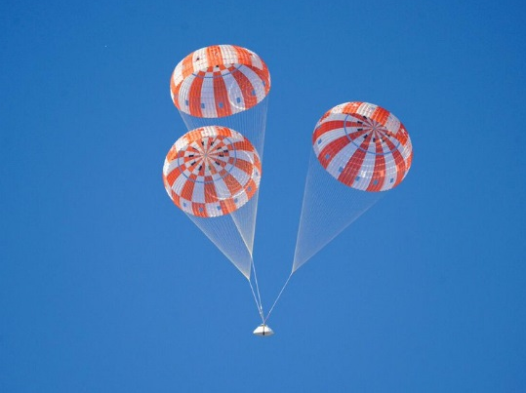
Orion Parachute Innovations Carry Commercial Rockets Back to Earth
Johnson Space Center
Airborne Systems, Space and Recovery Systems
Santa Ana, California
NASA Technology
Johnson wanted the Orion spacecraft’s parachute system based on Apollo’s parachutes, but with updates and improvements
Johnson brought on Airborne Systems as a subcontractor to build the parachutes to NASA specifications
Technology Transfer
Airborne Systems has built and sold parachute systems based on its Orion work to companies like SpaceX, Boeing, and Blue Origin, who use them to recover their respective spacecraft
Benefits
Vent lines are replaced with vent hoops to reduce risk of tangling, while textile reefing loops can’t be crushed during packing
Pyrotechnic reefing cutters are better controlled
NASA carried out millions of dollars in necessary drop testing, money that Airborne customers don’t have to spend
Spinoff 2017
Transportation

Slide 13
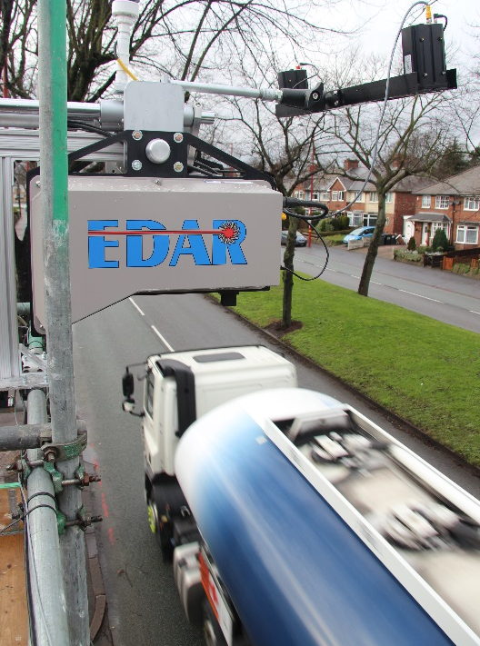
CO₂ Sensors Monitor Vehicle Emissions from Above
Langley Research Center
Hager Environmental and Atmospheric Technologies (HEAT) Inc.
Knoxville, Tennessee
NASA Technology
The ASCENDS project at NASA hopes to learn more about how carbon dioxide (CO₂) seasonally concentrates and dissipates in the atmosphere
A sensor developed at Langley for the project would use a trio of lasers to take CO₂ readings from space, including in darkness or through cloud cover
Technology Transfer
Contractors working on the project brainstormed other possible uses for such a sensor
John Hager, one of the contractors, decided to leave NASA and found his own company, HEAT, to commercialize the technology
Benefits
HEAT’s first product, Emissions Detection and Reporting (EDAR), analyzes car exhaust from remote sensors installed above roads
Four states have deployed EDAR systems to audit emissions from vehicles
In the future, the system could replace the need for drive-in emissions tests
Spinoff 2017
Transportation

Slide 14
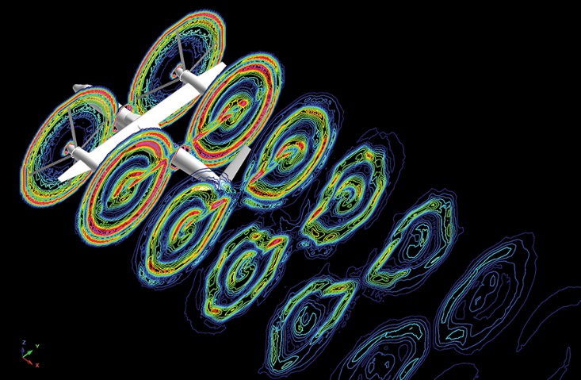
Software Opens Computational Fluid Dynamics to the Uninitiated
Ames Research Center
Sukra Helitek Inc.
Ames, Iowa
NASA Technology
With the help of Ames SBIR contracts, Sukra Helitek released its Rot3DC program for modeling rotor air flows in 2000
Under another series of Ames SBIR contracts, culminating in 2010, the company created RotCFD, short for “rotor computational fluid dynamics”
Technology Transfer
Company automated creation of a three-dimensional grid that defines the space around the rotorcraft, normally painstakingly created by hand
Development simplified some high-fidelity details to speed up code while still producing reliable results, and added user-friendly interface
Added ability to predict how rotor-generated flows will interact with buildings, other objects
Benefits
Previously, even NASA rotorcraft designers relied on CFD specialists to analyze designs; they now save time and money
RotCFD can solve for complicated, exotic problems but is designed for ease of use
Can introduce college and even high school students to an otherwise esoteric subject
Spinoff 2017
Transportation

Slide 15
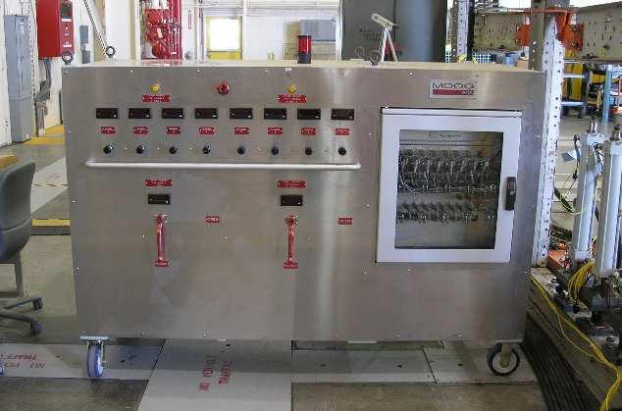
Hydraulic Carts Streamline Structural Tests for Aircraft and Space Vehicles
Armstrong Flight Research Center
Moog Inc.
East Aurora, New York
NASA Technology
Armstrong’s Flight Loads Laboratory tests aircrafts’ structural strength and endurance, applying pressure with hydraulic actuators and measuring strain
Its outdated system included a jungle of wires, hoses, and cables connecting gauges and actuators to the control room
Technology Transfer
Armstrong contracted Moog to build a system of hydraulic carts that could be rolled around the high bay, each connecting eight actuators and attendant gauges to a front-end computer with minimal wiring
The lab purchased 10 SmartCARTs, which now carry out everyday operations
At least one major helicopter producer has purchased a set of 10 SmartCARTs
Benefits
Moog estimates system saved Armstrong $350,000 in reduced cable quantity and infrastructure costs
Eliminates tripping hazards, space constraints, annoyances of traditional setup
Ideal for facilities that test a variety of vehicles, requiring frequent reconfiguration
Spinoff 2017
Transportation

Slide 16
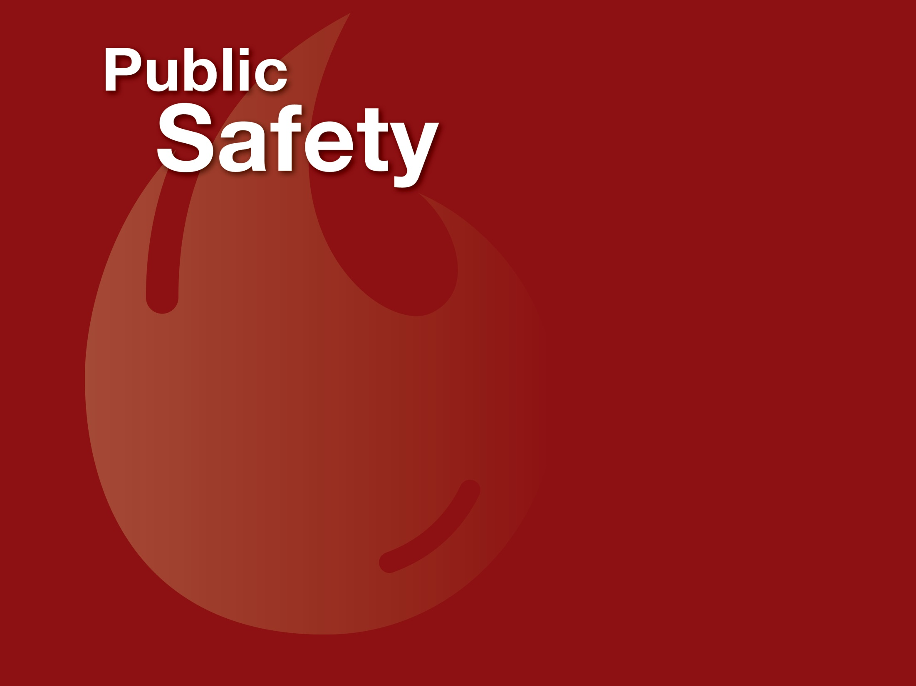

Slide 17
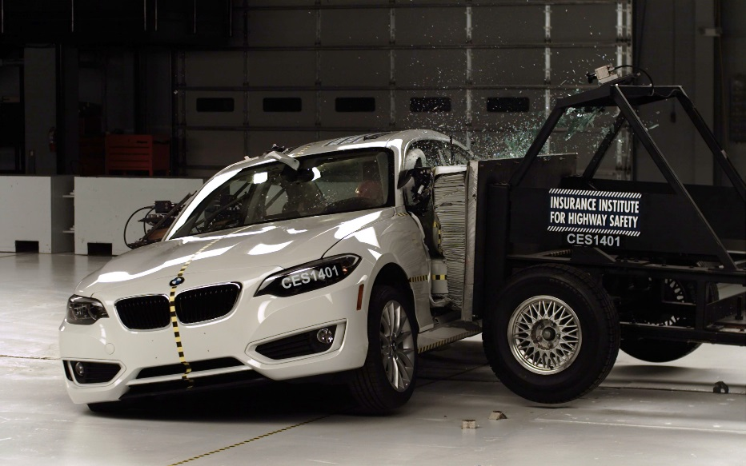
Orion Video Requirement Advances High-Speed, Compact Cameras
Johnson Space Center
Integrated Design Tools (IDT)
Pasadena, California
NASA Technology
To film parachute deployment during an Orion spacecraft test flight, Johnson engineers needed a small, lightweight, rugged, high-speed digital camera
The camera would need to back up data almost as fast as it recorded it so no data could be lost in the event of a power outage
Technology Transfer
Johnson contracted Integrated Design Tools, which specializes in cameras for scientific and industrial uses, such as crash testing
IDT built a palm-size, rugged camera that could transfer 10 to 12 gigabits per second to its hard drive, adjust to changes in light within milliseconds, and be programmed to record a sequence of events at varying frame rates, shutter speeds, and durations
Benefits
All of IDT’s new Os line of cameras, in which the “O” stands for “Orion,” incorporate the high-speed memory developed for NASA
High-speed backup ensures crash test data is secure before anything happens to cameras, lets film crews move on without backing up a slow-motion sequence, and lets military testers film and fire one test shot after another
Spinoff 2017
Public Safety

Slide 18
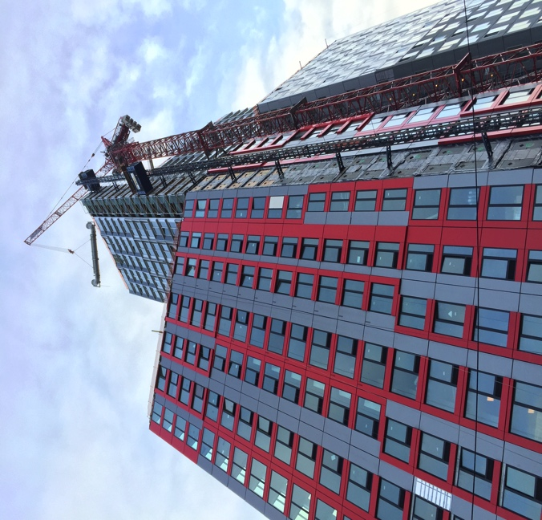
Rocket Technology Stops Shaking in Its Tracks
Marshall Space Flight Center
Thornton Tomasetti
New York, New York
NASA Technology
Ares I had a vibration problem—the first stage rocket booster caused a resonance with huge amplitudes dangerous for vehicle and crew
Traditional dampers would add too much mass
Marshall engineers designed a device that worked with fuel mass in second stage rocket
Benefits
Fluid Harmonic Damper uses conventional piping in water: cheaper and easier to make and install than traditional dampers
Device causes movement in the water, so it no longer acts as part of the overall structure—a paradigm shift in vibration mitigation
Can be used to mitigate shocks from an earthquake or swaying from heavy winds and any other cause of dangerous vibrations
Technology Transfer
Design-engineering firm Thornton Tomasetti obtained a research license to test the technology for their structures and then entered a Space Act Agreement to confirm more details
Satisfied, they then licensed the patent for exclusive rights to use the device in bridges and buildings
Inventors won NASA’s Exceptional Engineering Achievement Medal and got about a dozen patents
Spinoff 2017
Public Safety

Slide 19
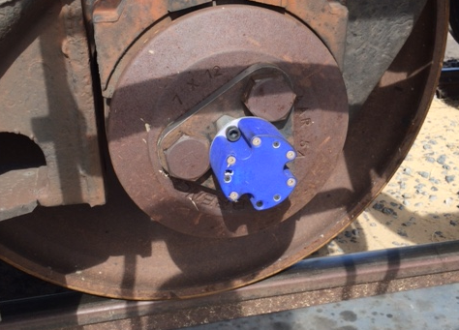
Micromachined Sensors Monitor Train Rails, Predict Failures
Glenn Research Center
Ridgetop Group Inc.
Tucson, Arizona
NASA Technology
Under SBIR contracts with Glenn, Ridgetop developed tiny, sturdy motion sensors to mount on gears in a helicopter transmission and the software to identify anomalies in data they transmitted
Testing on Glenn’s Helicopter Transmission Test Stand showed the system could predict failures
Technology Transfer
Ridgetop adapted its RotoSense sensors to be mounted on train axles, where they monitor vibrations
Software to identify the significance of any anomalies was rewritten specifically for rail
Testing of the new RailSafe system at the Federal Railway Administration’s Transportation Technology Center showed promise; RailSafe launched in 2015
Benefits
The ability to detect a problem in a train rail can avert catastrophe
Ridgetop offers installation and training for the kit—sensors, data collection hub, and software
The system is planned to one day be able to predict useful life of both wheels and rails and warn of failures before they occur
Spinoff 2017
Public Safety

Slide 20
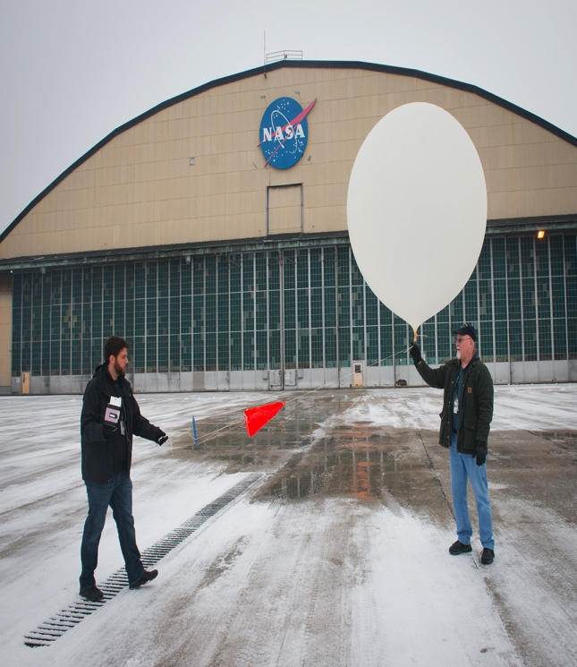
Wire Sensors Alert to Dangerous Conditions in the Clouds
Glenn Research Center
Anasphere Inc
Bozeman, Montana
NASA Technology
At high altitutes, ice can easily coat airplane wings and even engines, a common hazard for flying
NASA is developing a ground-based system to detect icing conditions and, to verify its results, needed to fly sensors to test when the hazard is present
NASA wanted a lightweight, inexpensive sensor that could fly on weather balloons
Benefits
Inexpensive, low power super-cooled liquid water sensor allows researchers to use multiple units together to develop a vertical profile
Can be used with Anasphere’s Tethersonde, so they can be reeled back in and re-used
Department of Energy uses them in cloud formation studies in the Arctic; a Chinese company will market them to farmers to warn when icing conditions threaten crops
Technology Transfer
Anasphere founder John Bognar had an idea for a vibrating wire sensor using piezoelectric elements
He got a Phase I SBIR contract to develop it and a Phase III SBIR contract to produce more for NASA
In 2015, sensor was a finalist for an R&D 100 award
Spinoff 2017
Public Safety

Slide 21
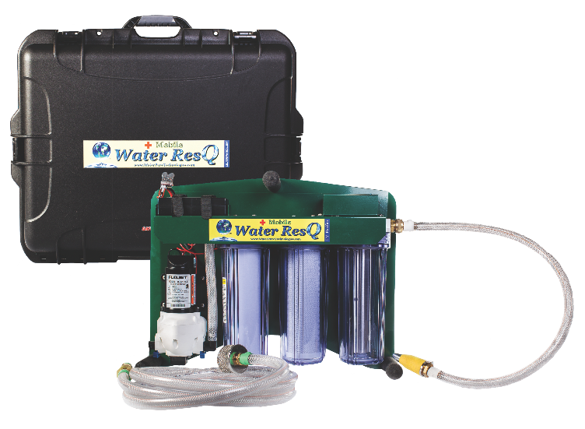
Fast-Flow Nanofiber Filters Purify Water at Home and in the Field
Johnson Space Center
Water Pure Technologies
Murray, Utah
NASA Technology
Astronauts need to reuse and recycle every drop of water, meaning high level filtration to make it safe
Many inexpensive filters cannot filter out viruses or many bacteria and single-celled organisms
Powerful filters are often extremely slow, because they have membranes with tiny pores to block contaminants
Benefits
Water ResQ line includes several multi-stage filtration systems, both portable and installed
NanoCeram filter eliminates more than 99.9% of viruses and bacteria without chemicals
Larger pore size—2 microns—allows filter to work fast, key for goal of offering systems that filter a lot of water at a very low cost
Clients include California fire-jumper brigades
Technology Transfer
Argonide discovered NanoCeram fibers made excellent water filters, because they were strongly bioadhesive—bacteria and viruses stuck to them
Technology was developed under two SBIRs
Argonide licenses the technology to other companies for sale. Water Pure buys from them
Spinoff 2017
Public Safety

Slide 22
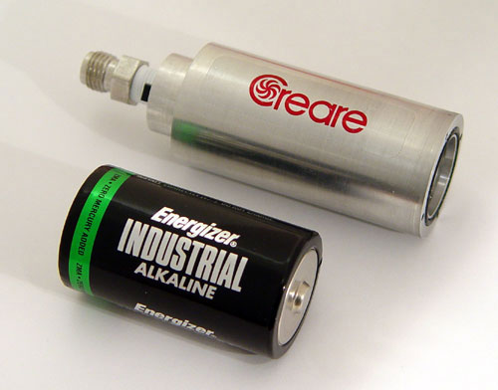
Miniaturized Vacuum Pumps Play Big Roles on Mars and Earth
Jet Propulsion Laboratory (JPL)
Creare Inc.
Hanover, New Hampshire
NASA Technology
One of Curiosity’s most pressing objectives was to assess the surface chemistry of Mars for clues to its watery past
The Sample Analysis at Mars spectrometer was designed to perform this task and required a lightweight, rugged vacuum pump
Technology Transfer
JPL hosted a series of workshops in the late 1990s to find a company capable of making the device
Creare developed a relationship with JPL through the workshops and miniaturized one of its vacuum pumps through a series of SBIR contracts it won
The company is also developing a pump for the European ExoMars rover, which launches in 2018
Benefits
Creare’s miniaturized vacuum pumps are used in spectrometers for a variety of industries, ranging from mining operations to chemical-weapon and bomb detectors
The company is targeting future growth in the defense, healthcare, and environmental industries
Spinoff 2017
Public Safety

Slide 23


Slide 24

CMOS Sensors Enable Phone Cameras, HD Video
Jet Propulsion Laboratory (JPL)
GoPro Inc.
San Mateo, California
NASA Technology
Complementary metal oxide semiconductor (CMOS) active pixel sensors invented at JPL promise smaller, more efficient digital imagers than those based on earlier charge coupled device technology
Other camera electronics can be integrated onto chip with pixel array: first “camera on a chip”
Technology Transfer
JPL inventor founds Photobit with exclusive license for CMOS imaging. Webcams, ingestible “pill cameras” for endoscopy, and more follow
Photobit is sold; license returns to California Technical Institute
Need for small, efficient cell phone cameras drives mass production of CMOS imagers, leading to improvements in quality, manufacture
Benefits
CMOS imagers enable small, high-definition video cameras; devices like GoPro body-mountable cameras fully leverage advantages
CMOS takes over digital imaging, including automotive, surveillance, and medical fields
Phone cameras revolutionize social media
By 2015 CMOS imaging market nears $10 billion
Spinoff 2017
Consumer Goods

Slide 25
Novel Threading Enables New Approach to Golf Clubs
Goddard Space Flight Center
Cobra Puma Golf
Carlsbad, California
NASA Technology
When the Space Shuttle Program started using reusable engines, NASA was interested in fasteners that wouldn’t jar loose under repeated vibrations
A researcher at Goddard ran extensive tests on Spiralock, a new, alternative bolt threading; he detailed his findings in a 1984 paper
Technology Transfer
Thanks in part to the validating research, Spiralock came to be used in missiles, engines, oil wells, fiber-optic networks, human joint implants, and more
Cobra Puma Golf wanted to commemorate a recent NASA collaboration with a “spaceport door” in its new driver, but the tiny door came loose after repeated strikes; the company consulted NASA research and discovered Spiralock threading
Benefits
Spiralock threading holds fast the spaceport door in the new KING LTD Driver
The door offers unprecedented access into the club head, allowing precise weight placement
Together with the weight of the door, this allowed for the first zero-center-of-gravity club, maximizing energy transfer from club to ball
Spinoff 2017
Consumer Goods

Slide 26
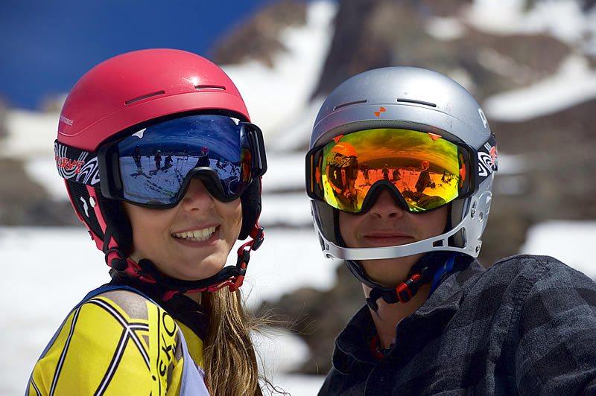
Blue-Light-Cancelling Lens Gives Skiers a Clearer View
Ames Research Center
Optic Nerve Inc.
Wheatridge, Colorado
NASA Technology
Human eyes are particularly sensitive to blue and green light, which comprise the middle wavelengths of the visible spectrum
In the 1990s, an Ames scientists developed an optical filter that cancels blue and green light while amplifying other hues
Technology Transfer
NASTEK, a company based in Oregon, entered a Space Act Agreement with Ames to utilize the research
The company developed its own line of optical filters based on the technology and partners with other companies to incorporate it into consumer products
Benefits
Optic Nerve is the latest company to partner with NASTEK, resulting in a line of ski goggles
The lens cancels as much as 95 percent of blue light, giving the average wearer an increase of 12-15 percent in visual acuity and depth perception
Spinoff 2017
Consumer Goods

Slide 27
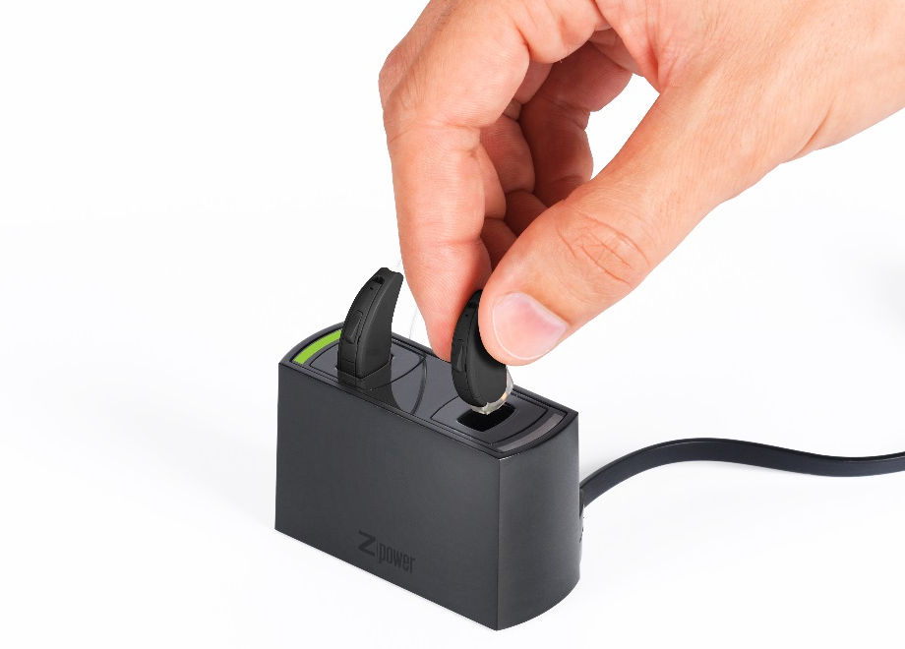
Rechargeable Hearing Aid Batteries Draw from NASA Research
Glenn Research Center
ZPower LLC
Camarillo, California
NASA Technology
Silver-zinc is the most mass-efficient battery couple but degrades very easily
In the 1960s and ’70s, researchers at Glenn worked to mitigate degradation and make the batteries rechargeable
Technology Transfer
Zinc Power Matrix, now called ZPower, was founded in 1996 and used NASA’s research, which was made public, as part of its starting point toward the first commercial rechargeable silver-zinc batteries
After long research and development, ZPower released its first commercial, rechargeable silver-zinc cells in 2013
Benefits
These are the first rechargeable hearing aid batteries to hold a charge for more than a day
Custom battery door allows overnight charging without handling tiny batteries
Batteries are recycled and kept out of landfills
ZPower plans to expand to other wearable electronic applications
Spinoff 2017
Consumer Goods

Slide 28
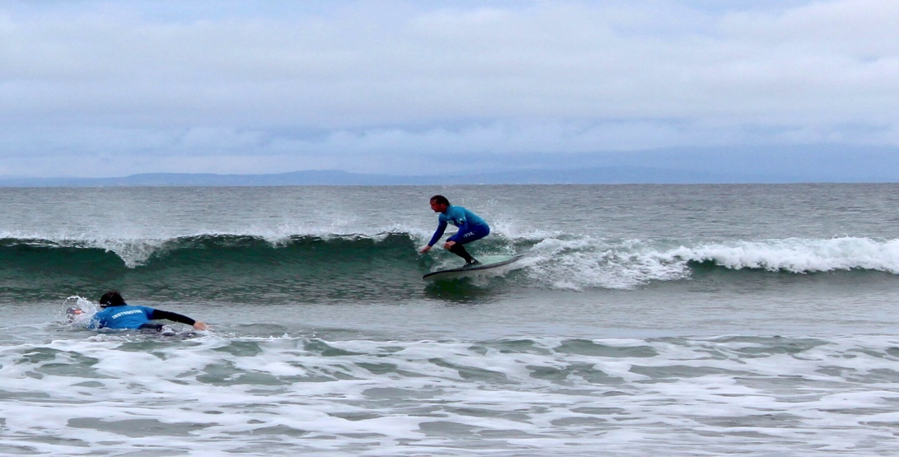
Large-Scale 3D Printer Brings Manufacturing to the Masses
Johnson Space Center
re:3D
Houston, Texas
NASA Technology
NASA sent a 3D printer to the ISS to to explore printing needed items on long-duration missions
A series of successful test prints included a ratchet, the first item printed from a design sent from Earth
3D printing could one day print objects that can’t be launched
Technology Transfer
A group of Johnson employees wanted to make large-scale 3D printing available in the developing world
Engineer Matthew Fiedler, who honed skills in the neuroscience lab of Johnson’s human research program, designed Gigabot in his garage
Johnson and Langley have both bought Gigabots
Benefits
Standard configuration prints 30 times larger than competing desktop models, up to 8 cubic ft.
Units start at just $8,550, far less than other large-scale printers
Fiedler designed the system to be easy to use, sturdy, and reliable
One printer donated for every 100 sold
Spinoff 2017
Consumer Goods

Slide 29
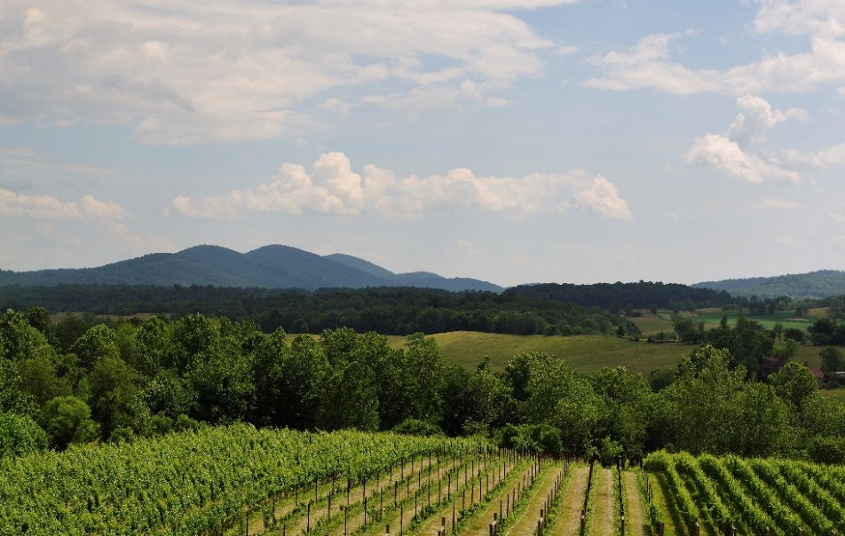
Professional Development Program Gets Bird’s-Eye View of Wineries
Langley Research Center
Virginia Wine Board
Richmond, Virginia
NASA Technology
Each year up to 400 students and professionals in science, technology, math, and science participate in 80 projects under NASA’s DEVELOP Program
DEVELOP, headquartered at Langley, carries out all projects using Earth-observation data
Technology Transfer
The U.S. Department of Agriculture stopped providing the Virginia Wine Board with detailed vineyard acreage data several years ago
A Langley scientist, also DEVELOP’s national science advisor, oversaw a team’s effort to use Landsat data to map Virginia vineyards
Benefits
The team confirmed about 80 percent of the self-reported acreage tracked in Wine Board member surveys
Participants discovered discrepancies, such as wineries listed in one county with significant acreage in other counties
Future work could classify grape plots
Spinoff 2017
Consumer Goods

Slide 30
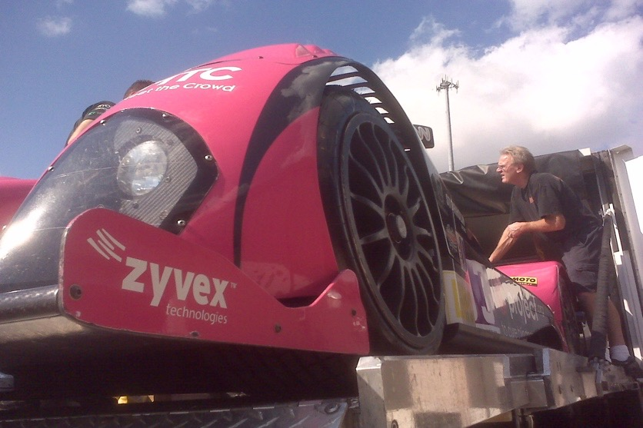
Carbon Nanotube Resin Shores Up Boats, Bikes
Johnson Space Center
Zyvex Technologies
Colombus, Ohio
NASA Technology
At 100 times the strength of steel and1/6 the weight, carbon nanotubes are attractive for spacecraft
NASA didn’t discover CNTs but was instrumental in funding research to solve challenges in using it
CNTs are flat carbon sheets that roll up, but they tend to clump together in mixtures
Technology Transfer
SBIR contracts in 2003 and 2006 funded research on incorporating CNTs into a functional material and using that material as a lightweight radiation shield
A polymer treatment helped CNTs disperse evenly in resin to strengthen composite materials
Working with NASA , Zyvex was able to achieve high concentrations of CNTs with excellent dispersion
Benefits
CNT-infused resin makes already tough composites even tougher while maintaining or increasing stiffness and reducing wear
Zyvex sells 6 formulations of CNT additives for resins, under the ZNT product name
It also sells composites pre-treated with a CNT-infused epoxy under the Arovex product name
Spinoff 2017
Consumer Goods

Slide 31


Slide 32
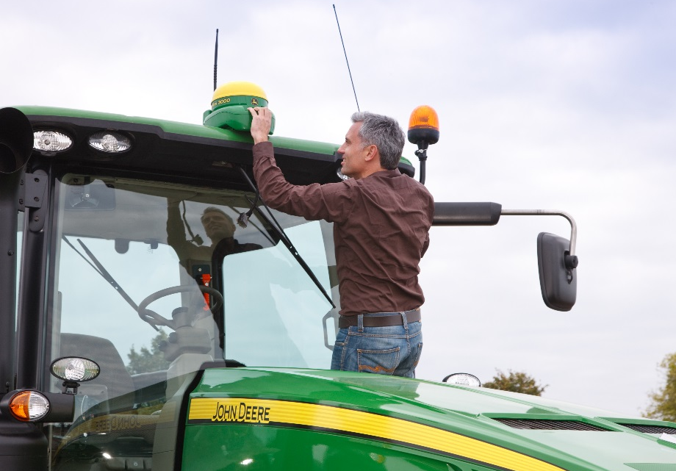
GPS Correction Technology Lets Tractors Drive Themselves
Jet Propulsion Laboratory (JPL)
John Deere
Moline, Illinois
NASA Technology
JPL developed the first global tracking system for GPS satellites, followed by Real-Time GIPSY software to stream satellite tracking data in real time
Together these constitute one of NASA’s most important contributions to modern society, enabling accurate GPS navigation anywhere on Earth
Technology Transfer
John Deere and subsidiary NavCom independently developed GPS-based guidance for farm equipment
In 2001 John Deere licensed Real-Time GIPSY and contracted with JPL to receive data from the center’s global network of reference stations
Company’s 2004 StarFire system, using JPL software and ground stations, was first global GPS for farm equipment that didn’t require signal towers
Benefits
GPS guidance eliminates overlap of tractor rows in fields, saving seed, fertilizer, pesticide, time, fuel, and machine wear while reducing runoff and allowing more accurate crop yield maps
John Deere let license expire after developing its own system, but not before partnership improved farm guidance technology, took it worldwide, and popularized idea of precision agriculture
Spinoff 2017
Energy and Environment

Slide 33
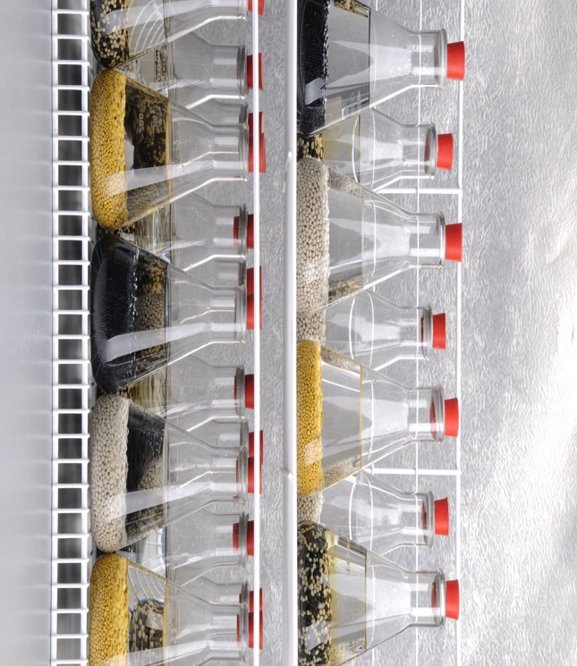
Controlled-Release Fertilizer Takes Root in Fields, Groves Worldwide
Kennedy Space Center
Florikan
Sarasota, Florida
NASA Technology
Veggie project aims to grow food in space for long-duration voyages
Soil can be inconsistent, so researchers chose a porous baked-clay substrate, and rely on fertilizer to provide nutrients
Market testing found best fertilizer for the project was Florikan controlled-release fertilizer
Benefits
Patents bought by J.R. Simplot company, which now sells fertilizer as Gal-Xe^{one.} Florikan maintains license to sell product in eastern US
Controlled release means nutrients get where need, when needed, so can use less, avoiding damaging run-off into groundwater
One application can last 6 or 9 months, meaning less work overall
Technology Transfer
Florikan fertilizer was developed with 40 hours of NASA SATOP consulting, which helped perfect the polymer coating method
Awarded the Gulf Guardian Award by the US EPA
Created new formulations of nutrients based on plants Veggie plans to grow next, which are now offered for sale
Spinoff 2017
Energy and Environment

Slide 34
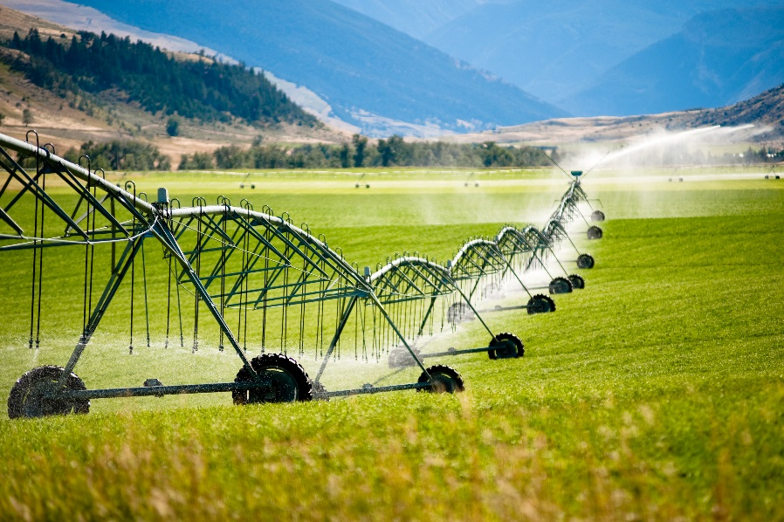
Satellite Imagery Sheds Light on Agricultural Water Use
Goddard Space Flight Center
Google
Mountain View, California
NASA Technology
Landsat Earth-observing satellites capture images of the Earth’s entire surface every 8 days
Infrared pictures, via thermal imagers on Landsat 7 and 8, can help show levels of evaporation and transpiration, which have cooling effects
Technology Transfer
University of Idaho professor Rick Allen began using Landsat imagery in 1999, thanks in part to a grant from NASA aimed at boosting Landsat usage
Allen developed an algorithm, METRIC, using Landsat images to map evapotranspiration as a way to monitor water use across large regions
When NASA and USGS made Landsat data freely available, Google used it to create Google Earth Engine, to facilitate research access
Benefits
EEFlux adapts METRIC to work with Earth Engine, so anyone with Internet access can use Landsat data to create an evapotranspiration map within seconds
Early beta users include California Department of Water Resources and the World Bank
Helps monitor water use to see if it’s sustainable, if it’s growing, if a drought is starting
Spinoff 2017
Energy and Environment

Slide 35
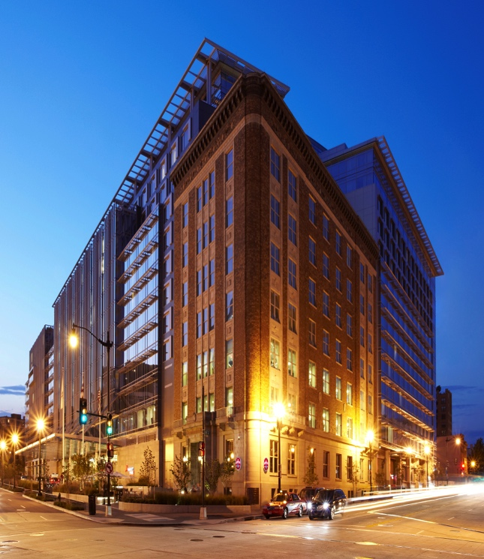
Building Sensors Monitor Power Usage, Device by Device
Ames Research Center
Verdigris Technologies Inc
Moffett Field, California
NASA Technology
Sustainability Base was designed to be the greenest, most energy-efficient federal building
Needed a way to monitor energy consumption by occupants, to find other ways to reduce energy use
Sensor plugs into circuit panel and uses deep packet algorithm to break out usage by device
Technology Transfer
Verdigris had developed the sensor, approached NASA about a research partnership
Non-reimbursable Space Act Agreement, to validate device in Sustainability Base, accelerated development, because of the expansive testing at NASA
Possible future uses for NASA missions could alert to failures and breakdowns before they happen
Benefits
Sensor collects performance data in the cloud, so a device’s energy consumption can be compared to a baseline
System sends regular reports via email and can also be monitored on the Web or in app
Customers so far include hotels, corporate offices, hospitals, and manufacturers
Spinoff 2017
Energy and Environment

Slide 36
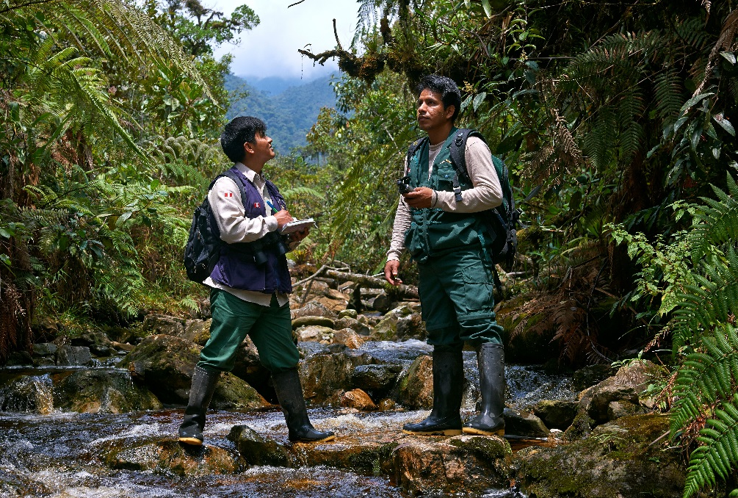
Earth Observation Spots, Helps Prevent Rainforest Fires
Ames Research Center
Conservation International
Arlington, Virginia
NASA Technology
About two dozen NASA missions chart aspects of Earth’s surface, oceans, and atmosphere from space
NASA Earth Exchange (NEX) at Ames leverages supercomputing to analyze Earth-observation data
Technology Transfer
Conservation International (CI) won NASA funding to overhaul, combine rainforest fire-risk forecasting and fire-alert systems, both based on satellite data
CI used NEX to prototype new fire-risk system, incorporating new satellite data, expanding territory
OnSight platform made with Stennis Space Center SBIR augments fire-alert system, while Goddard Space Flight Center provides seasonal forecasts
Benefits
Fire-risk and fire-alert used to make Firecast
Expanded Firecast forecasting from Bolivia to nine more countries
OnSight lets users upload observations, data from ground to improve investigations, patrols
Fire-alert helps stop illegal slash-and burn, while fire-risk helps plan controlled, legal burns
Spinoff 2017
Energy and Environment

Slide 37
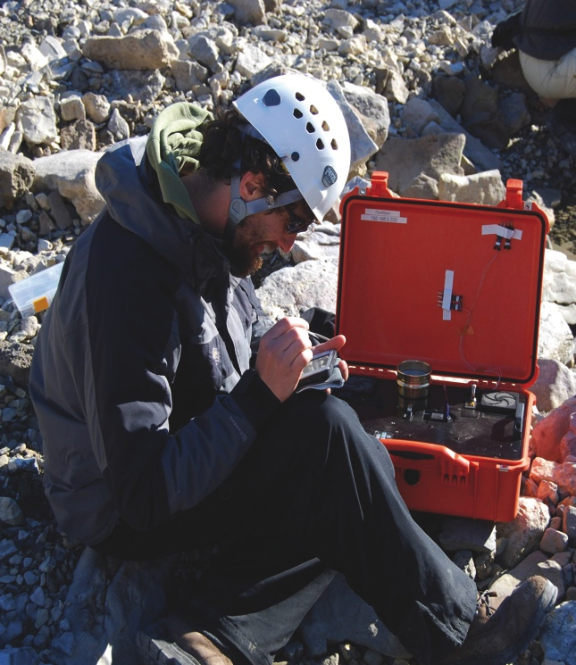
Mineral Analyzer Shakes Answers out of Soil and Rocks
Ames Research Center
Olympus Scientific Solutions America
Waltham, Massachusetts
NASA Technology
Mineral analysis, through X-ray Diffraction (XRD), gives clues about whether Mars could support life
Traditional XRD machines are big, heavy and require precise movements from the machine and in preparing the sample—unrealistic for a rover
CheMin vibrates the sample, allowing for a stationary X-ray beam and larger grains
Benefits
TERRA, for fieldwork, and BTX II, for labs, are small, easy to use, and extremely rugged
Each costs less than $100,000, compared to several hundreds of thousands for traditional lab-based XRD devices
Largest market is in oil and gas exploration. Others include drug makers and watchdogs
Technology Transfer
CheMin development started at Ames, and then continued under an SBIR with inXitu Inc, founded by one of the lead developers
inXitu licensed the patents and sold the product to industry; in 2011, Olympus bought inXitu, and now sells the device in portable and benchtop models
Spinoff 2017
Energy and Environment

Slide 38
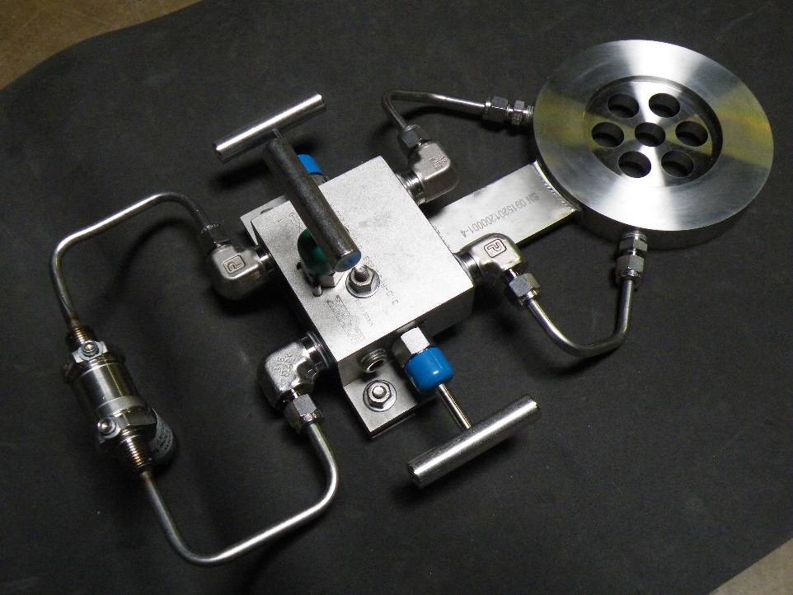
Low-Cost Flow Meters Bring Efficiency, Reliability to Nuclear Plants
Marshall Space Flight Center
Graftel LLC
Elk Grove Village, Illinois
NASA Technology
Under a 2001 Space Act Agreement, Marshall and Quality Monitoring and Control developed a meter to measure liquid oxygen flow in Space Shuttle engines
The resulting balanced flow meter is a plate with several holes placed, numbered, and sized by proprietary software according to each application
Technology Transfer
Quality Monitoring and Control spun off A+ FlowTek to market the patented meters to aerospace companies, refineries, and chemical, power, and pharmaceutical plants, among others
Graftel obtained an exclusive license to market A+ FlowTek balanced flow meters (BFMs) to the nuclear industry—which has stringent standards and requirements—making its first sales in 2013
Benefits
BFM is highly accurate, with consistent results, even near pipe bends that throw off other meters
Unlike other flow plates, does not cause drop in pressure of flow being measured, meaning operational efficiency is improved, money saved
BFM is low-cost and long-lasting
Doesn’t produce loud noise like other flow plates
Spinoff 2017
Energy and Environment

Slide 39
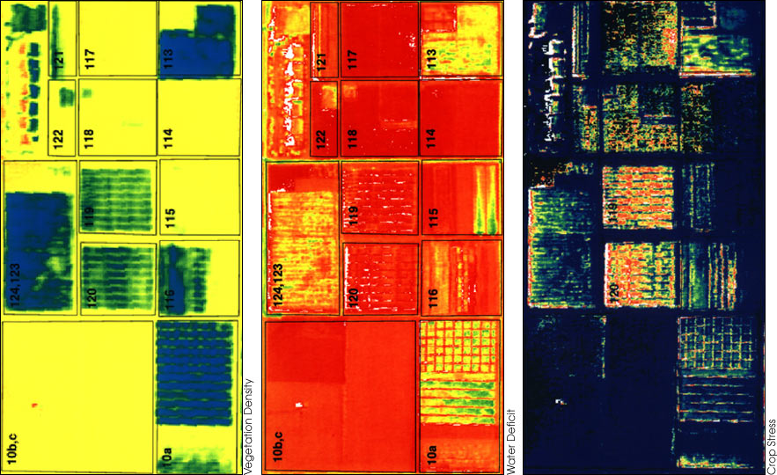
Computer Learning Program Inventories Farmers’ Fields
Goddard Space Flight Center
GeoVisual Analytics
Boulder, Colorado
NASA Technology
NASA Center for Climate Simulation at Goddard works to assimilate, analyze Earth-observation data from NASA-built satellites
GeoVisual Analytics proposed continuously updated global land-cover classification map and was awarded Goddard SBIR
Technology Transfer
Under SBIR contracts, GeoVisual used Landsat data to develop algorithm to analyze imagery, pixel by pixel, and assign vegetation index number and land cover classification to each dot
Created Computer Learning Imagery Platform (CLIP)
Benefits
CLIP won attention of Taylor Farms, world’s largest producer of fresh-cut vegetables, which became GeoVisual’s first CLIP customer
GeoVisual uses drone imagery to assess health, predict annual yields of Taylor Farms’ fields
Company plans to go global, one day predicting annual worldwide yields of staple crops
Spinoff 2017
Energy and Environment

Slide 40


Slide 41
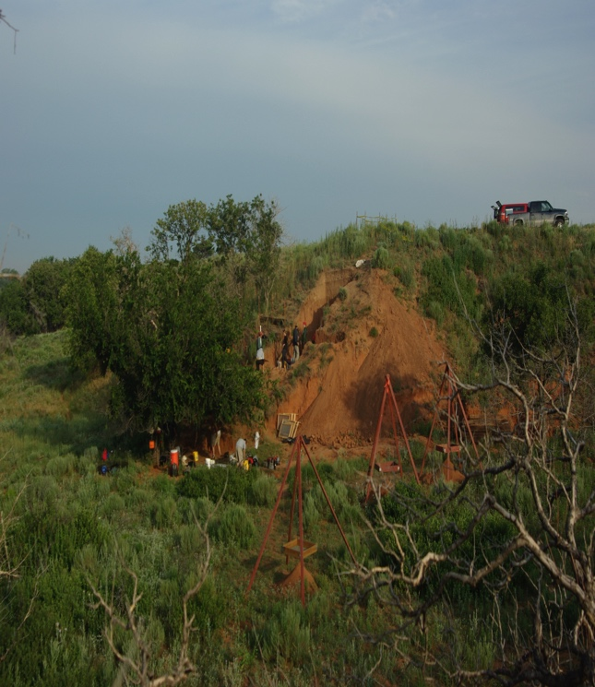
Laser Imaging Helps Archeologists Dig Up History
Goddard Space Flight Center
Teledyne Optech
Henrietta, New York
NASA Technology
Laser imagers, or lidars, first flew on Apollo 15 in 1971, and have aided in many NASA discoveries over the decades
The upcoming OSIRIS-REx asteroid return machine will use a lidar scanner to build a 3D topographical map and help choose sample sites
Technology Transfer
Lidar device maker Teledyne Optech has made imagers for several NASA missions, including OSIRIS-REx and earlier Phoenix Mars lander
Space-ready lidars needed to be smaller, more rugged, and use less power—innovations that translated well to commercial offerings
Optech lidar on Phoenix lander discovered snow in Martian atmosphere
Benefits
Archeology is one of many fields now benefitting from laser imaging
Technology helps uncover features across a wide swath of landscape that are difficult to see with the naked eye
Teledyne Optech device used in Beaver River region of Oklahoma to help discover artifacts from 10,500 years ago
Spinoff 2017
Information Technology

Slide 42
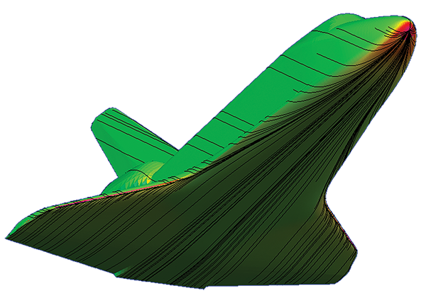
Program Predicts Aerothermodynamics of Reentry, Subsonic Flight
Ames Research Center
Orbital ATK
Dulles, Virginia
NASA Technology
Computational fluid dynamics (CFD) software could model aerodynamics and aerothermodynamics but was slow; faster programs weren’t compatible with computer-aided design (CAD) software
An Ames researcher created Configuration-Based Aerodynamics (CBAERO) program in early 2000s
Technology Transfer
Made available through software usage agreements in 2006, CBAERO has been used by more than 20 businesses, at least half a dozen military agencies, four universities, as well as all NASA field centers
Nearly every company building commercial space vehicles uses CBAERO, including Orbital ATK, which has used it for its Cygnus spacecraft and various military projects
Benefits
Moves designs easily from CAD and into CFD
Can model in seconds what takes thousands of hours in CFD, with results nearly as accurate
Has “batch mode,” running automatic results on a family of vehicles with a range of designs
Can create database of forces, temperatures across surfaces at range of speeds, angles, etc.
Spinoff 2017
Information Technology

Slide 43
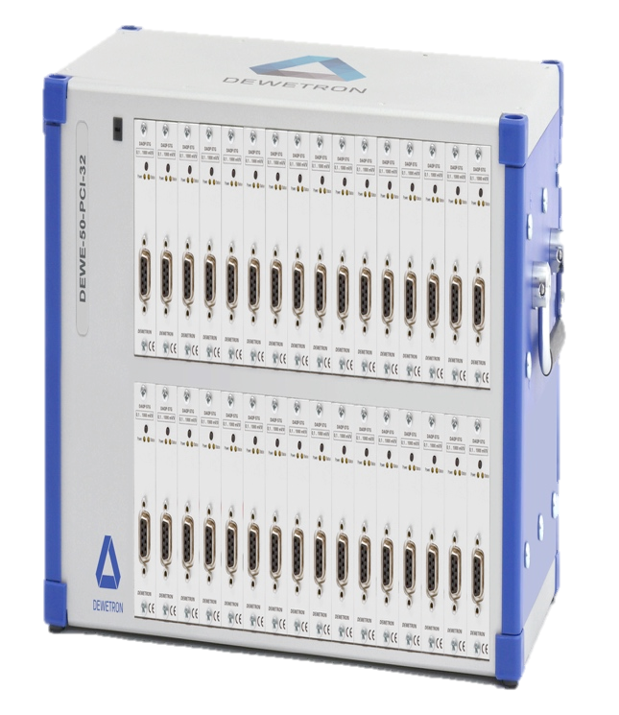
Data Acquisition System Captures Machine Performance
Kennedy Space Center
Dewetron
Wakefield, Rhode Island
NASA Technology
To ensure the Space Launch System mobile launch platform works as intended, some 500 sensors measure strain, load, pressure, acceleration, etc.
The results are all captured, store, and transmitted to the control center by a data acquisition system
NASA needed a single, universal signal conditioner that could handle every kind of sensor
Benefits
The DAQP-STG was lower cost and smaller than competing universal signal conditioners and could handle more sensor types
Dewetron incorporated updated versions of the signal conditioner in its subsequent data acquisition systems
Sold “many thousands” of the conditioners, at around $1000 each, sometimes in orders of 800 or more
Systems are used by car, aerospace and structural monitoring industries
Technology Transfer
Dewetron specializes in data acquisition systems, but the contract with NASA required something more powerful, more complicated
Under contract, the company took an existing signal conditioner and increased its voltage input range, voltage isolation, and added other capabilities
Spinoff 2017
Information Technology

Slide 44
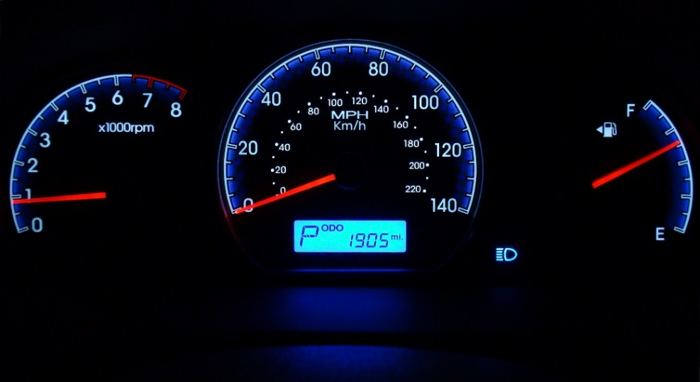
Light-Analysis Software Explodes across Industries
Jet Propulsion Laboratory
Lambda Research Corporation
Littleton, Massachusetts
NASA Technology
In 1993 JPL granted two SBIR contracts to Lambda to develop a user-friendly program for modeling light behavior, to predict stray light in NASA imagers
The Terra satellite’s Multi-Angle Imaging Spectroradiometer became the first NASA imager designed with the help of Lambda’s TracePro
Technology Transfer
Before the second SBIR contract was finished, the first commercial version of TracePro was released
TracePro was the first light-ray-modeling software compatible with CAD software and Windows
Lambda discovered that a multitude of industries have an interest in predicting light behavior; TracePro remains the company’s flagship product
Benefits
Biggest market is in optimizing overhead lighting
Popular uses also in light pipes for electronics displays, design of solar collectors, virtual prototyping of car dashboard displays, and camera and telescope designs
Multiple noninvasive health monitoring applications, plus laser and LED surgical devices
Spinoff 2017
Information Technology

Slide 45

Connectors Link Data Networks for Orion, Industry
Johnson Space Center
Smiths Connectors
Thousand Oaks, California
NASA Technology
For Orion spacecraft, Johnson wanted to replace multiple data networks of previous craft with single, integrated, one-gigabit Ethernet network
New network required lighter, smaller, rugged connectors with higher-than-standard impedance to transmit more data at lower voltages
Technology Transfer
Smiths Connectors was selected as subcontractor in 2010; spent five years developing qualified connectors
Connectors met all expectations during Orion’s December 2014 test flight
Based on Orion work, company released commercial High-Speed Ruggedized D-Sub connector
Benefits
Ability to endure harsh environments while quickly transmitting large amounts of data
In commercial aviation, allows sensors near high-vibration areas like wings or engine
Petroleum drilling endures high pressure, vibration; train data networks survive vibration
Military, aerospace are also markets
Spinoff 2017
Information Technology

Slide 46
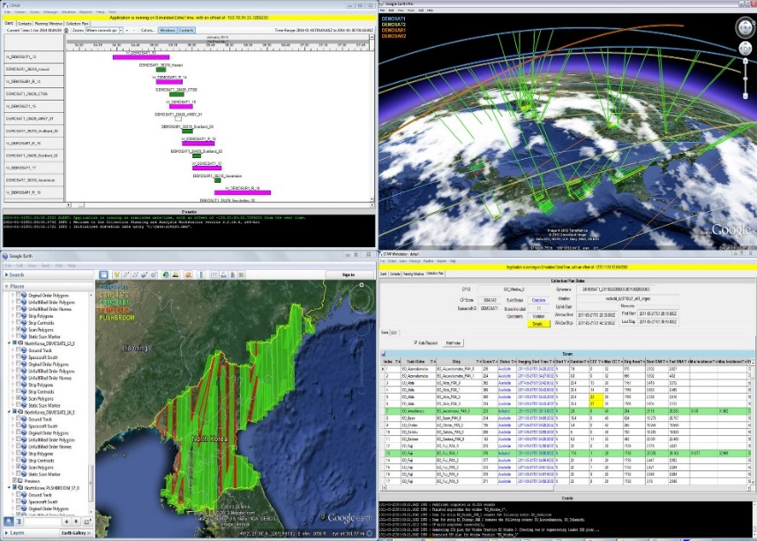
Scheduling Software Plans Public, Private Space Missions
Johnson Space Center
Goddard Space Flight Center
Orbit Logic
Greenbelt, Maryland
NASA Technology
Alex and Ella Herz supported payload operations at Johnson in late 1980s, early ‘90s
Alex, Doug George later built scheduling software for planned Vegetation Canopy Lidar at Goddard
The trio founded Orbit Logic in 2000
Technology Transfer
In partnership with two other companies, created STK Scheduler, the first generic, reconfigurable space-mission scheduling software; released in 2002
Program built on experience scheduling payloads at Johnson, building scheduling software at Goddard
Benefits
Instead of using massive spreadsheet, taking days to optimize schedule changes, STK Scheduler reschedules mission in seconds
Over 250 customers have purchased license
With constellations of dozens of satellites in the works, scheduling software becomes imperative
Spinoff 2017
Information Technology

Slide 47
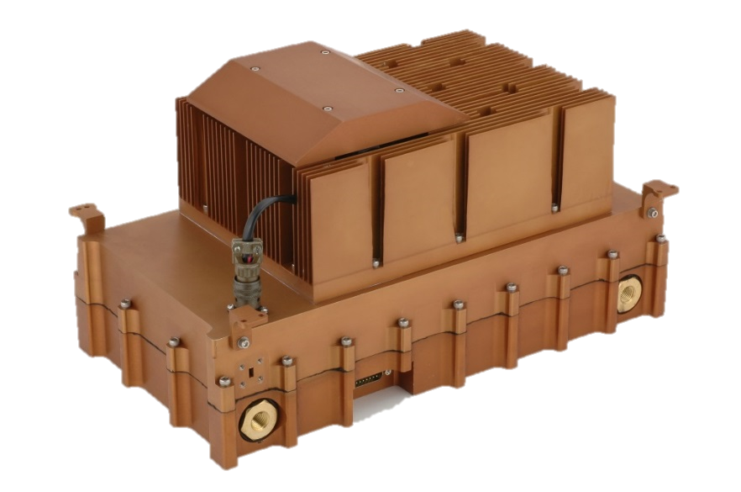
Power Amplifiers Boost Radar, Communications, Defense Systems
Jet Propulsion Laboratory (JPL)
QuinStar Technology
Torrance, California
NASA Technology
QuinStar subcontracted in 2009 under JPL SBIR contract to build solid-state power amplifier (SSPA) for airborne radar to test equipment for future Surface Water Ocean Topography mission
SSPA delivered was cheaper, more compact, more reliable than earlier, tube-based power amplifiers
Technology Transfer
Following initial success, JPL, other NASA entities and contractors ordered more QuinStar SSPAs
Resulting innovations advanced QuinStar’s commercial offerings, from environmental research radars to communications and electronic warfare
Benefits
SSPA packs capability of tube-based power amplifier about five times its size and weight
Small, lightweight amplifier enables use on UAVs
Other SSPAs lose 20 percent energy when recombining signals; QuinStar’s lose 8 percent
Collision avoidance, surveillance, defense are other possible applications
Spinoff 2017
Information Technology

Slide 48


Slide 49
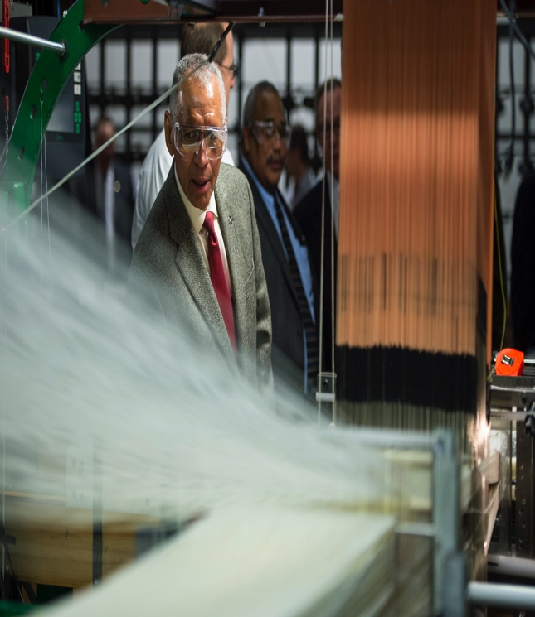
3D Weaving Technology Strengthens Spacecraft, Race Cars
Ames Research Center
Bally Ribbon Mills
Bally, Pennsylvania
NASA Technology
A connection point on Orion’s heat shield needed to be a powerful insulator and structurally strong
Previous materials, such as woven steel and carbon fiber composites, proved insufficient insulators
A new composite, 3D-woven quartz, is stronger and has extremely low thermal conductivity
Benefits
3D orthogonal weave, with fibers perpendicular in all directions, is strongest possible
3D-MAT can be a structure, an insulator, and a shock absorber and can carry loads
In addition to aerospace customers, race car companies are exploring larger, denser carbon fiber blocks made on equipment designed for NASA
Technology Transfer
The material, 3D-MAT, was funded in part through seed money from Ames and SBIR contracts
Bally Ribbon built special equipment to make the 3-inch blocks and denser weave NASA required
Company is working with Ames on other materials and considering how to use 3D-MAT elsewhere on Orion
Spinoff 2017
Industrial Productivity

Slide 50
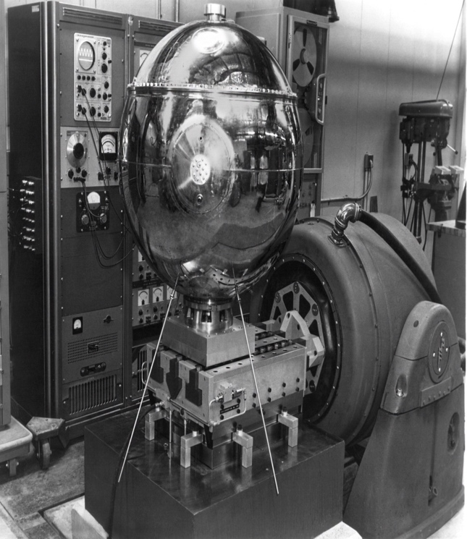
Vibration Tables Shake Up Aerospace, Car Testing
Goddard Space Flight Center
Team Corporation
Burlington, Washington
NASA Technology
NASA tests all its equipment on vibration tables, to ensure it won’t come apart during launch
Team Corporation has been providing the test equipment since the 1950s, including for Vanguard 1, one of the first satellites ever launched
Team built new, state-of-the-art vibration testing equipment for the James Webb Space Telescope
Benefits
Team specializes in high-end, custom equipment to meet customer needs
Shaker devices can recreate a bouncing road or a massive earthquake
One big market is car industry, which tests car components as well as the assembled vehicle
Also widely used in aerospace and defense industries
Technology Transfer
Over the decades, innovations Team has created for NASA projects have been included in their commercial offerings
Stiff, frictionless Model 1830 T and V bearings were first made for a NASA shaker table, now found all over the world in Team products
Spinoff 2017
Industrial Productivity

Slide 51
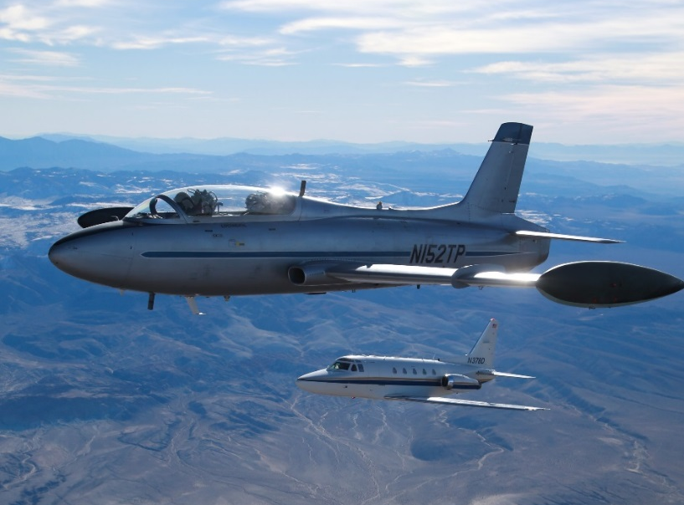
Astronauts Instruct Newcomers on Peculiarities of Spaceflight
Johnson Space Center
International Flight Test Institute
Mojave, California
NASA Technology
NASA astronauts are among the most thoroughly, heavily trained professionals on Earth
Astronaut training and experience include not only operating, piloting in orbit but also space law, spacecraft testing, contingency planning, and much more
Technology Transfer
With the help of two former astronauts, National Flight Test Institute offers spaceflight course
Aims to give engineers on the ground in commercial aerospace business an understanding of industry
One-week classroom session focuses on topics from orbital mechanics to administrative paperwork; following one-week hands-on session applies lessons in simulated zero- and high gravity
Benefits
Engineering graduates may have little knowledge of space operations
Instructors gain experience, credibility from training, time in orbit, and experience piloting shuttles and choreographing spacewalks
Lessons help new commercial aerospace workers be productive from the start
Spinoff 2017
Industrial Productivity

Slide 52
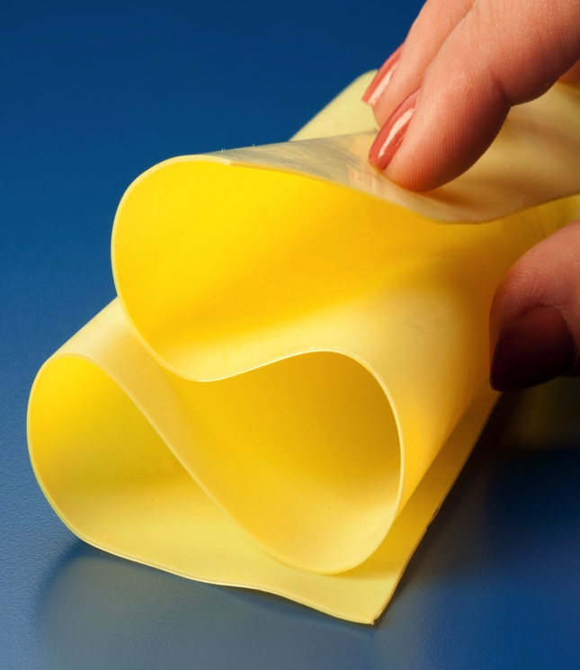
Polyimide Aerogels Boost Antennas, Insulate Pipes
Glenn Research Center
FLEXcon
Spencer, Massachusetts
NASA Technology
NASA needed a powerful insulating material that was strong, lightweight and flexible
The material was to be used in an inflatable decelerator for, for example, sending a larger spacecraft to Mars
Aerogels are mostly air, and, when made from polyimides, they are also very strong, can be cast in a thin, flexible layer, and be very heat-resistant
Benefits
Strong, flexible, not bulky; open cell structure allows moisture to get out while keeping heat in
Thin film rolls are sold to insulate pipes in extreme environments; FLEXcon is also exploring market in consumer goods, like coats
High porosity offers low resistance to electromagnetic waves, excellent for antennas
Technology Transfer
In 2015, FLEXcon licensed the patent for polyimide aerogels for the thin-film format
In partnership with another company, Blueshift, makes and sells 100-foot rolls at thicknesses of from 2 thousandths of an inch (0.5 mm) to 80 thousandths of an inch (2 mm)
Spinoff 2017
Industrial Productivity

Slide 53
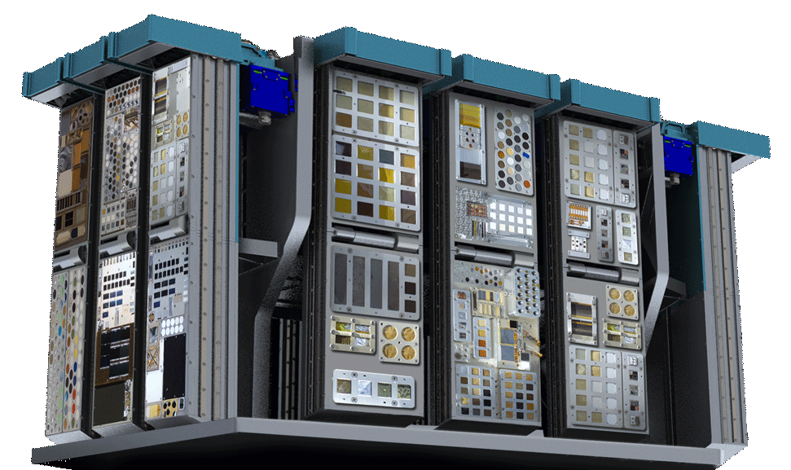
Privately Built Facility Offers Advantages in Space Exposure Testing
Johnson Space Center
Alpha Space
Houston, Texas
NASA Technology
NASA, military Space Test Program have carried out Materials International Space Station Experiment (MISSE) series since 2001
Materials, usually planned for space applications, are housed outside ISS to see how they’re affected by exposure to space environment
Technology Transfer
National Lab Office at Johnson contracted Alpha Space to build permanent MISSE facility, manage MISSE deployments starting in 2017
Under cooperative agreements, NASA and Alpha Space share funding, risks
Space on MISSE not used by NASA will be rented to commercial, government, educational entities
Benefits
Permanent facility, robotic installation and removal of samples keep costs low
Samples can be exposed to different elements for different lengths of time
Fast data connections offer real-time monitoring
New sensors include high-resolution cameras, extremely precise contamination sensor
Spinoff 2017
Industrial Productivity

Slide 54
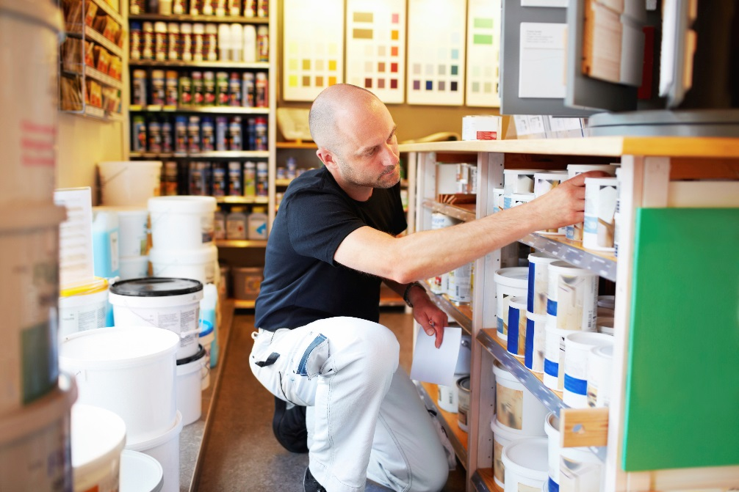
Optical Filters for NASA Imagers Focus on Cutting Edge
Goddard Space Flight Center
Materion Precision Optics
Westford, Massachusetts
NASA Technology
Goddard hired Barr Associates, now part of Materion, to meet stringent, complicated requirements for updates to Hubble Space Telescope cameras
Optics for Curiosity Mars rover, James Webb Space Telescope continued to push company’s capabilities
Technology Transfer
Hubble needed four light filters on a single optical component
James Webb Space Telescope Near-Infrared Camera required unprecedented uniformity in mid- and long wavelength light, where filter coating methods blur
Benefits
Technique developed to put multiple filters on one optic led to paint color matcher
Protocols to eliminate defects, new coating recipes are now used in Materion’s daily coating processes
Optics for products including cell phones, tablets, laptops, and other electronics all benefit
Spinoff 2017
Industrial Productivity

Slide 55
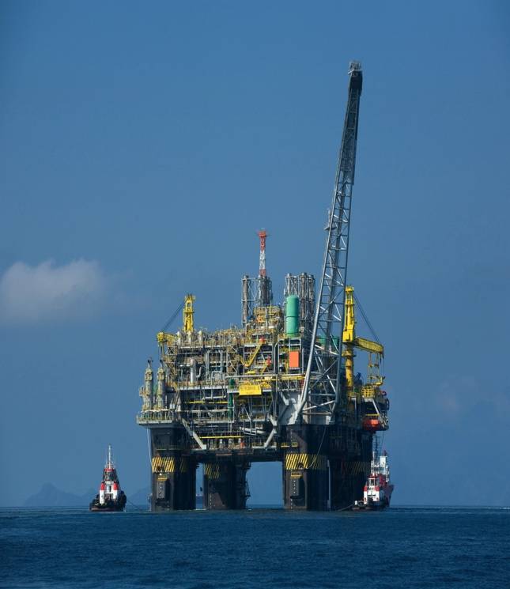
Zinc-Silicate Coating Blocks Corrosion
Goddard Space Flight Center
Polyset
Mechanicville, New York
NASA Technology
Coatings for steel help prevent rust and corrosion that weaken the strong material
Zinc-silicate coating perfected at Goddard in the 1970s bonds chemically with the steel for long-lasting, very effective protection
Used to protect seaside structures at Kennedy Space Center
Benefits
In 2010, Polyset began selling coating as WB HRZS Single Coat System
One of Polyset’s first clients was Chevron, which uses the coating on offshore oil rigs
Because coating bonds chemically, water doesn’t seep under, even when it is damaged
It is water-based, so no hazardous thinning agents or solvents
Technology Transfer
Patent was licensed by Inorganic Coatings, which turned to Polyset to help manufacture liquid potassium silicate, a key ingredient
Inorganic Coatings saw early success but went out of business in part because its attempts to make potassium silicate itself were inconsistent
Now Polyset markets the coating directly
Spinoff 2017
Industrial Productivity

Slide 56
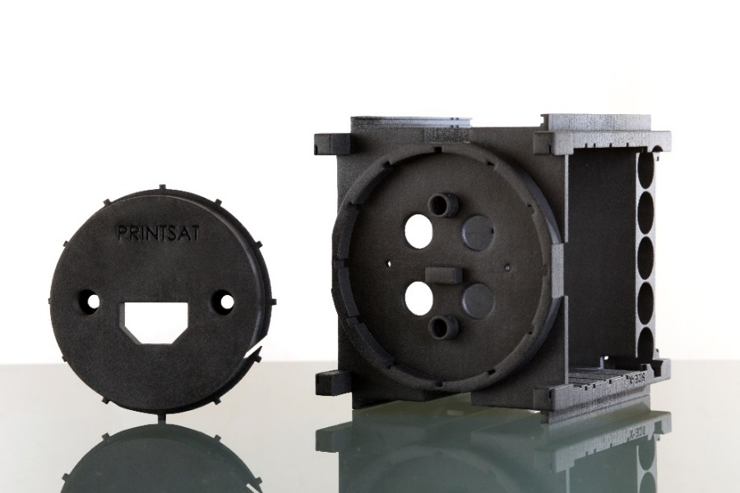
Outgassing Test Facility Brings New Materials into Space Industry
Goddard Space Flight Center
CRP USA
Mooresville, North Carolina
NASA Technology
In space, condensable volatile compounds can outgas from spacecraft materials and condense on crucial components like lenses, mirrors
Outgassing Laboratory at Goddard tests all materials considered for space applications to ensure minimal or no outgassing
Technology Transfer
In 2013 the Outgassing Laboratory tested four of CRP’s Windform 3D printing materials, finding them suitable for space applications
Two materials, LX 2.0 and XT 2.0, had no volatile compounds
Results of all outgas testing are available on Outgassing Laboratory’s website
Benefits
Following testing CRP has found business with 10 to 15 aerospace companies
Windform materials offer high strength at low weight, a boon to any space application
Materials can be used in selective laser sintering 3D printing, which never leaves voids
Universities have made satellites with Windform
Spinoff 2017
Industrial Productivity

Slide 57
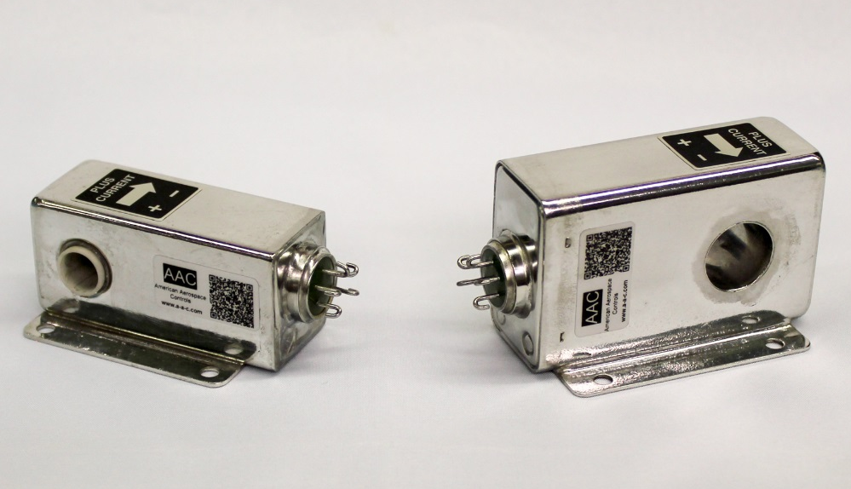
Shuttle, Hubble Work Lead to Strength in Custom Current Sensors
Johnson Space Center
Marshall Space Flight Center
American Aerospace Controls Inc.
Farmingdale, New York
NASA Technology
The Space Shuttle, built at Johnson, had an early all-digital fly-by-wire system; all subsystems were automated and connected by computer
The Hubble Space Telescope, built at Marshall, must collect and manage enough energy during each solar exposure to operate for an entire orbit
Technology Transfer
American Aerospace Controls (AAC) provided custom current sensors as a subcontractor for the Shuttle, followed by similar work for Hubble
To meet requirements such as ruggedness against a variety of conditions, AAC brought quality-control staff and equipment in-house
AAC hired engineers to document rigorous testing
Benefits
Shifted from standardized to specialized custom current sensors, vastly enlarging parts catalog
Reputation for reliability expanded market to military satellites, foreign space agencies and companies, commercial aeronautics
Rail, industrial, and helicopter companies also take advantage of rugged, reliable parts
Spinoff 2017
Industrial Productivity

Slide 58
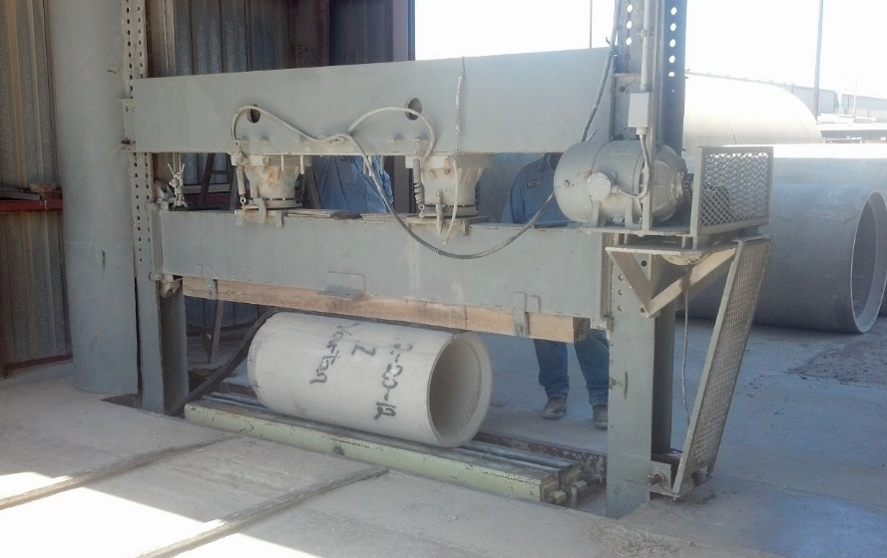
High-Heat Cement Gives Ashes New Life
Stennis Space Center
Alchemy Geopolymer Solutions
Colombus, Ohio
NASA Technology
Flame trenches under rocket test stands at Stennis need to withstand the inferno of a rocket plume and resist wearing away
Geopolymer concrete—made with fly-ash from burning coal and then mixed with the right aggregates and alkali activators—can be stronger and more heat-resistant than non-recycled materials
Benefits
Using waste ash means less sent to a landfill and less emissions and energy consumption from producing limestone cement
Impressive heat- and compression-resistance and and anti-corrosion properties
Clients get custom design based on locally sourced fly ash and other specified needs
Technology Transfer
A Louisiana Tech University team designed multiple geopolymer concretes to test under a Dual Use Technology Development cooperative agreement
The successful test results prompted the team to start Alchemy Geopolymer Solutions to design geopolymer concrete for clients around the country
In 2014, won the prestigious Startup Louisiana Prize
Spinoff 2017
Industrial Productivity

Slide 59

Visit the Spinoff website for more examples of NASA technology transfer: http://spinoff.nasa.gov

Slide 60


