Slide 1
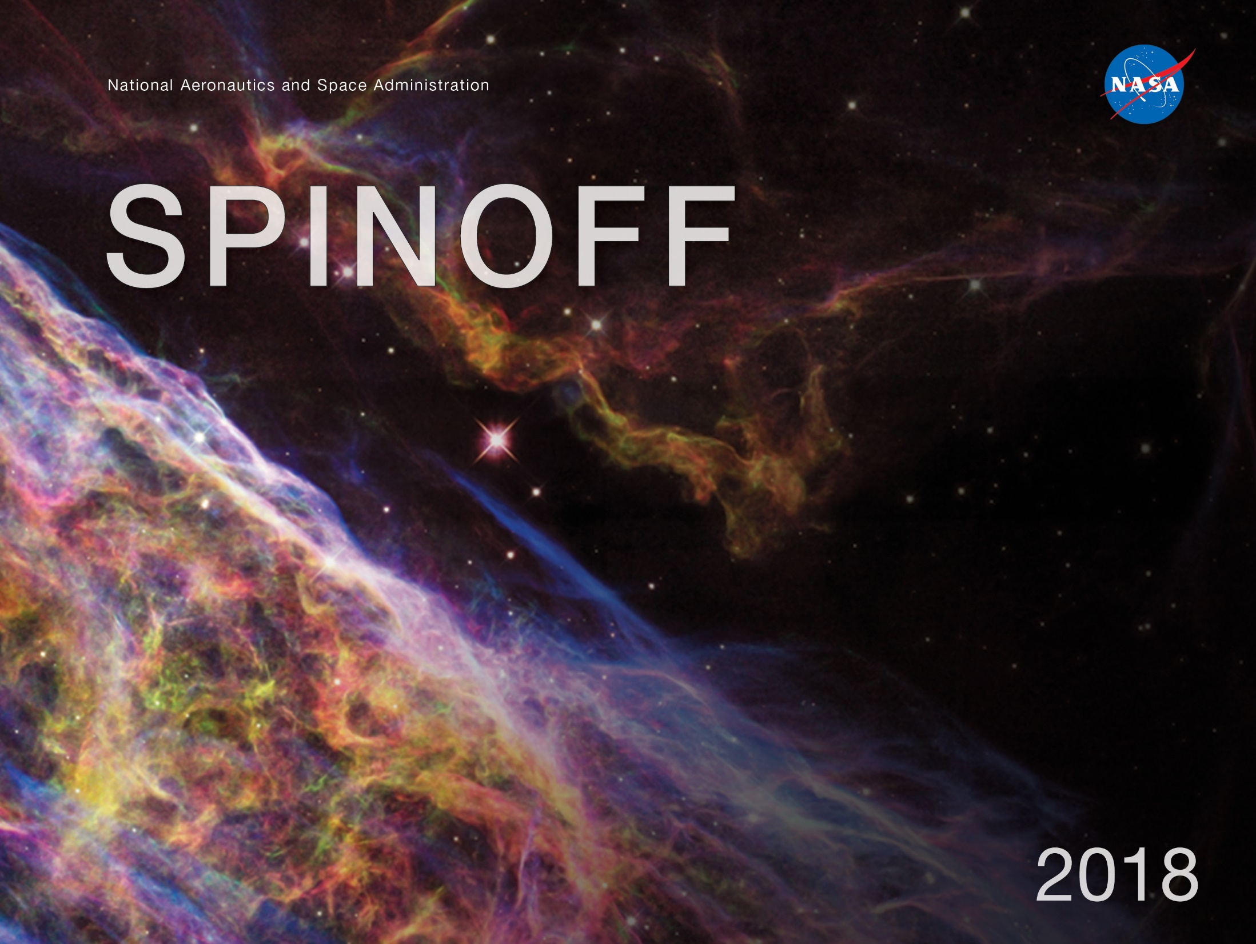

Slide 2
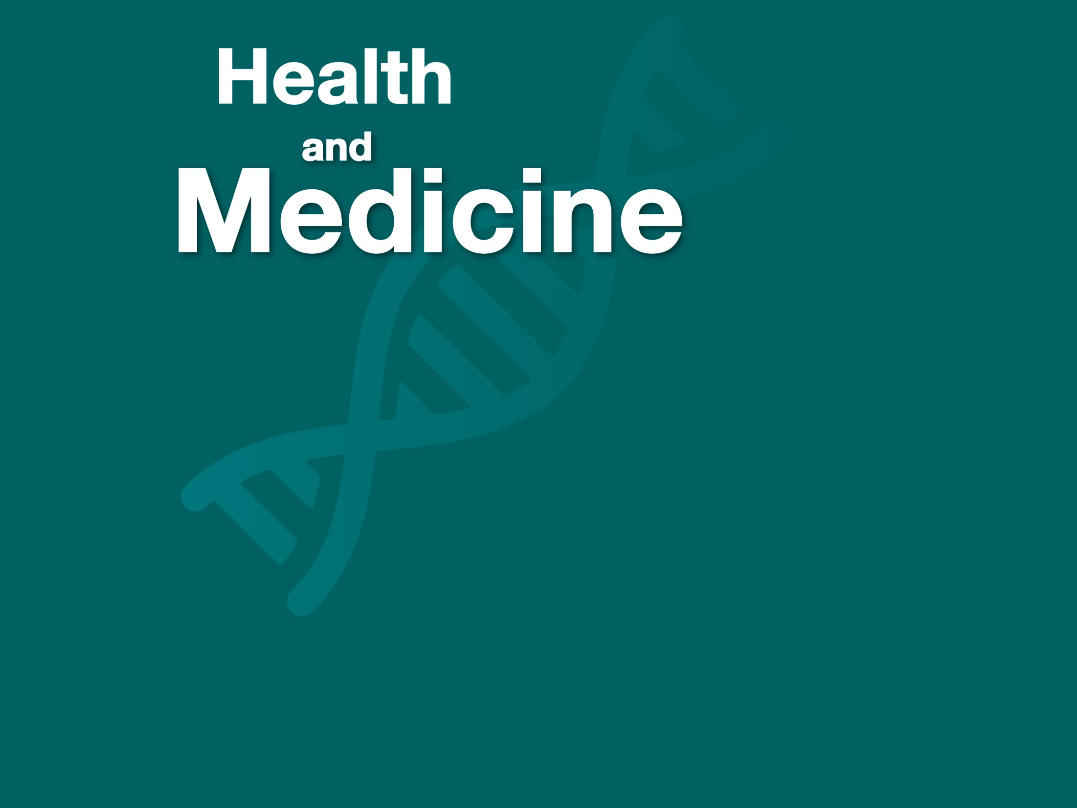

Slide 3
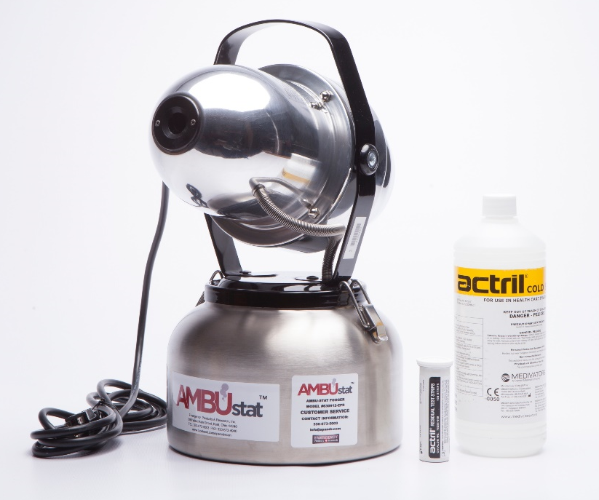
Sterilizing Fogger Cleans Ambulances With a Breeze
Glenn Research Center
Emergency Products + Research
Kent, Ohio
NASA Technology
Atomic oxygen—single O atoms—are prevalent in the upper atmosphere and can be very destructive
Without a special coating to prevent this oxidation, the ISS solar arrays would break down in months
NASA has built up expertise on atomic oxygen by working on problems like this
Technology Transfer
Through the Regional Economic Development Program, NASA experts consult with companies
EP+R was close to a viable design but needed technical help to get past the finish line
Glenn’s Sharon Miller helped the company set up a testing protocol, similar to what she does for space environments, and helped flag potential problems with the working design
Benefits
AMBUstat creates a mist with a solution of water, peracetic acid, and hydrogen peroxide.
It sterilizes an ambulance interior in just minutes
The first order, from an EMT group in Texas, came before EP+R had even set a price
It is now used across the country and there is interest internationally
Spinoff 2018
Health and Medicine

Slide 4
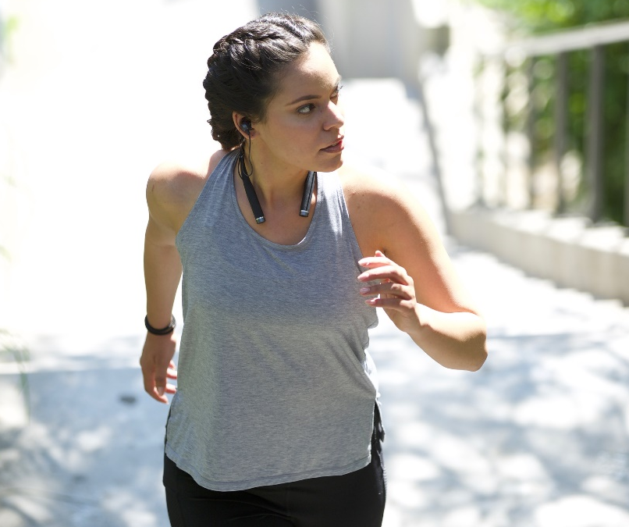
Biometric Sensors Optimize Workouts
Ames Research Center
LifeBEAM
New York, New York
NASA Technology
Heavy G-forces can lead to a blackout, a potential problem for pilots and astronauts
By the time they notice or signal a problem, it may be too late to correct
Biometric sensors that could sound an early warning may prevent a dangerous situation
Technology Transfer
Singularity University has a Space Act Agreement with Ames Research Center; NASA experts work with some participants, including LifeBEAM
During the three-month program, LifeBEAM created a prototype sensor for pilots and astronauts
The company used the experience as a launchpad for its efforts to build a lower-cost commercial sensor
Benefits
Vi is a voice-activated device embedded in earphones that tracks heart rate, steps, mileage, weather, elevation, and more
Its AI software can react with the data and offer workout suggestions tailored to the users’ goals
Initial Kickstarter raised nearly $1.7 million and sold more than 8,000 units
Spinoff 2018
Health and Medicine

Slide 5
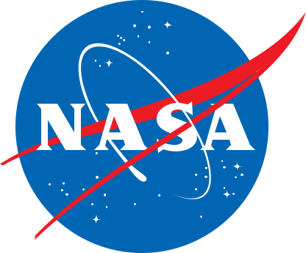
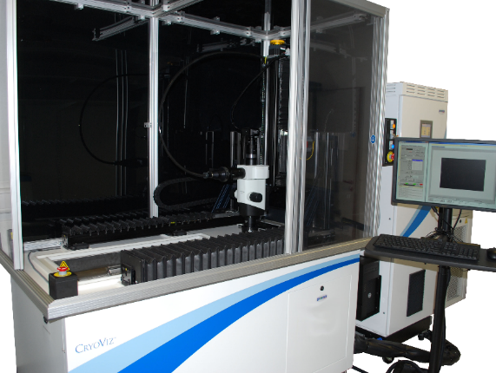
Optimized Imager Tracks Cancer, Stem Cells in Medical Research
Glenn Research Center
BioInVision
Cleveland, Ohio
NASA Technology
Company had device for imaging all fluorescent-tagged cells in a medical specimen but wanted optimization for a smaller desktop version
Glenn optics lab specializes in work like diagnostic imaging for combustion and fluid physics, optical communications, custom sensors, and light-based metabolic analysis
Technology Transfer
Under Adopt a City, BioInVision was selected to receive 40 hours of free NASA expertise
Head of Glenn optics lab came up with several combinations of affordable, off-the-shelf components
Desktop version is still in the works, but Glenn’s suggestions were incorporated into existing CryoViz device
Benefits
Updated product is more sensitive, more efficient, cheaper to make, and has one less part
Saved time, R&D money, and potential costs of any design errors
CryoViz is helping with cancer research and development of stem cell therapies in the U.S., Canada, Europe, and Asia
Spinoff 2018
Health and Medicine

Slide 6
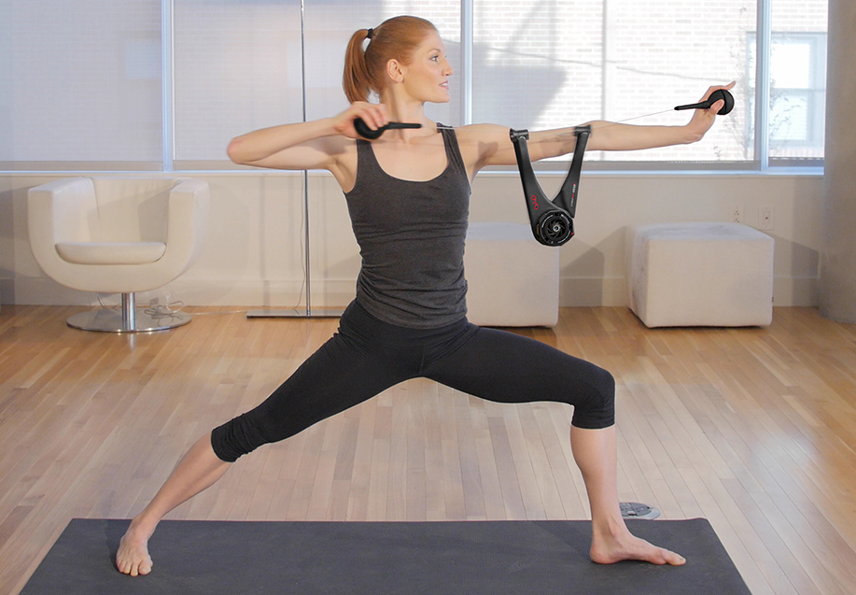
Weightless “Weight”-Lifting Builds Muscle on Earth
Johnson Space Center
OYO Fitness
Kansas City, Missouri
NASA Technology
Astronauts lose bone and muscle mass during stays in space, because of the lack of gravity
Exercise combats this loss, but equipment must be specially modified for zero gravity
To get the effect of “weight-lifting,” astronauts use resistance-based exercise machines
Technology Transfer
In the 1990s, inventor Paul Francis won a NASA competition with technology he called “Spiraflex”—a spiral torsional spring made out of elastomer
With NASA funding, Francis began to develop a device with Spiraflex to use on the International Space Station; it was used from 2000 to 2009
Francis licensed his patents to Bowflex, and later developed his own fitness equipment using Spiraflex
Benefits
The Doubleflex weighs just two pounds and can be folded to fit in a small backpack
The minituraized Spiraflex technology can create up to 25 pounds of linear resistance; users can add additional resistance with FlexPacks
The DoubleFlex applies resistance to both sides of muscle groups in one motion, enabling balanced bodybuilding in half the time
Spinoff 2018
Health and Medicine

Slide 7
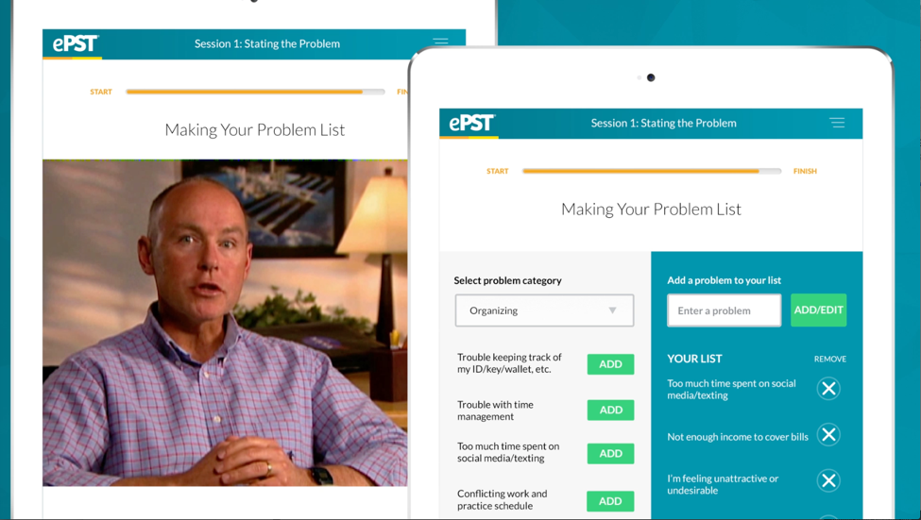
Virtual Therapist Offers Out-of-This-World Depression Treatment
Johnson Space Center
everMind
Norwich, Vermont
NASA Technology
Long duration space missions are challenging psychologically and emotionally
Access to a therapist from space is difficult
One solution to address this problem is virtual therapy, via a video-based computer program
Technology Transfer
In the 1990s, psychologist James Cartreine began building a modular system to treat mental health problems through a video-based interface
He got grants from Johnson Space Center-funded National Space Biomedical Research Institute
He always intended to adapt it for public health, and he negotiated to take the intellectual property to a private company
Benefits
everMind’s first product, ePST is a direct translation of the Virtual Space Station module for depression
ePST was the first software cleared by the FDA as software therapy for depresion
Software removes barriers to therapy like high cost, logistic barriers, and social stigma
Spinoff 2018
Health and Medicine

Slide 8
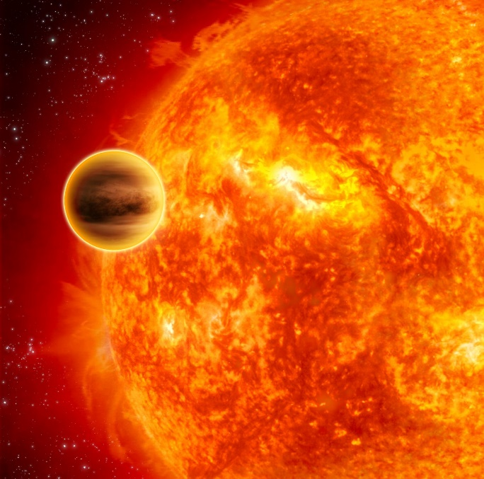
Compact Spectrometers Unveil Clues to Diagnose Cancer
Goddard Space Flight Center
Hindsight Imaging Inc.
Boston, Massachusetts
NASA Technology
In the 1990s, the hunt for exoplanets intensified—first confirmed detection was 1992
One early method was radial spectroscopy, to detect the wobble of a star to infer a planet tugging at it
However, existing spectrometers weren’t precise enough to get the results astronomers wanted
Technology Transfer
Arsen Hajian was one scientist working on building a better spectrometer
His background, in radio astronomy, helped him look for an unorthodox approach to get around the typical size/resolution tradeoff
Much of his funding came from NASA grants, including ROSES and ATI, available to civil servants
Benefits
Hindsight spectrometers are nearly 30 times smaller than conventional high-res versions
Currently sold as components for larger instruments; in mid-2017, company released first two complete systems—one to detect melanoma
Hajian envisions future tools to noninvasively “biopsy” tumors and measure blood composition
Spinoff 2018
Health and Medicine

Slide 9
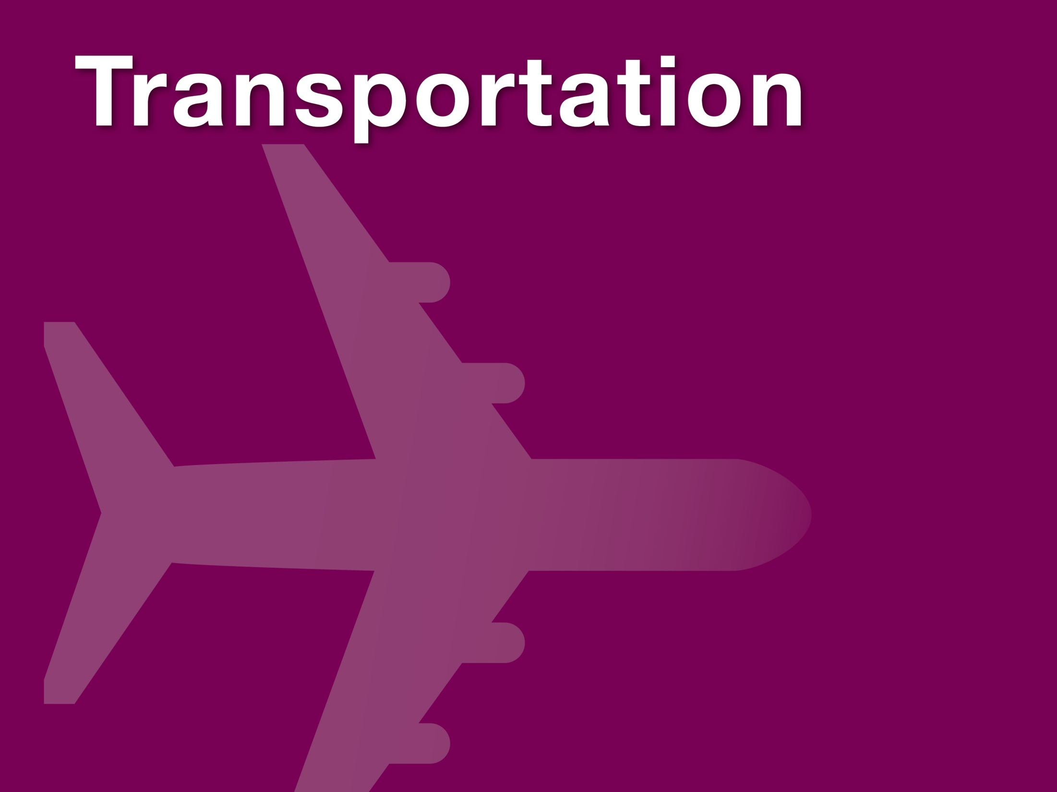

Slide 10
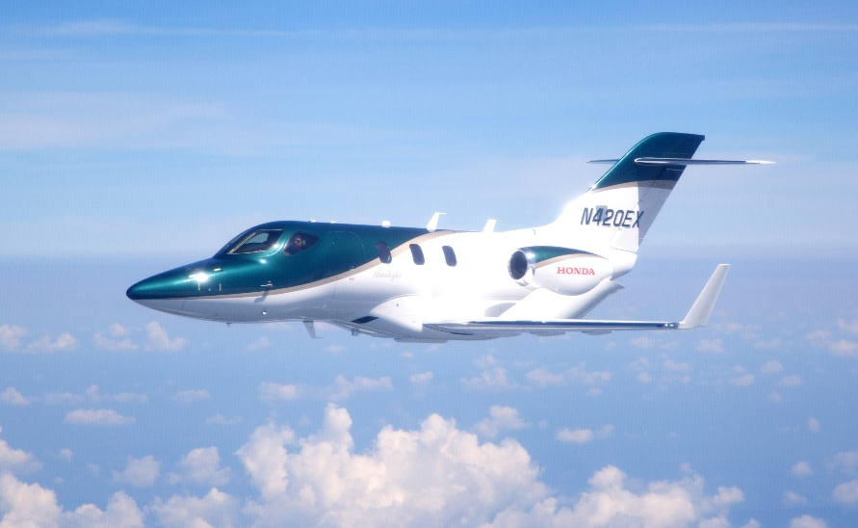
Innovative Design Propels Small Jet Faster, Farther with Less Fuel
Langley Research Center
Honda Aircraft
Greensboro, North Carolina
NASA Technology
The National Transonic Facility at Langley Research Center opened in 1983
It is one of only two wind tunnels like it in the world—it both pressurizes air and supercools it to better simulate for models the conditions full-size aircraft will fly in
Technology Transfer
Honda Aircraft contracted to use the facility to test its new design to ensure it would perform as predicted
The contract was fully reimbursable, meaning Honda paid all costs and retained the rights to all results
The team worked with NASA wind tunnel experts to ensure the 10%-size model was properly designed to withstand high-speed testing and could interface with all instruments
Benefits
HondaJet’s main innovation is the over-the-wind engine mount, which leaves more room in the cabin, reduces noise, and decreases drag
Maximum cruising speed is 422 knots, fastest in its class, and maximum altitude of 43,000 feet, also highest in its class
Lower drag also ups fuel efficiency by up to 17%
Spinoff 2018
Transportation

Slide 11
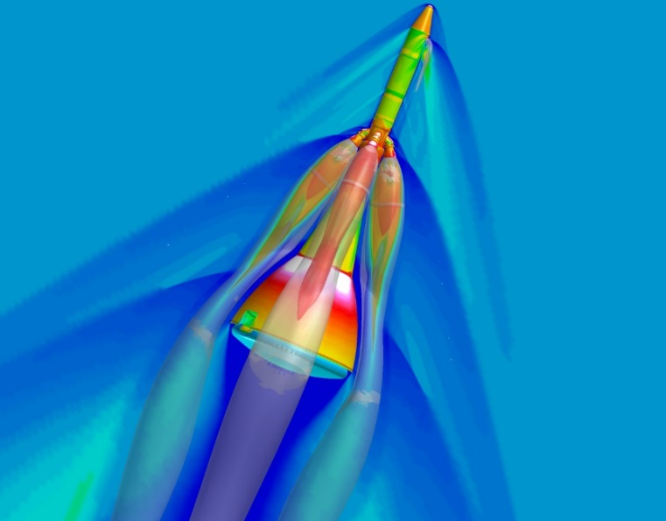
Design Software Transforms How Commercial Jetliners Are Built
Ames Research Center
Boeing
Seattle, Washington
NASA Technology
Pegasus software began as a NASA-Air Force partnership, with Micro Craft company and Boeing
A preprocessor for overset-grid computational fluid dynamics simulations, the program speeds and simplifies simulations of aircraft performance
Won the 2016 NASA Software of the Year award
Technology Transfer
Boeing was one of the first to apply Pegasus 5 to aircraft configurations, and it soon became the company’s primary overset connectivity tool
NASA continues to make improvements and issue new versions
The code has been distributed to more than 470 organizations in industry, academia, and defense
Benefits
Boeing uses Pegasus 5 to design commercial and military planes and spacecraft, and to make changes to existing aircraft
Saves time and money and reduces user error
Eliminates much of the uncertainty from the design and analysis process
Spinoff 2018
Transportation

Slide 12
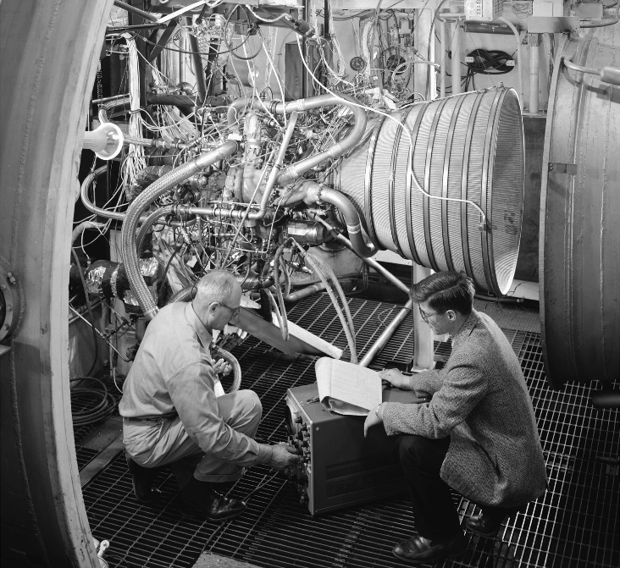
Original Cryogenic Engine Still Powers Exploration, Defense, Industry
Glenn Research Center
Aerojet Rocketdyne
West Palm Beach, Florida
NASA Technology
The RL10, an upper-stage engine, was the first engine to run on cryogenic liquid hydrogen
The engine was matured at Lewis Research Center, now Glenn, in partnership with Pratt & Whitney Aircraft, now part of Aerojet Rocketdyne
Lewis had worked on liquid hydrogen in the 1950s
Technology Transfer
Pratt & Whitney eventually took over the RL10, manufacturing it commercially
RL10 powers the Centaur, still the most-used upper stage in the U.S., and has powered several others
It remains the premier upper-stage engine in the country, half a century after its creation
Benefits
Reliable: only one failure in over 400 flights
Unique expander cycle means high efficiency
Can make multiple restarts in space
Cryogenic engine technology gave critical advantage to U.S. military, industry, exploration
Helped launch 20 years’ worth of commercial satellites, still military’s preferred upper stage
Spinoff 2018
Transportation

Slide 13
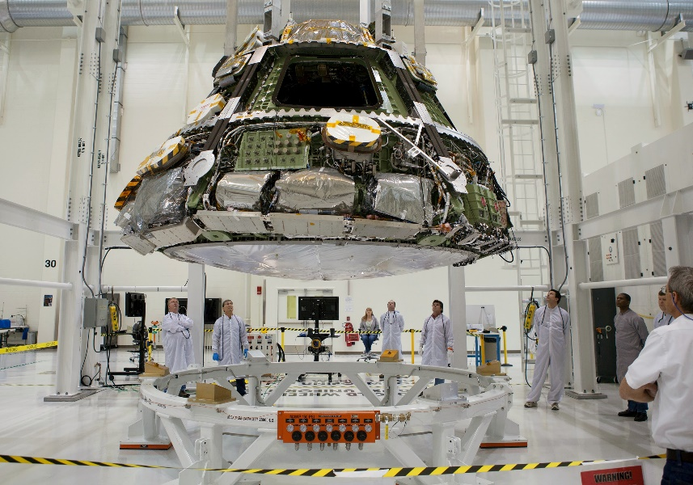
Time-Triggered Ethernet Slims Down Critical Data Systems
Johnson Space Center
TTTech
Andover, Massachusetts
NASA Technology
Past spacecraft avionics subsystems have been housed on separate computers and speak to each other indirectly
For Orion, Johnson wanted a more integrated system
TTTech had an early version of Time-Triggered Ethernet (TTEthernet), which prioritizes messages to guarantee the delivery of critical signals
Technology Transfer
TTTech was subcontracted to provide TTEthernet technology to enable integrated, modular avionics
Under a Space Act Agreement, NASA worked with SAE International to develop a standard for TTEthernet, helping others adopt the technology
Feedback and lessons learned from Orion work made products more refined, robust, and marketable
Benefits
Significant reductions in mass, volume, and power come from reducing the number of computers
Modular approach lets functions be added or removed without affecting the rest of the system
TTEthernet is now used in other space systems, wind turbines, and especially driver assistance and the self-driving cars to come
Spinoff 2018
Transportation

Slide 14
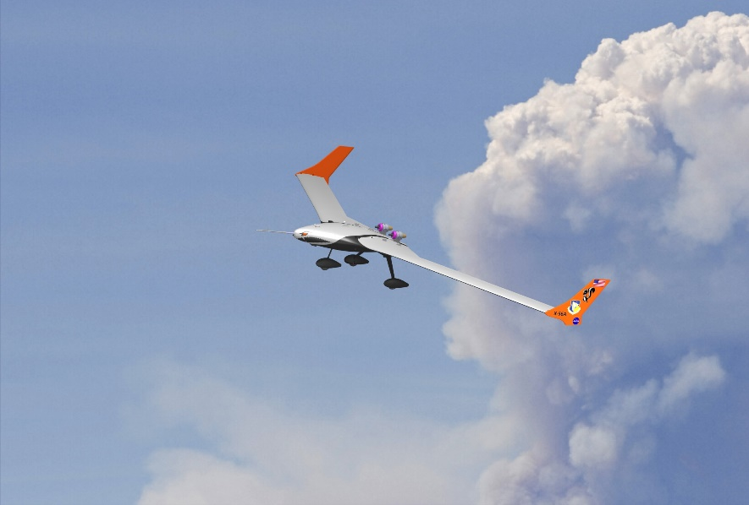
Simplified Aircraft Modeling Packs Weeks of Analysis into Minutes
Langley Research Center
CFD Research Corporation
Huntsville, Alabama
NASA Technology
Engineer Walt Silva’s specialty is aeroelasticity: the interaction between aerodynamics and the structure
Modeling this in computational fluid dynamics programs is complicated and time-consuming
Silva built a software tool that creates a reduced order model to get computational results faster
Technology Transfer
Silva spent more than two decades developing the tool, for which he now holds a patent
In 2014, the software earned honorable mention for NASA’s invention of the year, and Silva earned a Space Act Award from NASA
The software is now available to license, and is increasingly being used by private companies
Benefits
Reduced Order Model (ROM) software uses a mathematical tool, system identification, to create its simplified model
Instead of weeks a supercomputer, calculations can now be done in days on a laptop
CFDRC is using the software to build a tool for the Air Force to model aircraft wear and tear
Spinoff 2018
Transportation

Slide 15
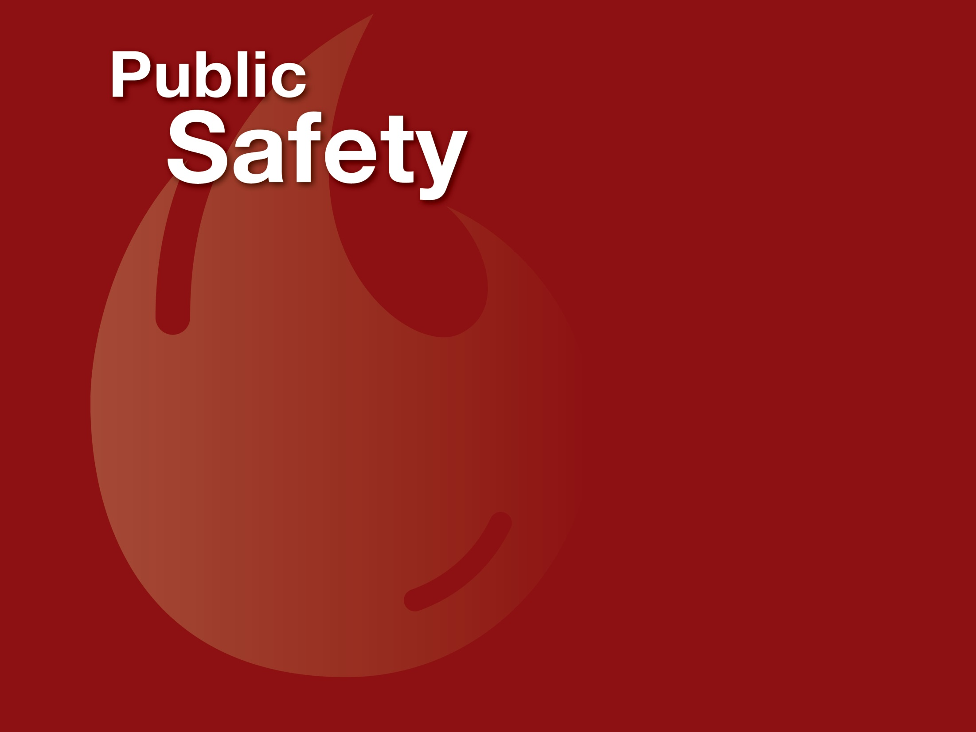

Slide 16
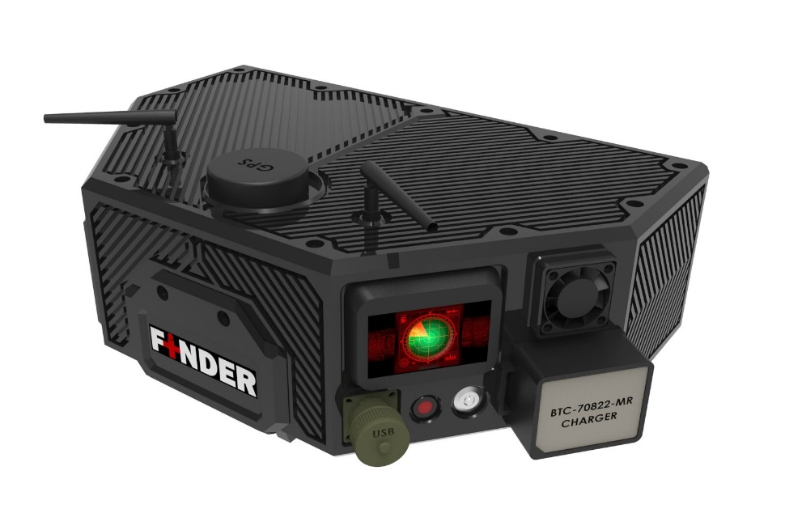
Radar Device Detects Heartbeats Trapped under Wreckage
Jet Propulsion Laboratory (JPL)
R4 Inc.
Edgewood, Maryland
NASA Technology
NASA often analyzes weak radio signals to identify slight physical movements, like minor alterations in a satellite’s orbit that might indicate gravity fluctuations
The departments of Defense and Homeland Security approached JPL about using such technology to identify survivors on a battlefield or trapped under rubble
Technology Transfer
With Department of Homeland Security funding, JPL developed a prototype able to locate living humans by using radar to detect breathing and heartbeats
R4 licensed the technology and made it more rugged, lightweight, and accurate and improved the graphical user interface
Benefits
FINDER located four men trapped under rubble after a 2015 quake in Kathmandu, saving them
Device is proven capable of detecting humans through 30 feet of dense rubble and up to 100 feet away in the open with 80 percent accuracy
FEMA now provides funding for municipalities to buy the device; first customers were U.S. Army and Ecuadorian fire department
Spinoff 2018
Public Safety

Slide 17
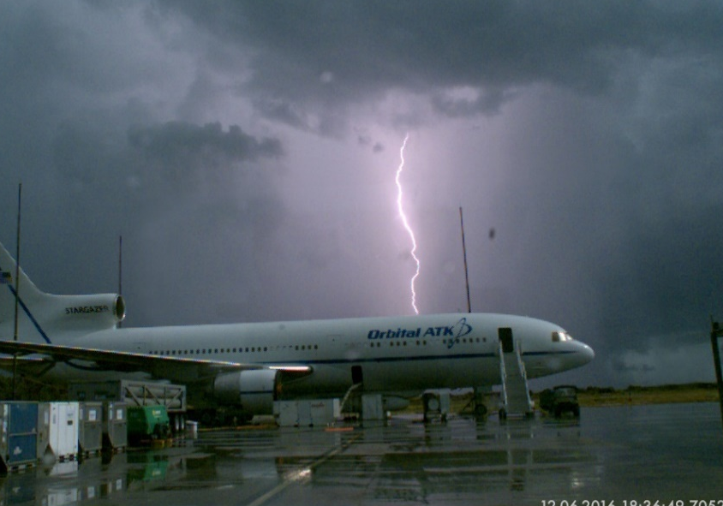
Surveillance System Captures, Maps Lightning Strikes
Kennedy Space Center
Scientific Lightning Solutions, LLC
Titusville, Florida
NASA Technology
Lightning strikes, even indirect, can cause critical damage to electronics systems
If it’s possible a strike hit within the danger zone, launches must be delayed and systems retested
NASA wanted a more reliable system to capture and measure 100% of strikes near launch pads
Technology Transfer
Carlos Mata was instrumental in designing a new system as lightning subject matter expert at Kennedy
Even before fully installed, the cameras captured a strike the day before the final Space Shuttle launch, enabling it to proceed on schedule
Mata partnered with East Coast Lightning Equipment to create a company to sell the system commercially
Benefits
Optical Jupiter Precision Lightning Surveillance is a stand-alone system that detects 100% of strikes within range
High speed cameras visually locate each strike; sensors measure intensity
Can be used at wind farms, airports, and to verify insurance claims
Spinoff 2018
Public Safety

Slide 18
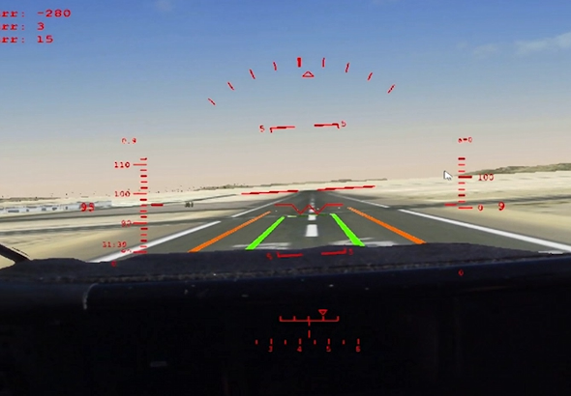
Virtual Reality Platform Helps Pilots Land in the Sky
Armstrong Space Flight Center
Systems Technology Inc.
Hawthorne, California
NASA Technology
A simulator that can hook into an airplane and layer a virtual scene over the real world outside the cockpit could improve airplane testing and training
This would be more accurate than a ground-based simulator because external conditions would be real
Can more safely test how an airplane maneuvers
Technology Transfer
Initial work, for Air Force and Navy, built a virtual reality tool for static vehicles on the ground that would allow pilots to see interior of the cockpit
NASA SBIR contracts, phase I and II, asked STI to develop the platform as an in-flight simulator
Later, STI was awarded center innovation funds for additional development and test flights, including to make the system compatible with any aircraft
Benefits
Fused Reality system allows pilots to practice difficult landing or mid-air fueling maneuvers with a virtual runway or second airplane
System can be moved from plane to plane or helicopter: every aircraft can become a simulator
Software works with off-the-shelf components so system is very inexpensive
Spinoff 2018
Public Safety

Slide 19
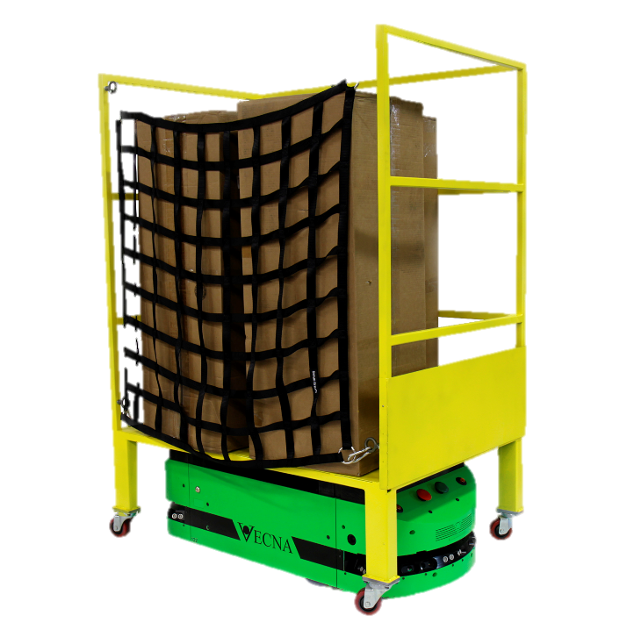
Autonomous Robots Take on Dangerous Warehouse Jobs
Johnson Space Center
Vecna Technologies
Cambridge, Massachusetts
NASA Technology
Autonomous robots working in space can help humans or prepare for their arrival
A prototype robot team was designed in 2005 to assemble a solar array on the moon
Three specialized robot types were linked by software
Technology Transfer
Robot team was led by Johnson, with contributions from the Jet Propulsion Laboratory, Langley Research Center, and Carnegie Mellon University
Carnegie Mellon grad student Fred Heger worked on software for the robots
Now at Vecna, Heger has built software for autonomous robot fleets based on NASA code
Benefits
Vecna’s autonomy kit can turn “anything that moves” into an autonomous robot; “Robot supervisor” software ensures each machine is where it needs to be
Vecna has a contract with a major U.S. shipping company to automate warehouse equipment
Safety system prevents collisions
Spinoff 2018
Public Safety

Slide 20
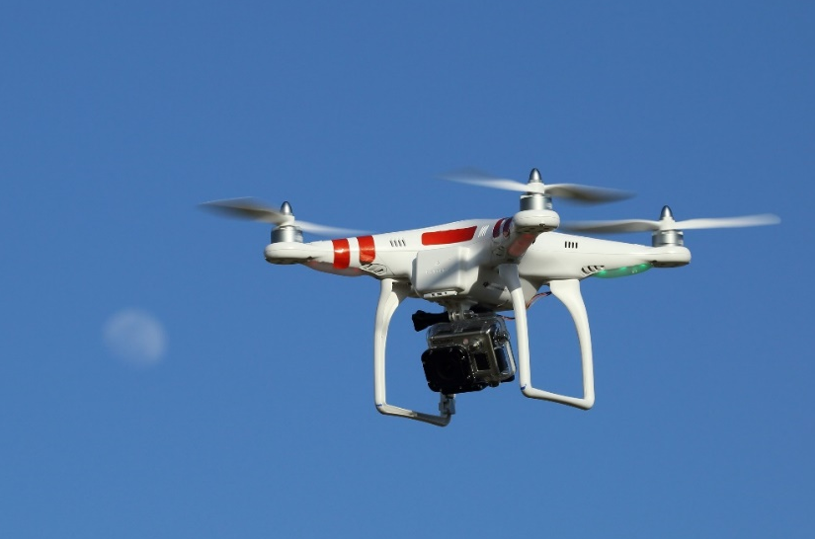
Drone Traffic Forecasts Show Commercial Skies of the Future
Ames Research Center
Intelligent Automation Inc. (IAI)
Rockville, Maryland
NASA Technology
Federal Aviation Administration (FAA) needed drone flight data to write regulations that would let large, high-flying drones operate among existing aircraft
Without regulations, drones couldn’t fly, so no data existed
Ames team worked with FAA to enable drone flight
Technology Transfer
Ames funded SBIR work by IAI and Virginia Tech to research future drone traffic
IAI was surprised to find companies and agencies had already planned future drone operations
Company built database of 19 mission types, including 26,312 likely daily drone flights above 2,000 feet
Benefits
Ames team used IAI data to draft technical drone requirements for the FAA
IAI built interface that can filter the drone categories, altitude, duration, and more, which it sells as UAS-Max
Drone researchers, airspace regulators, military organizations, and NASA are all customers
Spinoff 2018
Public Safety

Slide 21
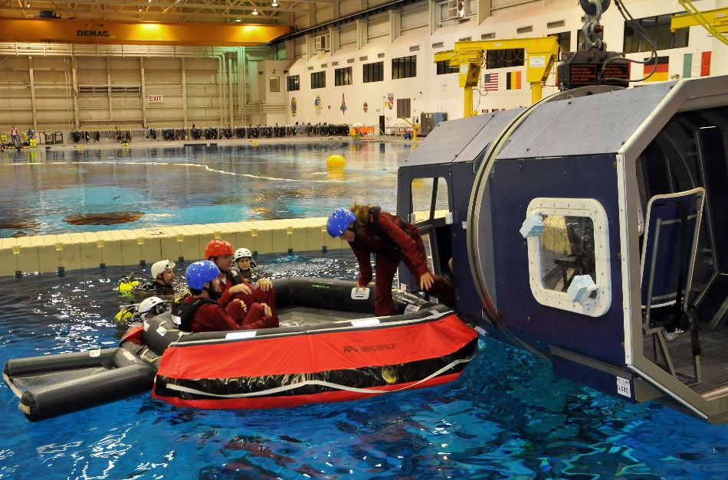
Offshore Oil Workers Learn Survival Skills in Astronaut Training Pool
Johnson Space Center
Bastion Technologies
Houston, Texas
NASA Technology
NASA astronauts train underwater to simulate weightlessness
The Neutral Buoyancy Lab (NBL) is NASA’s largest, most sophisticated astronaut training pool, built to accommodate space station mockups
Following space station completion, Johnson started leasing portions of the facility to outside customers
Technology Transfer
Under a Space Act Agreement, Bastion, which already supported the NBL, offers survival and fire training there for offshore oil workers
Bastion now offers 10 courses, certified by the international Offshore Petroleum Industry Training Organization
Company is by far the NBL’s biggest customer
Benefits
NASA safety practices, standards, record were already established
Company enjoys spacious, comfortable facility
Overhead cranes, A/V system, skybox control rooms, hyperbaric chamber, ample staging areas, onsite medical team are all assets to training
Spinoff 2018
Public Safety

Slide 22


Slide 23
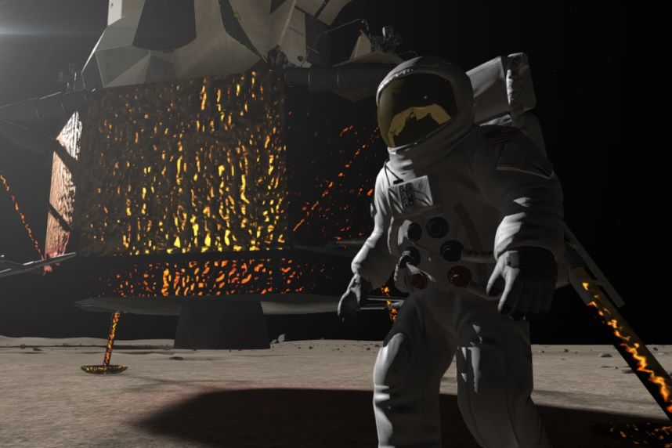
Apollo 11 History Archive Helps Virtual Reality Program Come to Life
Headquarters
Immersive VR Education
Waterford, Ireland
NASA Technology
NASA’s history department preserves artifacts and archives from past missions and makes the data available on public websites
The Apollo mission pages, detailing the moon landings, with audio, transcripts, designs, imagery, and more are among the most popular
Technology Transfer
The company used detailed design plans of the interiors of the spacecraft, lander, and command module from NASA’s archives
Apollo 16 astronaut Charlie Duke gave feedback to ensure total accuracy
A NASA-created photo mosaic of the moon landing site provided the base for the virtual world
Benefits
The VR demonstrates a new way of teaching history, and the program is free for teachers
Compatible with several VR headsets and more than 40,000 copies were sold its first year
The company went on to develop a free Mars Rover experience and hopes to make additional NASA-related programs about Hubble, the shuttle, and more
Spinoff 2018
Consumer Goods

Slide 24
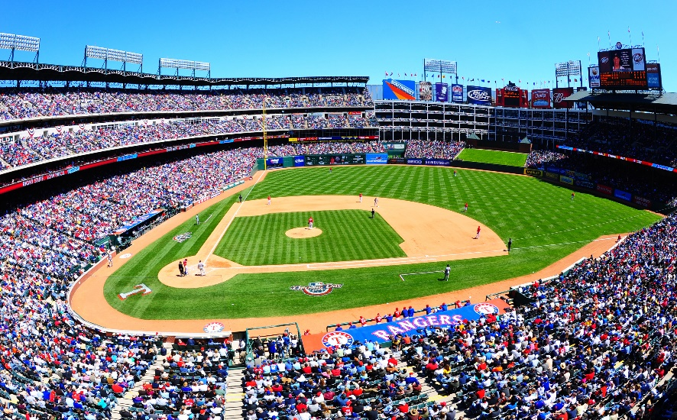
Light-Induced Oxidation Cleans Air, Surfaces, Clothes
Marshall Space Flight Center
Aerus Holdings LLC
Dallas, Texas
NASA Technology
Researchers at Wisconsin Center for Space Automation and Robotics, a NASA Research Partnership Center, hit on photocatalytic oxidation to scrub ethylene — an undesirable gas — from air
Process also eliminates other airborne organic compounds and bacteria, viruses, and molds
Technology Transfer
Several companies based products on the discovery
Aerus bought a company that had developed ActivePure, which sends out oxidizers to air and surfaces, rather than cleaning air passively
Aerus further improved technology and sells many variations, including clothes-washing and car applications
Benefits
$100 million in annual sales in 72 countries
Proven to reduce bacteria, even in sterile hospital settings
Reduces rates of infection, illness, allergies, absences from work and school
Used in hospitals, hotels, athletic facilities, schools, restaurant kitchens, homes, and more
Spinoff 2018
Consumer Goods

Slide 25
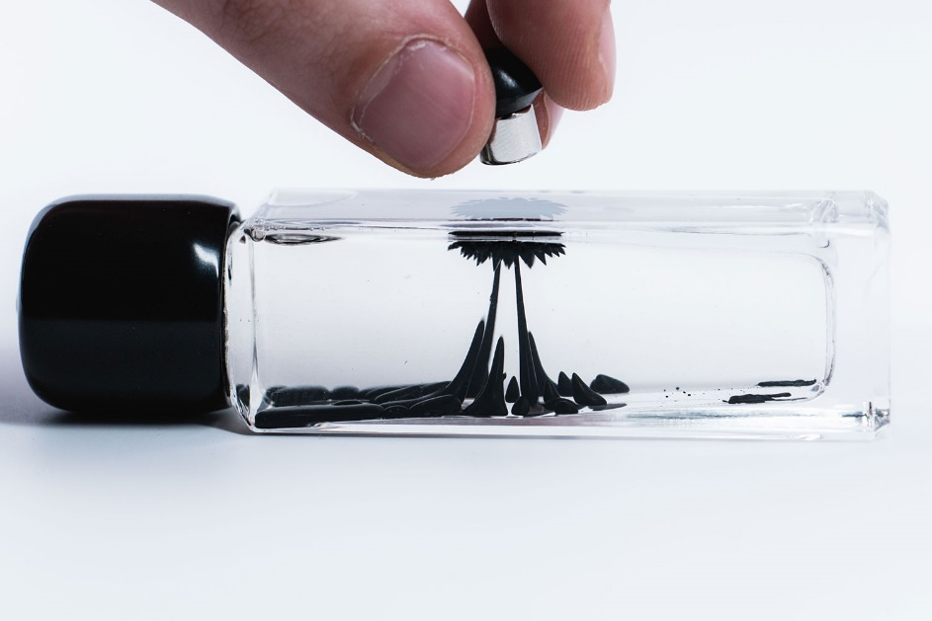
Ferrofluid Technology Becomes a Magnet for Pioneering Artists
Glenn Research Center
Concept Zero
Hamburg, New Jersey
NASA Technology
The first magnetized fluid, or ferrofluid, was invented at Glenn in the 1960s as a possible way to manage fuel in a tank in zero gravity
Two Avco engineers, who worked on NASA contracts, licensed the technology and founded Ferrofluidics Corporation, now Ferrotec
Technology Transfer
Since around 2000, a number of artists have started working with ferrofluid
Concept Zero founder developed a suspension fluid that prevents ferrofluid from staining glass and now produces cases with a bit of ferrofluid that can be manipulated with a magnet
Ferrofluid still comes from Ferrotec
Benefits
Desktop ferrofluid displays are popular as a sort of “high-tech stress ball”
Concept Zero partners with artists, who use ferrofluid for photography, movies, sculpture
Artists continue to find new uses for the technology—one used magnetic pixels to create a simple video game
Spinoff 2018
Consumer Goods

Slide 26
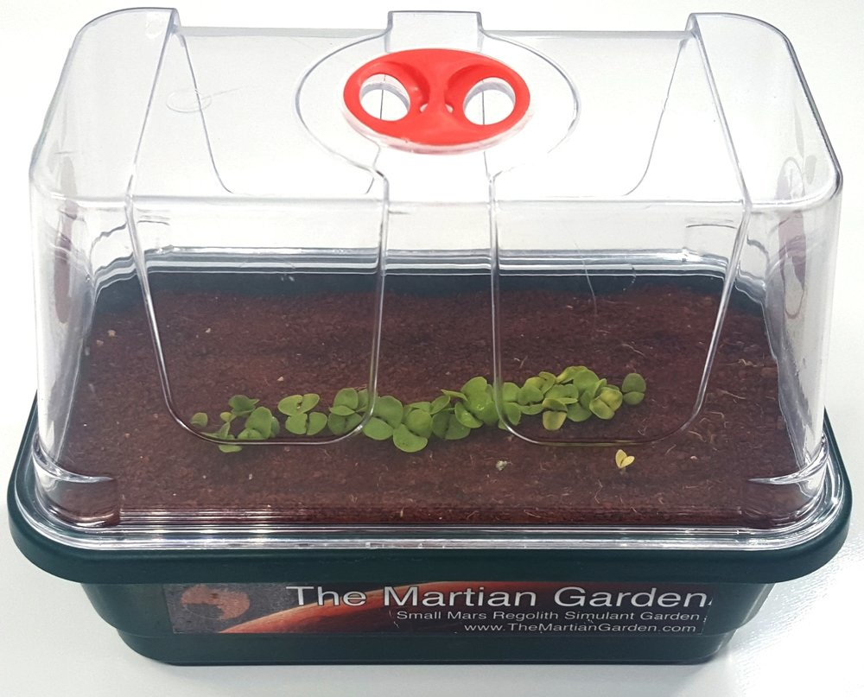
The Martian Garden Recreates Red Planet’s Surface
Jet Propulsion Laboratory (JPL)
The Martian Garden
Austin, Texas
NASA Technology
Since the 1990s, NASA engineers had tested Mars landers and rovers in dust, sand, and rocks from a Hawaiian volcano to simulate the Martian surface
An engineer at JPL decided to try material from a basalt quarry in the Mojave Desert
It turned out to behave more like Martian dirt
Technology Transfer
JPL now uses Mojave Mars Simulant (MMS) to test Mars rovers
The founders started the company, which sells Martian gardening kits using MMS, as well as bulk MMS
The company is now the sole commercial provider of Mars simulant
Benefits
Schools use the products to teach students about Mars and pique interest in space travel, universities use them for research, and hobbyists face the challenge of gardening on Mars
The company is working on versions that are closer to Martian soil than anything JPL had
Spinoff 2018
Consumer Goods

Slide 27

Aerogel Insulation Makes Thinner, Warmer Outerwear
Kennedy Space Center
Oros
Cincinnati, Ohio
NASA Technology
Silica aerogel is one of the lightest materials on Earth and also one of the best insulators
Although it was first created nearly 100 years ago, it was too brittle to be useful in most applications
In the 1990s, a NASA researcher had the idea to infuse the aerogel into a composite material
Technology Transfer
Kennedy awarded an SBIR contract to Aspen Systems Inc. to develop a durable, flexible aerogel composite and later spun off a division to sell it
Oros co-founder Michael Markesbury discovered the material when he won $10,000 from the Astronaut Scholarship Foundation and met NASA personnel
He invested the money into his new startup and began making jackets with Aspen Aerogel insulation
Benefits
Oros continues to innovate with aerogel materials, and now offers a full line of outerwear with its proprietary, aerogel-based SolarCore insulation
The company says just 3 mm of insulation makes the jackets so warm, they needed vents
Extremely lightweight, 2.5 pound jackets
Spinoff 2018
Consumer Goods

Slide 28
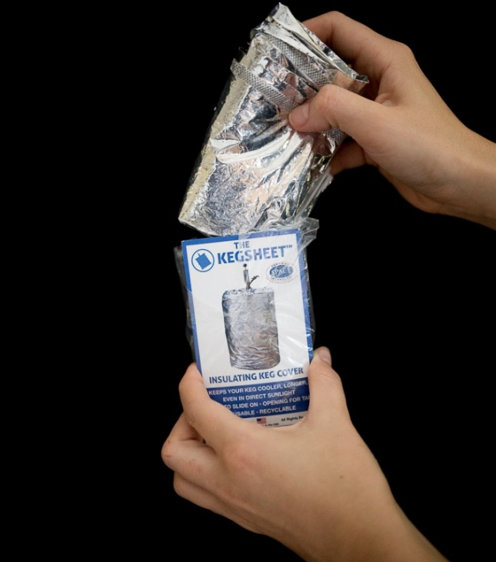
Space-Grade Insulation Keeps Beer Colder on Earth
Marshall Space Flight Center
JUNTO LLC
Philadelphia, Pennsylvania
NASA Technology
The first multilayer reflective insulations were created for Marshall Space Flight Center in the mid-1960s
NRC-2, made from sheets of crinkled, aluminized Mylar by National Research Corporation, became the model for a host of “superinsulation” materials
This radiant barrier technology is used in every spacecraft and spacesuit
Technology Transfer
Radiant barrier insulation has spinoff applications that include clothing, firefighting and camping gear, building insulation, cryogenic storage, and more
JUNTO LLC sells KegSheets, with radiant barrier insulation fitted for beer kegs, to keep beer cold
AFMInc, founded by a former employee of an early NASA insulation provider, makes the KegSheets
Benefits
Keeps beer significantly colder than an unwrapped keg
Lightweight and folds to pocket size
Strong, washable, reusable, and recyclable
On a sunny 90-degree day, a KegSheet-wrapped keg warmed by only 9 degrees over eight hours, compared to an unwrapped keg’s 24 degree rise
Spinoff 2018
Consumer Goods

Slide 29
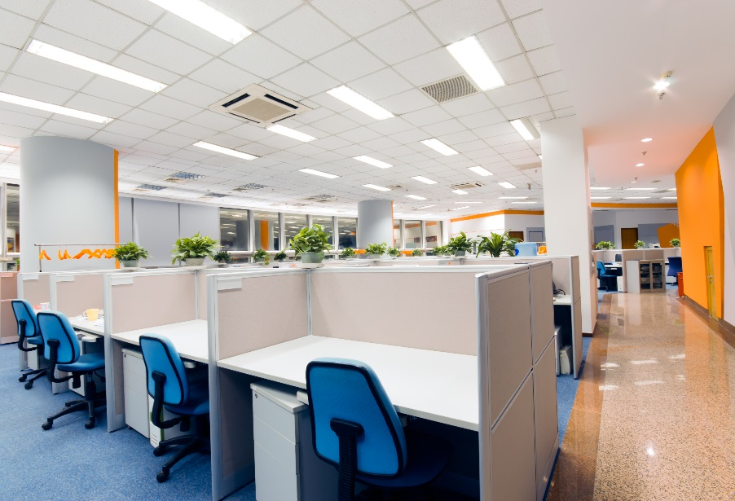
High-Efficiency LEDs Grow Crops, Stimulate Alertness
Kennedy Space Center
BIOS Lighting
Melbourne, Florida
NASA Technology
NASA has extensively researched and experimented with using LEDs for growing plants in space
NASA has collaborated on studies into the effects of certain wavelengths of light on wakefulness and circadian rhythms, as astronauts, who don’t experience 24-hour daylight cycles, often have difficulty sleeping
Technology Transfer
Two former NASA contractors worked on using LEDs for agriculture and human lighting at Kennedy and are now lead engineers at BIOS
LEDs have become more efficient, less expensive, and better able to produce any given wavelengths, allowing them to successfully compete with other lighting technology
Benefits
LEDs use less energy, cost less over time, and are safer than alternatives
LED grow lights produce little heat and most light in wavelengths that drive photosynthesis
BIOS’s LED indoor lighting has high output in wavelengths that stimulate alertness, leading to higher productivity and more regular sleep patterns
Spinoff 2018
Consumer Goods

Slide 30
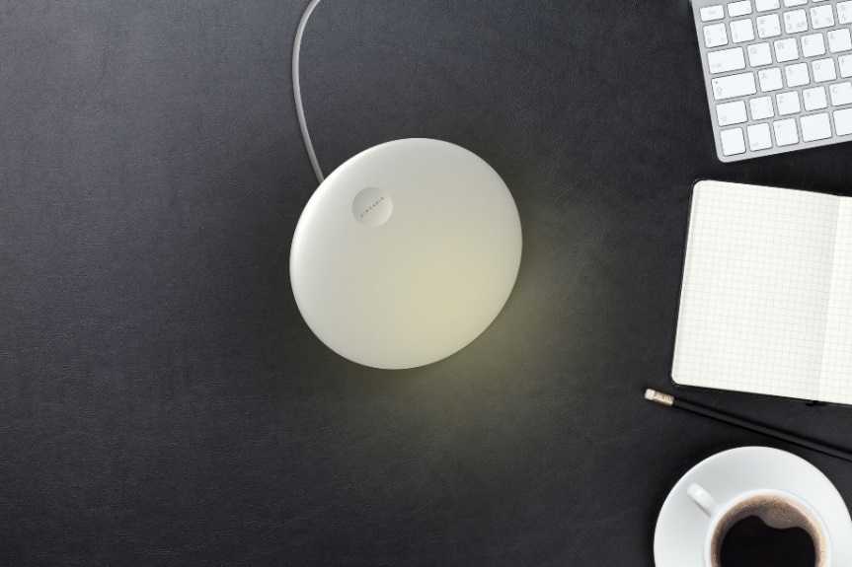
Paired Sleep Tracker, Light Therapy Tools Retrain Circadian Rhythms
Johnson Space Center
Circadia
San Francisco, California; London, England
NASA Technology
The NASA-funded National Space Biomedical Research Institute (NSBRI) has collaborated on multiple groundbreaking studies into effects of light on wakefulness and circadian rhythms
Directly and through NSBRI, NASA helped fund software to predict circadian patterns
Technology Transfer
Product based on research by NSBRI and others
Radar-based sleep tracker monitors sleep stages; app based on NASA-funded software sets light therapy according to sleep data; portable light provides light therapy throughout the day
Benefits
Short wavelengths stimulate daytime wakefulness, resulting in nighttime sleepiness
Can retrain circadian rhythms
Better sleep results in reduced stress, improved concentration, short-term memory, productivity
Better sleep also staves off long-term ailments like type 2 diabetes, obesity, and cancer
Spinoff 2018
Consumer Goods

Slide 31


Slide 32
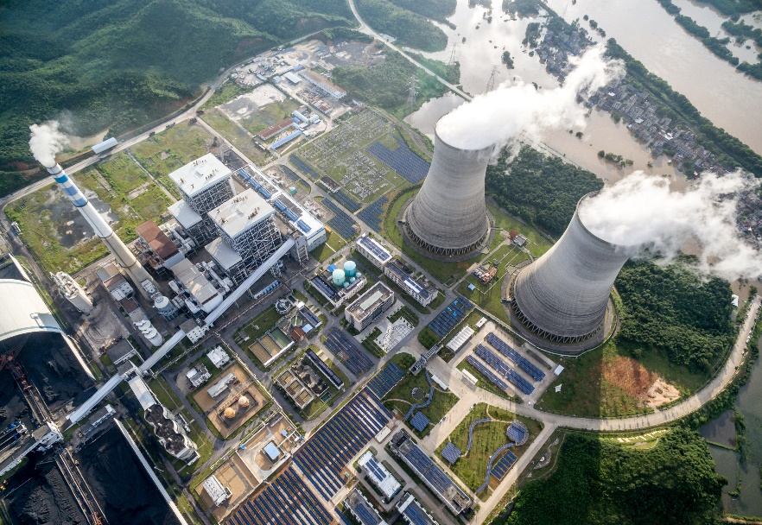
Organic Compound Turns Toxic Waste into Harmless Byproducts
Kennedy Space Center
Hydrazine Neutralizing Solutions Inc.
Marietta, Georgia
NASA Technology
Under a Space Act Agreement with Johnson Space Center, researchers at New Mexico Highlands University found that alpha-ketoglutaric acid (AKGA) neutralizes common toxic rocket fuel hydrazine
Kennedy, where rockets are fueled for launch, produces about 15,000 gallons of hydrazine waste per year, and disposal is costly and difficult
Technology Transfer
Kennedy contacted Johnson and had experiments done to confirm the results
Kennedy funded a series of experiments by its contractors and University of Central Florida to determine the effectiveness and ideal procedures for using AKGA to neutralize hydrazine
Benefits
Cape Canaveral Air Force Station has obtained permission to pour the resulting byproducts down the common drain
Hydrazine Neutralizing Solutions Inc. now markets a line of ZeenKleen products
Power plants and the plastics, pesticide, and pharmaceutical industries use hydrazine
Spinoff 2018
Energy and Environment

Slide 33
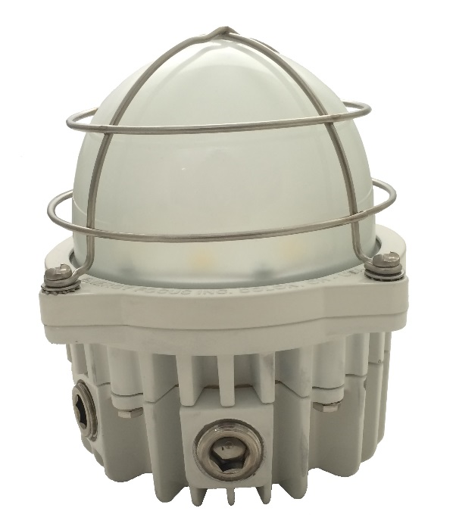
LED Lighting Improves Efficiency, Imaging, Cuts Maintenance
Stennis Space Center
Energy Focus
Solon, Ohio
NASA Technology
Rocket test stands at Stennis traditionally use an array of metal halide bulbs to light engines for imaging during testing
The bulbs have to survive hazardous conditions and must be sealed to avoid possible explosions
Technology Transfer
To reduce energy consumption, Stennis issued Small Business Technology Transfer contracts to Energy Focus to develop floodlights for engine imaging, as well as hazardous area lights for general lighting
The hermetic seal impeded heat management until the company developed a new technique
Highly efficient optical cones developed for floodlight
Benefits
Better heat management extends the life and improves efficiency of all the company’s LEDs
The LED floodlights produce cleaner, whiter light for more accurate imaging
LED replacements for fluorescent lights are more efficient and safer, last longer, and don’t cause headaches
Spinoff 2018
Energy and Environment

Slide 34
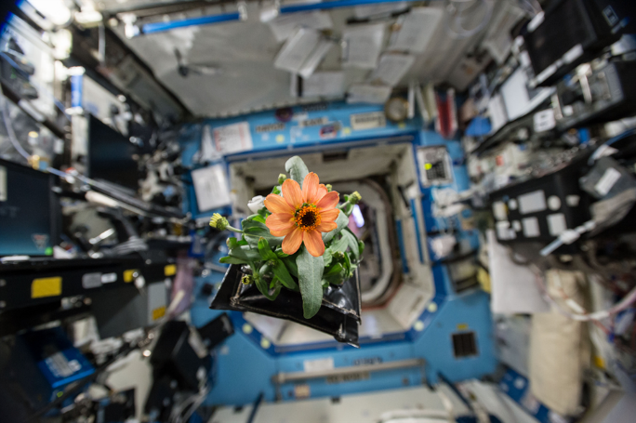
Plant Food for Space Grows Crops on Earth
Kennedy Space Center
Florikan
Sarasota, Florida
NASA Technology
NASA wants to grow tomatoes with its current Veggie units on the International Space Station
Kennedy had already partnered with Florikan to develop controlled-release fertilizer
Florikan fertilizer used to grow lettuce on the space station wasn’t optimized for flowering plants
Technology Transfer
Florikan created 14-4-14 NPK formulation with less nitrogen and more potassium to support hydroponic tomatoes in Veggie
Company patented formula, which it sells to growers
Company also created nano-sized version with smaller granules
Benefits
The first controlled-release fertilizer to work successfully in vertical hydroponic farming
Eliminates need for multiple applications
Testing found almost perfect yield on nearly every seed
Reduces growers’ expenses and environmentally hazardous runoff
Spinoff 2018
Energy and Environment

Slide 35
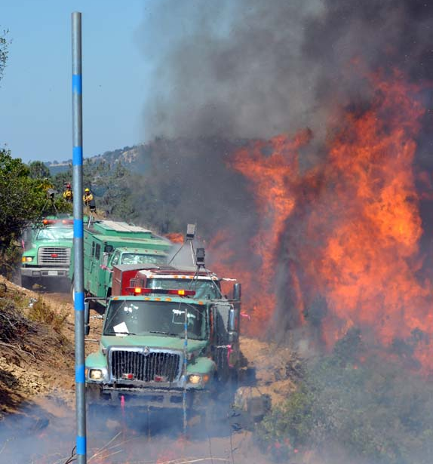
Remote Sensing Technology Fights Forest Fires Smarter
Ames Center
U.S. Forest Service
Washington, District of Columbia
NASA Technology
NASA has a long-standing relationship to share technical expertise with the U.S. Forest Service
Of particular interest: leveraging remote sensing technology to improve real-time fire data
Technology Transfer
Previously, Forest Service would drop printed reports from airplanes
NASA experts helped evaluate and choose a downlink communications network to send data
Chose a commercial system, GoGo Business Aviation, based on NASA recommendation
Benefits
Up-to-date fire data can be sent simultaneously in near real time to front lines and planning office
Fewer takeoffs and landings: can cover more ground, more safely
A 2008 test run helped determine where to send resources and whether to evacuate California town, reducing potential injuries and damage
Spinoff 2018
Energy and Environment

Slide 36
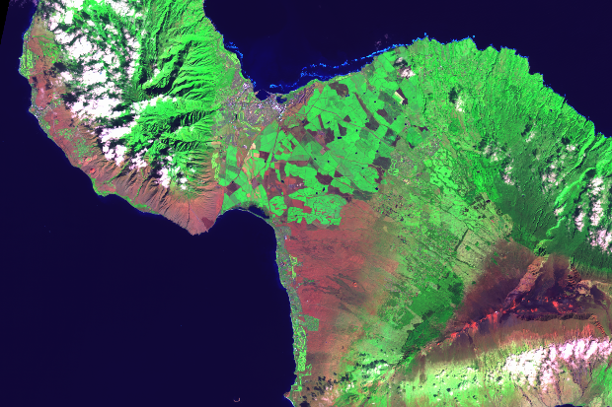
Earth Images Enable Near Perfect Crop Prediction
Goddard Space Flight Center
Tellus Labs
Somerville, Massachusetts
NASA Technology
NASA has been taking pictures of Earth from space since it was founded, enabling extensive research many aspects of Earth Science
Today, much of the data captured by satellites is publicly available for researchers outside NASA and even private companies to use
Technology Transfer
TellusLabs cofounder Mark Freidl has been working with NASA satellite data for years
As sensors improved, the historical record grew, and computing advanced, he saw an opportunity
He and cofounder David Potere built a crop prediction model that combines NASA and USGS data with historical data and other sources like weather
Benefits
In its first year, TellusLabs’ initial product accurately predicted final corn and soy yields nearly two months before the USDA
Within a year, they had more than 600 subscribers, from investors to farmers
Their models take traditional crop forecasting and add space-based observation to increase accuracy
Spinoff 2018
Energy and Environment

Slide 37
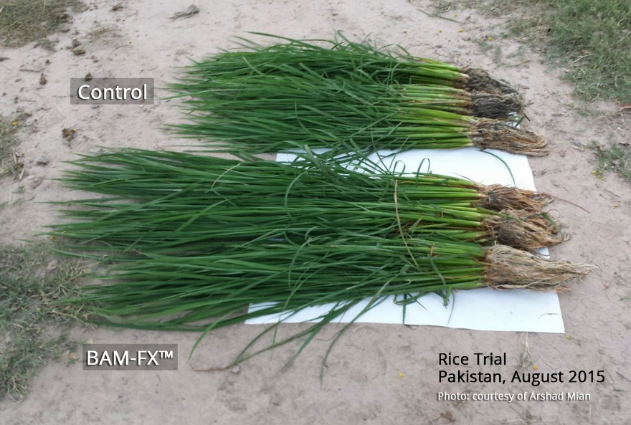
Micronutrient Formula Strengthens Plants, Increasing Yields
Ames Research Center
Zero Gravity Systems Inc.
Boca Raton, Florida
NASA Technology
Astronauts need to maximize nutrition on long-duration voyages
They will likely need to grow some of their food
In addition to fertilizers, a solution could infuse extra nutrients in plants as they grow
Technology Transfer
ZGSI got funding to develop a nutrient delivery system to increase mineral levels in plants
Zinc, copper, and other minerals are important to human health; these micronutrients also enhance plant health
Currently working with NASA to evaluate the system for commercial agriculture and space; a broccoli trial was sent to the space station in 2017
Benefits
BAM-FX can be applied as a soil drench at planting or spritzed onto growing leaves
Studies showed crop yield up by 25% with BAM-FX, even with less fertilizer; plants are also more robust and larger
Potential big impact in developing world; orders already in from India, Malaysia, and Indonesia
Spinoff 2018
Energy and Environment

Slide 38
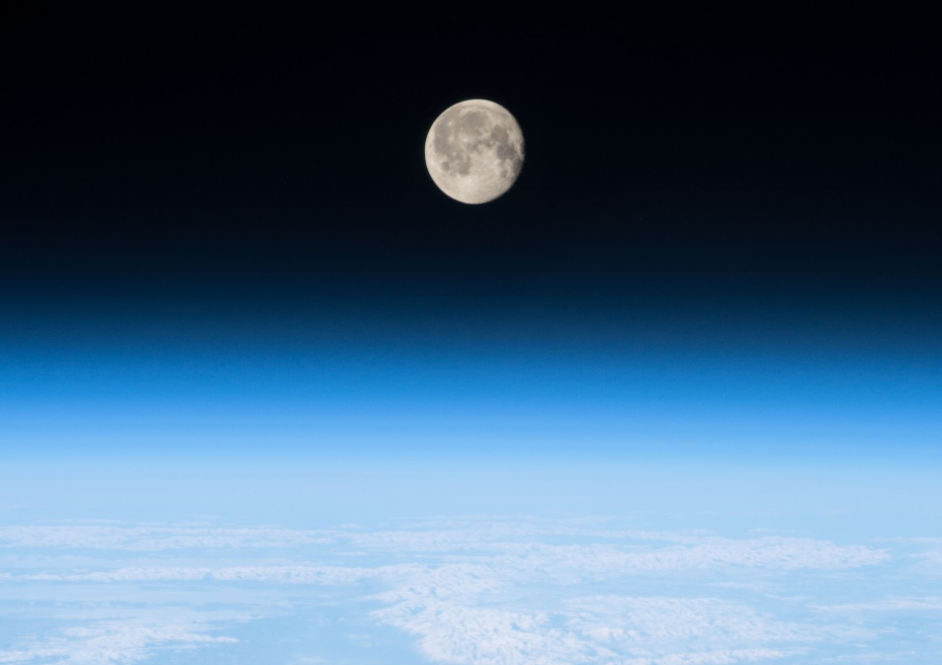
Chemical Simulation Software Predicts Climate Change, Air Quality
Ames Research Center
ParaTools Inc.
Baltimore, Maryland
NASA Technology
Modeling chemical reactions in the atmosphere is complex and requires intensive computing power
Earlier software to perform these calculations dated to the 1970s and was due an upgrade
A new package takes advantage of the more powerful modern microprocessors
Technology Transfer
Computational scientists that work with climate and air quality researchers at Goddard were interested in developing a new chemical solver
ParaTools was already working on it, under and SBIR contract from Ames
Goddard team is exploring using the software for NASA climate and atmosphere models, eg GEOS-5
Benefits
ParaTools’ software, Kppa, vastly accelerates the speed chemical reactions can be computed
That also means researchers can use it to increase the resolution of their models or include more factors
Software works on most cutting edge hardware and uses the latest mathematical solvers
Spinoff 2018
Energy and Environment

Slide 39
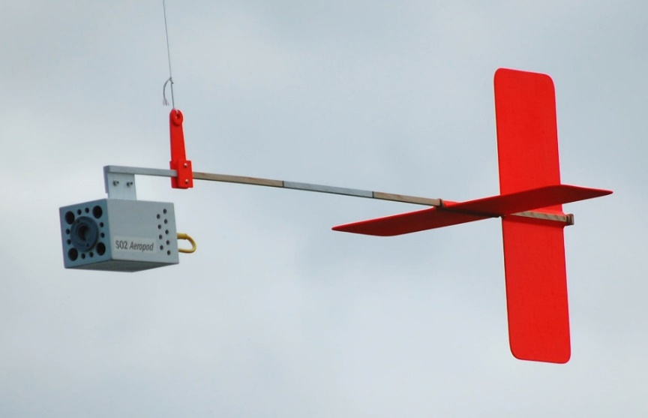
NASA Kite Invention Spurs Ever-Growing Educational Program
Goddard Space Flight Center
Wayne RESA
Wayne County, Michigan
NASA Technology
Wayne Regional Educational Service Agency (RESA) contacted NASA about aerial monitoring for an environmental project
Engineers at Goddard’s Wallops Flight Facility had invented an aerodynamically stabilized, kite-suspended AeroPod device that could be outfitted with sensors
Technology Transfer
Under a NASA Cooperative Agreement Notice award Wayne RESA and Wallops engineers developed 60 units of curriculum, the Investigating Climate Change and Remote Sensing Project
To license the AeroPods, Goddard created a new educational license that requires feedback rather than monetary payment
Benefits
The program has grown to involve schools and organizations across the country
Led to another program that involves AeroPods and waterborne sensors, also designed by NASA
Procedures are based on NASA flight protocol
Students collect real-world data, come up with the questions they want data to answer
Spinoff 2018
Energy and Environment

Slide 40
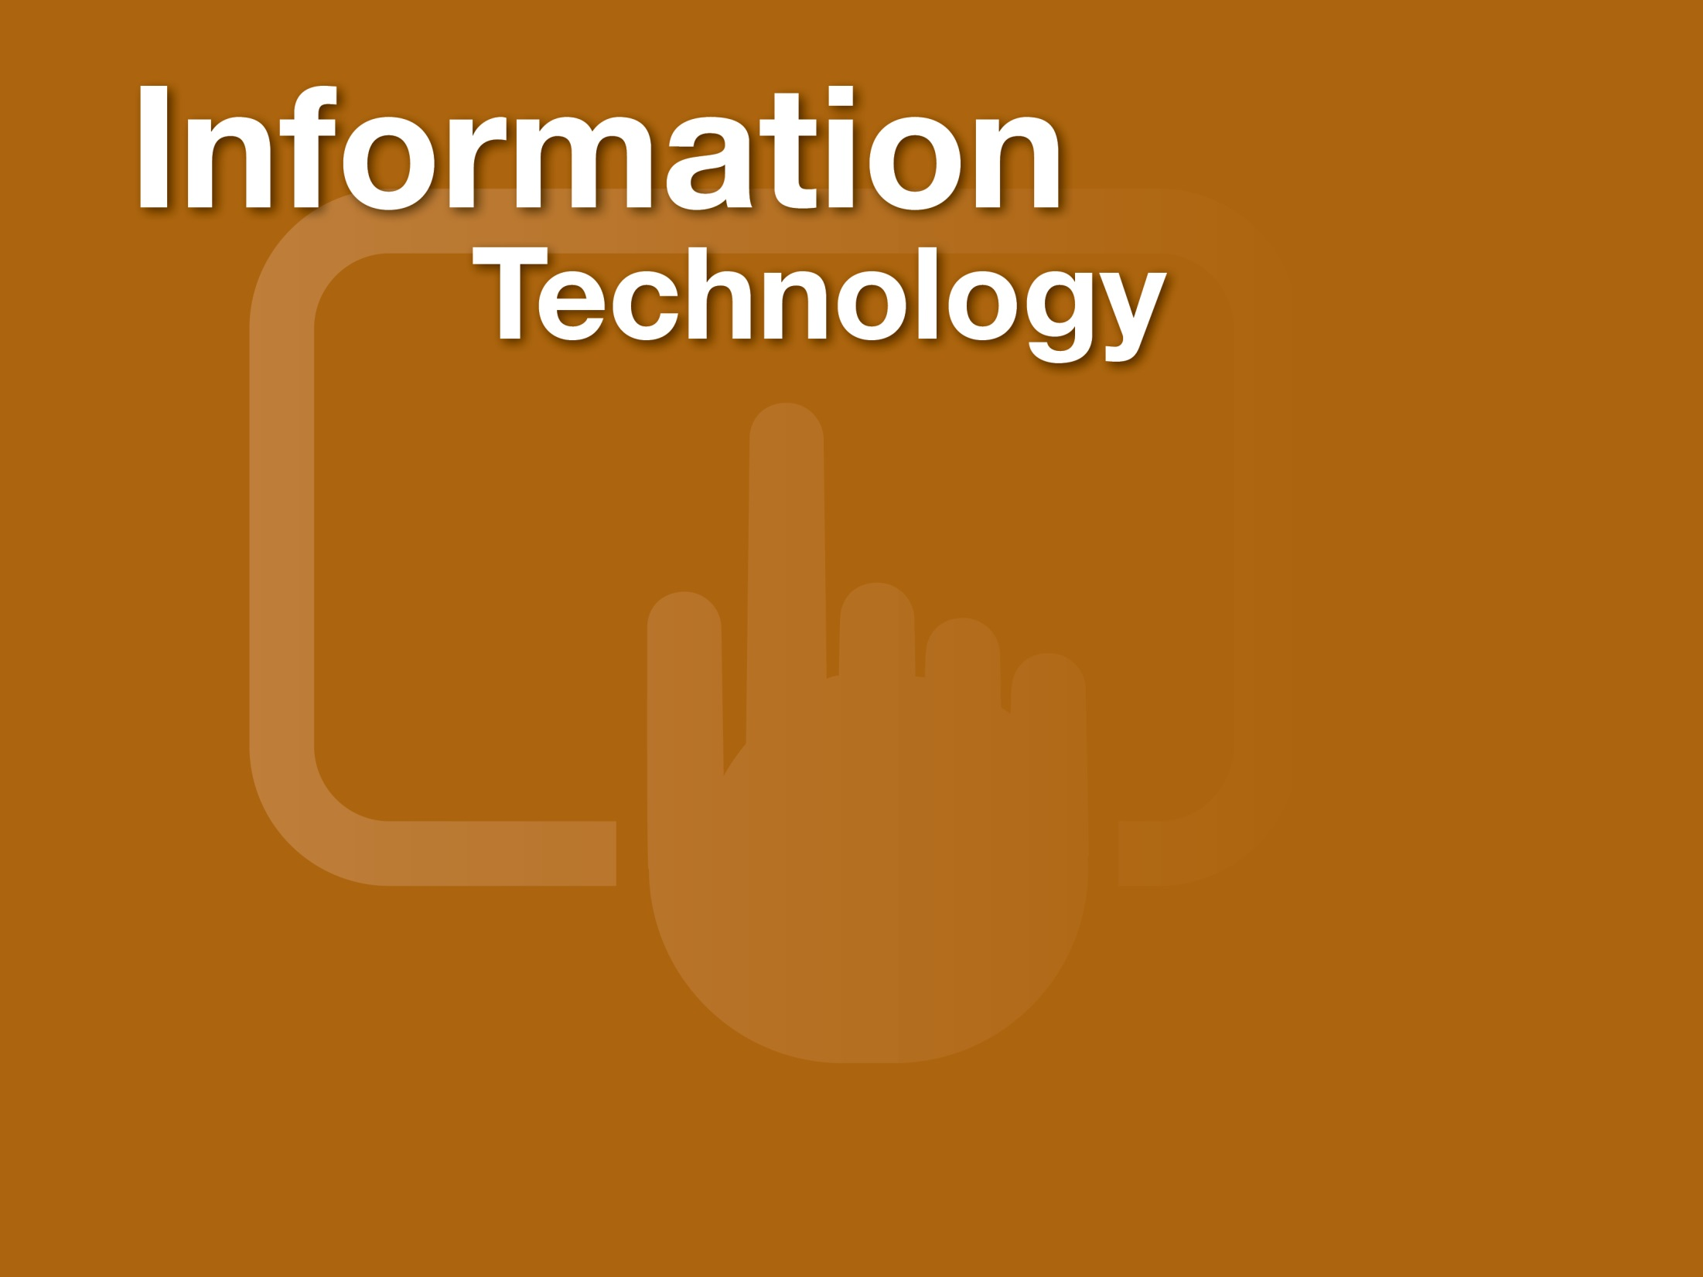

Slide 41
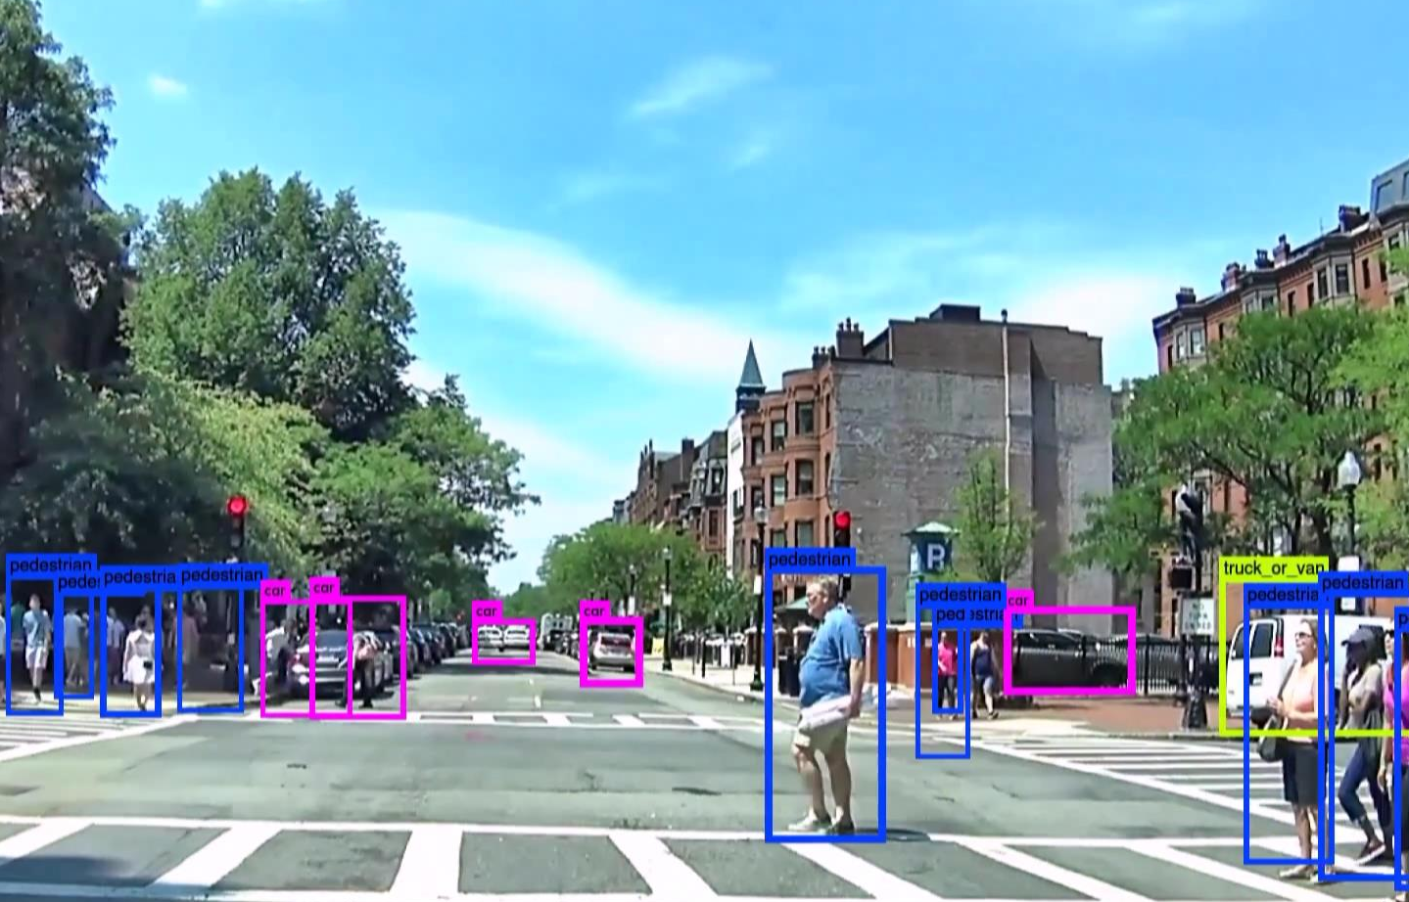
Planet-Navigating AI “Brain” Helps Drone and Cars Avoid Collisions
Langley Research Center
Neurala
Boston, Massachusetts
NASA Technology
Rovers on Mars need to navigate difficult terrain, and many require human control and power-hungry sensors for even basic functions
Self-learning, artificially intelligent software could enable rovers to learn to recognize and avoid obstacles, for example
Technology Transfer
NASA became aware of Neurala’s “brain”-inspired system after a project the company did for DARPA
The goal, to have high level computational capability and memory, stored in the same place, sparked interest at Langley
Langley awarded the company an STTR contract focused on software to enable a rover to navigate autonomously
Benefits
Neurala’s core insight is to integrate advanced graphics cards into AI software in a “brain”-like structure; each pixel is treated like a neuron
Neurala has created apps for consumer robots and drones
Has contracts with industrial drone and robot makers and a major automaker for self-driving cars
Spinoff 2018
Information Technology

Slide 42
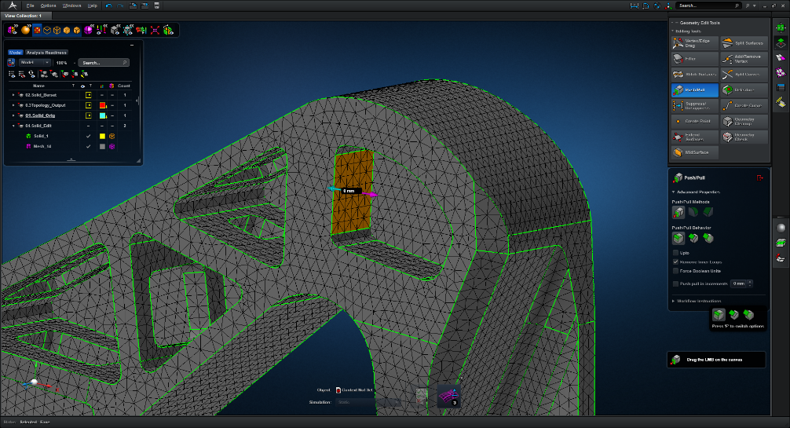
Early NASA “Dream Computer Program” Still Optimizes Designs
Goddard Space Flight Center
MSC Software Corporation
Newport Beach, California
NASA Technology
NASTRAN, an early finite element analysis program, was created at Goddard in the 1960s to help with problems like spacecraft design but also to be applicable to any design process
The program, capable of structural analysis and simulation, was modular, flexible, and extensively documented
Technology Transfer
NASTRAN is available as an open source software
MSC, which helped create the program, quickly began developing its own versions
NASTRAN remains at the cutting edge of its field and has been used in virtually any industry that designs products, from cars to printers to roller coasters
MSC built new Apex programs on NASTRAN code
Benefits
One of NASA’s most-used codes, NASTRAN popularized computer-aided design (CAD), changing the design process for many industries
Apex has an easy-to-use interface, eliminates most manual work of CAD, and eliminates errors
Enables design in a fraction of the time required for predecessors
Spinoff 2018
Information Technology

Slide 43
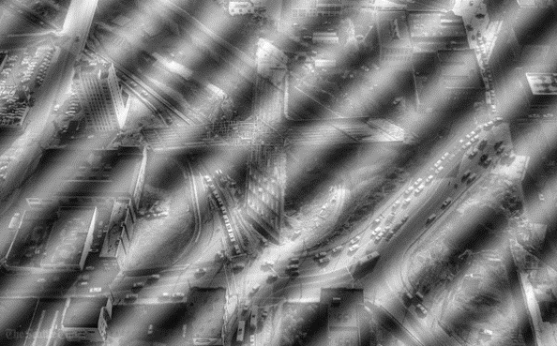
2D Analysis Software Clarifies Medical, Weather, Intelligence Images
Goddard Space Flight Center
Syneren Technologies Corporation
Arlington, Virginia
NASA Technology
Goddard oceanographer Norden Huang came up with the Hilbert-Huang Transform (HHT), an algorithm to extract information from datasets
A Goddard engineer figured out how to apply HHT to images, eliminating “noise” for the data processor on Soil Moisture Active Passive spacecraft
Technology Transfer
Syneren licensed the software, and a Space Act Agreement provided the company with consultations
Syneren rewrote the software in C++, fixed bugs, and enriched it
The company will tailor the program to clients’ image analysis needs
Image analysis applies to a wide range of industries
Benefits
Can discern features in radar weather images
Can differentiate normal and abnormal living cells
For defense, can remove fog from images, spot footprints, identify structures among foliage
Can identify patterns that suggest oil deposits
Can find highest concentration in oil spills
Can benefit anyone working with image analysis
Spinoff 2018
Information Technology

Slide 44
Quake Hunter Maps a Century of Quakes Worldwide
Ames Research Center
Quake Hunter
Mountain View, California
NASA Technology
Ames created World Wind, an open source virtual globe, as a standalone app under NASA’s Learning Technologies program in 2003
In 2006, the U.S. Department of Energy paid Ames to build a World Wind software development kit, which was quickly snapped up by other government agencies, companies, and nonprofits
Technology Transfer
Using the World Wind software development kit and a century’s worth of earthquake data from the U.S. Geological Survey (USGS), interns at Ames built an app that maps every earthquake of the last 100 years
The USGS had recently funded work to allow visualization of subsurface data in World Wind, which allowed quakes to be plotted by their hypocenter, the point underground where the rupture occurs
Benefits
Quake Hunter offers unprecedented access to earthquake data
Quakes can be filtered according to ranges of dates, depths, and magnitudes
Patterns in tectonic activity become clearer
The same interns built apps to track thousands of satellites in space and to track global weather
Spinoff 2018
Information Technology

Slide 45
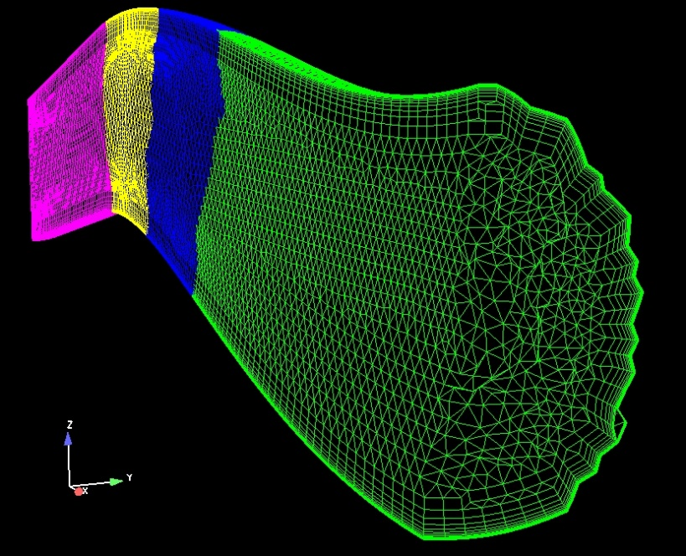
Free Aerodynamic Simulation Code Supports Industry, Education
Glenn Research Center
Innovative Technology Applications Company
Chesterfield, Missouri
NASA Technology
NASA and the Air Force formed the National Program for Applications-Oriented Research in CFD (NPARC) Alliance to create better computational fluid dynamics (CFD) software
McDonnell Douglas, now Boeing, provided its CFD software, which became the basis for Wind-US
Technology Transfer
Wind-US is available for free to any U.S. entity
Innovative Technology Applications Company (ITAC) was started largely because of the founder’s knowledge of Wind-US and its applications
ITAC uses Wind-US in consulting or helps companies make their own modifications to the program
Benefits
With many capabilities, Wind-US is a “Swiss Army knife for flight CFD”
For years, program was popular among government agencies, companies, and universities, helping to popularize CFD
Universities get free access to program, and students can make changes to source code, providing a powerful learning tool
Spinoff 2018
Information Technology

Slide 46
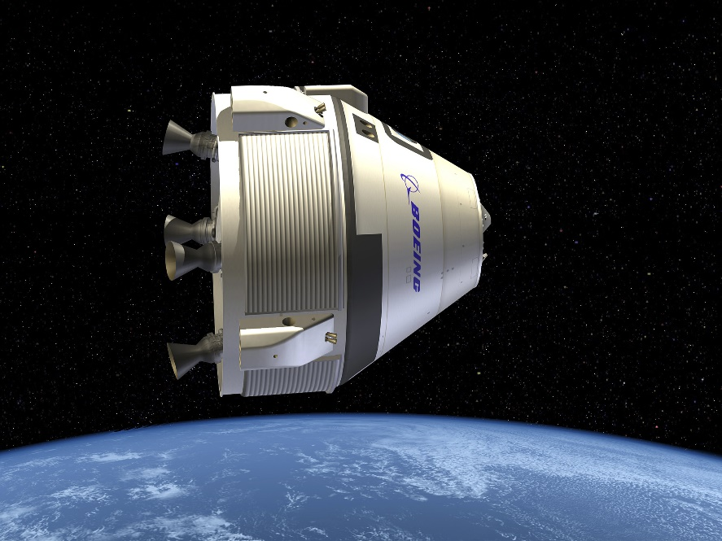
Software Models Air and Winds for Spacecraft
Marshall Space Flight Center
Boeing Defense, Space & Security
Berkeley, Missouri
NASA Technology
Atmospheric conditions vary depending on location, season and altitude
Flying, and landing, safely requires accurate understanding of those conditions
Software modeling Earth’s atmosphere built in 1972; also versions for Mars, Venus, Neptune, and Titan
Technology Transfer
GRAM, or global reference atmospheric model, family of software is available for free, one of many offered as a benefit to the public
All the GRAMs, especially Earth-GRAM, are used by researchers and companies
Boeing used it first on Starliner, in part because it was already approved by NASA, but later expanded use to other projects
Benefits
Unlike earlier models, GRAM has global statistical data, so can generate a profile for any location, any time of year
The model can generate thousands of potential atmospheres on a given day and predict impact of winds
Because of high accuracy, Boeing is also using it for simulations to train Starliner crew members
Spinoff 2018
Industrial Productivity

Slide 47
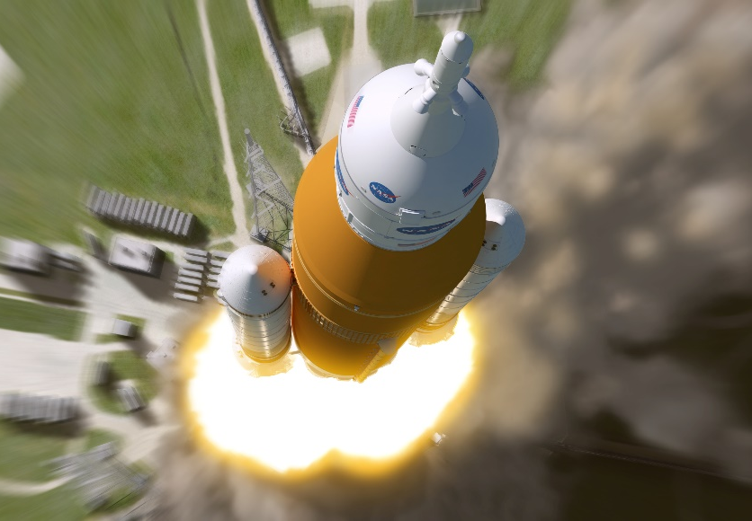
Software Takes Cost Estimating to the Stars
Marshall Space Flight Center
Lockheed Martin
Bethesda, Maryland
NASA Technology
Cost estimating is a crucial part of designing new spacecraft, including the new SLS
Difficulties arise because industrial base is small and specialized and everything it typically custom
New software from Marshall adds flexibility and transparency over previous package from the 1990s
Technology Transfer
Project Cost Engineering Capability is one of Marshall’s most downloaded codes
It is the only publicly available cost-estimating model for aerospace
It is available for free in the U.S. and internationally
It has been used at universities, private companies, government agencies, international organizations
Benefits
Lockheed Martin uses PCEC as a cross-check for its own cost-estimating models, especially in proposals for NASA
Improvements including a better historical dataset and better algorithms mean they will use it more than its predecessor
Increased user flexibility is also a big plus
Spinoff 2018
Information Technology

Slide 48
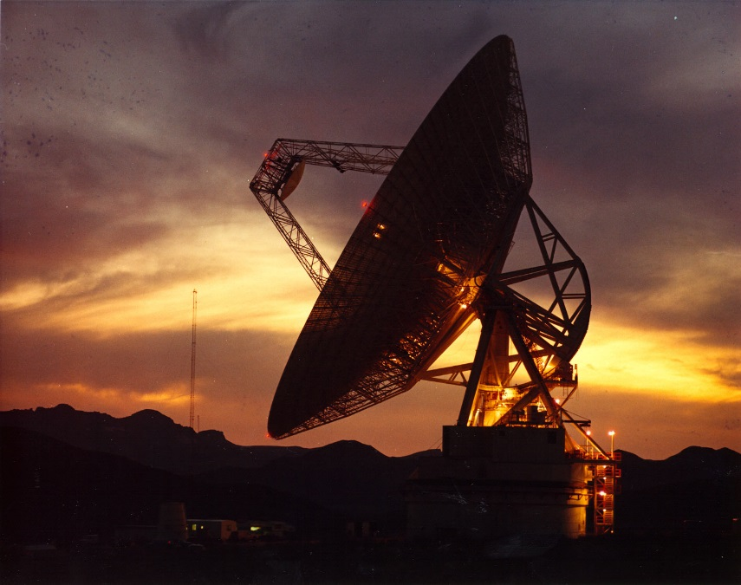
Communication Devices Ease Contact with Commercial Spacecraft
Johnson Space Center
AMERGINT Technologies Inc.
Colorado Springs, Colorado
NASA Technology
By 2010, the system for downlinking data from the International Space Station was at full capacity
As part of an upgrade, the Communications Data Processor at Mission Control was updated
AMERGINT was chosen for its flexible architecture, using “Software Devices,” rather than hardware
Technology Transfer
Company significantly expanded its library of Software Devices to meet Johnson’s needs
SOFTLINK architecture gained robustness, high-performance throughput to pass rigorous testing
Customers now include various NASA sites, United Launch Alliance, GPS constellation, Boeing, commercial satellite companies
Benefits
Software Devices are like virtual LEGOs, with customers able to add their own or make modifications without returning to AMERGINT
End products can be totally different applications built from same software
Company’s target moved from small systems to major projects and customers
Spinoff 2018
Information Technology

Slide 49
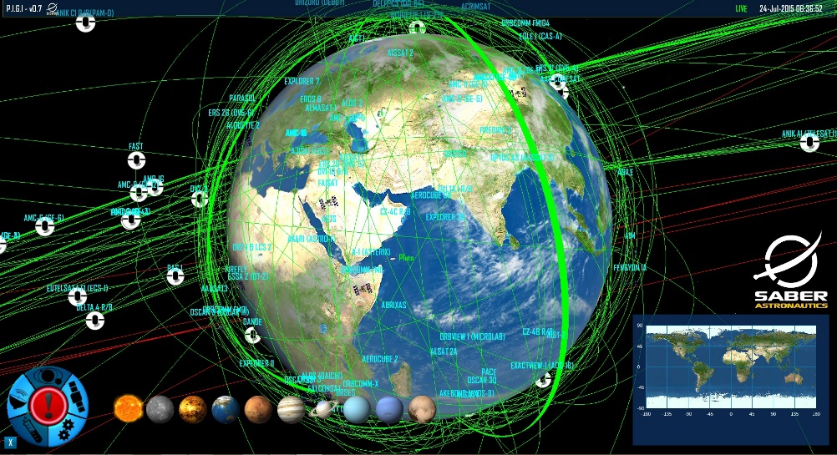
Mission Control Software Manages Commercial Satellite Fleets
Goddard Space Flight Center
Saber Astronautics
Denver, Colorado
NASA Technology
Goddard’s Advanced Composition Explorer (ACE) was launched in 1997 to observe charged particles from the sun, the stars, and other origins
Saber Astronautics had a user-friendly data-mining software capable of modeling and predicting a complex system’s behavior but wanted to validate it for monitoring and predicting spacecraft health
Technology Transfer
Goddard provided the entire ACE data archive
Saber “trained” its software using ACE performance data from two periods—one calm and one around a severe solar storm—and then successfully predicted performance during a later solar flare
With that validation, the company started building its Predictive Interactive Groundstation Interface (PIGI) mission control software
Benefits
PIGI can map, monitor, and predict interactions among all spacecraft components and the space environment for entire satellite constellations
User-friendly, video game-style interface
Available as products with varying levels of sophistication or as mission control service
Will allow deep space missions with signal delay
Spinoff 2018
Information Technology

Slide 50


Slide 51
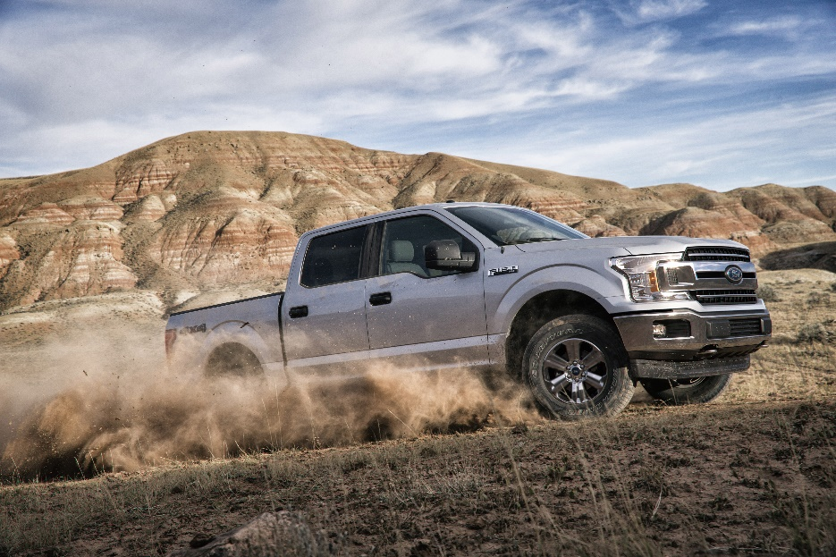
High-Speed Cameras Test Material Performances on Impact
Glenn Research Center
Trillion Quality Systems
Philadelphia, Pennsylvania
NASA Technology
Before returning to flight after the Space Shuttle Columbia disaster, NASA spent months investigating
One tool to understand impacts and recreate the conditions of the accident is stereo photogrammetry
Two synchronized cameras film an impact and software analyzes how the surface moves
Technology Transfer
ARAMIS photogrammetry software existed in 2003, but it was not optimized for high speed cameras
Trilion worked with NASA to calibrate the high speed cameras and develop a way to transfer the images into the software for calculations
Trilion continues to improve and streamline its high speed system, which has been used on multiple NASA projects
Benefits
High-Speed ARAMIS system analyzes materials under strain to improve performance and safety
Accounts for 20% of current business
Used in car, medical, consumer industries
Used in design of an Adidas running shoe, as well as to test Ford F150 as company switched to an all-aluminum body
Spinoff 2018
Industrial Productivity

Slide 52
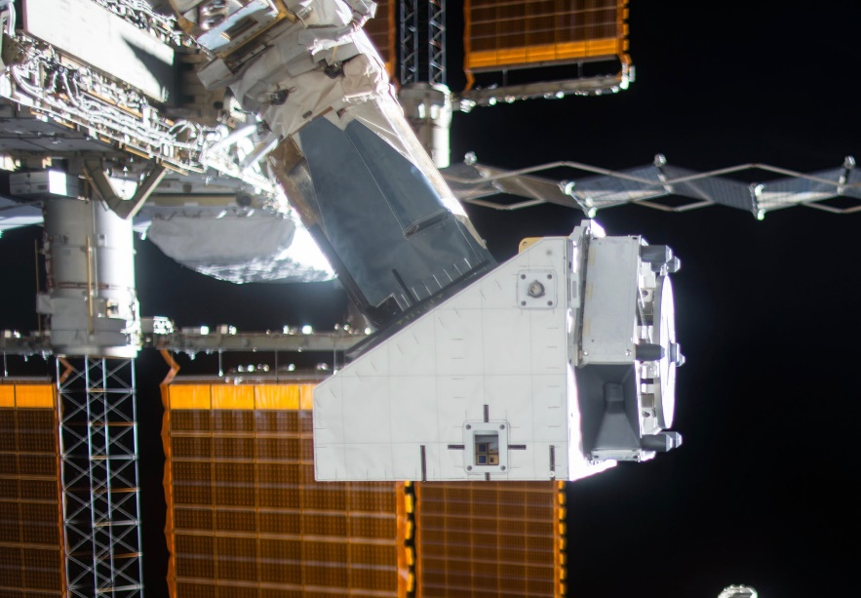
External Platform Enables Space Research
Johnson Space Center
Airbus DS Space Systems
Houston, Texas
NASA Technology
NASA has been use external platforms for observations and to test materials for decades
These external platforms have evolved over the years. There are currently several mounted on ISS
One plus is that the payloads are more accessible for repair or replacement than on satellites
Technology Transfer
Airbus DS Space Systems has worked with NASA on more than one external platform over the years
That experience and know-how contributed to NanoRacks choosing the company to build a new, compact platform
NanoRacks also had a Space Act Agreement with NASA to provide some resources, but the project was funded, and is now operated, commercially
Benefits
The NanoRacks External Platform became operational in August 2016. Developers expect two airlock cycles a year
No need for spacewalks: it can be assembled inside ISS and mounted with a robotic arm
NREP has nine 10x10x40 cm slots, that can be configured to handle a variety of payloads
Spinoff 2018
Industrial Productivity

Slide 53
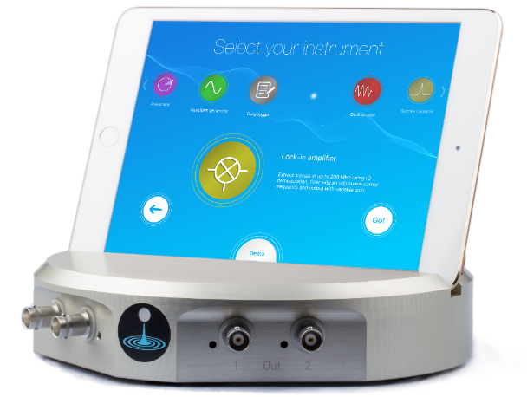
All-in-One Lab Device Gets New Instruments via Software Update
Jet Propulsion Laboratory (JPL)
Liquid Instruments
Canberra, Australia
NASA Technology
JPL worked for years on the Laser Interferometer Space Antenna (LISA) for detection of gravity waves
After NASA dropped out of the project, many of those engineers were reassigned to the Gravity Recovery and Climate Experiment (GRACE) Follow-On mission, also at JPL, based on similar technology
Technology Transfer
As JPL employees and/or under an agreement between NASA and the Australian space agency, a group at the Australian National University developed instruments for LISA and GRACE
After Australian space agency ended, they applied expertise they’d developed in signal processing and chip programming to create Moku:Lab
Benefits
Field-programmable gate array can reconfigure itself to function as eight different common electronics test and measurement instruments
Devices downloaded free as they’re developed
User-friendly iPad interface
Combines functions of several expensive instruments in one inexpensive device
Spinoff 2018
Industrial Productivity

Slide 54
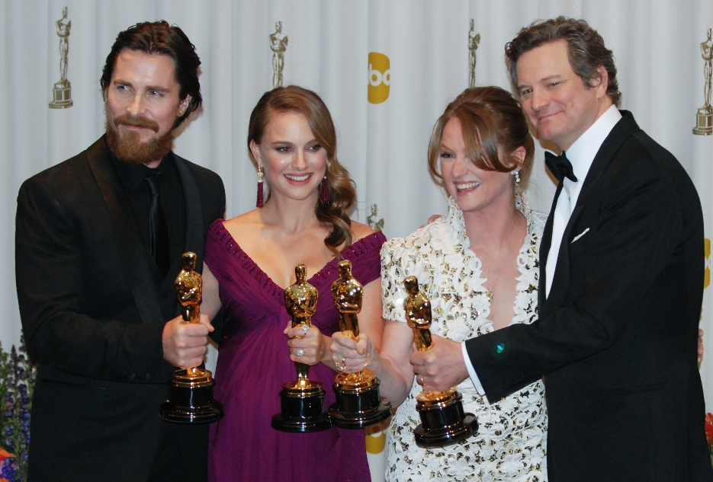
Gold Coating Keeps Oscars Bright
Goddard Space Flight Center
Epner Technology
Brooklyn, New York
NASA Technology
Gold is highly reflective: helpful in detecting infrared light from far away as well as in blocking radiant heat
Also, gold is inert so it doesn’t tarnish
Because of these features, NASA uses gold on spacecraft like the James Webb Space Telescope
Technology Transfer
Epner Technology developed an innovative method of gold plating that achievied almost the same reflectivity as solid gold and was very durable
In the 1990s, it improved its processes due in part to a contract for the Mars Orbiter Laser Altimeter
The resulting coating maintained high reflectivity while also achieving hardness triple that of pure gold
Benefits
LaserGold is an electroplating process first used on laser components
NASA has used it on spacecraft since the 1970s and continues to use it on modern missions
Thanks in part to the reputation and processes developed through the NASA work, Epner has a wide customer base—including the Oscars
Spinoff 2018
Industrial Productivity

Slide 55

3D Printer Aims to Accelerate Materials Development
Glenn Research Center
PrintSpace 3D
Rexburg, Idaho
NASA Technology
NASA works with and creates cutting edge, high performance materials for its missions
The heat treatment facility processes materials to make them harder, tougher, and stronger as needed
NASA has also been exploring 3D printing as another way to manufacture parts
Technology Transfer
Mark Jaster worked at Glenn’s heat treatment facility for years, gaining knowledge and skills related to materials, thermal management and automation
He relied on this expertise to help him build a new, high-end 3D printer when he founded PrintSpace 3D
The company won a local startup contest soon after launch, earning increased publicity and $5,000
Benefits
The Altair 3D printer prints more than 25 different materials, with more continuing to be added
It prints extremely fast—the hot end heats up in seconds and is extremely accurate for different materials—and has a user-friendly interface
Company intends it to help engineers make end use products, not just prototypes
Spinoff 2018
Industrial Productivity

Slide 56

Silicon Diode Sensor Tracks Extreme Temperatures
Kennedy Space Center
Scientific Instruments Inc.
West Palm Beach, Florida
NASA Technology
Liquid hydrogen and oxygen rocket fuel must be kept hundreds of degrees below zero
Temperature must be maintained precisely to ensure optimal flow (i.e., no gas bubbles)
Sensors must be reliable and extremely accurate at extremely low temperatures
Technology Transfer
Scientific Instruments has been making temperature sensors for NASA since the days of Apollo
For Space Shuttle, Kennedy wanted an upgrade to improve resolution an extremely low temperatures
Scientific Instruments already made silicon diode sensors that worked better, but needed to modify them to withstand harsh launch conditions and other specific NASA requirements
Benefits
The sensors read temps from 1.5–450 Kelvin, or from -460 to 350°F; they are interchangeable and don’t require individual calibration
NASA continues to use the sensors for its fuel lines and on other missions, including Hubble
Similar model also sold to private space companies and for MRI magnet production
Spinoff 2018
Industrial Productivity

Slide 57

Tunable Liquid Crystals Grab Particles and Cells Using Only Light
Jet Propulsion Laboratory (JPL)
Meadowlark Optics
Frederick, Colorado
NASA Technology
Remote imaging can reveal different information depending on which wavelengths are captured
A tunable light filter allows a single, remotely controlled sensor to observe any portion of the light spectrum instead of needing to swap out filters
Technology Transfer
Meadowlark Optics received two SBIR contracts, first from the Air Force and the second from JPL, to develop its first liquid crystal variable retarders
It won a Photonics Circle of Excellence Award from Photonics Spectra Magazine for the device
The company now uses it and derivatives in 30–40% of its products
Benefits
Liquid crystal variable retarders can be tuned to different wavelengths electronically
Spatial light modulators us a large array of tiny LCVRs to shape and split laser beams
Optical tweezers use a spatial light modulator to help grab and move genetic material and other tiny particles
Spinoff 2018
Industrial Productivity

Slide 58

Visit the Spinoff website for more examples of NASA technology transfer: http://spinoff.nasa.gov

Slide 59


