Slide 1
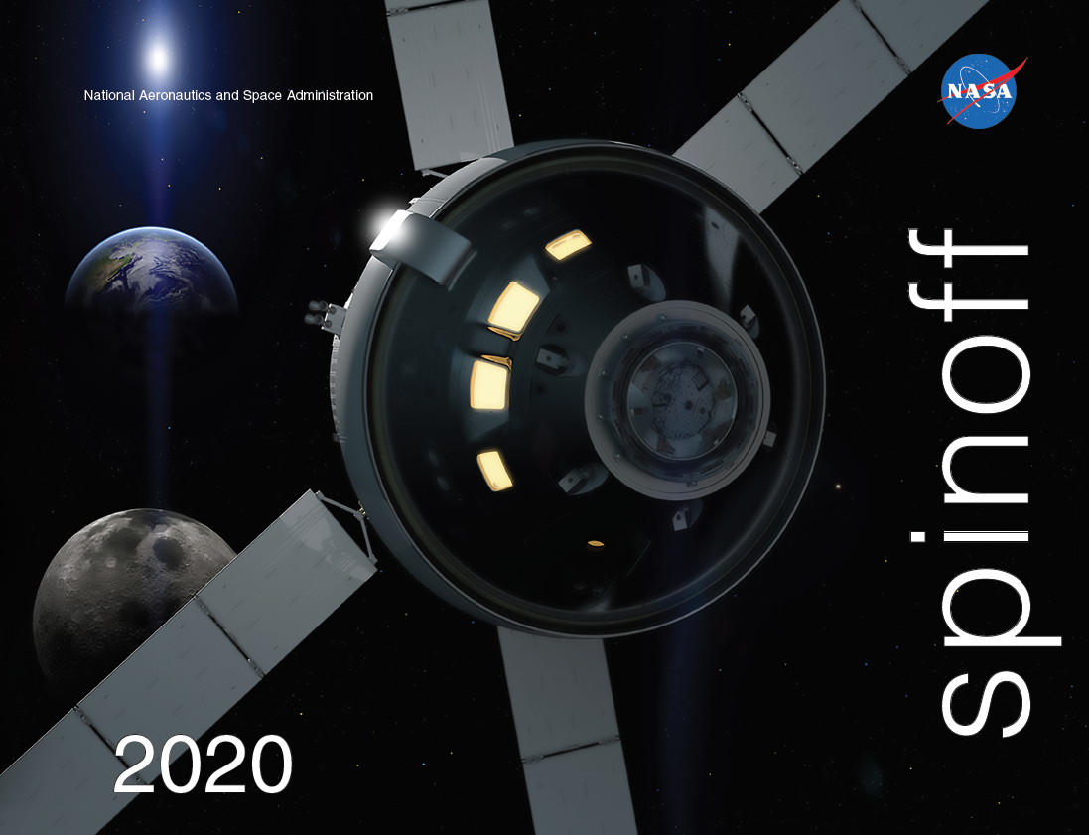

Slide 2
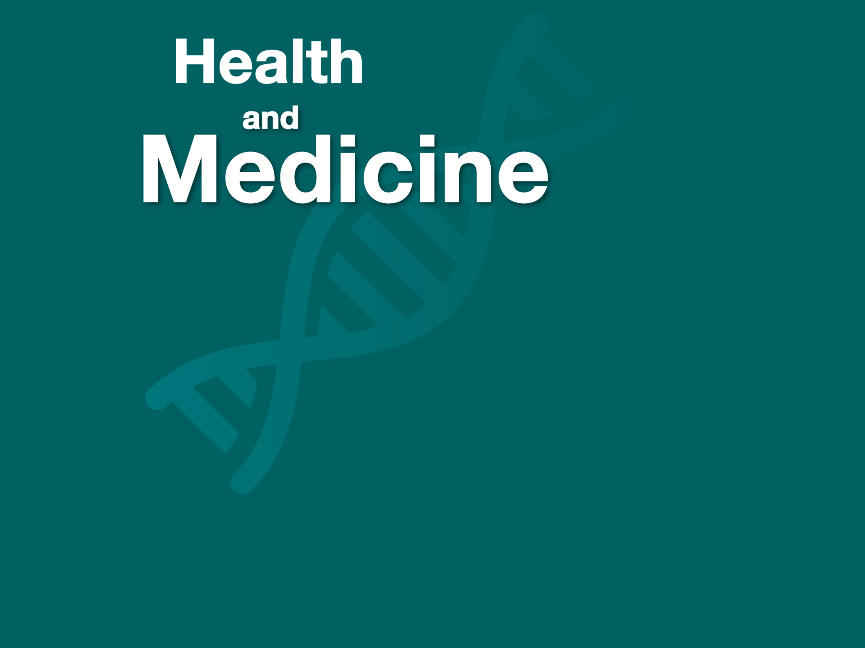

Slide 3
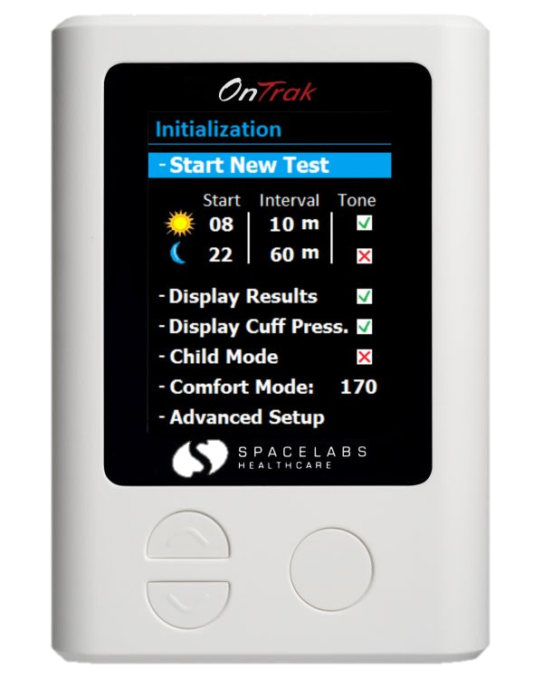
Remote Monitoring Promotes Community Health beyond Hospitals
Johnson Space Center
Spacelabs Healthcare Inc.
Snoqualmie, Washington
NASA Technology
The Gemini Program needed to develop techniques for safe, long-term space travel
Data was essential to understand how human bodies react in real time to being off-planet
Heart rate, body temperature, sleep cycle, breath exhalation were measured with multiple devices
Technology Transfer
Remote monitoring of vital signs required small, rugged, yet safe electronics for each astronaut
Meeting NASA specifications, Spacelabs designed and built three monitoring devices and the onboard system to transmit data via radio frequencies
Systems for space improved over time, collecting more comprehensive and accurate data
Benefits
Miniaturization allows for portable devices providing nonstop monitoring in the hospital
Automatic updates to medical staff support specialized monitoring of at-risk patients, preventing medical problems from escalating
Home-based health monitoring devices now improve post-hospitalization outcomes
Spinoff 2020
Health and Medicine

Slide 4
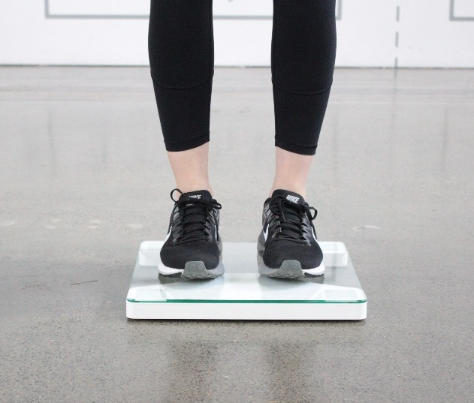
Balance Scale Predicts, Helps Prevent Falls
Johnson Space Center
Zibro Inc.
Houston, Texas
NASA Technology
Astronauts on extended space missions can return home to space-induced balance disorders
A better understanding of how the brain controls balance was needed to support astronaut health
Existing diagnostic tools used to study astronauts when they return to Earth needed improvement
Technology Transfer
NASA research identified patterns of the brain searching for information from the bottom of feet
Johnson team showed algorithms could use data from pressure sensors under feet to quantify postural stability, a new technique to measure balance
An exclusive license made it possible to develop portable scales for clinical and home use to measure and improve balance, prevent falls
Benefits
SmartScale assesses balance and can even predict the risk of falling
The Zibrio app or a physician use data to generate a personalized plan to improve balance
Clinical version provides more diagnostic data
Benefits not only the elderly but anyone seeking to improve physical performance
Spinoff 2020
Health and Medicine

Slide 5
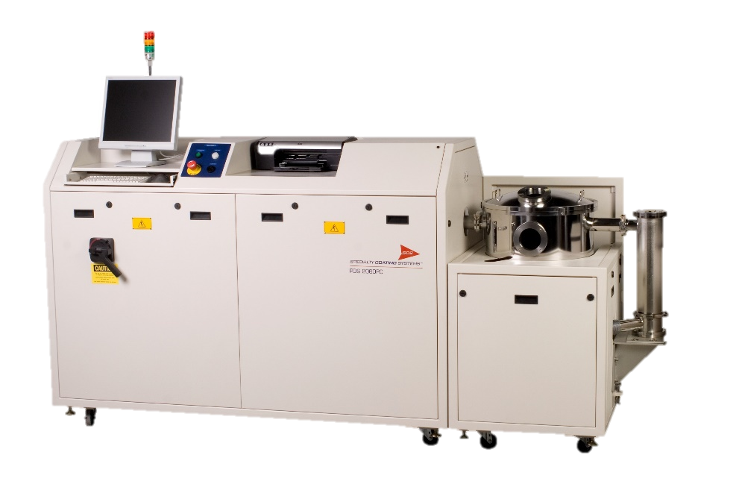
Low-Outgassing, Space-Grade Coatings Cover Electronics, Sensors, Pacemakers
Goddard Space Flight Center
Specialty Coating Systems Inc.
Indianapolis, Indiana
NASA Technology
NASA tests coatings for outgassing to avoid evaporation and resettling of compounds, which can impede optical equipment and other components
A NASA-tested Parylene coating was used on the circuit boards of the Juno spacecraft’s JunoCam, which is capturing high-resolution images of Jupiter
Technology Transfer
Data generated by NASA testing proved that multiple Parylene coatings demonstrate ultra-low outgassing
Parylene HT passed testing for the highest-temperature situations, including offshore and down-hole exploration sensors and feedback devices
Results included in the publicly available NASA database increase manufacturer interest
Benefits
Five Parylenes are commercially available
Some, which NASA testing has proven stable, are now used in medical devices such as pacemakers, cochlear implants, and catheters
Parylenes are used in emission sensors, fuel cells, and electronics systems in hybrid cars
NASA testing reinforces safety assurance
Spinoff 2020
Health and Medicine

Slide 6
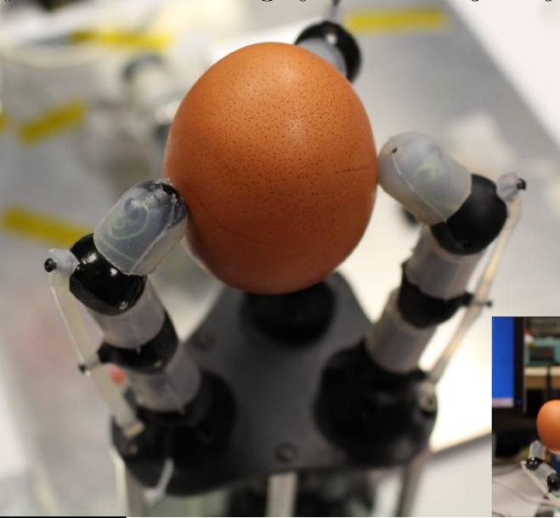
Fiber-Optic “Nerves” Enable Sensitive Surgery Tools
Johnson Space Center
Intelligent Fiber Optic Systems (IFOS) Corp.
San Jose, California
NASA Technology
NASA was interested in tactile sensing for the first Robonaut's hands to enable more complex tasks
Also needed was a means to monitor multiple sensors simultaneously to allow for much faster readings to detect the tiny, rapid vibrations caused by friction
Technology Transfer
Two Small Business Innovation Research contracts funded initial technology development to create gloves for the first Robonaut’s hands
The optical interrogator used light along fiber optics to detect slight changes in strain or temperature
Prototype fingertip sensors also tested successfully
Too large for space, NASA saw commercial potential
Benefits
Refinement of the technology lets surgical equipment sense pressure, extrapolate position
Fiber-optic sensing offers uniquely high-resolution, three-dimensional mapping of instrumented biopsy needles for MRI- and ultrasound-assisted surgeries
Universities, companies helping commercialize
Spinoff 2020
Health and Medicine

Slide 7
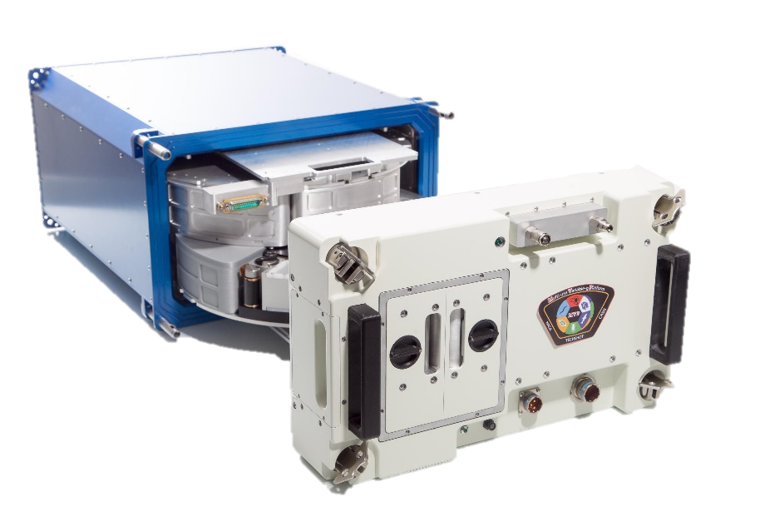
Variable-Gravity Device Enables Medical, Pharmaceutical Research
Johnson Space Center
Techshot Inc.
Greenville, Indiana
NASA Technology
The long-term effects of partial gravity on the human body are unknown, requiring extensive research
Experiments on the space station build knowledge
NASA needed technology to simulate different forces of gravity for numerous experiments on the space station
Technology Transfer
Small Business Innovation Research contracts funded technology development and a Space Act Agreement leveraged NASA expertise
Gravity settings range from weightlessness to 2 G, simulated by centrifugal force
Modules have lighting, video cameras, microscopes, and oxygen and carbon dioxide sensors, and customized modules can be snapped in and out
Benefits
Academic institutions, government agencies, and commercial entities can rent space in the Multi-Use Variable-Gravity Platform to run experiments
Modules accommodate many kinds of testing, ranging from human cells or flies to plants
Biopharmaceutical companies want to learn how gravity affects biological processes
Spinoff 2020
Health and Medicine

Slide 8
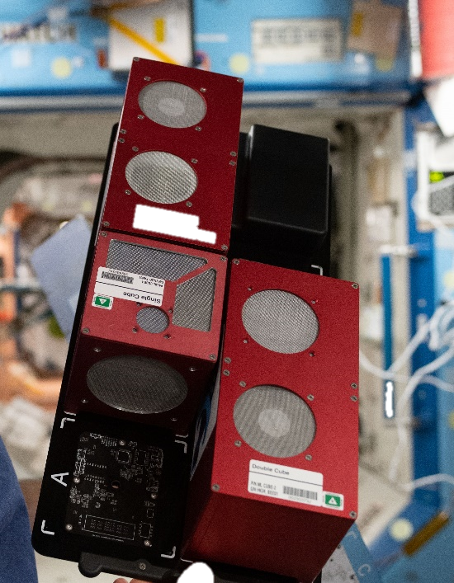
Space Station Research Platform Paves Way for Zero-G Manufacturing
Johnson Space Center
Space Tango
Lexington, Kentucky
NASA Technology
NASA uses zero-gravity research to prepare for future space missions and benefit people on Earth
The zero-gravity environment of the space station requires space-adapted technology
Commercial partnerships enable NASA research and expand public and private research opportunities
Technology Transfer
A Space Act Agreement to work with NASA safety and engineering staff vets the designs and improves safety, particularly electrical systems of TangoLabs
Each lab houses multiple modules called CubeLabs, enabling research in plant biology, microbiology, medical devices, and other fields
Each device runs simultaneous experiments using space station power and data networks
Benefits
With two TangoLabs in orbit, over 100 experiments launched for multiple customers
Increasing access to space provides research opportunities for schools, nonprofits, research groups, Fortune 500 companies, and others
A new orbiting platform called ST-42 will support larger-scale manufacturing
Spinoff 2020
Health and Medicine

Slide 9
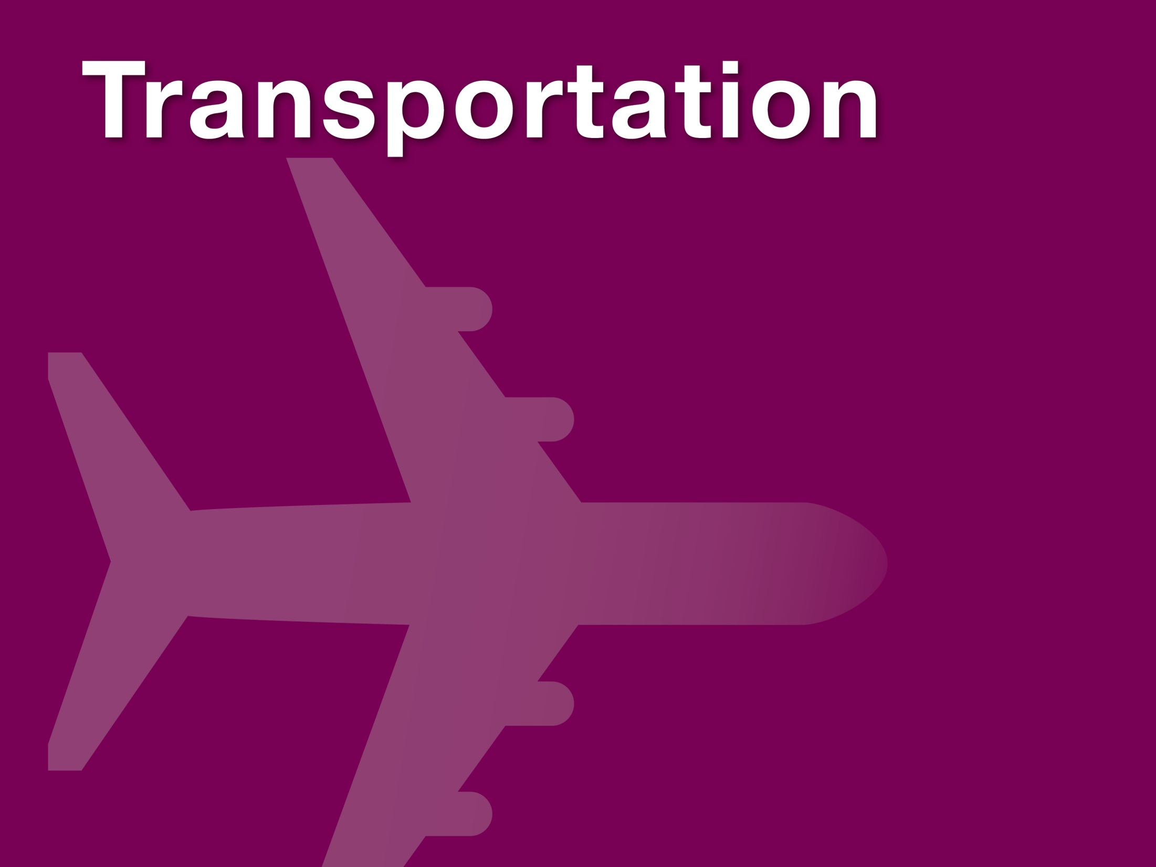

Slide 10
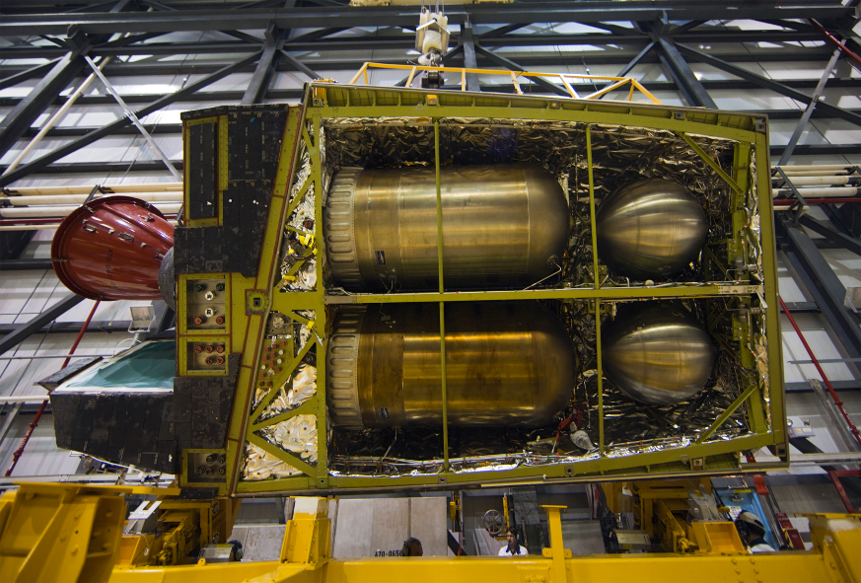
Pressure Vessels Improve Transportation of Liquid Fuels
Marshall Space Flight Center
Cimarron Composites LLC
Huntsville, Alabama
NASA Technology
Lightweight, durable tanks for liquids and gases were needed for nearly every space vehicle
Research to support X-planes and Space Shuttles advanced composite overwrapped pressure vessels (COPVs), producing several patents
The work inspired valuable commercial products
Technology Transfer
NASA originally developed COPVs to let smaller, lighter vessels hold more contents under greater pressure
A Space Act Agreement and exclusive patent licenses supported development of a plastic liner, proprietary resin, and carbon overwrap systems
Marshall provided cryogenic proof and cycle tests, resulting in approval for use on U.S. roads
Benefits
New all-composite COPV is lighter and has greater capacity than metal predecessors
Moving highly volatile liquids and gases is safer
Commercial space launch vehicles use COPVs
A 7,500-pound-per-square-inch hydrogen tube called Neptune will be instrumental for hydrogen fuel cell transportation system in development
Spinoff 2020
Transportation

Slide 11
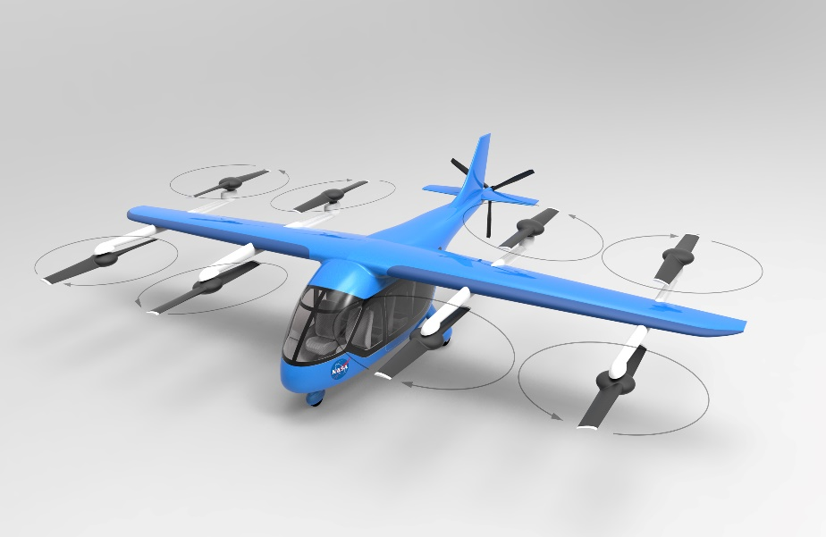
Weight-Estimating Software Helps Design Urban Air Taxis
Ames Research Center
M4 Engineering Inc.
Long Beach, California
NASA Technology
An aircraft’s weight is an important variable for how it will fly—heavier planes need more fuel, put more stress on structures, and may need more reinforcement, which then further adds to the weight
Previous weight estimate methods for novel designs could take months and were often inaccurate
Technology Transfer
NASA Small Business Innovation Research awards funded development of software to quickly and accurately predict the weight of structures
The program integrates open source NASA code as well as NASTRAN, another NASA spinoff software
The NASA funding first helped develop the code for fixed-wing aircraft; later funding extended its use to vertical takeoff vehicles
Benefits
The software generates weight estimates for novel designs within days, enabling quicker design and modeling process for new aircraft
Uber is using a variation of the software to develop urban taxi prototypes
Supersonic jets, the drone industry, and high-altitude glider designers also use the program
Spinoff 2020
Transportation

Slide 12
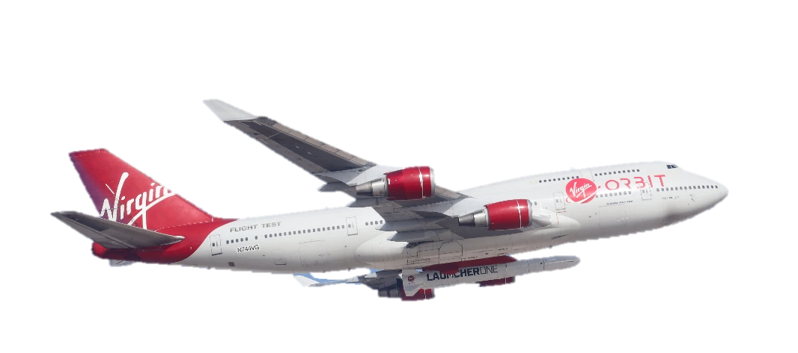
Plane-Launched Rocket Opens Up Space for Small Satellites
Marshall Space Flight Center
Virgin Orbit LLC
Long Beach, California
NASA Technology
NASA is supporting the development of satellite launch methods to increase access to low-Earth orbit
Mid-air launches required new technology, testing
This new approach makes it possible to launch a rocket into space from anywhere
Technology Transfer
An Announcement of Collaborative Opportunity included NASA computer simulation to analyze aerothermodynamic performance of a plane carrying a rocket under its wing and the rocket’s heat shield
A collaboration to 3D-print engine parts from a NASA alloy and test them validated them for even higher temperatures and pressures than they were designed for—and will help save costs
Benefits
LauncherOne can insert satellites anywhere in low-Earth orbit up to about 310 miles and achieve sun-synchronous orbit
Smaller payloads no longer have launch, orbit dictated by missions they piggyback on
NASA, Department of Defense, Spaceflight Industries, and OneWeb are among customers
Spinoff 2020
Transportation

Slide 13
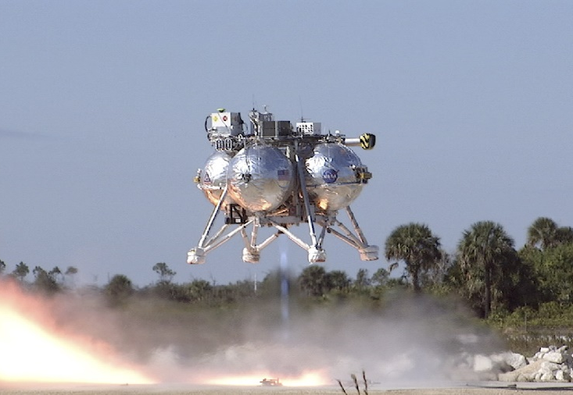
Flash Lidar Enables Driverless Navigation
Langley Research Center
Advanced Scientific Concepts Inc. (ASC)
Santa Barbara, California
NASA Technology
Precision landing is essential for getting astronauts and technology safely down onto celestial bodies
Flash lidar instantly creates a 3D topographical map of a surface, helping to guide landers
This technology makes it possible for spacecraft to land anywhere while avoiding ground hazards
Technology Transfer
ASC used Small Business Innovation Research and other funding to advance the flash lidar system later used in OSIRIS-Rex asteroid sample return mission
Flash lidar captures 15,000 pixels per pulse, increasing data speed and decreasing distortion
Automotive flash lidar was adapted from devices developed for aerospace with NASA funding
Benefits
Three systems are now available—Peregrine (for driverless cars), TigerCub (general purpose), GoldenEye with three-mile+ range (for space)
Devices are compatible with 532-nanometer lasers supporting marine-based navigation
For cars, the distortion-free, less computationally intensive imagery means faster hazard detection
Spinoff 2020
Transportation

Slide 14
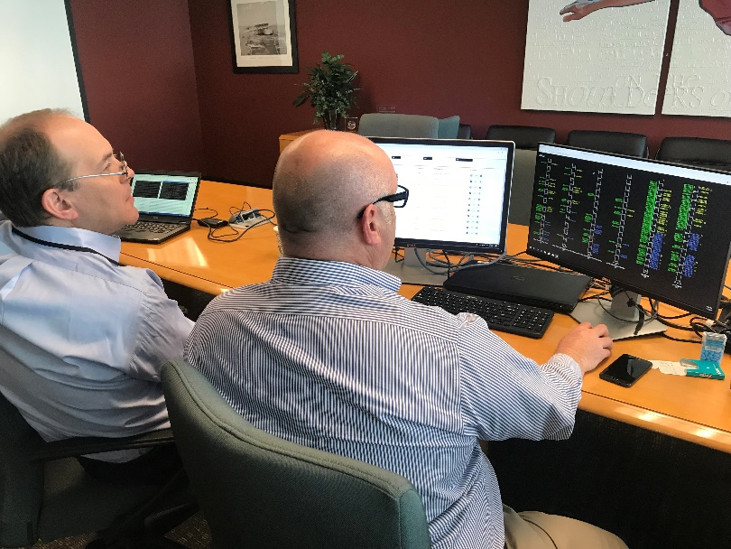
Virtual Airspace Hosts a Training Program for Air Traffic Managers
Ames Research Center
Mosaic ATM Inc.
Leesburg, Virginia
NASA Technology
Drones will multiply the number of aircraft in the U.S. national airspace
Training is essential to build air traffic control skills, but automation will also be necessary
NASA built the Air Traffic Management eXploration (ATM-X) Test Bed to host air traffic simulations
Technology Transfer
Phase I and II Small Business Innovation Research contracts developed a simulation platform to train managers supervising air traffic controllers
The platform works within the NASA’s ATM-X Test Bed, an airspace simulation that creates air traffic scenarios based on real FAA data
Other ATM-X simulations can also use the program
Benefits
Comprehensive Environment for Traffic Management Training by Simulation (COMETTS) can be adapted for other fields with complex operations involving many people
The program could be adapted for nuclear power plant management, hospital operations, first response, firefighting, and national emergencies
Spinoff 2020
Transportation

Slide 15
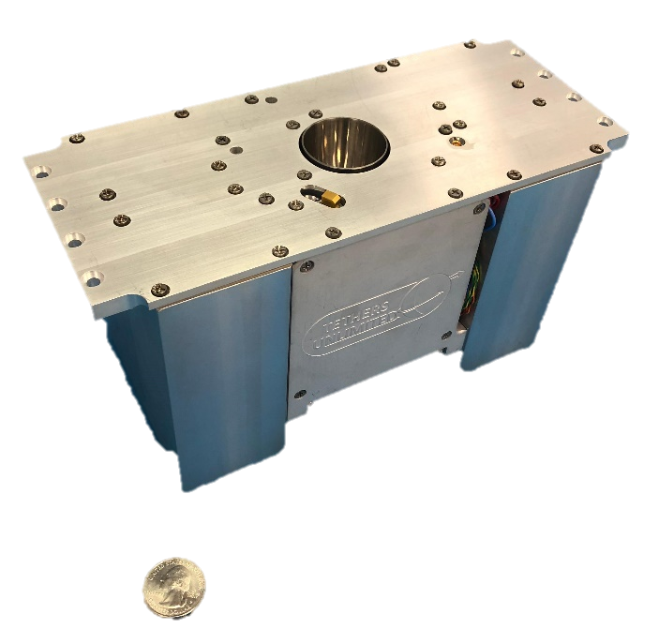
Water-Powered Engines Offer Satellite Mobility
Ames Research Center
Tethers Unlimited Inc.
Bothell, Washington
NASA Technology
NASA needs to enhance CubeSat capabilities for future science missions, letting small satellites change their altitude and maintain orbit long-term
Propulsion systems that electrolyze water found in space into rocket fuel have long been integral to NASA’s deep-space exploration plans
Technology Transfer
Small Business Innovation Research funding developed the initial propulsion system, and NASA’s Tipping Point Technologies program matured the HYDROS thrusters
An electrolyzer powered by solar panels splits onboard water into oxygen and hydrogen gases, stored in separate bladders to be transferred to the combustion chamber on demand
Benefits
The first viable water-electrolysis engine
A larger version called HYDROS-M is available for larger satellites (110 to 400 pounds)
Customers include the Air Force Institute of Technology and Millennium Space Systems
In the future, the company expects this technology to help support an in-space economy
Spinoff 2020
Transportation

Slide 16
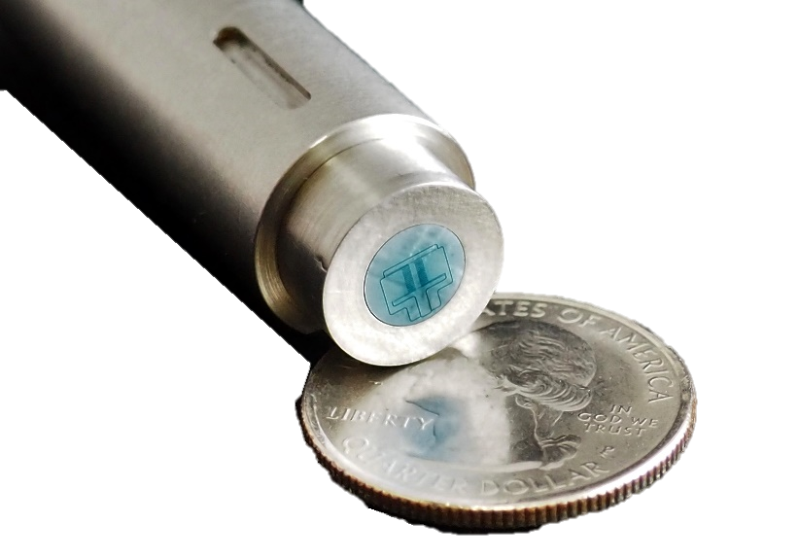
Unique Sensors Will Improve Aerodynamic Design, Aircraft Performance
Langley Research Center
Interdisciplinary Consulting Corporation (IC²)
Gainesville, Florida
NASA Technology
Wall shear stress, or skin friction, is a major factor in a vehicle’s drag, affecting fuel efficiency and aerodynamic performance
To measure the direct force of wind for the first time, NASA initiated the development of a new sensor to expand wind tunnel testing capability
Technology Transfer
Phase I, II, and III Small Business Innovation Research contracts developed a sensor resistant to temperature, pressure, humidity, electronic noise
It’s the first sensor to directly observe and quantify effects of mean flow and fluctuating turbulent air structures
Data can improve computational fluid dynamics software’s ability to digitally predict performance
Benefits
Improves subsonic wind tunnel testing
DirectShear sensor line includes six sensor heads varying in sensitivity, resolution, and bandwidth, depending on the application
Technology forms basis for pending wind tunnel testing instruments like high-frequency dynamic pressure sensors and aeroacoustic microphones
Spinoff 2020
Transportation

Slide 17
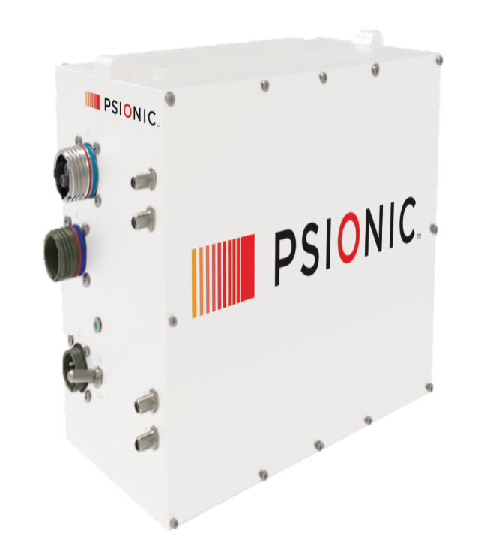
Doppler Lidar Makes Self-Driving Cars Safer
Langley Research Center
Psionic LLC
Hampton, Virginia
NASA Technology
NASA needs to make multiple trips to landing areas about the size of a football field
Lasers and sensors will scan the surface, feeding data to an onboard computer to identify the landing zone and avoid potential hazards
Navigational Doppler Lidar is one landing tool
Technology Transfer
A License for NASA Doppler Lidar and a Space Act Agreement helped modify the space-based system
The commercial products are smaller, cheaper, and perform better, with higher and faster velocity and range resolution
Psionic lidars scan 50 times per second, more than doubling the rate NASA needs
Benefits
Ignors other lasers so it’s tamper-resistant
Continuous generation of accurate data supports accurate velocity, altitude, direction calculations
Technology is being adapted for self-driving cars, military aircraft navigation, drone detection, rendezvous in space, and more
Spinoff 2020
Transportation

Slide 18
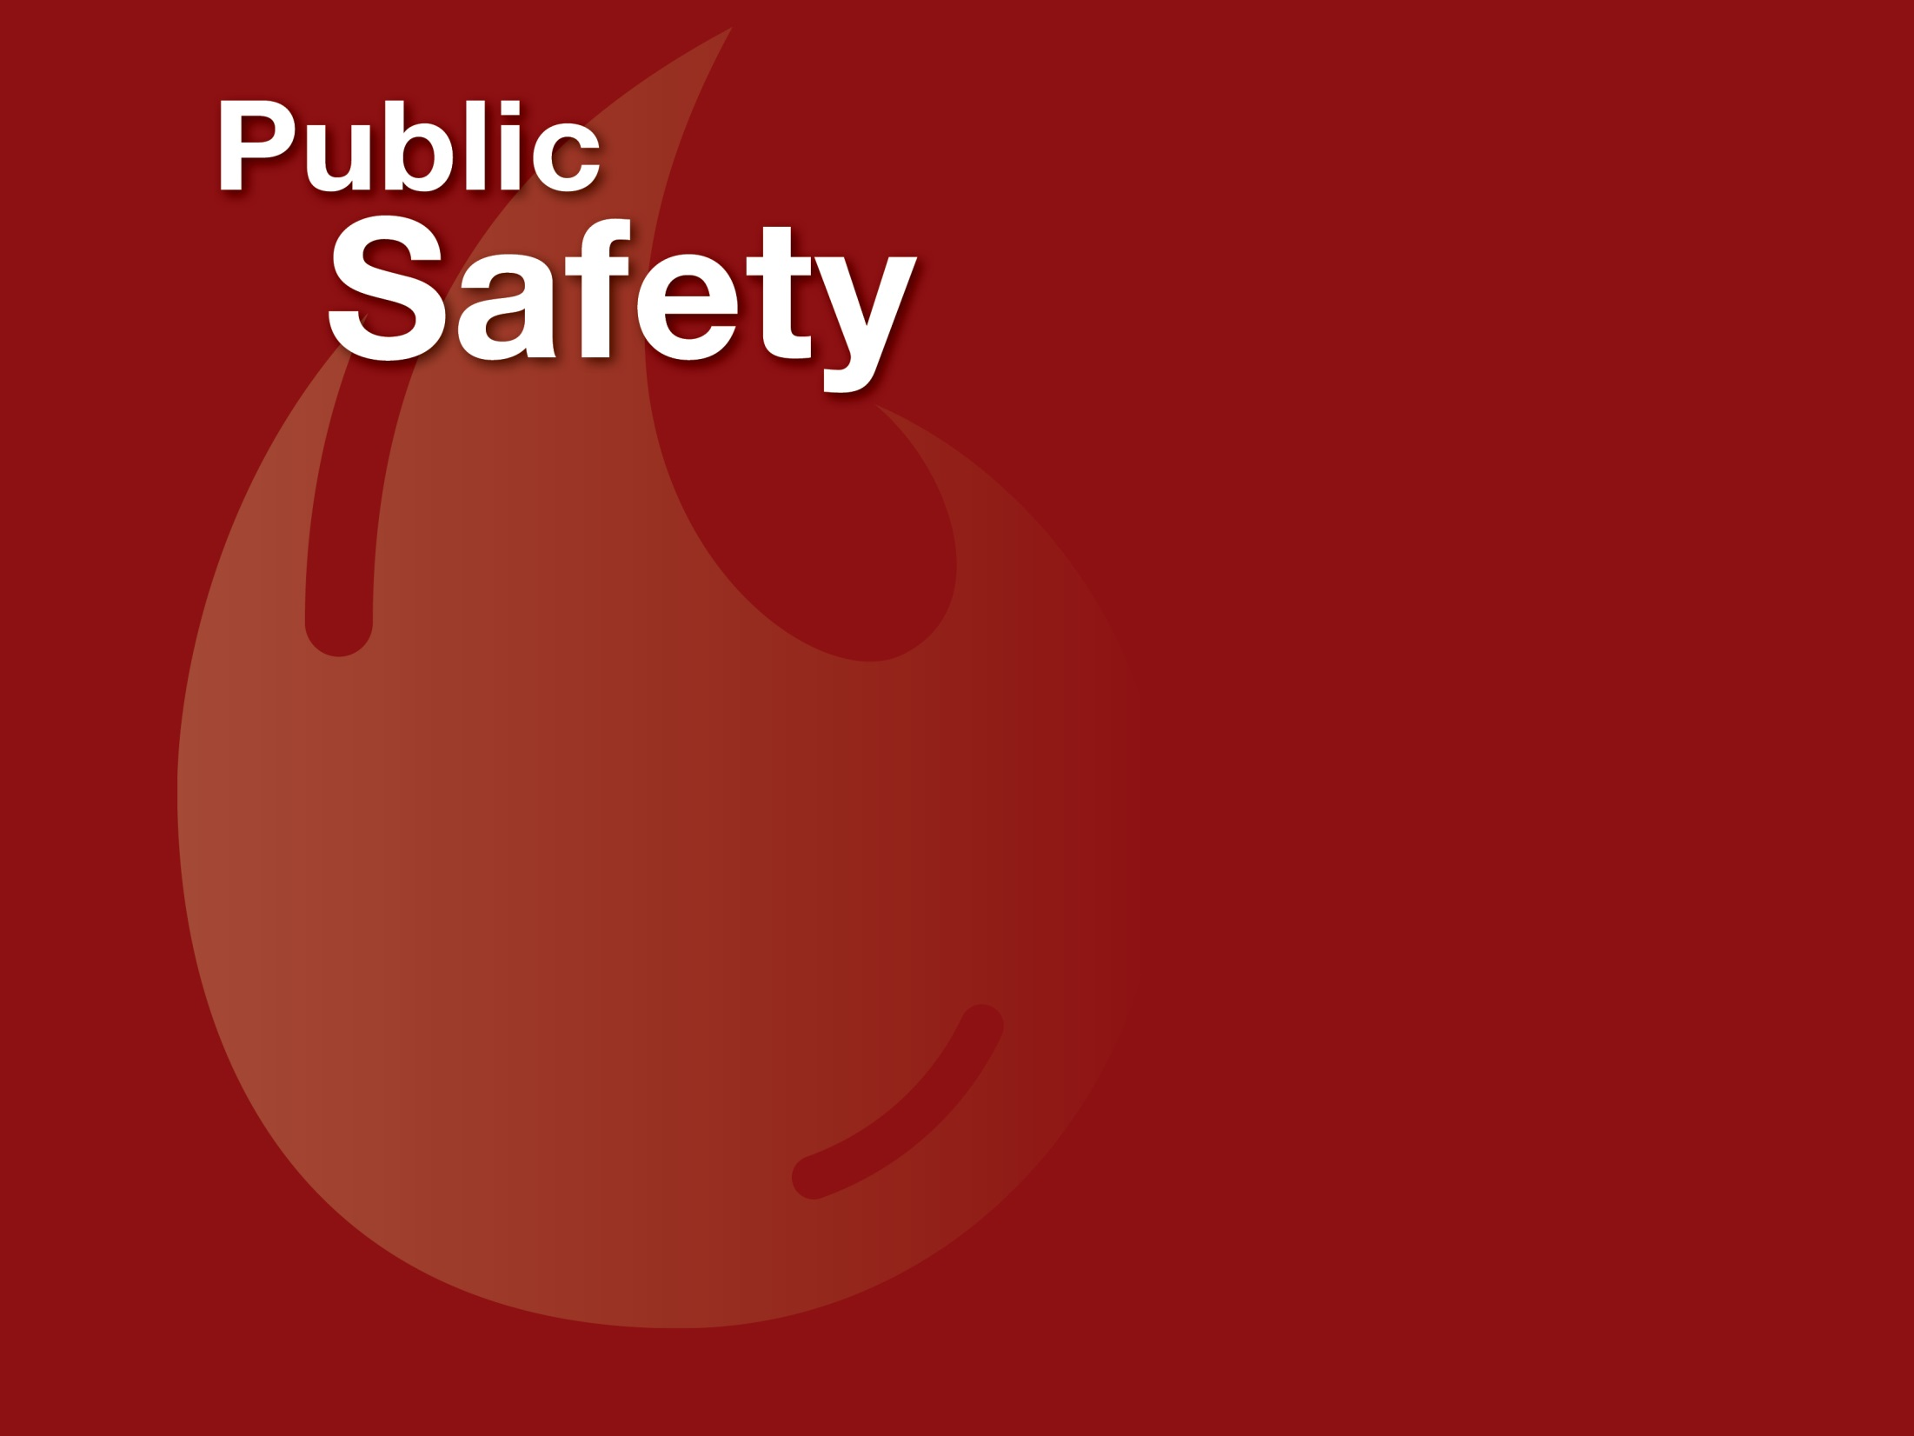

Slide 19
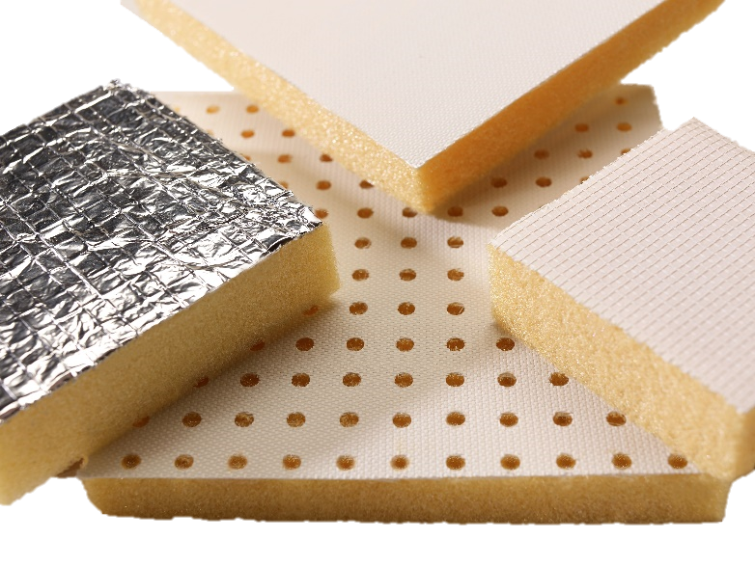
Polyimide Foam Offers Safer, Lighter Insulation
Johnson Space Center
Boyd Corporation
Magnolia, Arkansas
NASA Technology
In the 1970s, deaths from post-crash airplane fires, mostly due to smoke inhalation, became a concern
NASA Fire Resistant Materials Engineering Project refined fireproof polyimide foam for aircraft interiors
Formulations and processing and fabrication techniques were explored and assessed
Technology Transfer
NASA waived patents on resulting Solimide products to allow contractor to produce them commercially
Operation changed hands but continued to grow
Through 1980s and ’90s, Solimide gained popularity as lightweight, fireproof insulation for airplane fuselages, Navy ships, spacecraft, cryogenic applications but never made it into airplane interiors
Benefits
Solimide foams have no fibers or toxins and are lightweight, fireproof, durable, easy to handle
The material is cheaper to install and maintain
Solimide is being explored as an insulator in appliances, heating/ventilation systems
Sales are increasing, up from about 4.4 million board feet annually in 1998 to 6.5 million
Spinoff 2020
Public Safety

Slide 20
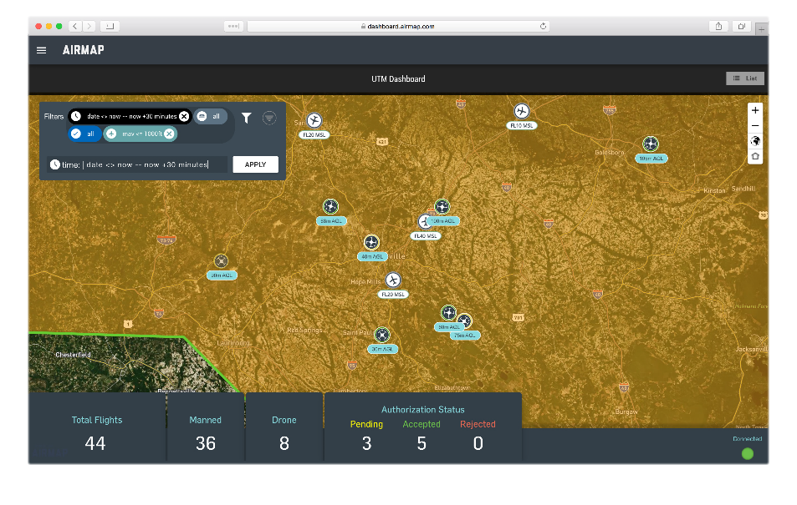
AirMap Guides Drones toward Widespread Use
Ames Research Center
AirMap Inc.
Santa Monica, California
NASA Technology
NASA is helping develop a system to integrate small remotely piloted and autonomous aircraft into the crowded U.S. airspace
Partnering with the FAA, the Unmanned Aircraft Systems Traffic Management (UTM) project brought together third-party developers
Technology Transfer
NASA established a set of standards and guidelines to ensure new technologies will integrate with current and future aviation systems
The Agency coordinated flight testing and data collection, and served as an interface with the FAA
Working with NASA and other partners, AirMap developed its UTM platform, which now enables more than 100,000 drones flights a day
Benefits
The free AirMap mobile app shows users their immediate airspace, gives alerts for nearby aircraft, drafts/submits flight plans to the FAA
AirMap software is being integrated into drones by some of the biggest drone manufacturers
The program will support autonomous flights beyond line of sight when the FAA allows them
Spinoff 2020
Public Safety

Slide 21
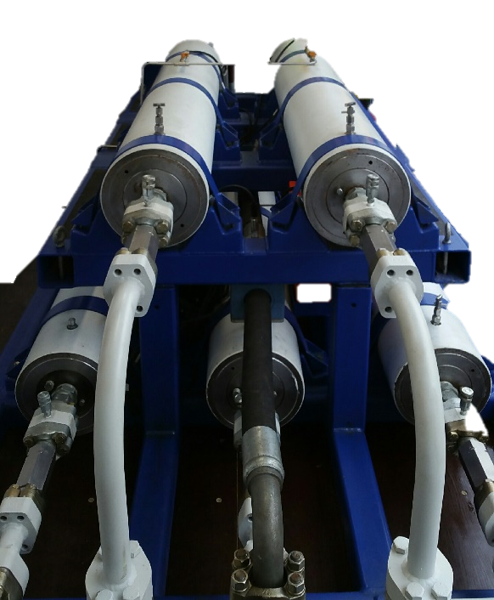
Rockets, Rovers Spur New Offshore Drilling Safety Technology
Marshall Space Flight Center
Jet Propulsion Laboratory (JPL)
Bastion Technologies Inc.
Houston, Texas
NASA Technology
Bastion works at most NASA field centers, primarily in safety, mission assurance, and structural analysis
Experience with propulsion systems, fuses, igniters, electronics, batteries, and software proved relevant
Rigorous mission assurance and safety standards set an example
Technology Transfer
Bastion also works in the oil and gas industry, and investigated the Deepwater Horizon disaster
Company developed a new, patented technology to shear and seal an offshore well’s drill pipe, powered by a solid propellant instead of pressurized gas
The design of the new marine oil drilling shutoff system is grounded in how NASA uses rocket fuels, fuses, igniters, electronics, batteries, and software
Benefits
SureShear is more than 99.9 percent reliable
The system is designed to prevent the next offshore drilling disaster
SureShear system can be about a tenth the size of a traditional blowout preventer, with the power to sever “unshearables” like drill collars
Less weight means less cost, more flexibility
Spinoff 2020
Public Safety

Slide 22
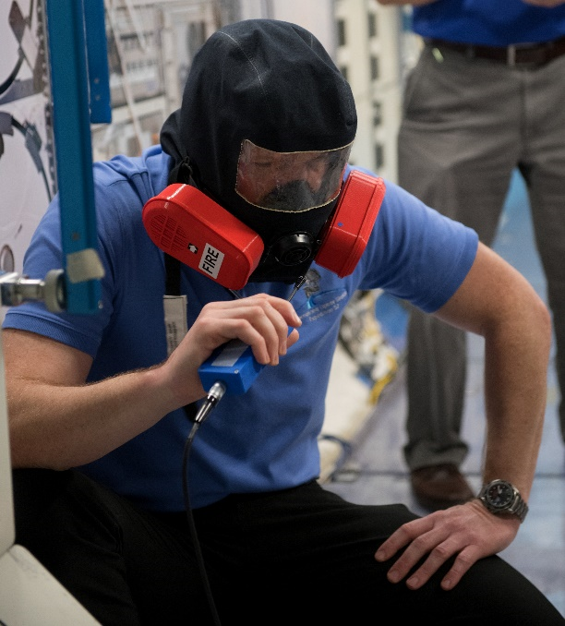
Wool Mask to Fight Fires in Space Inspires Fire Equipment on Earth
Johnson Space Center
Lanaco
Auckland, New Zealand
NASA Technology
The Orion spacecraft crew can’t use existing emergency breathing mask technology
On the space station, astronauts can move to another module after a fire; on Orion they can’t
Modifying existing, proven equipment was more efficient and cost effective than starting over
Technology Transfer
A pre-filter developed to meet NASA specifications protects the primary filter made of synthetic materials
Existing proprietary wool filter technology was the starting point for filtering the bigger, more dangerous materials that could hamper respirator function
Wool is fire- and bacteria-resistant and manages moisture and hot particles well, making it an ideal filter
Benefits
Helix filters capture coarse, hot particles, work well in high-moisture environments, and offer the lowest possible resistance to breathing
New filters for firefighters are in development, testing by Fire and Emergency New Zealand
Research on wool filter technology for NASA will inform sheep breeding, improving filtration
Spinoff 2020
Public Safety

Slide 23
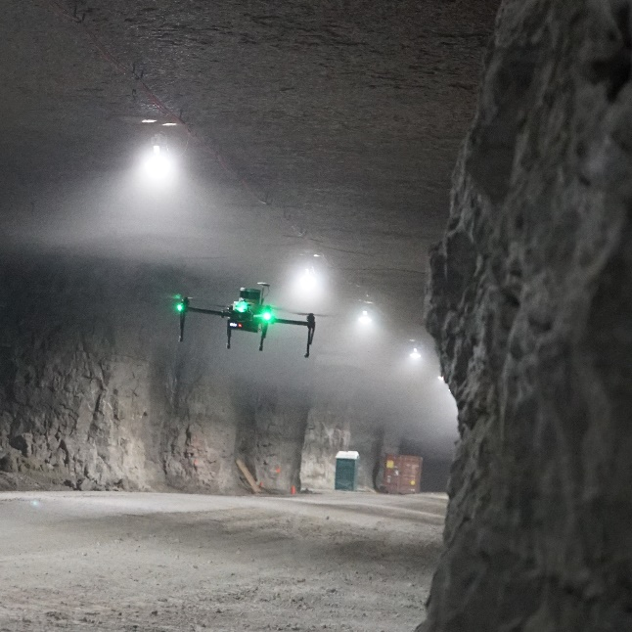
Autonomous Drone Navigation System Ends Reliance on GPS
Ames Research Center
Near Earth Autonomy Inc.
Pittsburgh, Pennsylvania
NASA Technology
NASA and the FAA are collaborating to collect data and develop vehicle requirements, flight regulations for safe drone flight in national air space
Allowing autonomous aircraft to fly beyond the operator’s line of sight requires independence from GPS
Technology Transfer
Phase I and II Small Business Innovation Research contracts funded new technology for safe, self-piloted takeoff and landing without GPS or maps
Simultaneous localization and mapping makes it possible for a drone to build a real-time map of the surroundings while tracking its own movement
Onboard lidar, sensors, camera, and algorithms contribute to the map construction and navigation
Benefits
This system could help drones navigate where GPS signals are unreliable or unavailable
Drones can now operate inside large structures that dampen or block GPS signals, for inspecting buildings, tunnels, tanks, and towers, as well as disaster sites
Could enable future drone transport and delivery
Spinoff 2020
Public Safety

Slide 24
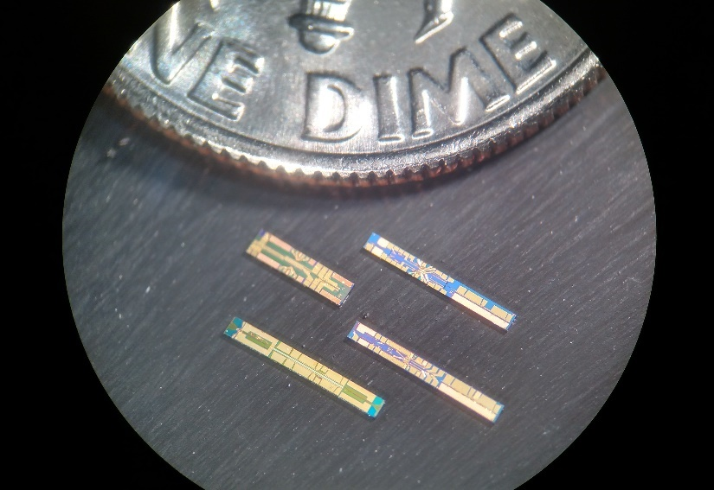
Smaller, Cheaper Lasers Can Detect Gas, Monitor Structures, Take Tissue Images
Goddard Space Flight Center
Freedom Photonics LLC
Santa Barbara, California
NASA Technology
NASA needed a methane detector for satellites to generate comprehensive greenhouse gas data
The Methane Sounder would use pulsed laser beam to detect and identify the presence of methane
The best wavelength for methane detection has been difficult to generate with lasers
Technology Transfer
Small Business Innovation Research and Tipping Point Technologies contracts funded development of two tunable 1,650-nanometer-wavelength lasers
The chip-scale semiconductor laser is much smaller, cheaper, simpler, and more energy-efficient than other types of tunable lasers
10-times cost reduction compared to solid-state lasers
Benefits
Chip-scale laser mainly used for gas sensing
Applications include environmental monitoring, finding emissions from oil and gas wells, locating gas line leaks, chemical plant safety checks
Potential uses include structural health monitoring, as well as optical coherence tomography used in ophthalmology, cardiology
Spinoff 2020
Public Safety

Slide 25


Slide 26
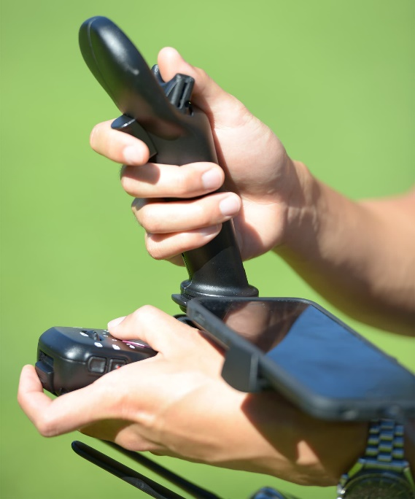
Astronaut Experience Inspires Single-Handed Drone Flight Controller
Johnson Space Center
Fluidity Technologies Inc.
Houston, Texas
NASA Technology
Astronauts train on and use controllers to pilot spacecraft, operate the space station’s robotic arm, and control a system for spacewalk emergencies
These controllers are joystick style, controlling movement back and forth, sideways, and up and down as well as through rotations (pitch, yaw, roll)
Technology Transfer
Expertise with joystick controllers inspired a former astronaut to develop controllers for other contexts
The FT Aviator Kickstarter campaign raised over $100,000 and generated hundreds of pre-orders
A high-profile appearance at CES in Las Vegas in January 2019 led to the technology being named a CES Innovation Awards 2019 Honoree
Benefits
FT Aviator puts all the primary drone flight controls in one hand, freeing up the other hand for tasks such as controlling an on-board camera
The device is intuitive, easy to learn
Drone, helicopter, and surgical and medical manufacturing companies are exploring technology partnerships
Spinoff 2020
Consumer Goods

Slide 27
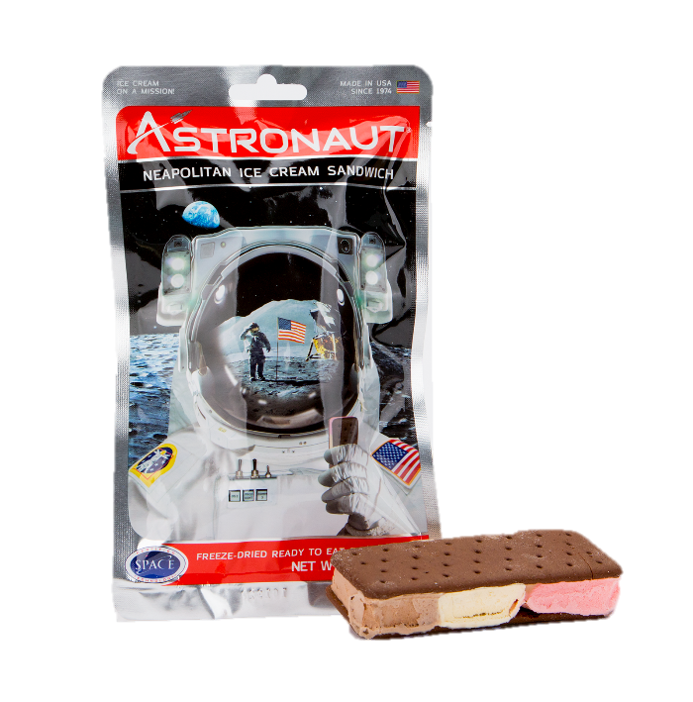
Freeze-Dried Foods Nourish Adventurers and the Imagination
Ames Research Center
American Outdoor Products Inc.
Boulder, Colorado
NASA Technology
Preparing nutritious, palatable food that will hold up in space is an ongoing focus for NASA
To improve the taste, texture, and nutritive value of food for space travel, the Agency funded research to improve existing techniques for dehydration, freeze-drying, and other types of food preservation
Technology Transfer
A new technique for reconstituting food with warm (not boiling) water made food for Gemini mission astronauts better tasting and easier to rehydrate
To develop “Astronaut Ice Cream” for visitors to Ames, a freeze-drying process that removes 99 percent of water produced a popular treat
The ice cream was never eaten by astronauts in space but fed interest in space travel
Benefits
The line of Astronaut Foods includes freeze-dried ice cream, yogurt, and fruits, with a new treat for pets called Astrodog
Freeze-drying has the best shelf life, preserving the most minerals, enzymes, and other nutrients
Astronaut Ice Cream is available at more than 1,000 retailers worldwide
Spinoff 2020
Consumer Goods

Slide 28
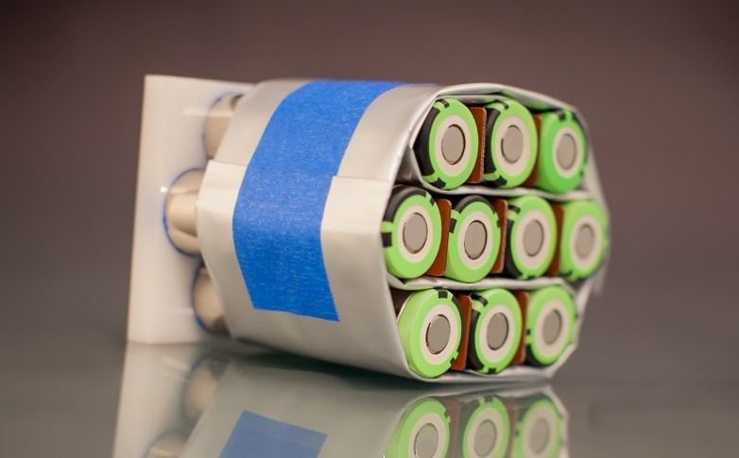
Carbon-Fiber Heat Sink Makes Batteries Safer for Electric Cars, Bikes, and More
Johnson Space Center
KULR Technology Inc.
Campbell, California
NASA Technology
NASA relies heavily on batteries and continues research to improve power, reliability, safety
One important challenge is managing the sometimes damaging or dangerous heat generated by batteries
Heat sinks often use phase-change reactions to “soak up” excess heat
Technology Transfer
Several Small Business Innovation Research contracts contributed to developing a new heat sink using water vaporization instead of wax melting
Evaporating water uses 10 times as much heat as melting wax
A thermal runaway shield for spacesuit lithium-ion battery packs combined carbon fiber velvet and a water-vaporizing heat sink to keep batteries cool
Benefits
KULR is now marketing the thermal runaway shield for commercial lithium-ion batteries
Thermal management makes batteries safer and more efficient—better discharge and recharge
Carbon fiber reduces weight and bulk, making the heat sink better for battery-powered devices such as electric bikes, scooters, cars, drones
Spinoff 2020
Consumer Goods

Slide 29
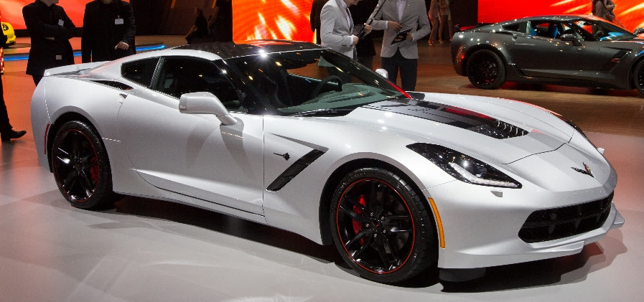
Nanotechnology Repairs Engine Damage in Cars
Glenn Research Center
TriboTEX LLC
Colfax, Washington
NASA Technology
NASA’s Space Grant program funds cutting-edge research that can help missions
In 2011, the program awarded a grant to a student developing a lubricant that could not only protect from wear but reverse it
Research into lubricants is ongoing
Technology Transfer
Nano-flakes are sticky on one side and smooth on the other, with the sticky side attracted to rough points of friction on metal
Layers of nanoparticles form until the rough spot is smoothed over, filling in the damage
An Indiegogo campaign raised over a half a million dollars to adapt this oil additive for use on Earth
Benefits
Non-toxic TriboTEX is now in 30,000+ cars
Specific products are formulated for small, high-performance, and semi-tractor trailer engines
Noise is decreased by filling in gaps and grooves as narrow as the width of a human hair
Increases engine power up to 3 percent, mileage up to 6 percent
Spinoff 2020
Consumer Goods

Slide 30
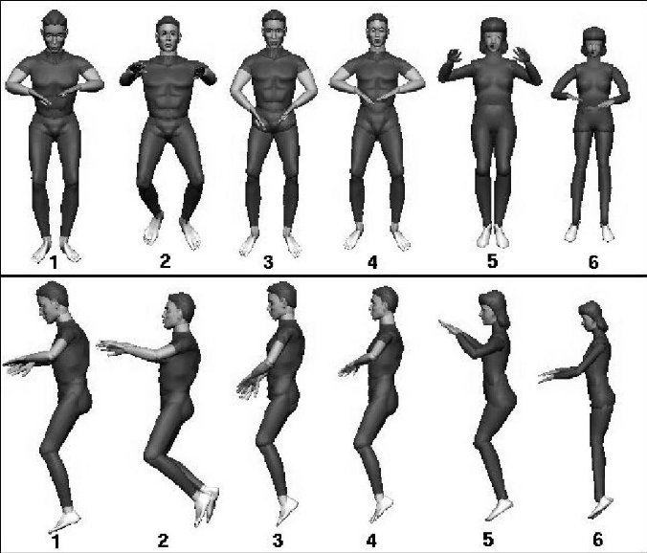
Zero-Gravity Body Posture Influences Acupressure Massage Chair
Johnson Space Center
LURACO Health and Beauty LLC
Arlington, Texas
NASA Technology
Making sure astronauts are comfortable and safe in space is an ongoing priority for NASA research
Standards for procedures and equipment are reviewed and updated to ensure safety, functionality
An ever-changing mix of astronaut body size and shape informs design and fabrication
Technology Transfer
Neutral body posture refers to the relaxed position a human body naturally assumes in zero gravity
A study aboard a 1993 Space Shuttle mission discovered a range of astronaut postures
NASA’s posture data has been available for decades and influences the design of consumer products such as car seats and office chairs
Benefits
iRobotic 7 PLUS massage chair Zero Gravity setting uses neutral body posture
The neutral posture facilitates circulation and relieves stress on joints
Acupressure point massage techniques applied to a reclining figure uses body weight and posture to support healing and manage pain
Spinoff 2020
Consumer Goods

Slide 31
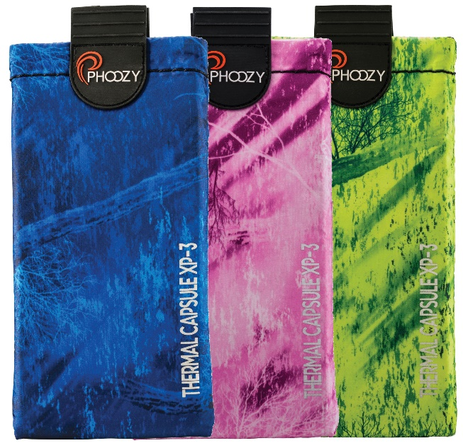
Spacesuit Insulation Protects Personal Devices
Marshall Space Flight Center
eXclaim IP LLC
Charlotte, North Carolina
NASA Technology
The first astronaut spacesuit needed to maintain body temperature in the extremes of space
Six years went into creating, testing, and refining the manufacture of multi-layer reflective thin-film insulation, which is lightweight and highly effective
The insulation also works well on Earth
Technology Transfer
The material prevents the sun’s heat from entering a spacesuit and the body’s heat from escaping
The technology, known as radiant barrier insulation, is widely used in many industries
A new, patented layering of materials called Chromium Thermal Barrier is based on the NASA insulation
Benefits
PHOOZY device-specific smartphone and tablet protectors prevent overheating and freezing
The insulation blocks 90 percent of the sun’s rays, and additional layers protect from other elements
Online sales have been so high that PHOOZY is now sold in several national retail outlets
Spinoff 2020
Consumer Goods

Slide 32


Slide 33
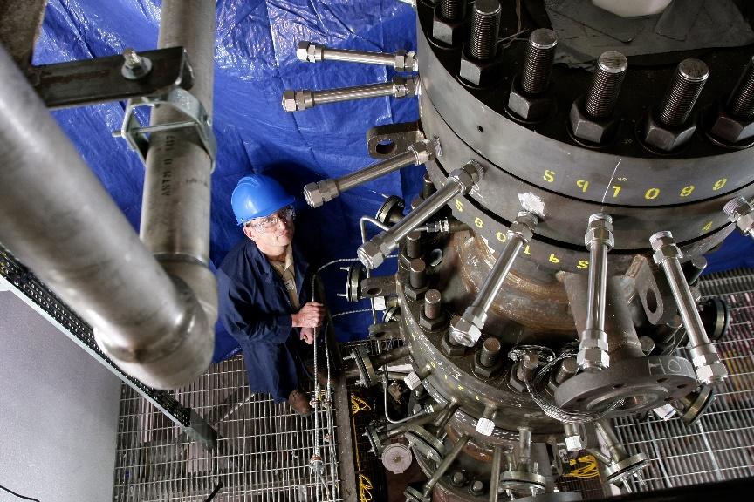
Rocket Expertise Assists Transition to Green Energy
Marshall Space Flight Center
Gas Technology Institute (GTI)
Des Plaines, Illinois
NASA Technology
Improving propulsion systems is an ongoing focus of NASA engineers to increase efficiency
Improvements in rocket technology over the past 50 years mean modern-day rockets generate more force with less fuel, creating less pollution
Technology Transfer
Numerous commercial partners supported NASA’s efforts to mature, build, and perfect rockets for years
The Agency has developed new systems for managing extreme heat and high pressures to maintain optimal efficiency
Those same systems help control the extreme temperatures that occur in gasification technology invented by former rocket scientists
Benefits
Compared to coal-fired power plants, gasification creates less toxic waste, releases fewer harmful gases into the atmosphere, and uses less water
The R-Gas gasifier achieves the high temperatures required to use the cheapest, hardest-to-process coal in a safer manner
Cheaper than a coal plant or other gasifiers
Spinoff 2020
Energy and Environment

Slide 34
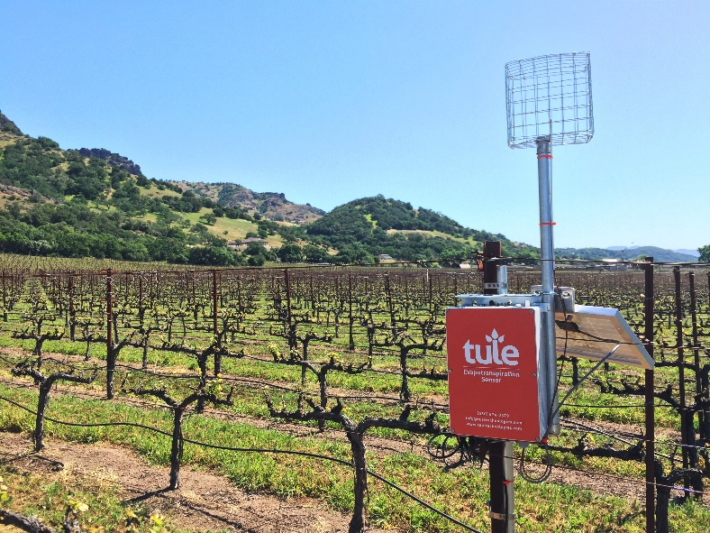
Satellite Imagery Helps Farmers Cut Water Use in Half
Goddard Space Flight Center
Tule Technologies Inc.
Oakland, California
NASA Technology
Geostationary Operational Environment Satellites, known collectively as the GOES-R series was built by NASA to take high-resolution images of Earth
Contributing to the development of scientific knowledge is a primary NASA mission, one that provides invaluable resources to people on Earth
Technology Transfer
Cost-free satellite imagery available to the public includes images in a wavelength spectrum commercial satellites don’t currently measure
To calculate water evapotranspiration, Tule combines NASA data with field sensor data measuring turbulent air flow, which plays a role in how quickly water vapor moves away from plants
Benefits
Accurate field data makes it possible for farmers reduce total water consumption or get better yields with the same amount of water
With 80 percent of fresh water used for irrigation, conservation efforts can reduce waste
A 100-acre vineyard in Southern California cut water usage by half with Tule’s assistance
Spinoff 2020
Energy and Environment

Slide 35
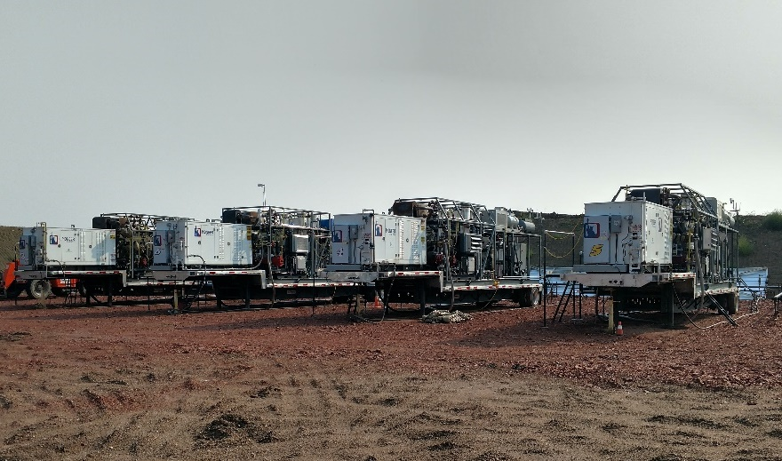
Gas Processors Turn Oil Drilling Emissions into Fuel for Sale
Johnson Space Flight Center
Pioneer Energy Inc.
Lakewood, Colorado
NASA Technology
To reduce the cost of human exploration of Mars, NASA explores the use of local or in situ resources
Pioneer Astronautics carried out much of this work, such as Small Business Innovation Research contracts for technology to turn carbon dioxide and hydrogen into propellants and oxygen
Technology Transfer
Pioneer Energy spun off to commercialize similar systems for marketing to the oil and gas industry
Adaptations of the Mars technology to instead capture methane and other gases released by oil wells can end the practice of burning them off in flares that release carbon dioxide and other pollutants into the atmosphere
Benefits
Flarecatcher and Vaporcatcher units capture and process natural gases onsite at oil wells, creating secondary fuels to sell
Capture eliminates the adverse effects of flaring, including climate change, respiratory problems
The value of the fuel produced is equal to or exceeds the cost of the system
Spinoff 2020
Energy and Environment

Slide 36
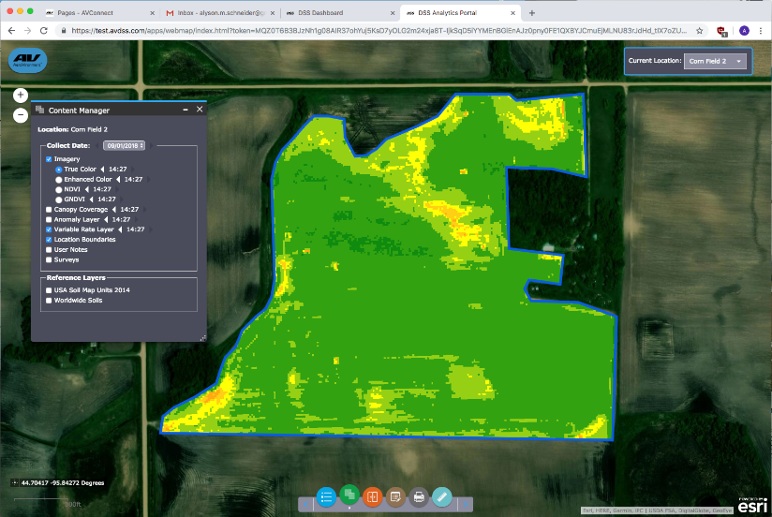
Field-Scanning Drone Gives Farmers Better Data
Jet Propulsion Laboratory (JPL)
AeroVironment Inc.
Los Angeles, California
NASA Technology
NASA aircraft fly in challenging conditions on Earth, such as the very thin upper reaches of the atmosphere, and soon, on Mars
These specially equipped autonomous vehicles help expand scientific knowledge of our planet and others
Technology Transfer
The Agency worked with AeroVironment Inc. in the 1990s on solar-powered autonomous aircraft that flew at nearly 100,000 feet
AeroVironment recently used its expertise in autonomous thin-air flight on the first-ever Mars helicopter; the atmosphere on Mars is 1% of Earth’s
The same expertise informed development of a commercial drone for agriculture
Benefits
Quantix is a durable drone that functions well in difficult conditions—dusty, humid, sunny—flying autonomously within specified boundaries
Two high-resolution cameras scan crops using different spectra identifying plant health issues
An orchard scan resulted in cultivation changes increasing yield more than $50,000 in one year
Spinoff 2020
Energy and Environment

Slide 37

Versatile Fuel Cells Stop Natural Gas Emissions at Oil Wells
Jet Propulsion Laboratory (JPL)
SAFCell Inc.
Pasadena, California
NASA Technology
Power sources for space are a continuous area of research for the Space Agency
In a new methanol-powered fuel cell, a solid-acid electrolyte eliminated the problem in liquid electrolytes of water decreasing efficiency by carrying fuel molecules across the cell membrane
Technology Transfer
A patented proton-conducting membrane designed with help from JPL and licensed from Caltech became part of the solid-acid cell design
Former Caltech students started the company to commercialize techniques for building solid-acid fuel cells learned from a JPL engineer
The team adapted the technology to power equipment at oil wells
Benefits
Fuel cell—instead of pressurized greenhouse gases—powers equipment at drilling sites
New emissions control rules have created an estimated $3.1 billion market for retrofitting wells
A partnership with another company led to wearable fuel cells for the Army, to power troops’ electronic devices
Spinoff 2020
Energy and Environment

Slide 38
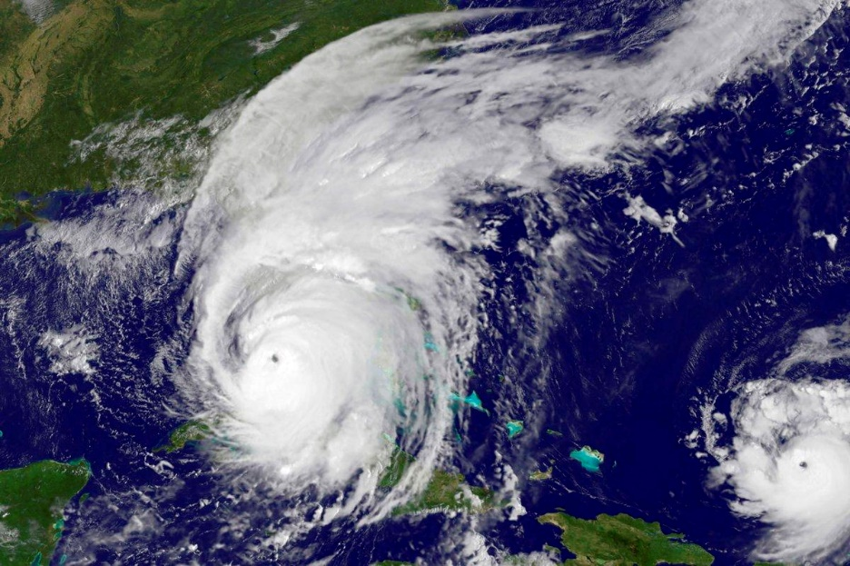
Laser Enables Precise Measurements for Weather Forecasting, Industry
Langley Research Center
ABB
Cary, North Carolina
NASA Technology
NASA needed a space-ready spectrometer to capture atmospheric temperature and humidity levels for weather forecasts
The Cross-Track Infrared Spectrometer needed precisely aligned mirrors to get accurate readings
That is accomplished with laser measurements
Technology Transfer
A standard helium-neon laser wouldn’t work in space, so a semiconductor laser had to be adapted
Semiconductor lasers are smaller, less power-hungry and longer lasting
ABB improved semiconductor lasers so they would hold wavelength constant to maintain accuracy
ABB uses the new laser in industrial spectrometers
Benefits
Industry uses spectrometers to measure quality-control parameters like octane, milk fat content
ABB sales of spectrometers with the semiconductor laser doubled the company’s business volume
The longer-lasting laser saves money by keeping systems online and reducing replacements
Spinoff 2020
Energy and Environment

Slide 39
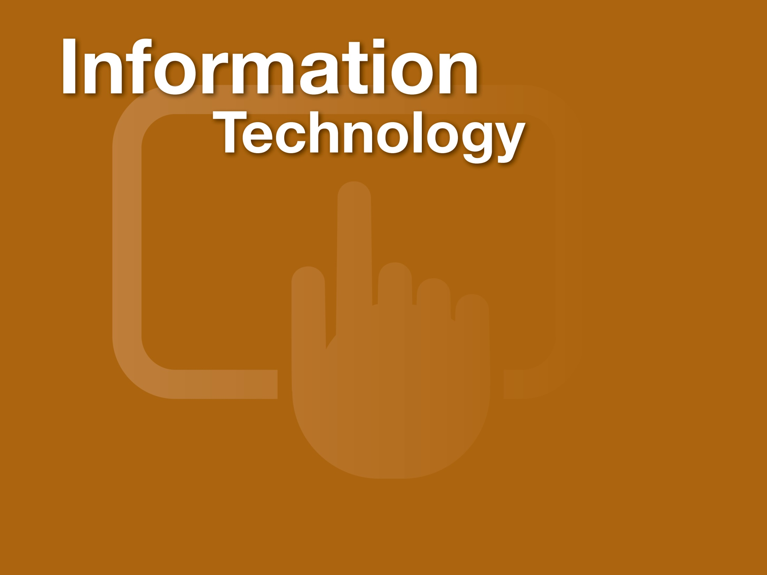

Slide 40
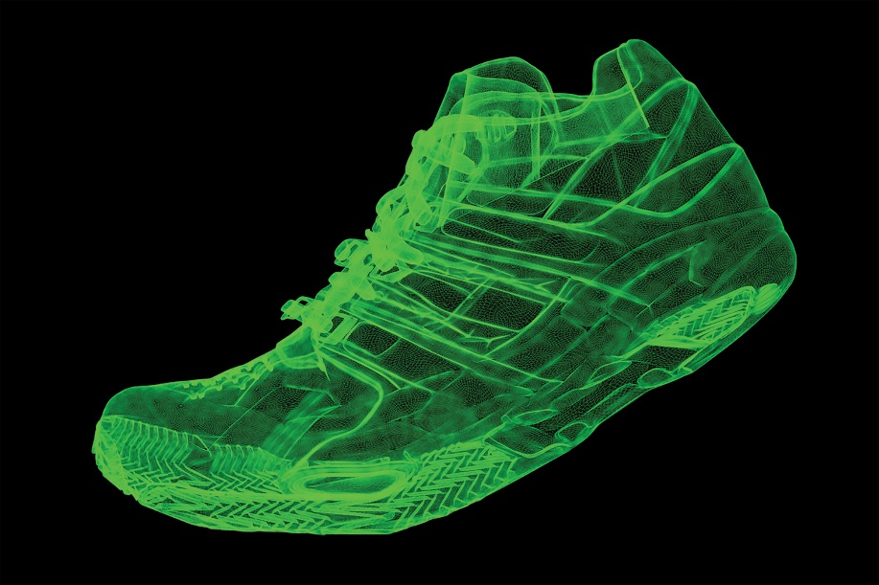
Beowulf Clusters Make Supercomputing Accessible
Goddard Space Flight Center
Nor-Tech Inc.
Minneapolis, Minnesota
NASA Technology
The Earth and Space Science program needed high-speed computing to process the high volume of data generated by several Earth-imaging satellites
Goddard engineers tried an unlikely solution—combining multiple off-the-shelf desktop systems to achieve unprecedented supercomputing power
Technology Transfer
The Beowulf cluster used Linux to make multiple standard PCs work in parallel on a single task
The Goddard team gave lectures and published a book on how to build a Beowulf cluster
The Ethernet driver software the team created to overcome Linux weaknesses was made open source
Most top supercomputers now are based on Beowulf
Benefits
Generating and testing computer-simulated models cuts manufacturing costs and speeds time to market with more reliable products
Nor-Tech custom-builds Beowulf clusters for customers, primarily for product design
The technology costs anywhere from a third to a tenth of the price of a traditional supercomputer
Spinoff 2020
Information Technology

Slide 41
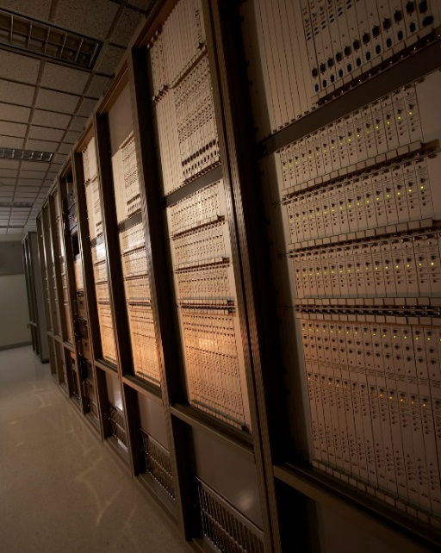
Mission Control Conference System Enables Global Collaboration
Goddard Space Flight Center
Compunetix Inc.
Pittsburgh, Pennsylvania
NASA Technology
NASA’s global and space communications networks required constant manual reconfiguration of cables
The Agency needed a digital switching and distribution system that would automatically reconfigure call connections and conference loops
Technology Transfer
NASA commissioned a digital conference system that allowed call connections and conferences to be configured at the push of a button
A patented non-blocking switch allows a set of ports to be hooked up so that group calls can be connected without requiring contiguous connections
Now, even web-based video conferences rely in part on the technology first developed for NASA
Benefits
Compunetix has millions of conference ports deployed worldwide
Chorus Call, a spinoff company that sells conference calling services using the system developed for NASA, is in 12 countries
Many other big-name conferencing services around the world use Compunetix hardware
Spinoff 2020
Information Technology

Slide 42
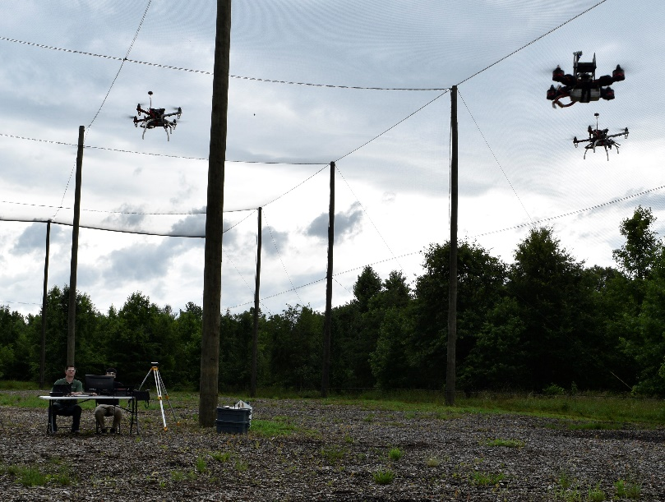
Swarming Technology Lets Drones Work as a Team
Langley Research Center
Heron Systems Inc.
California, Maryland
NASA Technology
Millions of drones will enter U.S. airspace in the near future—NASA is assisting with the research and development of drone technologies
The ability for aircraft to communicate with each other and autonomously coordinate actions would reduce the need for human oversight
Technology Transfer
Small Business Innovation Research contracts funded the creation of a command and control system for multiple drones
The Multi-Agent Cooperative Engagement (MACE) system for autonomous drone teamwork is used to create a swarm, negotiate tasking between drones, coordinate path planning, and establish ground control
Benefits
Heron Systems is pursuing an application coordinating virtual opponents in military training
When drone regulations are in place, autonomous swarms can monitor crops, infrastructure, and more
Software can inform future air traffic control
Swarms can sustain failures yet achieve mission
Spinoff 2020
Information Technology

Slide 43
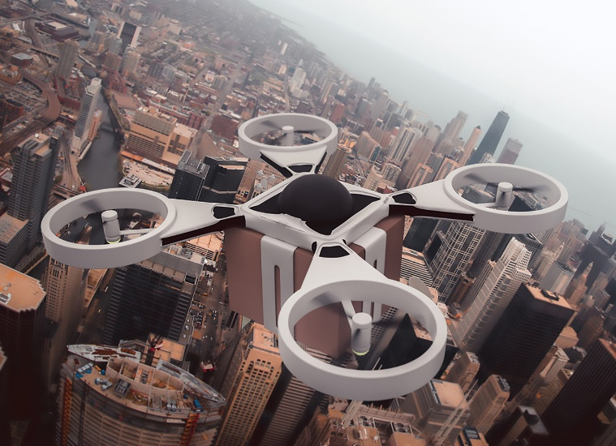
AURA Software Tackles Uncertainty in Complex Systems
Langley Research Center
Barron Associates Inc.
Charlottesville, Virginia
NASA Technology
In the mid-2000s, interest was growing in intelligent, automated systems that would detect and respond to aircraft failures and damage to support aircraft safety and autonomy
NASA needed a way to predict the performance of such systems and calculate odds of error or failure
Technology Transfer
Multiple Small Business Innovation Research contracts created a software package that could assess the performance of automated diagnostic and control systems for flight
Software is a general-purpose tool to predict probability of outcomes in any complex system
Tested and validated by NASA
Benefits
The software is being used to develop resilience and safety assurance for autonomous drones, to verify and validate advanced aviation safety systems, and to predict metabolism of drugs in the body
Other potential applications include the stock market, epidemiology, or actuarial sciences like insurance pricing
Spinoff 2020
Information Technology

Slide 44
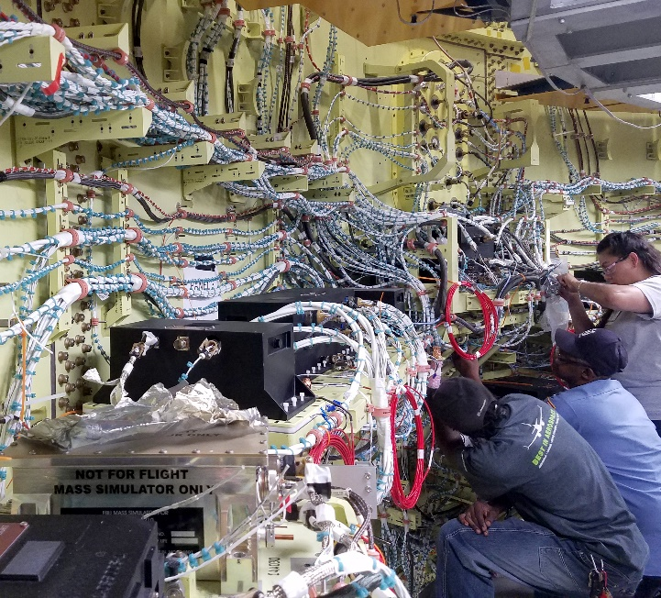
Simulation Software Optimizes High-Speed, Efficient Data Networks
Jet Propulsion Laboratory (JPL)
Mirabilis Design Inc.
Sunnyvale, California
NASA Technology
When NASA needed higher-speed onboard electronic and communication networks, Serial RapidIO communication protocol was a good option
But a performance simulation was necessary to predict potential issues in the unique environment of spacecraft and space travel
Technology Transfer
JPL partnered with Mirabilis to build a VisualSim library simulating Serial RapidIO-based spacecraft avionics for virtual testing
Result from the successful study led to combining physical electronics packaging standards with Serial RapidIO creating an interoperable set of standards for next-generation spacecraft avionics that’s being adopted across the industry
Benefits
RapidIO is becoming the fundamental standard for spacecraft, improving communications
Other customers are designers of lithography equipment for semiconductor manufacturing and builders of mobile phone infrastructure
Having more simulation libraries means more VisualSim customers
Spinoff 2020
Information technology

Slide 45
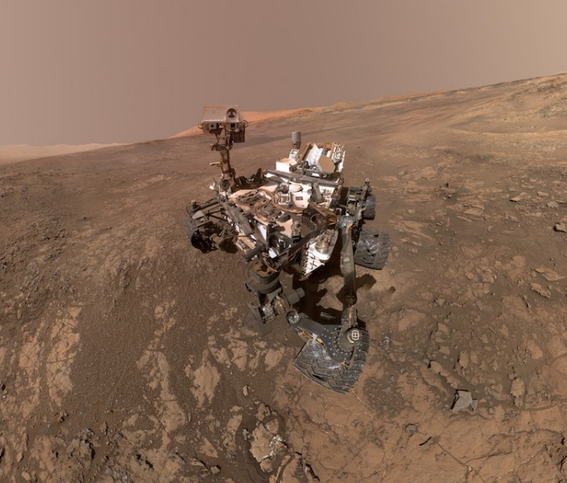
Data Visualization Platform Helps Missions Fly
Ames Research Center
OpenMCT
San Luis Obispo, California
NASA Technology
The Mars rover team wanted to be able to access to a full range of mission data on a single screen—electrical systems, weather reports, communications
Developing data integration and a display for multiple feeds in a flexible, dynamic interface yielded OpenMCT (mission control technologies)
Technology Transfer
Work on the back end converted data feeds into compatible formats and made it possible to display historical data to help visualize trends
In 2015 Ames released the software to the public as a free, open source code with an Apache 2.0 license through the software-sharing platform GitHub
NASA’s Advanced Multimission Operations System (AMMOS) enabled a web-based version
Benefits
OpenMCT can be adapted for planning and operations of any system that sends data
The program is flexible and user-friendly
The Planetary Society adopted OpenMCT to visualize incoming data from LightSail 2, a spacecraft orbiting Earth using solar power
Spinoff 2020
Information Technology

Slide 46
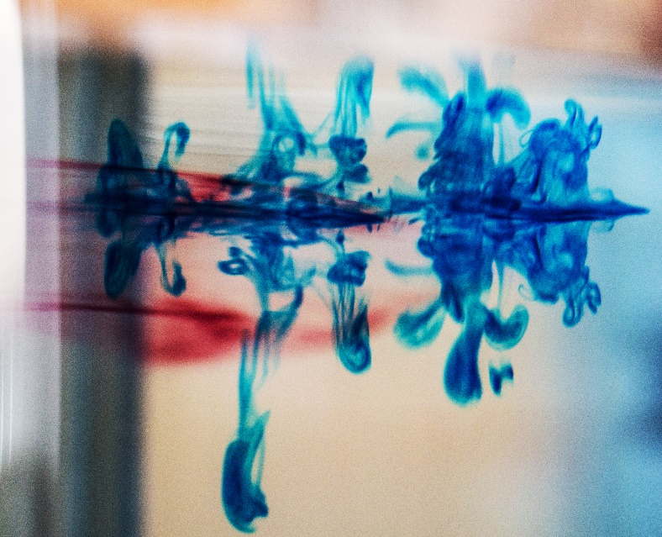
Turbopump Modeling Software Propels Fluid-Flow Simulations
Marshall Space Flight Research Center
Mode Technology Group LLC
Denver, Colorado
NASA Technology
Computational fluid dynamics programs—software that models fluid mechanics, thermodynamics, and heat transfer—couldn’t analyze the entire internal flow in a system as complex as a turbopump
Technologists created the Generalized Fluid System Simulation Program (GFSSP) to do that analysis
Technology Transfer
New capabilities have been continuously added for almost 20 years
NASA contractors have free access to the program that was groundbreaking in 2001, becoming the co-winner of NASA’s Software of the Year Award
Mode Technology Group licensed GFSSP for distribution, giving more businesses and academic and research institutions access to the program
Benefits
GFSSP predicts how fluids flow through any system, even if that fluid changes speed, temperature, and phase (liquid to vapor to liquid)
Mode can make custom changes to the program to meet clients’ needs
Schools can use the program to augment existing analytical tools with a low-rate license
Spinoff 2020
Information Technology

Slide 47
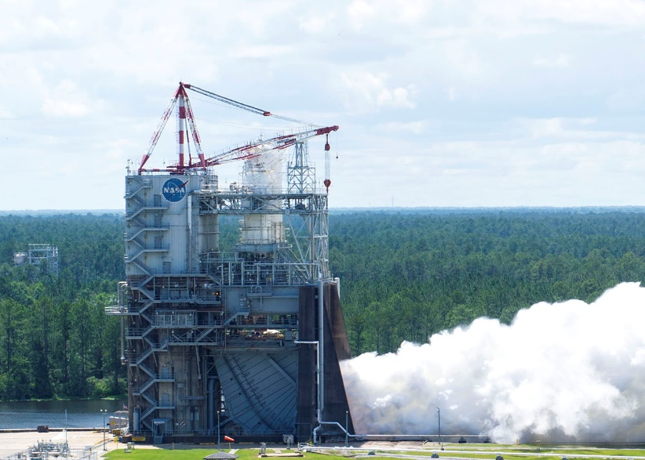
Smart Sensor Networks Monitor System Health—and Themselves
Stennis Space Center
American GNC Corporation
Simi Valley, California
NASA Technology
The Space Agency operates countless large, complex systems wherein small failures can trigger catastrophic ones
Automating systems to prevent failures requires the ability to detect anomalies, make a diagnosis, mitigate faults, and continue operations
Technology Transfer
Several Small Business Innovation Research and Small Business Technology Transfer contracts developed the software and hardware to monitor systems, detect and predict faults
System was designed for rockets and test stands
Each sensor contains specifications and calibration data for its own performance
Benefits
Commercial products include Smart Transducer Integrator and reconfigurable smart sensor node
Networks monitor system components and sensors themselves checking for faults
Technology can be applied anywhere large sets of sensors are needed
Working on communication through barriers
Spinoff 2020
Information Technology

Slide 48
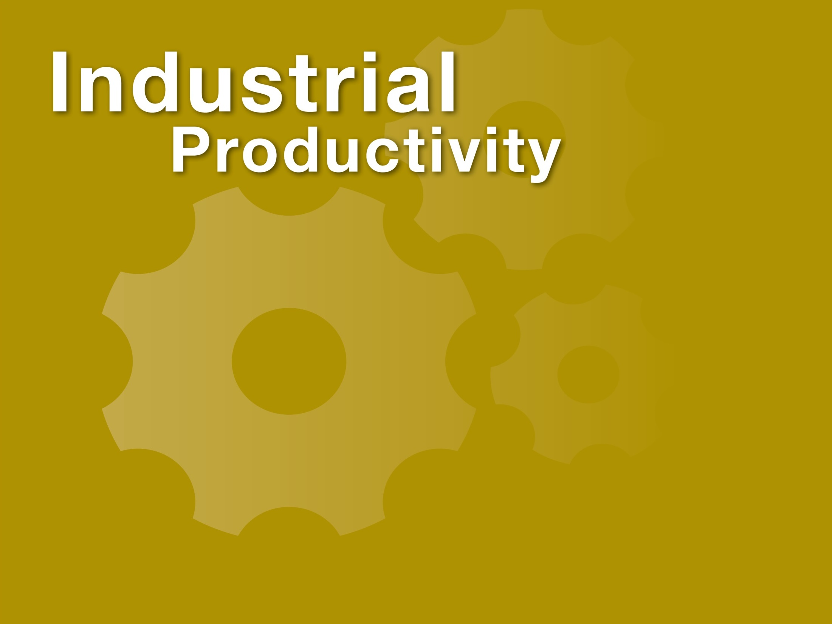

Slide 49
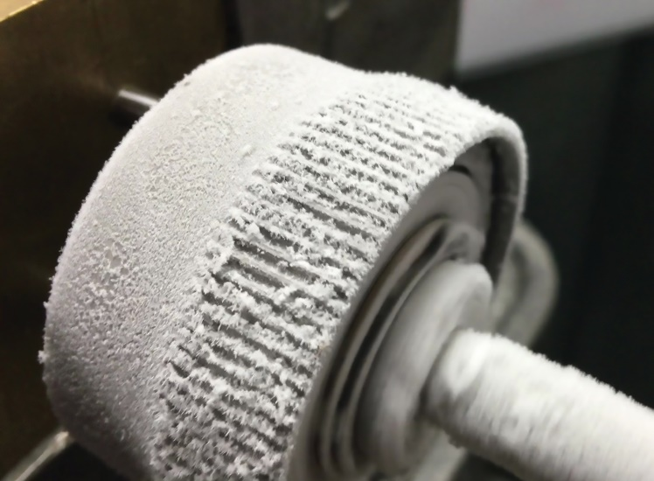
Metallic Glass Coatings Improve Power Plant, Oil Rig Productivity
Johnson Space Center
Liquidmetal Coatings LLC
Spring, Texas
NASA Technology
Since the 1980s, NASA has supported research into a material with the atomic structure of glass, more toughness than metal, and the versatility of plastic
Aluminum wheels are lightweight but get damaged on the rough terrain of Mars; more durable materials are often very heavy
Technology Transfer
NASA tested a metallic glass coating on rover wheels to protect the structure without adding weight
Liquidmetal Technologies licensed the original NASA-funded metallic glass patents and developed many products
In 2012, the company spun off its coatings division, developing new coatings and application methods
Benefits
Metallic glass coatings can be used anywhere corrosion, wear, and erosion are an issue
Liquid metal-coated boiler tubes at a biomass-fired power plant lasted for more than four years, compared to less than a year with other coatings
The oil and gas industry and paper and pulp industries make extensive use of the coatings
Spinoff 2020
Industrial Productivity

Slide 50
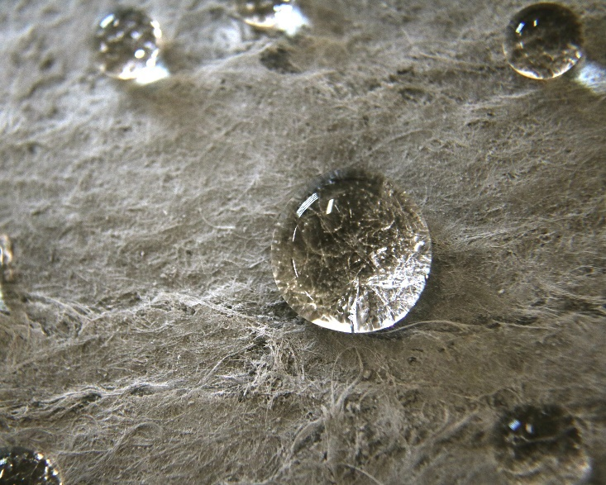
Aerogel Insulations Save Millions in Industrial Applications
Kennedy Space Center
Aspen Aerogels Inc.
Northborough, Massachusetts
NASA Technology
The Space Agency has to manage large amounts of cryogenic liquids on the ground
NASA called for an insulation made with aerogel, which was an extremely effective insulator but also expensive, brittle, and fragile at the time
Technology Transfer
Small Business Innovation Research funded production of silica aerogel reinforced with ceramic fibers
The insulation performance was so high that a new device, dubbed Cryostat-1, had to be created to adequately assess the prototypes
Aspen Aerogels spun off from Aspen Systems to market resulting insulations
Benefits
Insulations are thin, sturdy, water repellant, easy to use, low maintenance, and cover broad range of temperatures
About 300 people manufacture almost 40 million square feet of Aspen Aerogel insulation per year
Used globally in industrial plants, steam distribution systems, buildings, pipelines, more
Spinoff 2020
Industrial Productivity

Slide 51
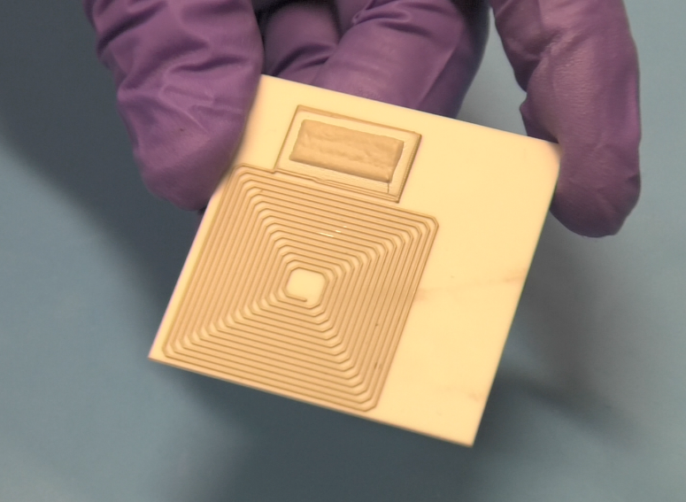
Revolutionary Battery Replacement Leads to a New Humidity Sensor
Marshall Space Flight Center
Roscid Technologies Inc.
Woburn, Massachusetts
NASA Technology
Understanding the reason for any failure is how NASA learns to make technology better
A failed battery system inspired research into developing a better battery—a solid, nontoxic, rechargeable power source that works in both hot and cold temperature extremes
Technology Transfer
NASA developed a new ultracapacitor designed to store energy that’s safer than batteries made with toxic liquids and gels
Testing by a NASA contractor proved it’s also remarkably sensitive to humidity
Two back-to-back evaluation licenses and a technology license resulted in a new solid-state humidity sensor
Benefits
The CBNS215 humidity sensor is a standalone technology for commercial applications
The material detects miniscule changes, easily sheds moisture so it doesn’t erode, and can withstand extreme heat and cold
Industries testing the CBNS215 include oil and gas, refrigeration, pharmaceuticals, aeronautics
Spinoff 2020
Industrial Productivity

Slide 52
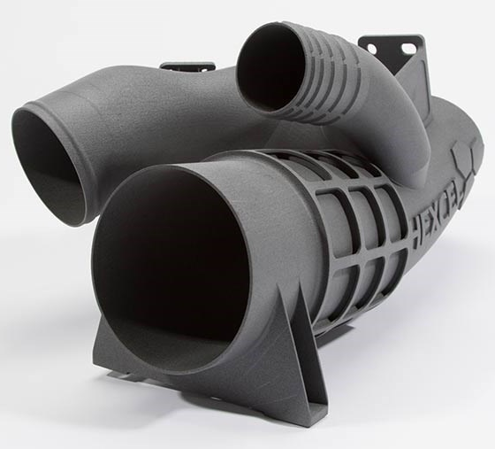
Printed Polymer Makes Integrated Airplane Parts
Goddard Space Flight Center
Hexcel Corporation
Stamford, Connecticut
NASA Technology
NASA has been exploring the use of 3D printing for a variety of spacecraft applications
It speeds up the development and production timeline for prototypes and enables replacement parts to be easily manufactured away from Earth
Research and testing were needed to mitigate risk
Technology Transfer
America Makes public-private partnership promoted research in and applications for additive manufacturing to broaden commercial potential
A thermoplastic called Polyetherketoneketone (PEKK) for 3D printing was proposed for testing
NASA funding supported America Makes, and the Agency participated in PEKK analysis, proposing 1,000 data points for space qualification
Benefits
NASA-funded testing enabled the company to demonstrate to customers printed PEKK showed almost no outgassing and resisted radiation
HexPEKK alloy and HexAM part fabrication process is in testing now for commercial airliners
Printing process lets multiple parts be combined into a single component, avoiding joints
Spinoff 2020
Industrial Productivity

Slide 53
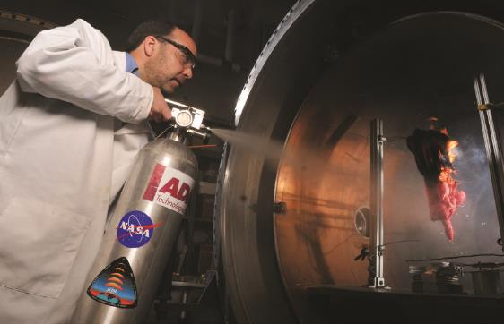
Zero-Leak Valve Holds Tight in Demanding Environments
Glenn Research Center
Doering Company LLC
Clear Lake, Minnesota
NASA Technology
Some fire extinguishers in NASA space vehicles and the U.S. modules of the space station contain carbon dioxide and halon, chemicals that can pose risks for humans and an enclosed environment, respectively
NASA needed a safer, hand-held fire suppression system what wouldn’t leak its contents
Technology Transfer
The zero-leak valve to meet NASA’s exacting specifications was designed to generate a fine water mist to quickly extinguish fires
The same valve is being incorporated into the next-generation fine-mist water fire extinguisher in development for the Orion spacecraft
Similar valves are now used in a number of industries on Earth where leaks are unacceptable
Benefits
The precision hardware offers a level of performance and safety that standard valves can’t achieve
The oil and gas industry relies on the zero-leak valve because it works well at any temperature
Automobile and industrial hydraulic applications are also benefiting
Spinoff 2020
Industrial Productivity

Slide 54

Pulsed Laser Innovations Power Nobel-Winners’ Research
Jet Propulsion Laboratory (JPL)
PolarOnyx Inc.
San Jose, California
NASA Technology
NASA needs more bandwidth to handle the ever-increasing amount of data sent to and from space
The Agency is developing optical systems for future communications
Lasers can send more data using a stronger signal and less power than current technology
Technology Transfer
Phase I and II Small Business Innovation Research contracts funded the development of short-pulse fiber lasers for optical communications from space
Where current systems offer data rates of about six megabits per second, the laser systems offer up to 100 megabits per second
Additional funding is continuing the development of fast-pulsed lasers and amplifiers
Benefits
Commercialized versions of the NASA fiber laser system are now used by research institutions, including Howard, Yale, and Stanford
The femto-laser pulses last just a quadrillionth of a second, even faster than the NASA system
Nobel-winning researcher Donna Strickland has used PolarOnyx lasers in her recent work
Spinoff 2020
Industrial Productivity

Slide 55

New Imaging Technique Measures Unseen Flows
Glenn Research Center
Tech4Imaging LLC
Columbus, Ohio
NASA Technology
Without gravity to help separate liquids and gases, NASA constantly seeks better ways to observe the behavior of these fluids in space
Improved electrical capacitance tomography could help monitor systems such as air and water purification in spacecraft
Technology Transfer
Small Business Innovation Research funding advanced Electrical Capacitance Volume Tomography (ECVT)
Multiplied electrical signals and a new sophisticated mapping software creates three-dimensional images
ECVT can measure the rate and amount of liquid, gas, and solid flowing by detecting shifting gradients in electrical capacitance
Benefits
Tech4Imaging is working with the oil and gas industry to develop a product for pipelines
Ohio State University faculty validated a product measuring powder and airflows in pharmaceutical manufacturing
Other applications include infrastructure testing, manufacturing optimization/monitoring, mining
Spinoff 2020
Industrial Productivity

Slide 56

Separation Device Launches New Science Payloads
Goddard Space Flight Center
Planetary Systems Corporation
Silver Spring, Maryland
NASA Technology
The Interstellar Boundary Explorer IBEX needed two rocket engines, which had to be carefully separated from the spacecraft and each other during flight
Off-the-shelf separation systems were too heavy, so the team worked with Planetary Systems to improve and shrink the company’s devices, called Lightbands
Technology Transfer
Metal rings attached to the spacecraft and clamped to each other by an inner ring separate when an electric motor activates a series of springs to push them apart
Exhaustive testing to meet NASA’s needs left a wealth of data that have benefited later customers
The IBEX success inspired a larger NASA mission
Benefits
Every Lightband Planetary Systems now builds makes use of improvements pioneered for IBEX
The device is 17 percent lighter
Around 40 Lightbands a year go to government, military, and commercial clients
The company doubled in size since the IBEX mission
Spinoff 2020
Industrial Productivity

Slide 57

Tiny Pulsed Lasers Have Medical, Industrial, Military, Environmental Applications
Goddard Space Flight Center
Q-Peak Inc.
Bedford, Massachusetts
NASA Technology
The Mars 2020 rover needed to pack more technology and functionality into the about same space as Curiosity, so everything had to get smaller
The laser for miniaturized laser-induced breakdown spectroscopy (LIBS) instrument may help rover search for signs of past microbial life on Mars
Technology Transfer
Small Business Innovation Research funding developed a pulsed laser source far smaller and more efficient than anything on the market
Engineering, packaging, and material choices reduced the laser to matchbox size, while other lasers of comparable power are shoebox-sized
Moonbow laser is marketed as the smallest laser of its kind
Benefits
Moonbow can be used in LIBS, Raman, and fluorescence spectroscopy
The Moonbow CB-G laser source is being incorporated into a small, portable, rugged unit to perform glaucoma treatment in the field
Lidar and non-lethal weaponry are other potential applications
Spinoff 2020
Industrial Productivity

Slide 58

Electrostatic Discharge Training Improves Manufacturing Practices
Goddard Space Flight Center
RMV Technology Group LLC
Moffett Field, California
NASA Technology
Electrostatic charge built up from simply walking can destroy sensitive electrical equipment such as the circuit boards that NASA uses
Protocols to avoid discharge prevent failures and the added cost of expensive replacement parts, but technicians need hands-on training for best results
Technology Transfer
NASA hired RMV to offer training in electrostatic discharge prevention, working with RMV to tailor the course to NASA’s processes and materials
At NASA’s request, RMV added modules on recognizing counterfeiting, to ensure outside suppliers meet required specifications
The company launched a subsidiary, ESD Aerospace Training, to market the course
Benefits
NASA and the Department of Defense have similar training requirements, so the U.S. military is benefiting from the new, deep-dive training
Commercial aerospace industry can also benefit
RMV partnered with an outside group to create an ESD Aerospace and Defense Engineer certification, earned with the training
Spinoff 2020
Industrial Productivity

Slide 59


Slide 60

Visit the Spinoff website for more examples of NASA technology transfer: http://spinoff.nasa.gov

