Slide 1
National Aeronautics and Space Administration
www.nasa.gov

Slide 2
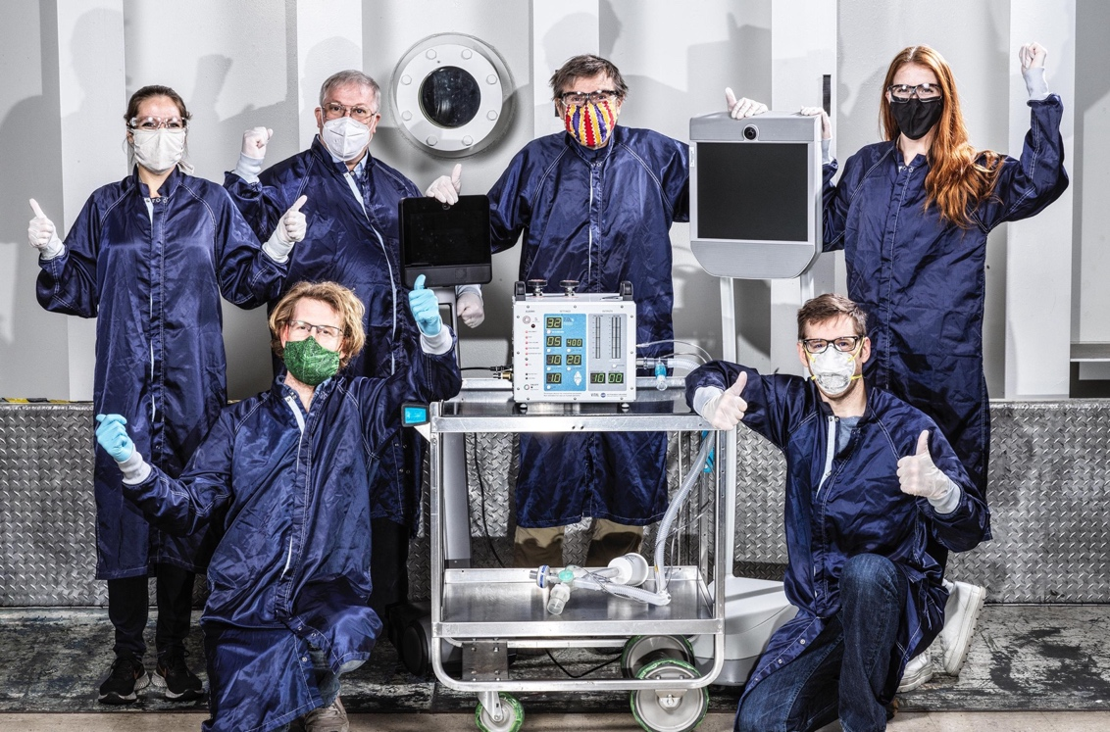
NASA’s VITAL Contribution to Global Pandemic Relief
NASA-designed ventilator helps save lives in developing nations
During the early stages of the COVID-19 Pandemic, engineers at the Jet Propulsion Laboratory designed a ventilator that could be produced quickly and cheaply. This design has since been licensed by several firms around the world and used to provide aid in countries with inconsistent medical infrastructure.

Slide 3
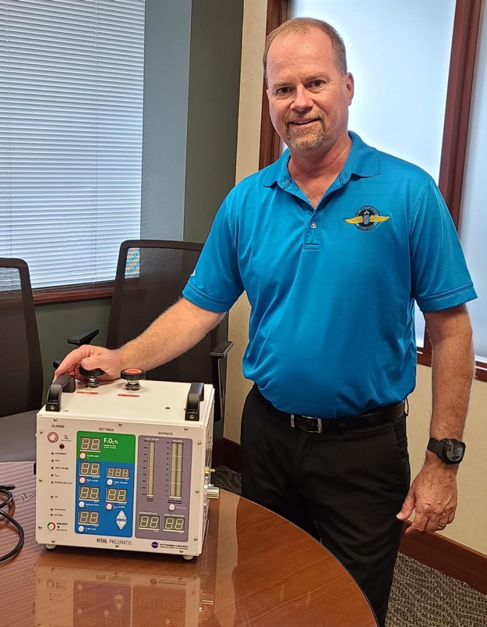
Ensuring Vitality
Jet Propulsion Laboratory
STARK Industries: San Francisco, CA
STARK Industries of Columbus, Ohio, licensed VITAL from NASA and spun off new company Spiritus Medical to distribute the ventilator around the world.

Slide 4
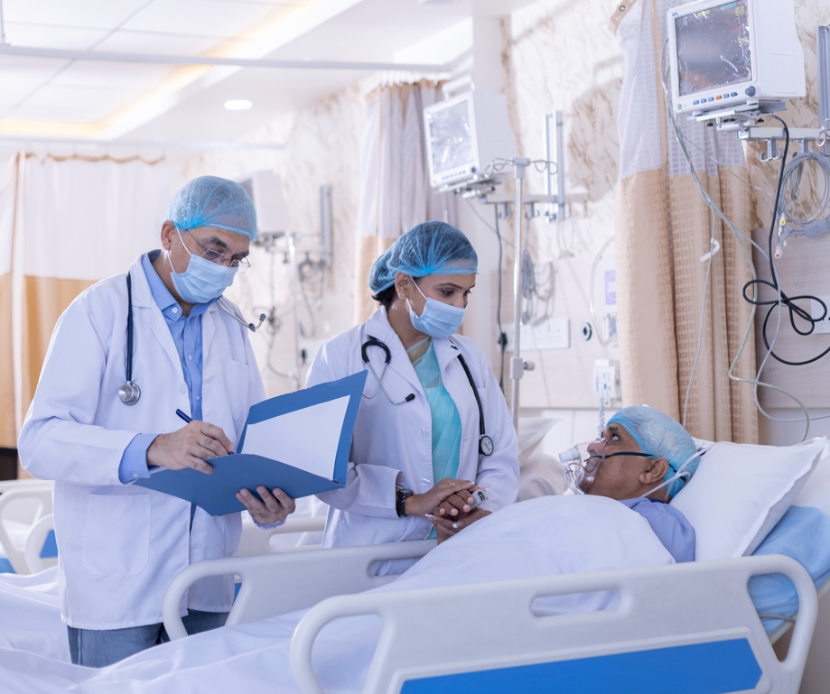
Forging a New Path
Jet Propulsion Laboratory
Bharat Forge: Prune, India
Bharat Forge Of Pune, India licensed VITAL to save lives in the country’s more rural areas, and distribute to places in need around Asia and Africa.

Slide 5
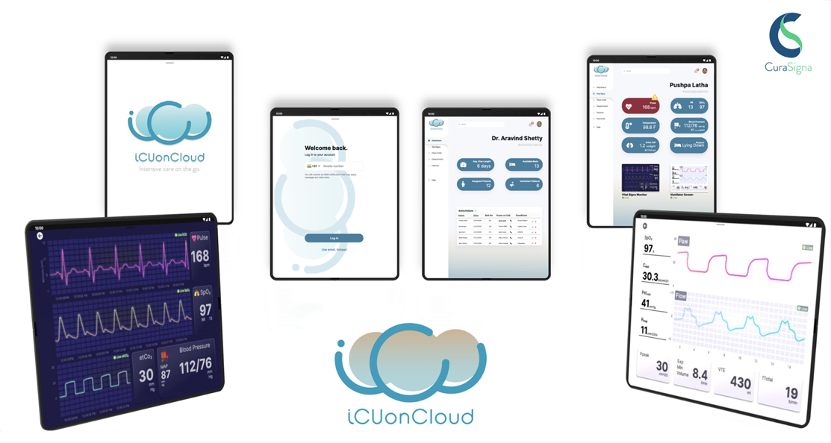
Intensive Care on the Cloud
Jet Propulsion Laboratory
CuraSigna: Bangalore, India
CuraSigna in Bangalore, India, licensed and integrated NASA’s VITAL ventilator design into a medical technology ecosystem for performing “virtual rounds” at intensive care units.

Slide 6
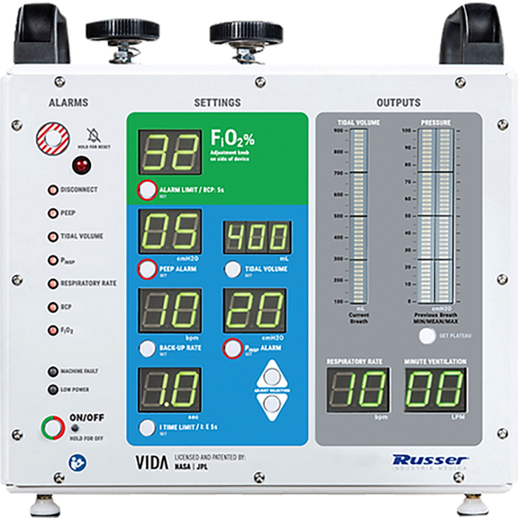
Saving Lives from Sao Paulo
Jet Propulsion Laboratory
Russer Brasil: Indaiatuba, Brazil
After licensing VITAL from NASA, Russer Brasil of Indaiatuba, Brazil, brought it into compliance with the country’s local requirements, selling hundreds of units.

Slide 7
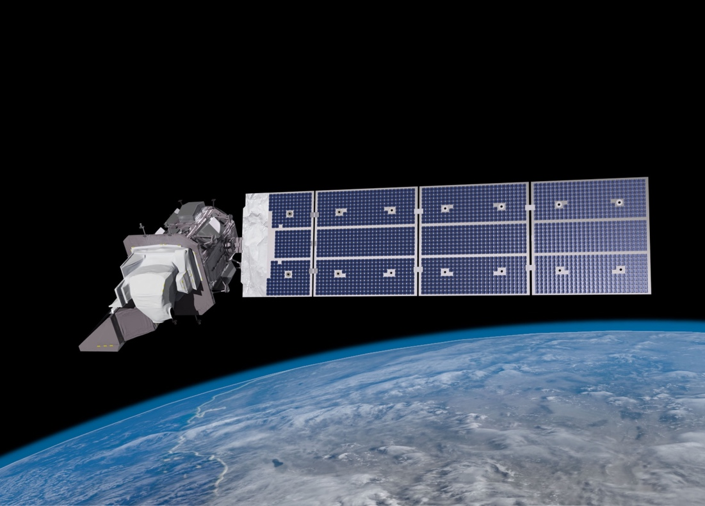
The View from Space Keeps Getting Better
After 50 years of Landsat, discovery of new commercial and scientific uses is only accelerating
For half a century, NASA-built Landsat satellites have been recording Earth’s surface, gathering science-grade imagery in various spectral bands. That data yields valuable information for farmers, water managers, food manufacturers, and countless others. It has also become the basis for many mapping applications for navigation, geolocation, and data visualization.

Slide 8
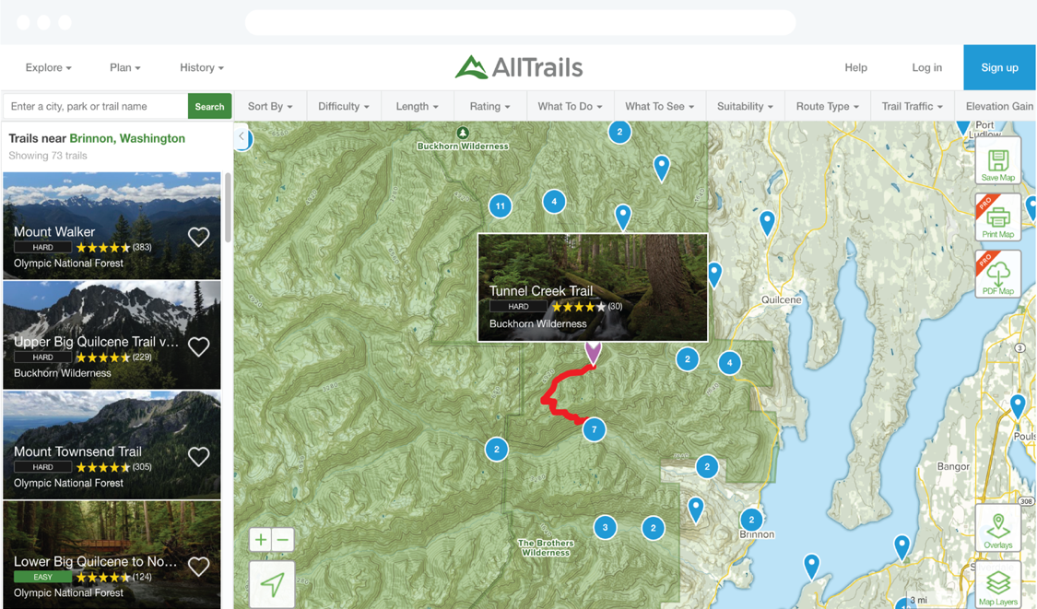
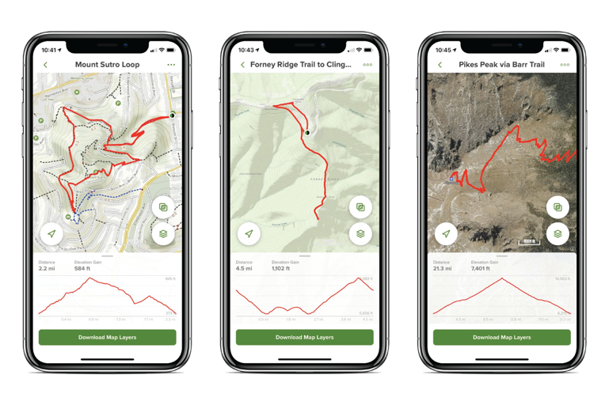
Landsat Maps a Path for Companies
Goddard Space Flight Center
Mapbox: Washington, D.C.
When it started, Mapbox Inc. of Washington, D.C., relied on Landsat imagery to build images of the planet. Today, Mapbox, which provides a platform and data for developers to build map-based applications, is a $1 billion company with dozens of household names among its customers.

Slide 9
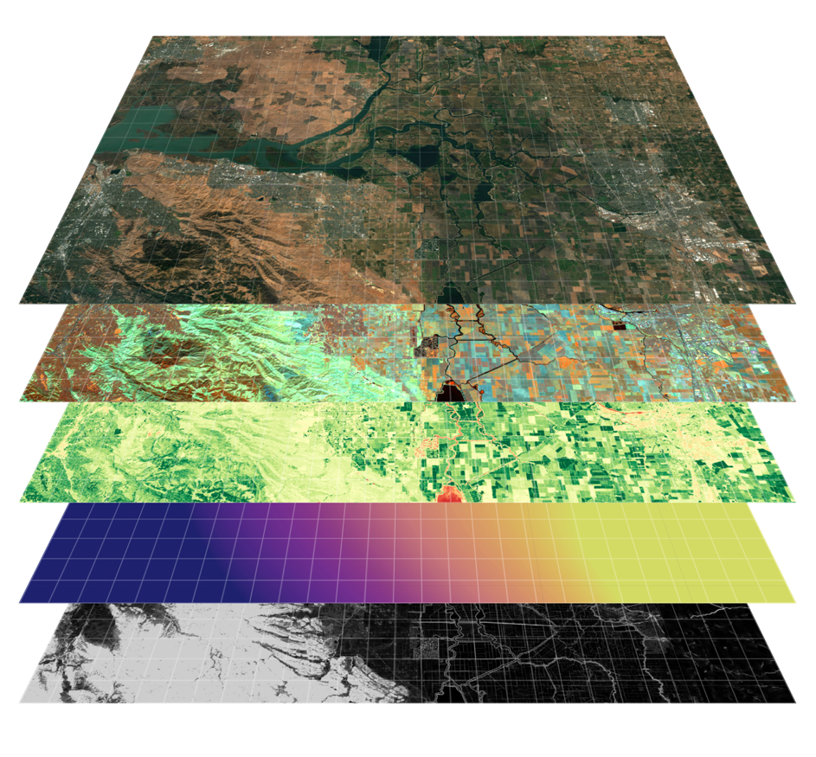
New Image Analysis Supports New Farming Techniques
Goddard Space Flight Center
Perrenial: Boulder, CO
Perennial Inc. of Boulder, Colorado, learned how to use data from Landsat and other satellites to determine soil carbon levels. Now the company helps farmers who want to earn carbon credits for changing their practices, food companies that want to reduce their carbon footprints, and many others.

Slide 10
Pulling Moisture Data from the Air
Goddard Space Flight Center
Baker Family Farm: Sacramento County, CA
Situated in the river delta that supplies most of California’s freshwater, Brett Baker’s family pear farm is required to monitor its water use. It was impossible to get useful data, though, until the release of OpenET, a platform that uses Landsat data to calculate evapotranspiration.

Slide 11
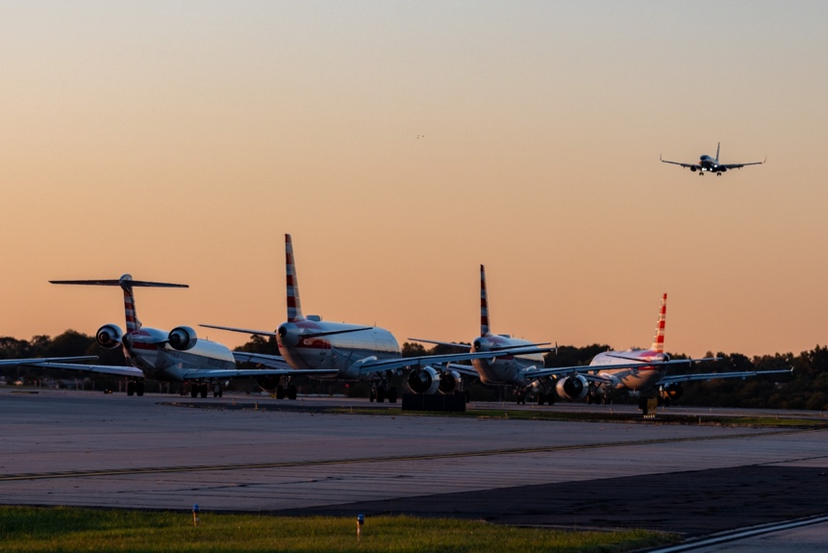
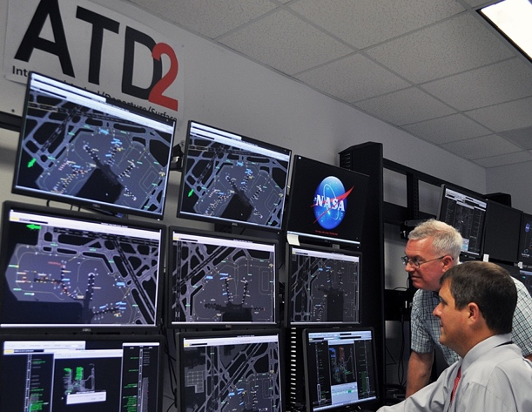
An Electronic Traffic Monitor for Airports
Ground traffic management program saves passengers and airlines time while cutting fuel costs
A collaboration between NASA, the Federal Aviation Administration, and the private sector developed and tested a new program to manage airport traffic on the ground – the Integrated Arrival, Departure, and Surface (IADS) system – leading to shorter wait times for passengers, less air pollution, and significant cost savings.

Slide 12
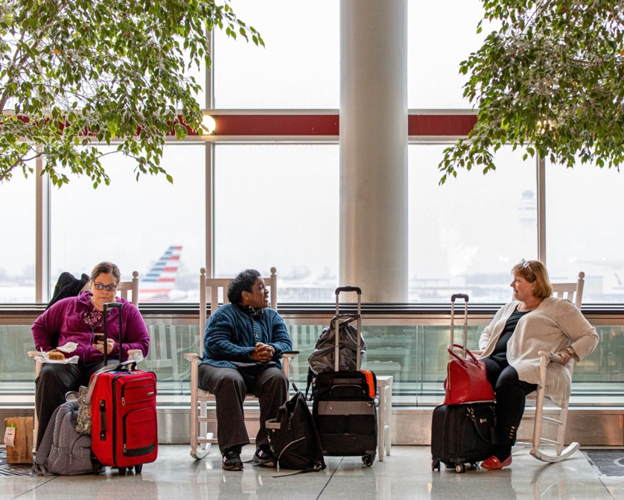
Ending Tarmac Gridlock
Ames Research Center
Charlotte Douglas International Airport: Charlotte, NC
Charlotte Douglas International Airport in North Carolina, the second-busiest airport on the East Coast, hosted the IADS system development. Giving passengers time in the terminal to grab a meal or charge their phones is one benefit of efficient takeoff scheduling that means less time spent on the tarmac waiting to take off.

Slide 13
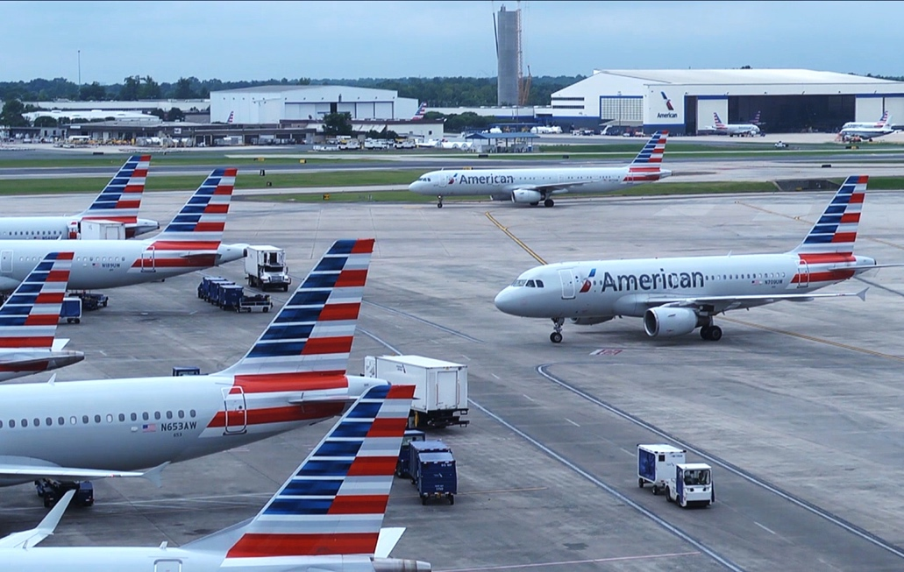
A Million Baby Steps
Ames Research Center
American Airlines: Fort Worth, TX
Fort Worth, Texas-based American Airlines Inc. gave NASA a wealth of information about everything from wait times and crew schedules to ground services. In return, the IADS system helped the airline save millions of gallon of jet fuel, eliminating tons of carbon from the environment.

Slide 14
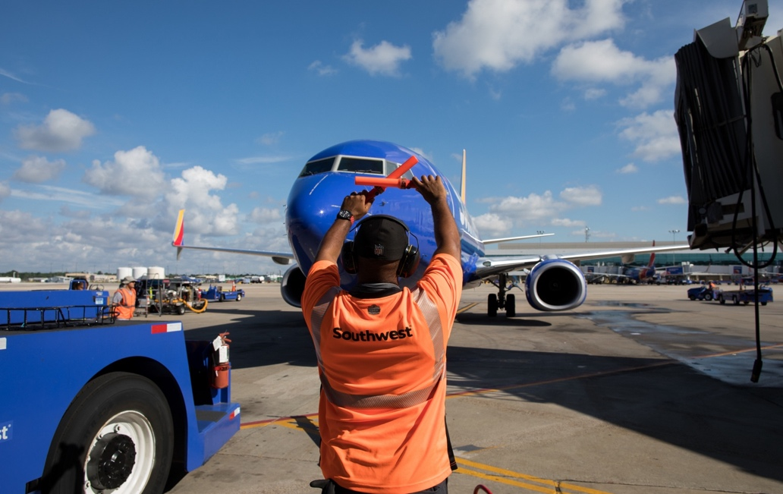
Filling the Gaps
Ames Research Center
Southwest Airlines: Dallas, TX
Dallas-based Southwest Airlines Co . tested and provided feedback on the IADS feature that enables airlines to review and revise flight routes and request changes. The opportunity to avoid restrictions that can cause delays contributes to more efficient operation, which translates into cost savings.

Slide 15
Weather Forecasters Adopt NASA’s ‘Occult’ Science
Radio occultation, pioneered by NASA for other planets, offers cheaper, better Earth weather data
Decades ago, NASA invented radio occultation, a technique that used radio waves to study the atmospheres of other planets. Now the proliferation of navigation satellites in Earth orbit – and a few companies’ specially outfitted small satellites – will enable more accurate weather readings on Earth.

Slide 16
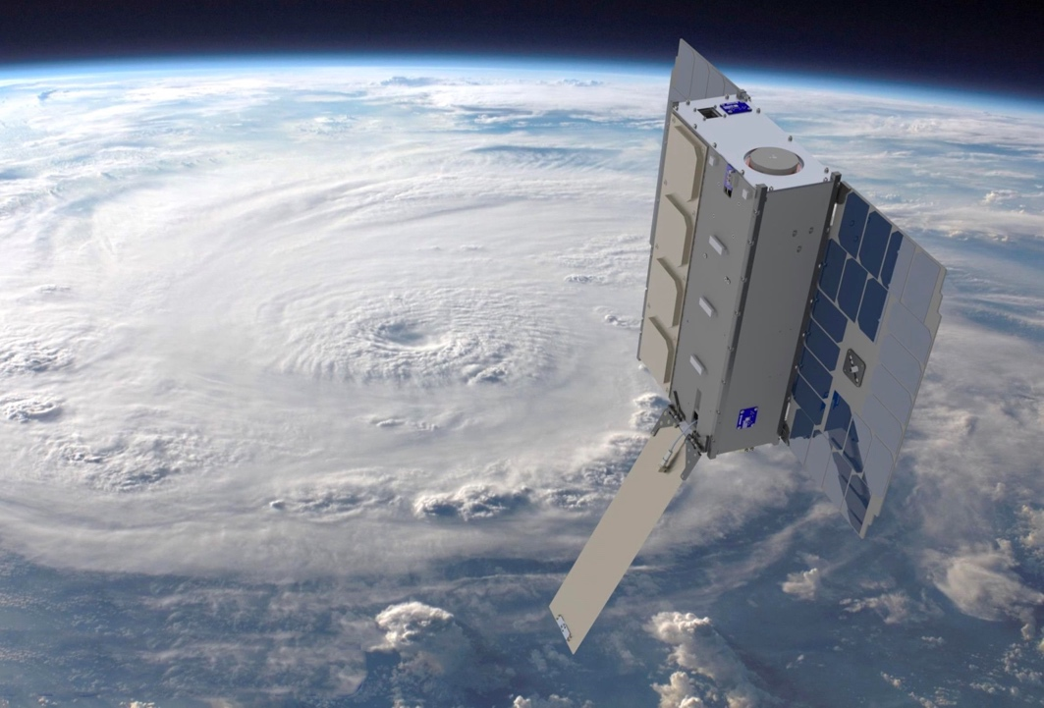
GPS Guides Radio Occultation Home
Jet Propulsion Laboratory
GeoOptics: Pasadena, CA
In the 1980s, a NASA scientist and future founder of GeoOptics proposed repurposing a technique NASA had pioneered for learning about other planets’ atmospheres to sound Earth’s atmosphere. Now the Pasadena, California company offers atmospheric data to improve weather forecasts.

Slide 17
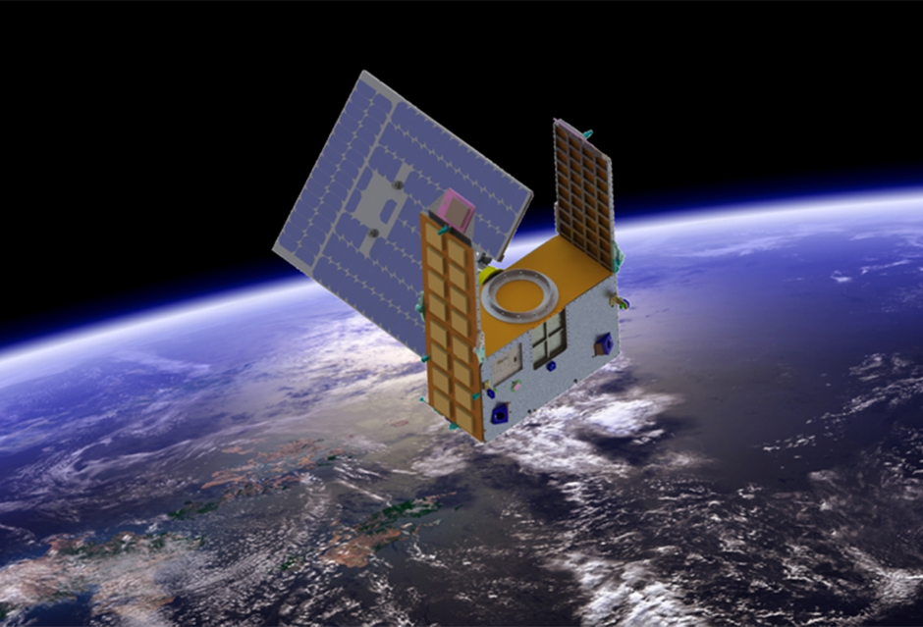
Divining the Future of Occultation Arts
Jet Propulsion Laboratory
PlanetIQ: Golden, CO
Having used radio occultation to gather information about other planets’ atmospheres, a former NASA scientist founded PlanetIQ in Golden, Colorado, to put the technique to use for Earth, commercializing atmospheric data for weather forecasting and other applications.

Slide 18
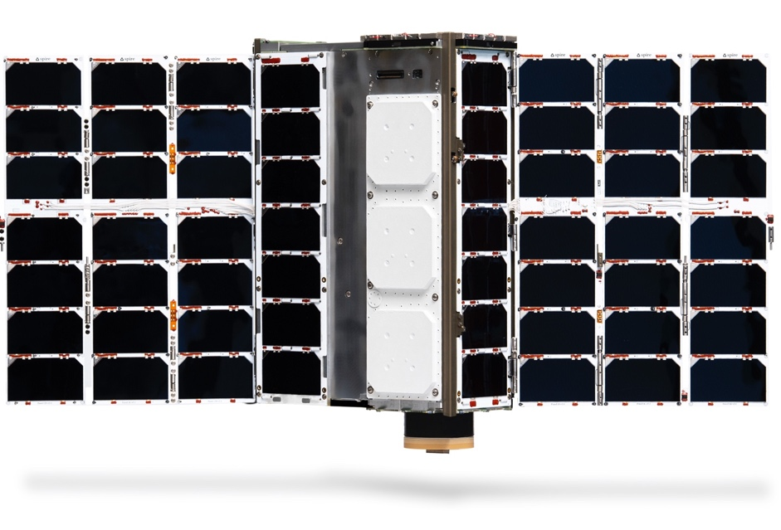
Little LEMURs Have Big Eyes
Jet Propulsion Laboratory
Spire Global : Vienna, VA
Spire Global of Vienna, Virginia, was founded to inexpensively collect large, valuable datasets with a constellation of CubeSats in orbit. Dozens of the company’s satellites now use a technique NASA invented to sound the atmosphere for weather and climate data.

Slide 19
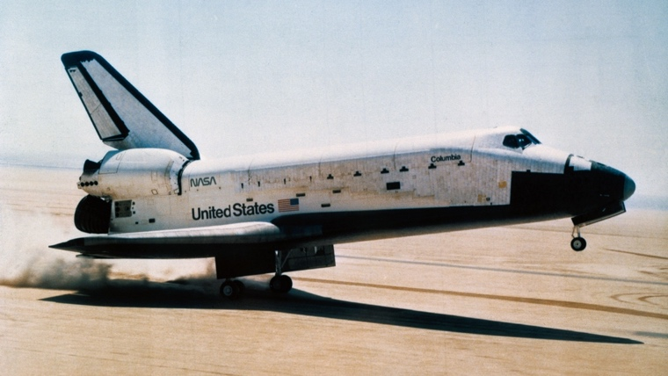
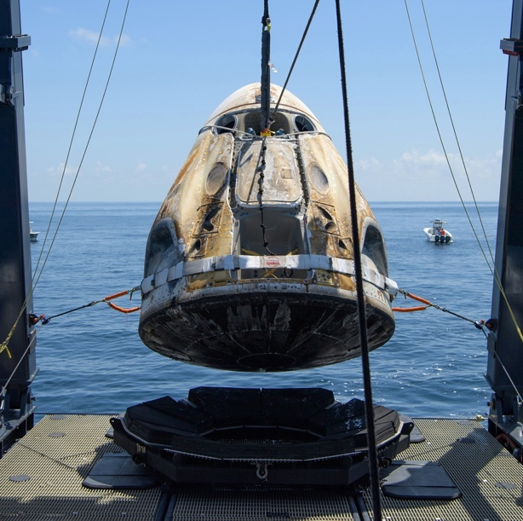
Shuttle-Analysis Software Improves Airplane, Turbine Safety
Crack-growth software that started with shuttle program has become global standard
NASA invented the NASGRO fracture-mechanics software to ensure the space shuttle’s safety. Now licensed through a separate research institute, NASGRO is used by almost a thousand companies, including aircraft and spacecraft manufacturers and turbine producers.

Slide 20
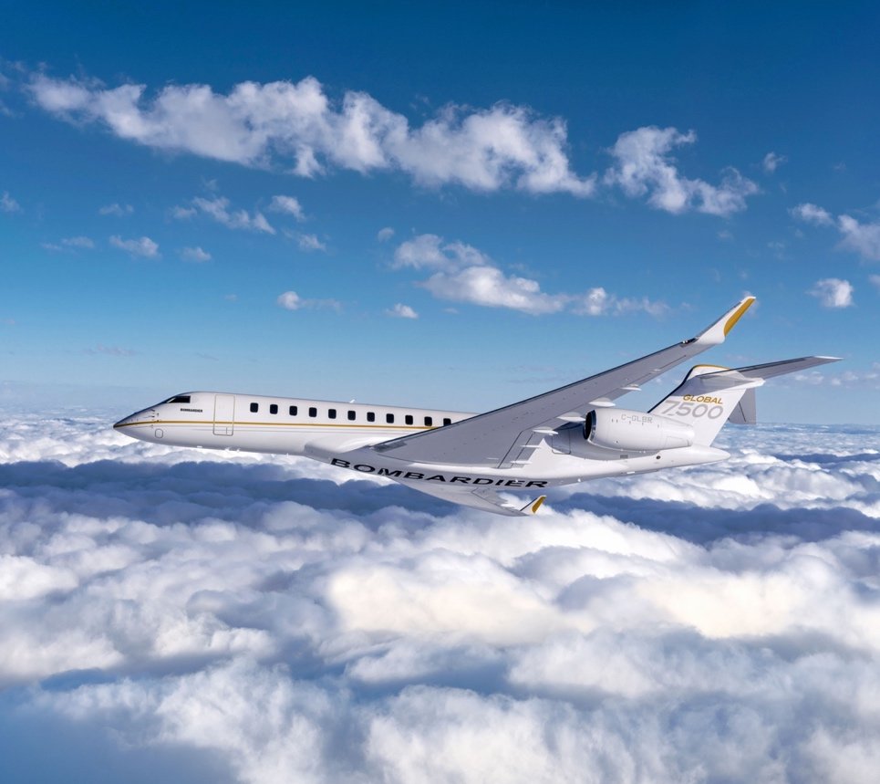
Competitors Cooperate to Ensure Safety
Johnson Space Center
Bombardier: Wichita, KS
Bombardier, with U.S. headquarters in Wichita, Kansas, is one of many aircraft manufacturers that licenses NASA’s fracture-mechanics software to design planes with optimal strength and weight and write repairs and maintenance schedules, ensuring their safety.

Slide 21
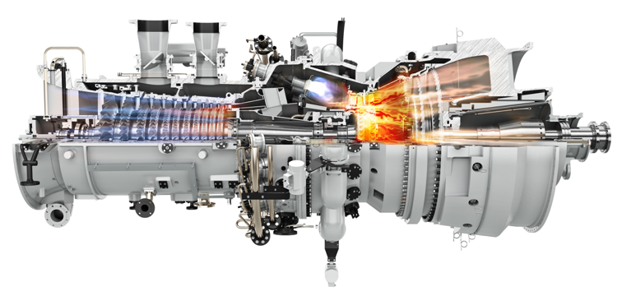
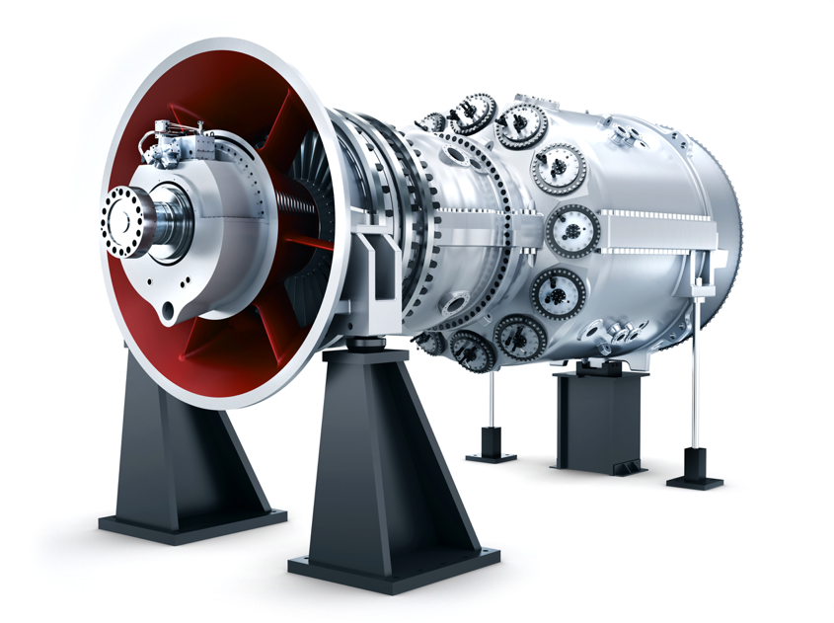
More Reliable Power to the People
Johnson Space Center
Siemens Energy: Orlando, FL
Siemens Energy, whose U.S. headquarters is in Orlando, Florida, licenses NASA’s fracture-mechanics software and helped modify it for gas turbine manufacturers. Siemens uses the program to design safe, huge, high-temperature turbines powering electrical grids.

Slide 22
A High-Tech Farmer’s Almanac for Everyone
NASA satellite data and climate modeling supports the development of crucial climate-resilience tools
A combination of NASA data with open-source analytics and NASA Earth science expertise is making it possible for the private sector to access the power of Earth-observation satellite data to navigate the challenges introduced by climate change.

Slide 23
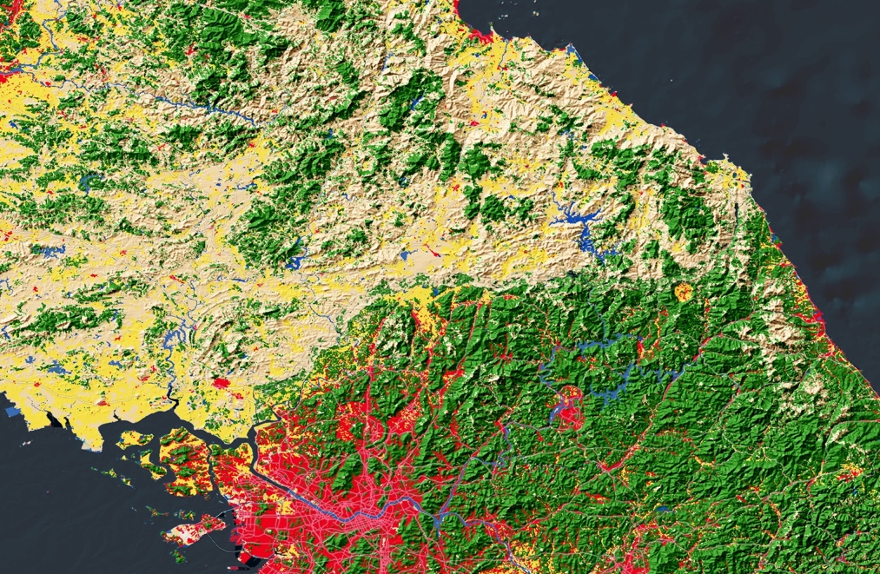
‘Flying Blind’ into the Future
Goddard Space Flight Center
Healthe: Redlands, CA
Partnering with NASA to standardize decades of Earth-observation datasets and move them into the cloud, Redlands, California-based Esri helped give everyone access to climate data. The company develops tools to support businesses building their climate resilience efforts.

Slide 24
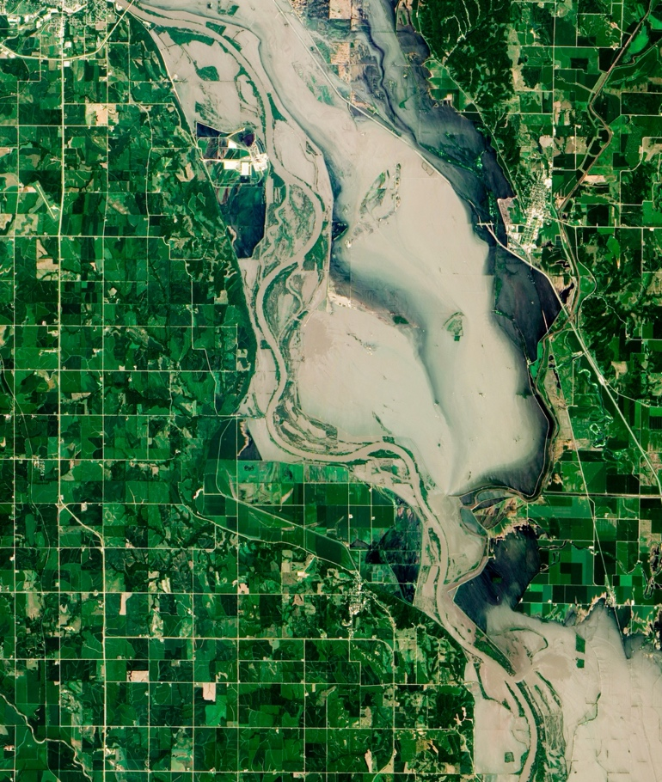
Water, Water Everywhere
Goddard Space Flight Center
First Street Foundation: Brooklyn, NY
A state-of-the-art flood risk modeling tool developed by Brooklyn, New York-based First Street Foundation uses NASA Earth-observation data and open-source analytics to assess flood risk for any U.S. address, making it a valuable resource for property developers, businesses, and homeowners.

Slide 25
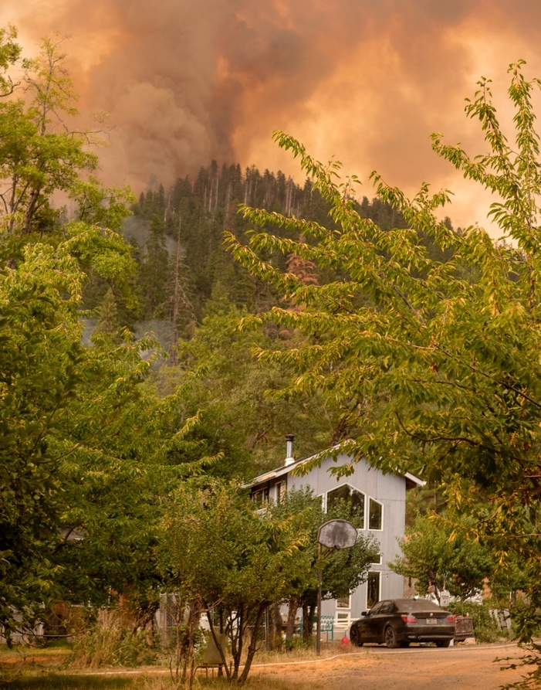
World on Fire
Goddard Space Flight Center
Delos Insurance Solutions: San Francisco, CA
A proprietary wildfire prediction model developed by Delos Insurance Solutions of San Francisco combines NASA data and open-source analytics with current climate science to offer property owners accurate risk assessments and the appropriate insurance.

Slide 26
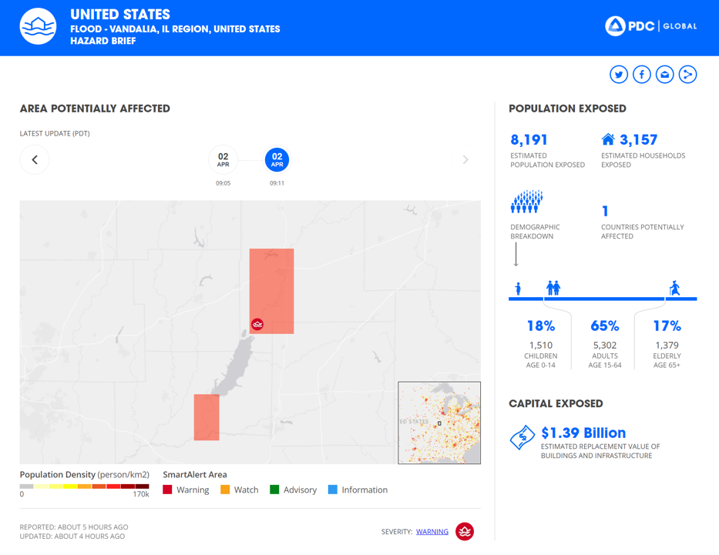
An Ounce of Prevention
Goddard Space Flight Center
Tenefit: San Jose, CA
Disaster risk prediction and near-real-time progress reports provided by San Jose, California-based Tenefit let companies mitigate impacts of weather-related disasters in a changing climate with a combination of NASA data, open-source analytics, and other datasets.

Slide 27
Spinoff Features
We are always advancing technology to enable exploration of our home planet and beyond. The following slides give a glimpse of some more ways this technology improves life on the ground.

Slide 28
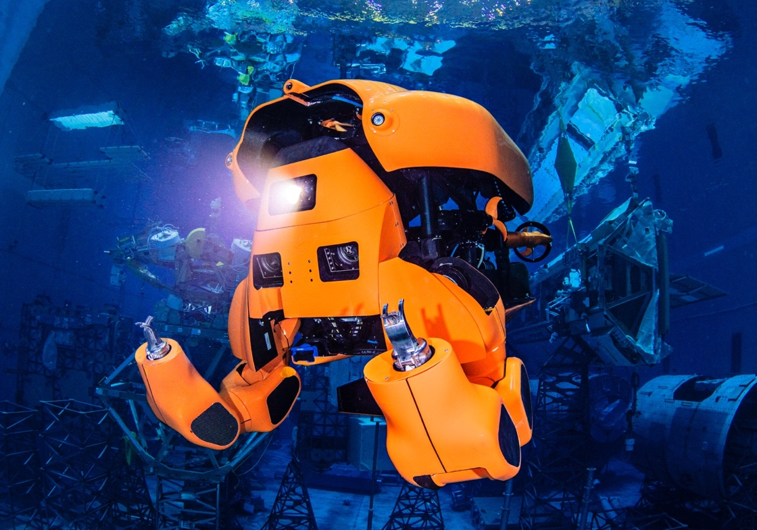
Space Robotics Take a Deep Dive
Aquanaut, built on lessons from NASA’s robot astronaut, will cut costs for ocean industries
Johnson Space Center
Nauticus Robotics: Houston, TX
Many of the engineers at Houston’s Nauticus Robotics built NASA robots, designed to operate in harsh, remote environments. Now they’ve applied that knowledge to an underwater robot that can carry out offshore operations with minimal support.

Slide 29
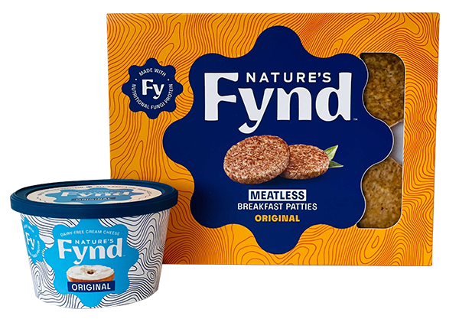
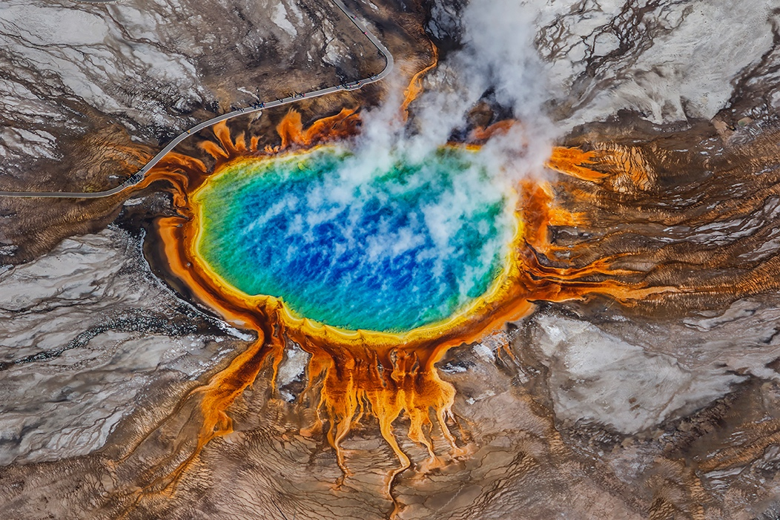
NASA Helps Serve Yellowstone Fungi for Breakfast
An organism found in the park is a sustainable protein on Earth and in space
NASA Headquarters
Nature’s Fynd: Chicago, IL
A microbe found in Yellowstone National Park during NASA-funded research is now the basis of a fungal protein from which Chicago-based Nature’s Fynd produces meat-alternative breakfast patties and non-dairy cream cheese.

Slide 30
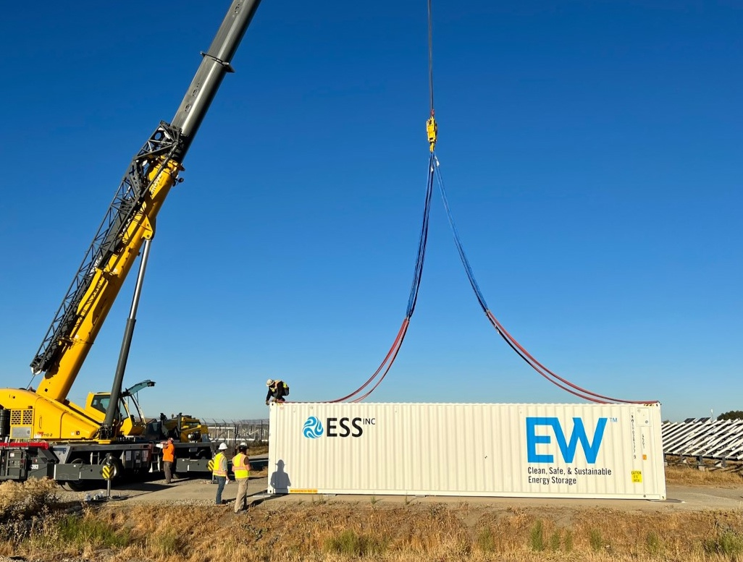
Giant Batteries Deliver Renewable Energy When It’s Needed
Flow battery company revives NASA research after nearly 50 years
NASA Headquarters
ESS: Wilsonville, OR
Wilsonville, Oregon-based ESS drew from NASA research to develop an all-natural, nontoxic flow battery that can store energy from wind and sunlight and deliver it when it’s needed.

Slide 31
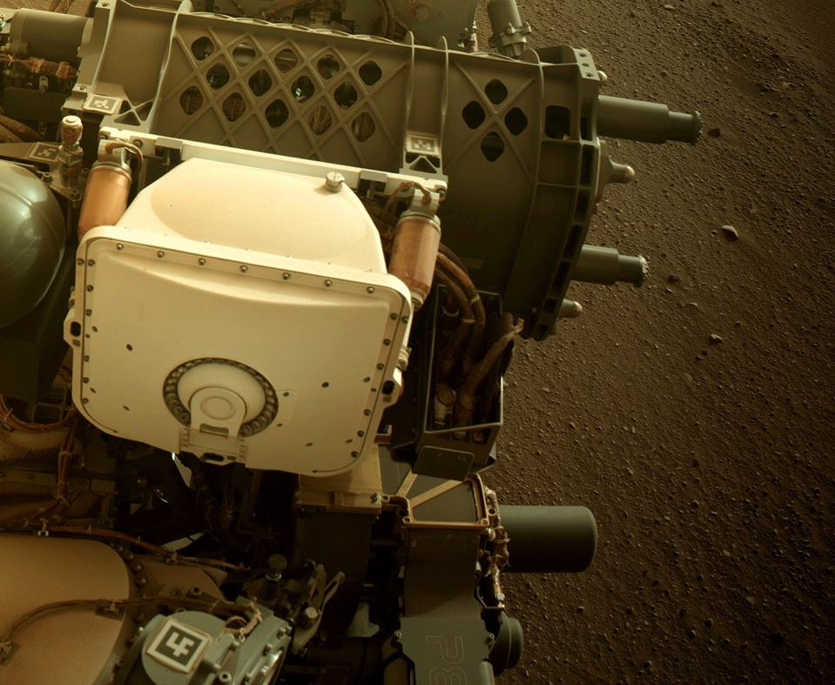
Cloning Metal Parts for Space and Earth
Software for modeling metal parts before 3D printing speeds development, cuts costs for NASA and business
Jet Propulsion Laboratory
Sentient Science: Buffalo, NY
A physics-based modeling program partly funded by NASA STTR contracts, called DigitalClone for Additive Manufacturing, tests virtual metal parts before fabrication. Many industries can benefit from the cloud-based software developed by Buffalo, New York-based Sentient Science.

Slide 32
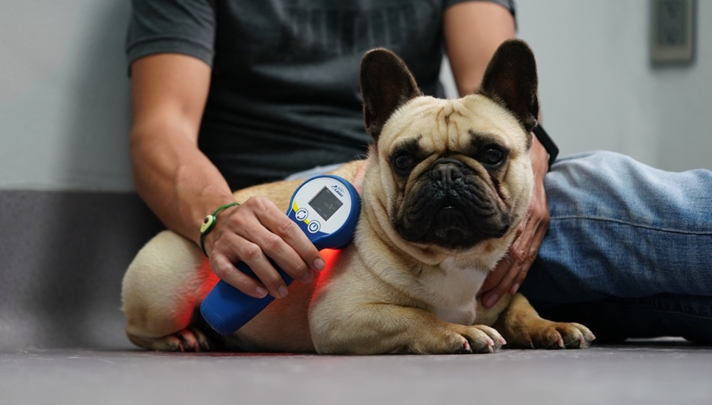
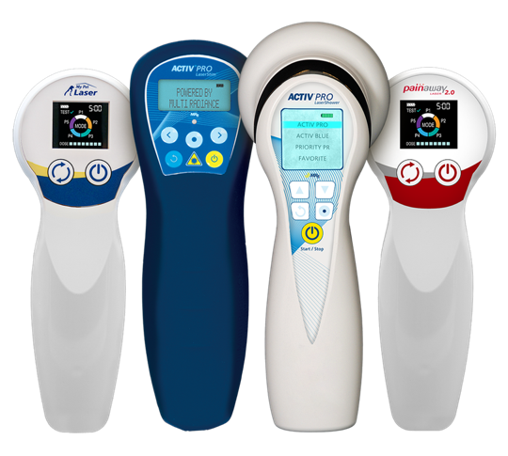
NASA Research Illuminates Medical Uses of Light
Experimentation helped demystify, legitimize, and simplify medical uses for long-known but little-understood light therapy
Marshall Space Flight Center
Multi Radiance Medical: Solon, OH
Multi Radiance Medical of Solon, Ohio, builds light-therapy devices based in part on NASA-funded research. NASA helped with experiments confirming the efficacy of light treatments for certain health applications and proving they could use safe, portable LED technology.

Slide 33
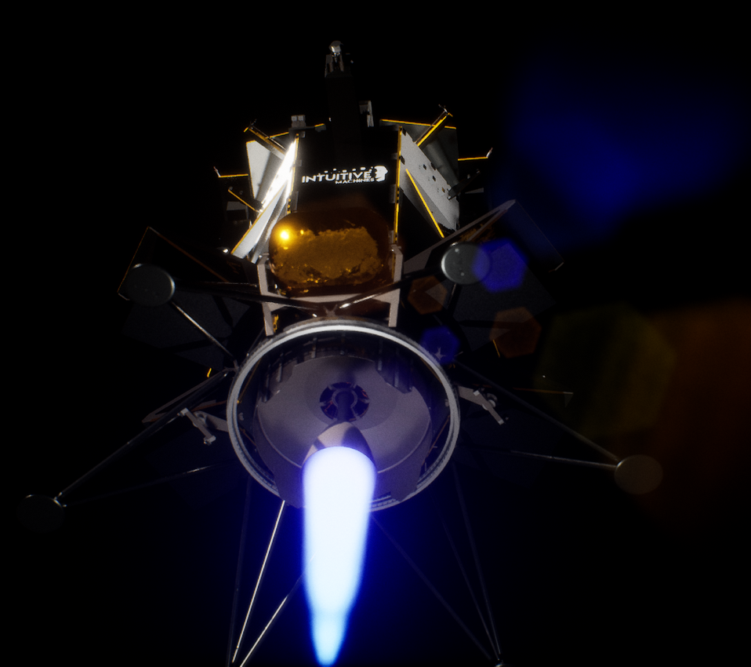
With NASA’s Help, the Moon Becomes a Commercial Destination
First of many commercial landers are headed to the Moon, paving the way for future missions
Johnson Space Center
Intuitive Machines: Houston, TX
Former NASA engineers at Houston-based Intuitive Machines created a lunar lander by applying both their experience building a NASA lander and support from NASA’s Commercial Lunar Payload Services program. The Nova-C will carry commercial and NASA payloads to the Moon.

Slide 34
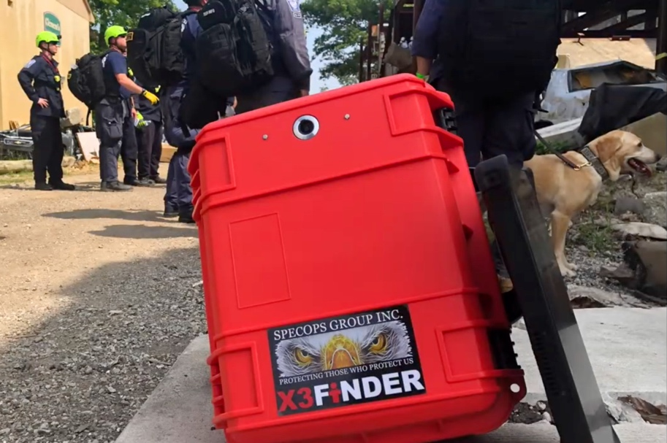
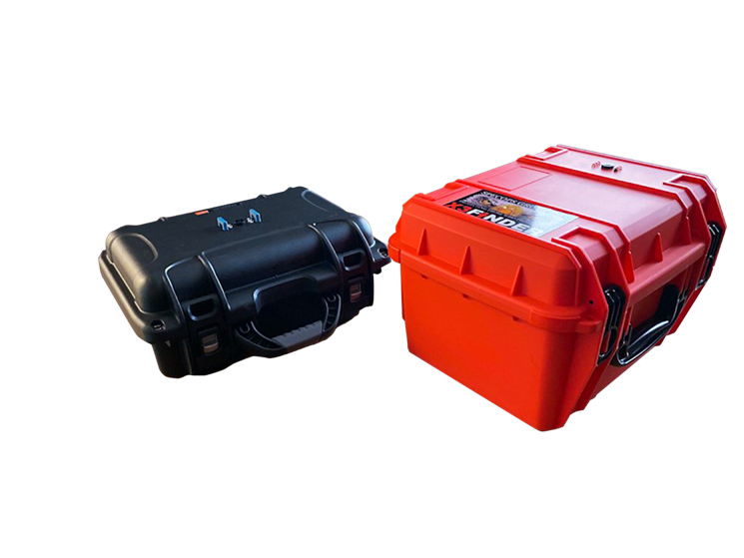
FINDER Finds Its Way into Rescuers’ Toolkits
NASA-designed technology helps find trapped individuals in the wake of disaster
Jet Propulsion Laboratory
SpecOps Group: Sarasota, NY
SpecOps Group of Sarasota, Florida, licensed a technology NASA developed to find people buried under dense material or rubble after a natural disaster and is now selling a version to public safety departments around the world.

Slide 35
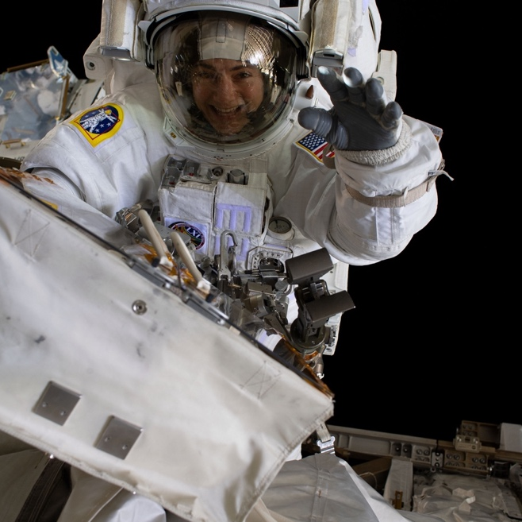
Space Radiation Research Fights Cancer on Earth
Research into a novel method for detecting molecular damage in astronaut DNA led to a new cancer test
Johnson Space Center
Promega: Fitchburg, WI
NASA-funded research found that certain segments of DNA can be used to measure the radiation damage astronauts experience while in space. Fitchburg, Wisconsin-based Promega used the technique to create OncoMate MSI Dx Analysis System, a diagnostic test that helps customize cancer treatment.

Slide 36
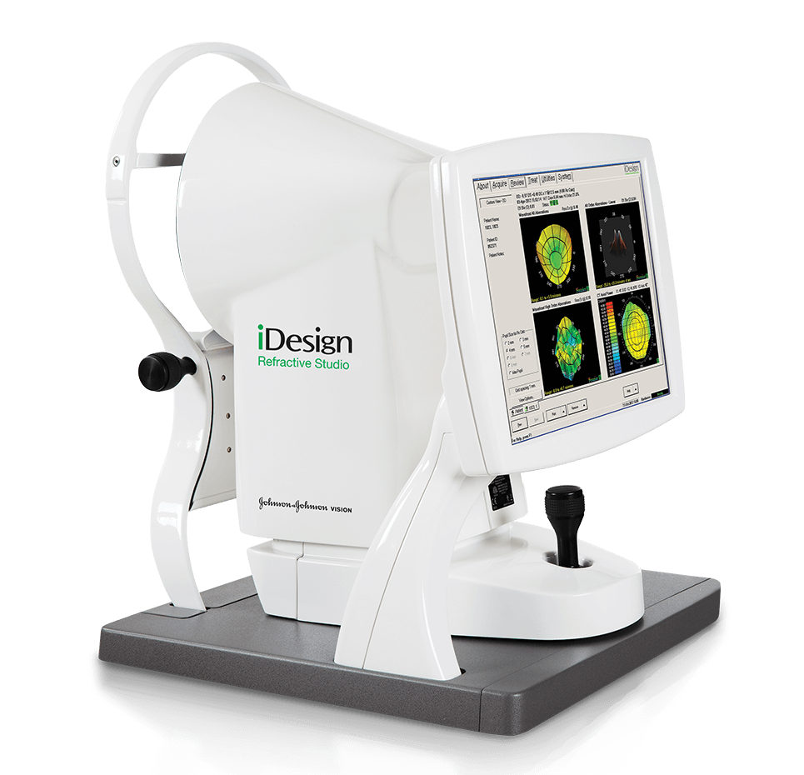
Telescope Mirror Tech Improves Eye Surgery
Technology to measure Webb mirrors boosts LASIK eye surgery precision
Goddard Space Flight Center
Johnson & Johnson Vision: Santa Ana, CA
Early work on the Webb Telescope mirrors led to improvements in eye-mapping software that were incorporated into a system for guiding Lasik eye surgery that is now sold by Johnson & Johnson Vision of Santa Ana, California.

Slide 37
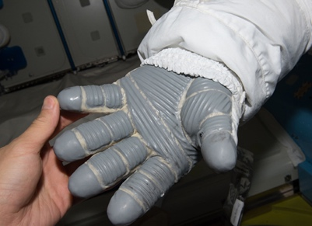
Feeling Hot, Staying Cool
NASA-funded technology helps relieve symptoms of menopause
Johnson Space Center
Fifty One: London, England
Using a temperature-controlling material developed in part under an SBIR from Johnson Space Center for spacesuit gloves, Fifty One Apparel of London is making clothes to alleviate the symptoms of menopause.

Slide 38
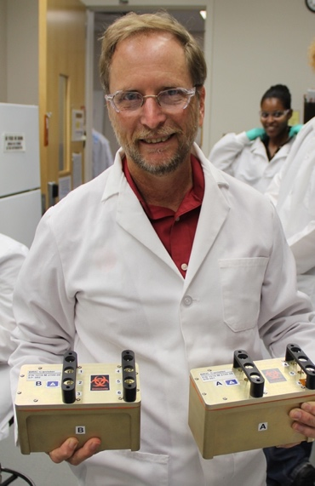
Astronaut Life Support for Earth Families
Grow towers for crops and seafood will soon drive self-sustaining shelters
Kennedy Space Center
Eden Grow Systems : Houston, TX
Eden Grow Systems of Houston built on decades of published NASA research and the expertise of a former Kennedy Space Center plant scientist to create automated, energy-efficient, aeroponic towers for growing crops and seafood.

Slide 39
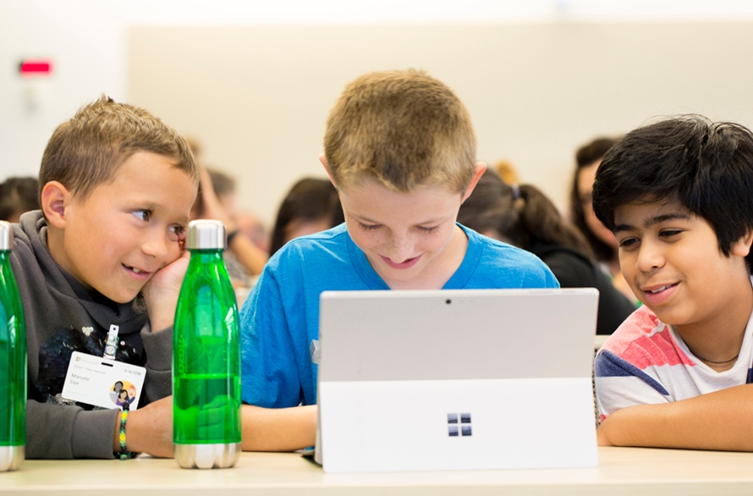
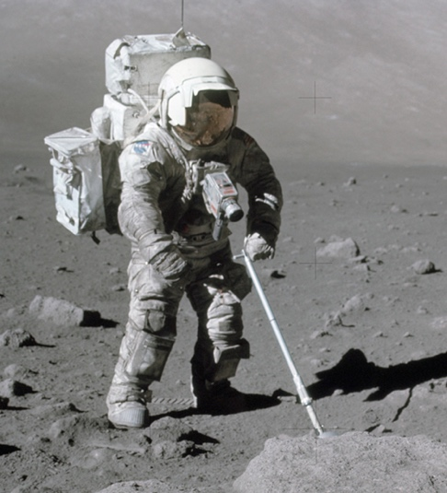
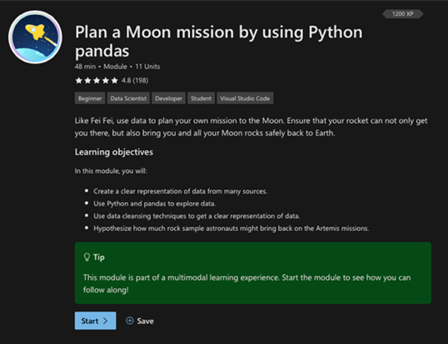
Learning to Code with NASA Data
Microsoft uses info and expertise from NASA to build STEM education lessons
NASA Headquarters
Microsoft: Redmond, WA
Under a Space Act Agreement, Microsoft of Redmond, Washington collaborated with the Office of STEM Engagement at NASA Headquarters to use NASA data and imagery in programming teaching materials.

Slide 40
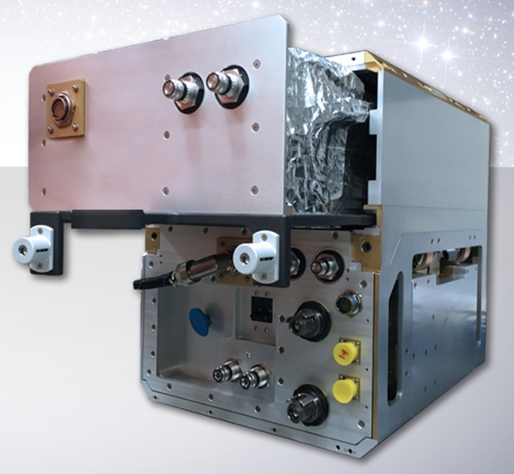
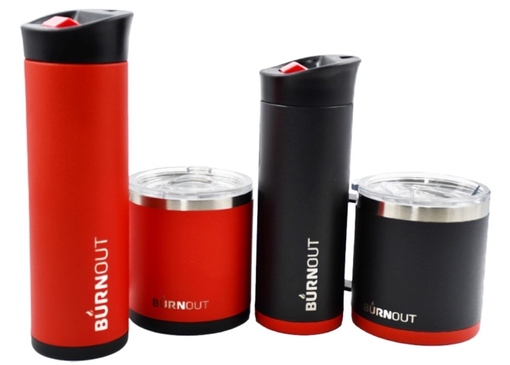
The Science of the Perfect Cup for Coffee
Phase-change material research is behind the design of a temperature-regulating mug
Johnson Space Center
ThermAvant International: Columbia, MO
A non-toxic phase-change material for a spacesuit thermal system originally tested by the Columbia, Missouri-based ThermAvant International LLC helps a mug transform scalding-hot coffee into a drinkable beverage in seconds and keep it warm for hours.

Slide 41
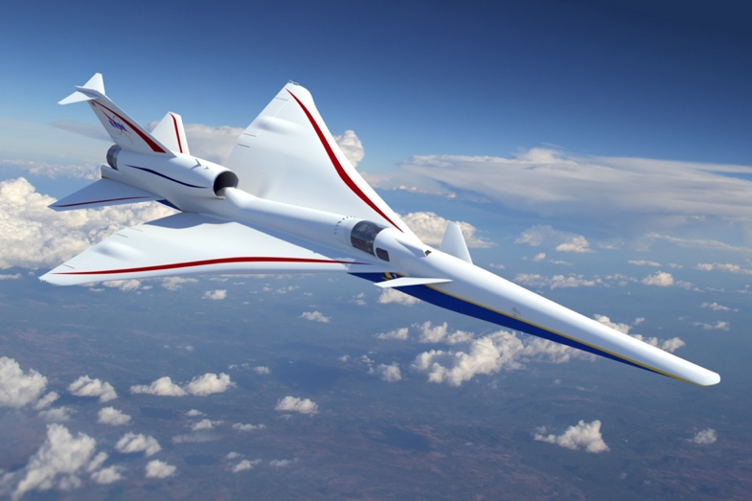
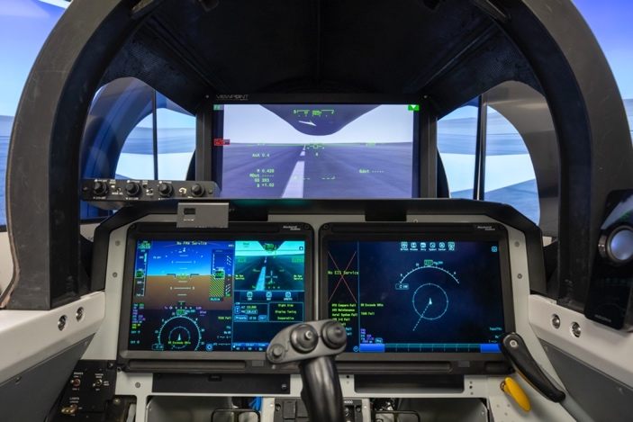
Flying (Not Quite) Blind
Ultra-high-definition video switcher for supersonic X-plane takes off in commercial aviation
Ames Research Center
Eon Instrumentation: Van Nuys, CA
Commercial helicopters now use the video switcher developed by Van Nuys, California-based Eon Instrumentation Inc. to meet Langley Research Center specifications. It enables the X-59 supersonic test plane to switch between two video feeds in milliseconds and also supports simultaneous recording of both.

Slide 42
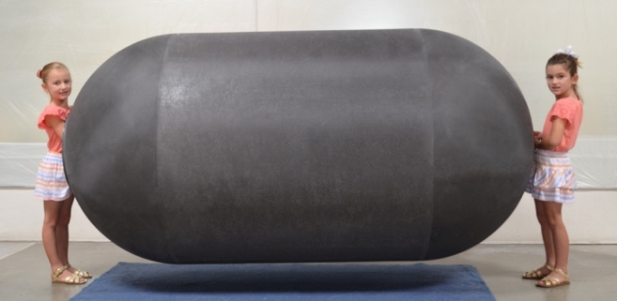
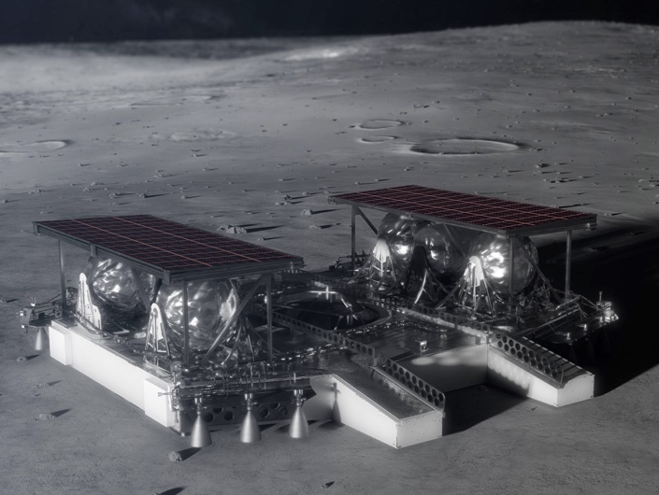
Cryofuels Come Under Pressure
A carbon composite tank developed for NASA enables the move from fossil fuels to cryofuels
Marshall Space Flight Center
Gloyer-Taylor Laboratories: Tullahoma, TN
NASA needs reliable cryofuel tanks for use in space, and the airline industry wants them to replace fossil fuels. SBIR funding from Marshall Space Flight Center for Tullahoma, Tennessee-based Gloyer-Taylor Laboratories Inc. helped develop a lightweight carbon composite tank that can work for planetary landers and industry.

Slide 43
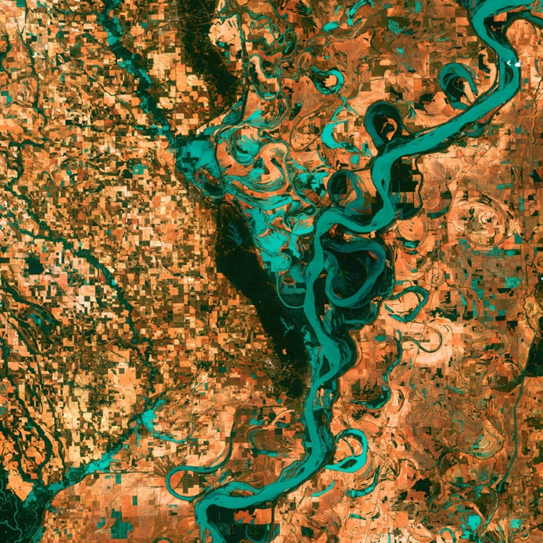
CubeSats Take a Bus into Space
NASA resources helped develop CubeSat infrastructure that anyone can use
Goddard Space Flight Center
Tyvak Nano-Satellite Systems: Irvine, CA
CubeSats start with a hardware bus that houses and enables payloads. NASA Tipping Point funding for test flights informed the development of the Trestles bus sold by Irvine, California-based Tyvak Nano-Satellite Systems Inc. Goddard Space Flight Center supports development of these technologies for agency and private sector activity.

Slide 44
Earth’s Twin Helps with Extreme Electronics
Plans to explore Venus give rise to new computer chips for high-heat conditions on Earth
Glenn Research Center
Ozark Integrated Circuits: Fayetteville, AR
A single-board computer module can withstand 900ºF conditions thanks to NASA SBIR funding. Ozark Integrated Circuits Inc. of Fayetteville, Arkansas, created its eXtreme Nodes to enable spacecraft, geothermal drilling, and other industries.

Slide 45
Suspended Solar Panels See the Light
NASA engineering validated pleasing, practical design
Glenn Research Center
Skysun: Cleveland, OH
To determine how well a suspended solar panel system would hold up to potentially destructive oscillations caused by wind, Skysun LLC in Cleveland, Ohio sought the help of NASA employees at Glenn Research Center through the Adopt-A-City program to verify its product would be safe from dangerous resonance.

Slide 46
Space Program Pumps Up Turbomachinery
NASA helped make turbopump advances, still used in aerospace and energy
Marshall Space Flight Center
Barber-Nichols: Arvada, CO
When NASA was looking for a low-cost solution to launch into orbit, Barber-Nichols of Arvada, Colorado was subcontracted to build the turbopump for the Fastrac rocket engine at Marshall Space Flight Center. Using lessons learned from this program, the company now produces similar turbomachinery for commercial rockets and other applications on the ground.

Slide 47
New Solar Array Design Saves Space
NASA’s Compact Telescoping Array will conserve commercial satellite launch costs
Langley Research Center
Northrop Grumman: Goleta, CA
A NASA team invented the Compact Telescoping Array concept, which can reduce a stowed solar array’s volume by a third. Now a Northrop Grumman facility in Goleta, California, is producing arrays based on NASA’s design.

Slide 48
Traveling-Wave Tubes Travel Far
Electronic components designed for NASA see use in satellite systems and ground applications
Glenn Research Center
Stellant Systems: Torrence, CA
To receive scientific data, NASA needed versions of electronic components that were small but powerful for launching on deep space missions, and contracted with Hughes to build them. A successor company, Stellant Systems of Torrence, California, is now the only company in the U.S. that produces space-worthy traveling-wave tubes necessary for communications satellites.

Slide 49
Private Lessons for Private Spaceflight
NASA facilities, practices, and experience used to train private astronauts
Johnson Space Center
Axiom Space: Houston, TX
To enable their private astronauts to live and work in orbit, Axiom Space of Houston used NASA facilities and people with NASA experience to train their crews of private astronauts that travel to the space station.

Slide 50
Device for Analyzing Deep Space Could Detect Tumors, Air Particles
A NASA-funded curved microchannel plate is now available for medical uses, air analysis, and nuclear waste detection
Goddard Space Flight Center
Incom: Charlton, MA
Supported by several NASA SBIR contracts, Charlton, Massachusetts-based Incom has developed curved microchannel plates that can fit directly on instruments without adapters to improve the detection of particles, such as faint signals from deep space or cancerous tumors in Earthbound patients.

Slide 51
Electrical Body Signals Help Researchers Restore Movement and More
Technology for understanding mind-body interface builds on research for space travel
Johnson Space Center
Delsys: Natick, MA
Delsys Inc. of Natick, Massachusetts, used SBIR and other funding from Johnson Space Center to develop technology for sensing the activity of motor nerves, helping researchers attempt such miracles as reversing paralysis and restoring speech.

