Slide 1
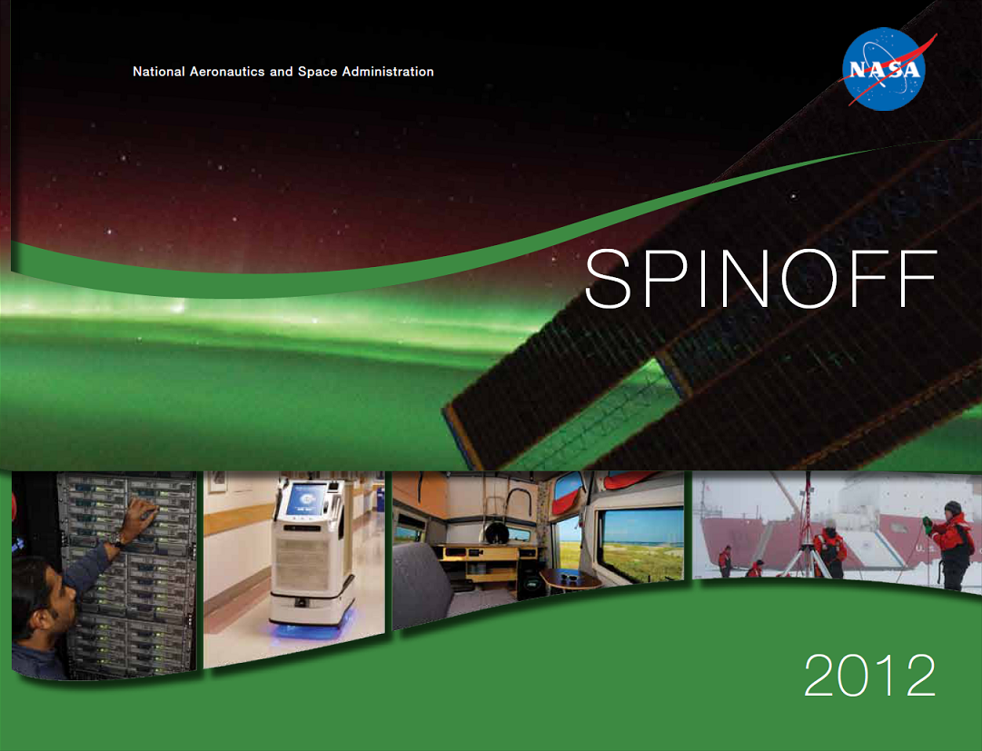

Slide 2
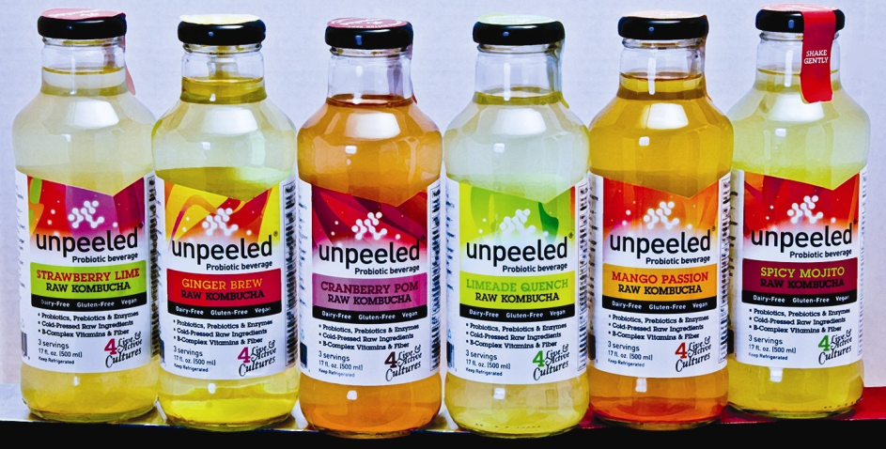
Water Treatment Technologies Inspire Healthy Beverages
Johnson Space Center
Unpeeled, Inc.
Minneapolis-St. Paul, Minnesota
NASA Technology
Astronauts in space must make use of everything at their disposal, including reclaimed urine for drinking.
NASA has developed several methods to reclaim wastewater, including the use of certain bacteria.
A special bioreactor developed at Johnson greatly increased bacteria growth and health.
Technology Transfer
A project employee, who later became a chiropractor and advised patients on nutrition, wanted to develop a healthy alternative to sugary beverages.
He used the same bioreactor concept to grow strong cultures of bacteria, which he used in making kombucha—a fermented probiotic tea.
Benefits
Unpeeled aids digestion, reduces inflammation, and uses organic and healthy ingredients.
The company is set to launch a coconut water-based probiotic beverage.
After selling over 1 million bottles in 2011, the company is on track to sell more than 5 million bottles in 2012.
Spinoff 2012
Health and Medicine

Slide 3
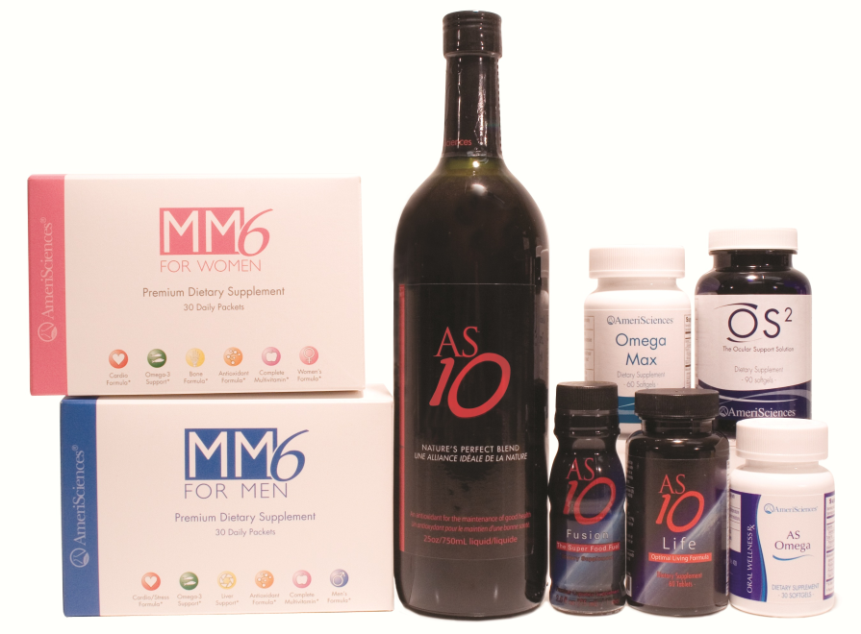
Dietary Formulas Fortify Antioxidant Supplements
Johnson Space Center
AmeriSciences LP
Houston, TX
NASA Technology
For astronauts in space, meeting daily nutritional needs is a challenge.
The Agency explored new ways of keeping astronauts nourished and protected from space-related illnesses such as oxidative stress, which is primarily caused by radiation.
Technology Transfer
Johnson Space Center entered into a formal Space Act Agreement with AmeriSciences to develop multivitamin supplements and antioxidant formulas to fight oxidative stress.
An experiment on irradiated mice revealed that specimens given the supplements lived longer and had fewer health problems.
Benefits
AmeriSciences now offers multivitamin supplements and vegetable-derived antioxidants to consumers through small retailers and doctors’ offices.
Nuclear power plant workers, populations near nuclear sites, healthcare radiology workers, and others could benefit from the products.
Spinoff 2012
Health and Medicine

Slide 4
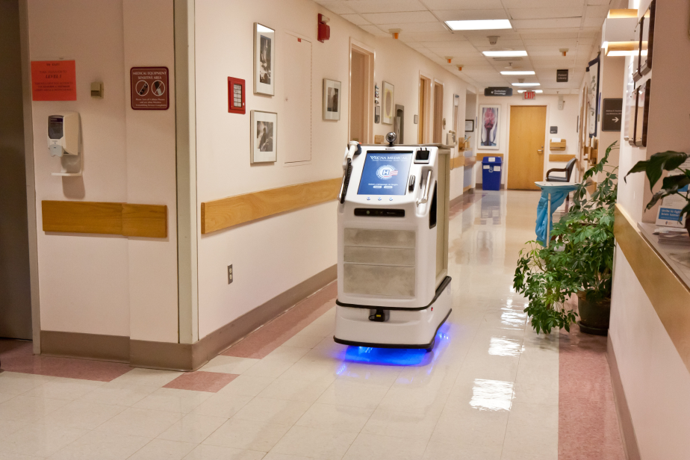
Rovers Pave the Way for Hospital Robots
Jet Propulsion Laboratory (JPL)
Vecna Technologies
Cambridge, MA
NASA Technology
Designing various Mars rovers over the years have yielded advances in artificial intelligence.
A prototype rover called Rocky 7 was developed in the mid 1990s, with the ability to discern which rocks were interesting enough to pick up and then to follow through with the action.
Technology Transfer
During this time, JPL provided the Massachusetts Institute of Technology (MIT) with funding to advance object acquisition capabilities in robots.
An MIT grad student built a mock-up of Rocky 7 and committed research toward autonomous robot behavior, then joined Vecna Technologies to develop robots that could be used on Earth.
Benefits
The QC Bot performs a variety of hospital-related duties—from completing bedside registrations to capturing vital signs—all while autonomously navigating itself around a facility.
The QC Bot is used in hospitals around the world, helping to improve efficiency and reduce medical errors.
Spinoff 2012
Health and Medicine

Slide 5
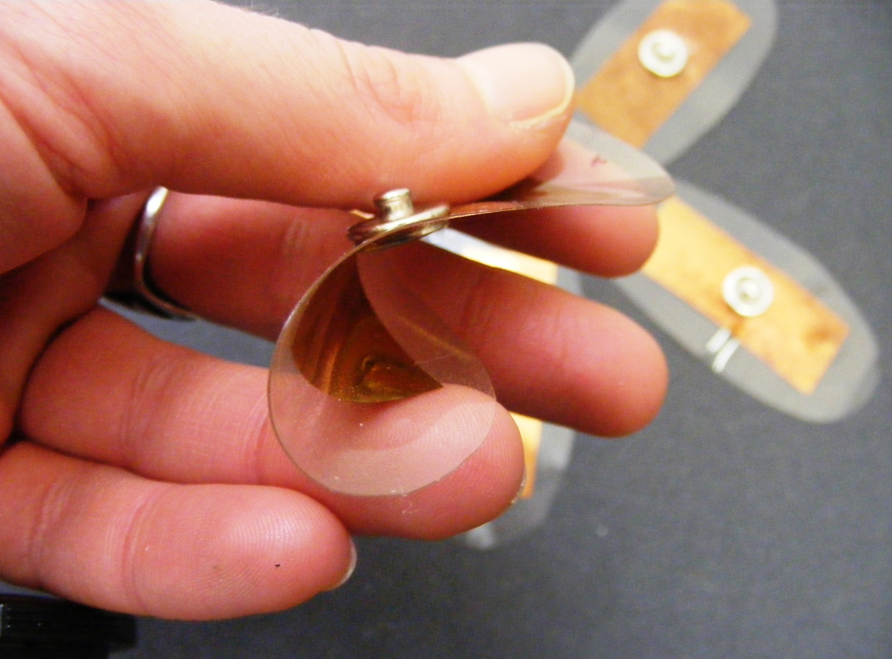
Dry Electrodes Facilitate Remote Health Monitoring
Johnson Space Center
NanoSonic Inc.
Pembroke, VA
NASA Technology
Without any doctors nearby, astronauts in space must monitor their own health, which poses challenges.
The spaghetti-like straps of an electrocardiogram (EKG), used to track heart rate, are both uncomfortable and hard to manage in microgravity.
Technology Transfer
Johnson Space Center awarded NanoSonic with Small Business Innovation Research (SBIR) funding to develop a more space-friendly device.
The company used its pre-existing Metal Rubber technology to create sensors that didn’t require moisture to stick to skin and wiring that didn’t get tangled.
Benefits
In 2011 NanoSonic began marketing its dry electrode sensors and also its EKGear sensor shirt, which transmits heart rate and cardiovascular activity wirelessly to a display.
With the sensors able to monitor temperature, respiration, and location, hospitals, the military, and first responders can also benefit.
Spinoff 2012
Health and Medicine

Slide 6
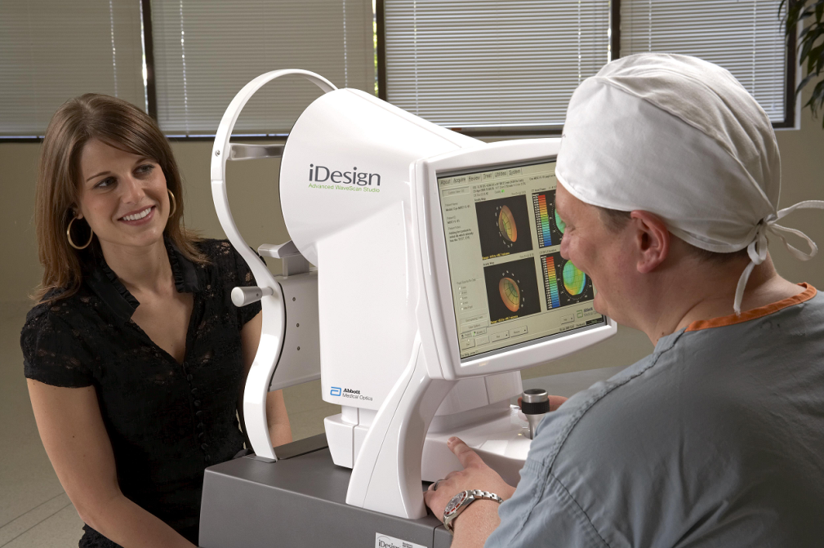
Telescope Innovations Improve Speed, Accuracy of Eye Surgery
Goddard Space Flight Center
Abbott Medical Optics
Santa Ana, CA
NASA Technology
Crafting the giant lenses for the forthcoming James Webb Space Telescope (JWST) requires a lot of grinding, polishing, and testing.
To polish the mirrors, NASA contracted with a company that innovated technology to hasten the process and reduce costs.
Technology Transfer
WaveFront Science, the subcontractor involved in the project, not only solved a problem for NASA but also created a device that produces detailed maps of the human eye useful for diagnosing disease.
Abbott Medical Optics acquired WaveFront Science and used the NASA-funded technology to develop its product, which maps the eye in preparation for LASIK surgery.
Benefits
The iDesign Advanced WaveScan Studio can map the contours of the eye in three seconds, with the resulting data transferred directly to the laser.
iDesign also measures distorted surfaces associated with nearsightedness, farsightedness, and astigmatism, among others.
Spinoff 2012
Health and Medicine

Slide 7
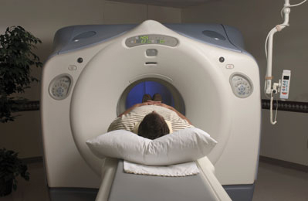
Superconductors Enable Lower Cost MRI Systems
Glenn Research Center
Hyper Tech Research
Columbus, OH
NASA Technology
In an effort to “green” air travel and make it more efficient, NASA is looking to motors made from superconductor material to reduce fuel burn.
The Agency considered the superconducting material magnesium diboride (MgB₂), but found it expensive and difficult to manufacture.
Technology Transfer
Hyper Tech Research, with Small Business Innovation Research (SBIR) funding, has been working with MgB₂ and has developed and patented its process for manufacturing superconducting wires.
The company is working with companies to develop MgB₂ wire for magnetic resonance imaging (MRI) devices in hopes of driving down their cost.
Benefits
Since 2003 Hyper Tech has increased its revenue from $1 million to $5.4 million and has hired 19 new workers.
The worldwide demand for lightweight generators for offshore wind power could create another market for MgB₂ wire.
Spinoff 2012
Health and Medicine

Slide 8
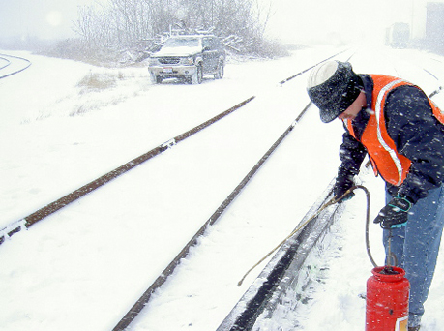
Anti-Icing Formulas Prevent Train Delays
Ames Research Center
Midwest Industrial Supply
Canton, OH
NASA Technology
Ice buildup on planes in the winter months make them dangerous to fly if not inoperable.
NASA scientists developed a nontoxic, biodegradable deicing fluid that replaced an earlier liquid application that was banned by the US Air Force.
Technology Transfer
Midwest Industrial Supply licensed the technology and improved its Ice Free Switch (IFS) product, a fluid that prevents train switches from freezing over.
Compared to its old IFS product, the new NASA-technology-infused solution is easier to apply and sticks onto vertical surfaces better.
Benefits
Midwest used the same technology to develop its Zero Gravity Third Rail product, which keeps the electrical rails—which power the trains—from freezing and causing delays.
The two products increase company revenues by $300,000 to $600,000 a year, helping to prevent seasonal layoffs in the winter.
Spinoff 2012
Transportation

Slide 9
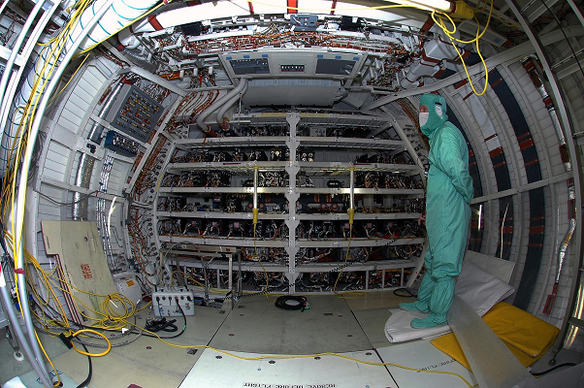
Shuttle Repair Tools Automate Vehicle Maintenance
Kennedy Space Flight Center
Diversified Industries (DI) CS&I Inc.
Orlando, FL
NASA Technology
Keeping up with the paperwork required for maintaining and repairing a space shuttle proved cumbersome for engineers and technicians.
A NASA contractor devised the System Maintenance Automated Repairs Tasks (SMART) software program that streamlines the process, saving time.
Technology Transfer
The contractor who designed SMART received a license from NASA to commercialize the technology and founded Diversified Industries.
Commercial aircraft, aerospace vehicles, and ships benefit greatly from SMART’s ability to manage repairs by accessing a robust data set of accepted procedures, thereby ensuring greater safety outcomes.
Benefits
The software cuts repair disposition time by 45 percent.
Time and paperwork savings make engineers’ lives easier while cutting down on costs.
Former NASA engineers now work at Diversified Industries because of their expertise with the software.
Spinoff 2012
Transportation

Slide 10
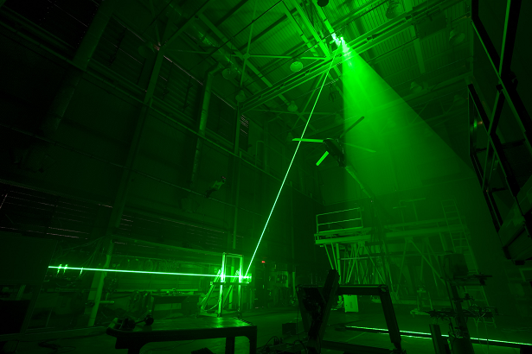
Pressure-Sensitive Paints Advance Rotorcraft Design Testing
Langley Research Center
Innovative Scientific Solutions Inc. (ISSI)
Dayton, OH
NASA Technology
Pressure-sensitive paint (PSP) allows for air pressure measurements throughout the entire surface of the vehicle.
NASA was seeking a technology that could gather instantaneous dynamic pressure data from surfaces moving at high speeds, such as rotor blades.
Technology Transfer
ISSI, through Small Business Innovation Research (SBIR) funding, developed the Fast PSP program.
Tests at Langley show that Fast PSP is able to show changes in the pressure of a single blade as it rotates around a helicopter.
Fast PSP can collect 1,000 pressure measurements in the time it takes PSP to collect a single one.
Benefits
Fast PSP has so far generated about $200,000 in commercial sales.
The product has generated interest from people working with helicopter rotors, wind turbines, and acoustic noise research.
ISSI and NASA are working toward applying PSP technology to actual flight tests.
Spinoff 2012
Transportation

Slide 11
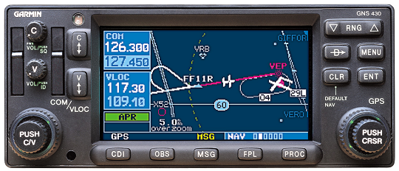
Speech Recognition Interfaces Improve Flight Safety
Langley Research Center
VoiceFlight Systems LLC
Troy, NY
NASA Technology
Manually inputting letters on a GPS for flight plans can be distracting for pilots who should have their eyes on the sky.
NASA’s Vehicle Systems Safety Technology (VSST) at Langley supports new ways to mitigate aircraft safety risks.
Technology Transfer
Through Small Business Innovative Research (SBIR) funding, the company that would become VoiceFlight created speech recognition software that interacted with GPS aviation devices.
Using their voices, pilots enter waypoints ten times faster than those using traditional knob-turning devices.
Benefits
In 2009 VoiceFlight’s speech recognition technology was the first to be certified for use in civilian aircraft by the Federal Aviation Administration (FAA).
In 2011 the company launched its products for use on smaller civilian planes, such as the Piper Arrow, Beechcraft Baron, and the FJ-4 Fury.
Spinoff 2012
Transportation

Slide 12
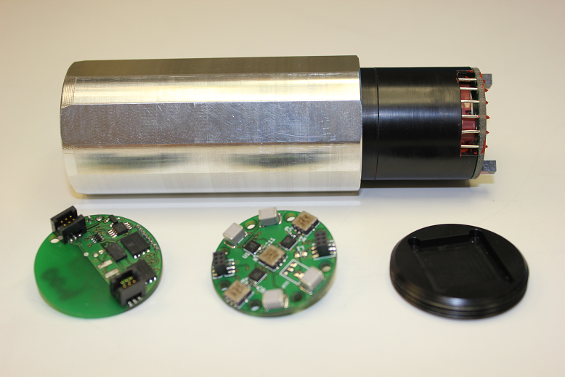
Wireless Sensors Pinpoint Rotorcraft Troubles
Glenn Research Center
Ridgetop Group Inc.
Tucson, AZ
NASA Technology
While more maneuverable than fixed-wing aircraft, helicopters, with their rotors in constant heavy vibration, require more persistent upkeep.
Retrieving data from deep within operating rotorcraft transmissions has been an impediment to finding faults or other issues in the system.
Technology Transfer
With a Small Business Innovation (SBIR) contract awarded by Glenn, Ridgetop developed wireless microelectromechanical sensors (MEMS) that can probe deeper than conventional tools.
Sensors are placed very close to gear teeth, where measurements are taken for use in algorithms that can reveal specific problems with the aircraft.
Benefits
The sensor data is sent to a hub that processes them into a noise signature, which is compared to a fault dictionary listing the transmission problems associated with that signature.
The sensor technology has potential applications for the oil drilling, automotive, and industrial equipment sectors.
Spinoff 2012
Transportation

Slide 13
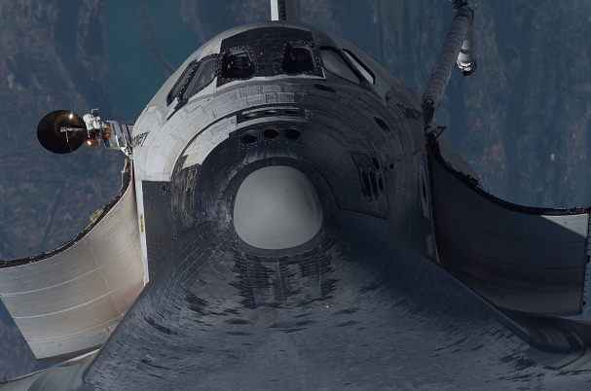
Polymers Advance Heat Management Materials for Vehicles
Marshall Space Flight Center
StarFire Systems Inc.
Schenectady, NY
NASA Technology
On Space Shuttle missions following the Columbia accident, a powerful sealant was to be made available on all flights to repair external spacecraft damage.
Especially important was that the sealant be resistant to extreme heat.
Technology Transfer
With NASA funding, StarFire Systems Inc. demonstrated and tested SMP-10, a polymer that would convert to ceramic when exposed to temperatures above 1500°F.
The ceramic held up to burning temperatures present during re-entry into the earth’s atmosphere.
Benefits
StarFire now has an offshoot line of extreme-heat-resistant polymers called StarPCS, used in the military, aviation, and automotive markets.
The product is being tested for use in Formula 1 race cars, both as a heat shield to protect drivers from engine components and as part of a new exhaust system meant to increase horsepower.
Spinoff 2012
Transportation

Slide 14
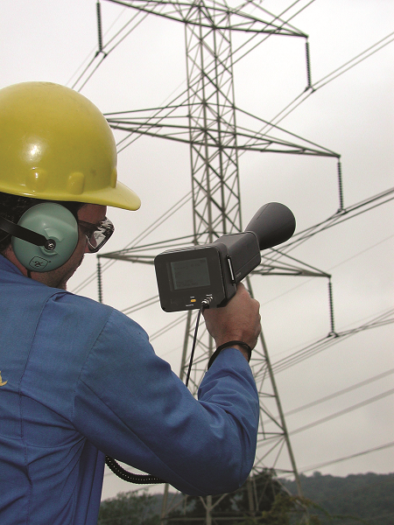
Ultrasonic Detectors Safely Identify Dangerous, Costly Leaks
Kennedy Space Center
UE Systems Inc.
Elmsford, NY
NASA Technology
Gas or fuel leaks on space shuttles can be detected by the ultrasonic noise emanating from the fissure.
Ultrasonic detectors can pinpoint a leak, but unsafe conditions can limit a person’s proximity to the fuel tank or rocket booster; too much distance weakens the device’s signal, rendering it ineffective.
Technology Transfer
Working with Kennedy, UE Systems developed a long-range attachment for the detector able to pick up ultrasonic noises from farther away than conventional detectors.
UE Systems has since licensed the technology for commercial distribution.
Benefits
Factories with compressed air systems benefit greatly because leaks can potentially cost them millions of dollars in wasted energy.
The detectors can also scan substations, transformers, and switchgear for costly and dangerous electrical discharge.
Spinoff 2012
Public Safety

Slide 15
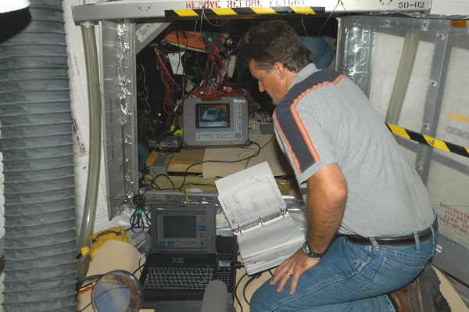
Detectors Ensure Function, Safety of Aircraft Wiring
Kennedy Space Center
Eclypse International Corp.
Corona, CA
NASA Technology
Finding the source of a short or open circuit onboard a space shuttle is difficult because cables are ubiquitous, and traditional multimeter devices cannot pinpoint the source of the fray.
A NASA scientist developed the Standing Wave Reflectometer (SWR) to locate short or open circuits.
Technology Transfer
Eclypse received an exclusive license for the SWR, then tweaked the interface for easier handling and made the casing more durable.
Called ESP+, the device can detect a fault in less than 5 seconds; electrical checks that used to take two people 8 hours now takes one person 45 minutes.
Benefits
The company started with 6 employees and now has 30 people onboard.
The US Army has purchased 300 ESP+ devices for use in their helicopter damage repair kits and, consequently, has saved $2.19 million.
The device enjoys wide usage on airplanes, sea vessels, and even Marine One.
Spinoff 2012
Public Safety

Slide 16
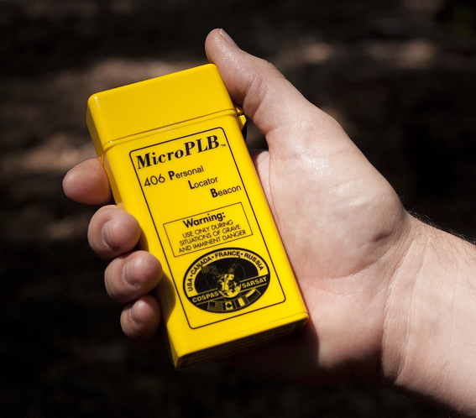
Emergency Systems Save Tens of Thousands of Lives
Goddard Space Flight Center
Techno-Sciences Inc. (TSi)
Beltsville, MD
NASA Technology
Following an Alaskan plane crash that killed two congressmen, Congress directed that better technology for distress calls be developed.
In 1982 the SARSAT satellite tracking system went online, and in 1985 countries around the world organized a system called Cospas-Sarsat.
Technology Transfer
TSi was contracted to develop the ground stations that receive beacon location transmissions from the GPS satellites.
The company’s work with NASA has allowed it to compete in the global market of search and rescue components.
Benefits
TSi has built ground stations in 19 countries for a variety of organizations.
The technology was instrumental in the high-profile rescue of 16-year-old Abby Sunderland, who in 2010 attempted to become the youngest person ever to sail solo around the world.
To date, over 30,000 people have been rescued.
Spinoff 2012
Public Safety

Slide 17
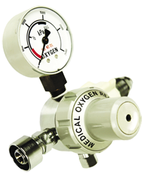
Oxygen Assessments Ensure Safer Medical Devices
Johnson Space Center
Wendell Hull and Associates
Las Cruces, NM
NASA Technology
Materials can combust when oxygen concentrations and pressures reach certain tipping points.
NASA scientists at the Johnson Space Center’s White Sands Test Facility (WSTF) developed a process to determine the oxygen fire hazard associated with a component or a system.
Technology Transfer
One scientist left to work for the engineering firm Wendell Hull and Associates (WHA), using his NASA training to perform forensic testing on the cause and origin of fires.
WHA now also specializes in flammability research and has helped to set new standards for oxygen regulators used by patients in hospitals, ambulances, and home healthcare.
Benefits
The company performs oxygen and hydrogen fire forensic origin and cause evaluations and also conducts safety trainings.
An ongoing project of WHA is working on more safety standards within the medical industry, including hyperbaric chambers and valve integrated pressure regulators (VIPRs).
Spinoff 2012
Public Safety

Slide 18
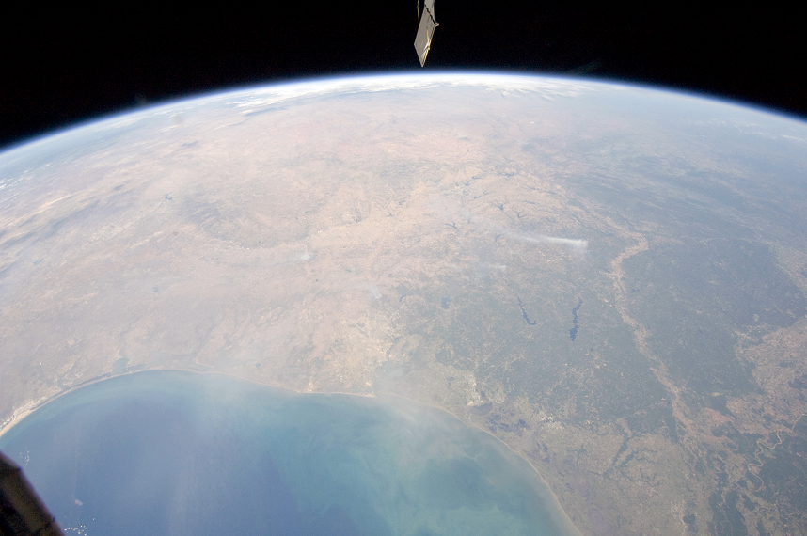
Collaborative Platforms Aid Emergency Decision Making
NASA Headquarters
StormCenter Communications Inc.
Baltimore, MD
NASA Technology
NASA wanted to make its real-time data, ranging from shifts in temperature to cloud formation to pollutions levels over highways, available for use to other agencies and the public.
The problem lay in creating a collaborative platform that could bring disparate data together coherently.
Technology Transfer
StormCenter bid on a Research Opportunities in Space and Earth Sciences (ROSES) grant, and used the funding to develop the Envirocast Vision Collaboration Module (EVCM).
The platform allows for emergency managers—confronting any number and type of disaster—to access real-time NASA data and other information that are vital to making public safety decisions.
Benefits
EVCM uses the Google Earth interface, making the learning curve small.
The National Weather Service awarded the company a contract to launch its program in Kansas City, with plans to expand.
StormCenter was selected as Maryland’s 2012 Incubator Company of the year.
Spinoff 2012
Public Health

Slide 19
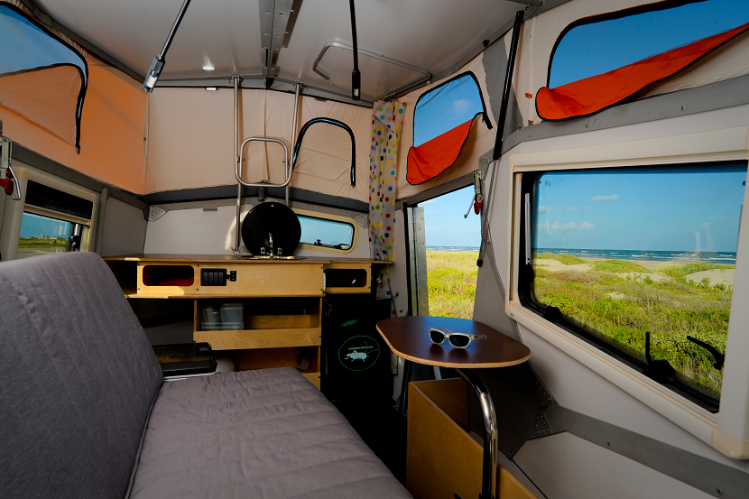
Space-Inspired Trailers Encourage Exploration on Earth
Johnson Space Center
Cricket
Houston, TX
NASA Technology
Physical space is limited on the International Space Station (ISS).
Johnson established the Habitability Design Center to create a Habitation Module for the living quarters of the ISS, with the goal of creating efficient, comfortable spaces for the crew.
Technology Transfer
An architect who joined the program used what he learned about space optimization to build and market a recreational camping trailer.
The philosophy behind both the camper and the Habitation Module is to create a living space that can comfortably house a person of any background, culture, or need.
Benefits
The trailer can house two adults and two children.
The entire apparatus weighs no more than 1,400 pounds, is slight enough to fit in most garages, and can be towed by a four-cylinder vehicle.
Cricket is meant to inspire people to connect with the natural world and see the national parks.
Spinoff 2012
Consumer Goods

Slide 20
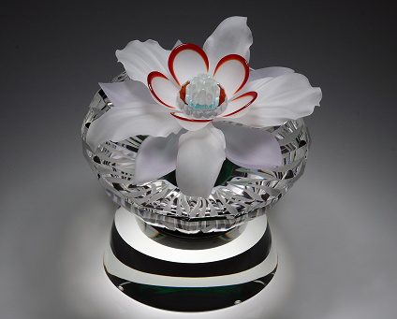
Ultra-Thin Coatings Beautify Art
Johnson Space Center
JL Crystal Artistry
Mount Pleasant, CA
NASA Technology
Ordinary clear substances do nothing to protect the human body from radiation damage.
NASA-developed a transparent, ultra-thin metal coating that prevents harmful radiation, which exists at high levels in space, from seeping into the human body.
Technology Transfer
Called dichroic glass, the technology also creates an aesthetic impact by reflecting and transmitting different colors.
JL Crystal Artistry uses the technology to accent its glasswork with touches of vivid color and texture.
Benefits
Jan Lewczenko, owner of JL Crystal Artistry, has designed pieces for every US president since George H. W. Bush and for popes John Paul II and Benedict XVI.
His art can also be found in the corporate collections of Tiffany, PepsiCo, Porsche, and the like.
Spinoff 2012
Consumer Goods

Slide 21
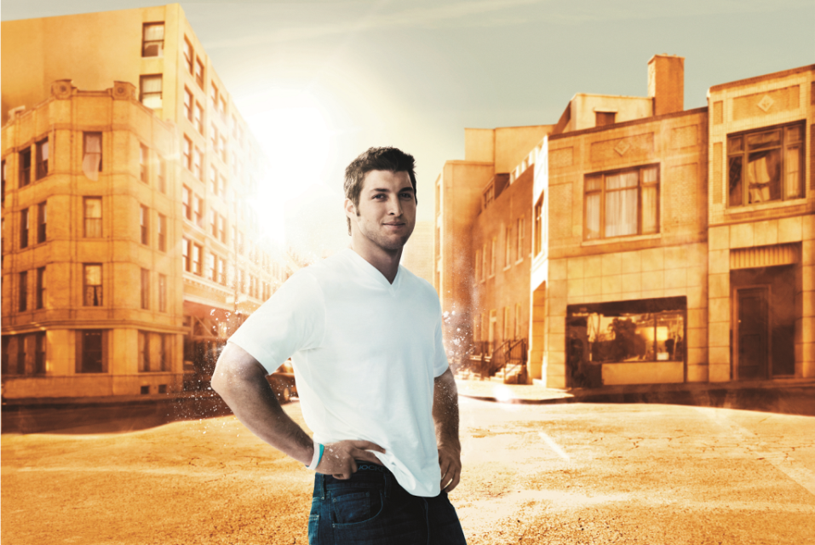
Spacesuit Materials Add Comfort to Undergarments
Johnson Space Center
Jockey International
Kenosha, WI
NASA Technology
Scientists developed a technology to help keep astronauts comfortable in their gloves, which have to accommodate temperatures from 250 °F to -250 °F.
NASA looked into phase change materials (PCMs), which either absorb or release heat to counteract their surroundings.
Technology Transfer
Through Small Business Innovation Research (SBIR) funding, one company incorporated PCMs in spacesuit fabrics. Later, another firm received exclusive commercial rights to the innovation.
Jockey then secured a license to print Thermocule technology into undergarment fabrics.
Benefits
By March 2011 Jockey released its staycool undergarments for both men and women.
The garments can regulate the temperature between a wearer’s skin and clothing by as much as 3 degrees, helping to reduce overheating and prevent chills.
Pro athletes and consumers alike wear staycool.
Spinoff 2012
Consumer Goods

Slide 22

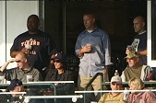
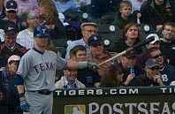
Gigapixel Images Connect Sports Teams with Fans
Ames Research Center
Major League Baseball Advanced Media LP (MLBAM)
New York, NY
NASA Technology
NASA’s twin Mars rovers, Spirit and Opportunity, use technology allowing them to take many photos of the planet’s surface that are then stitched together into one zoom-friendly, high-resolution image.
The GigaPan robotic platform was its first commercial offshoot.
Technology Transfer
Major League Baseball Advanced Media (MLBAM) worked with GigaPan engineers to produce large scale in-game shots of players and fans.
The imagery is so detailed that game-attending fans, when on a participating MLB team’s site, can now zoom in to photos of themselves in the stands.
Benefits
Fans can log into their Facebook accounts and tag themselves and their friends in the image.
Users are exposed to special offers run by the team for tickets, merchandise, and special events.
MLB teams use the technology to increase the number of hits on their websites.
Spinoff 2012
Consumer Goods

Slide 23
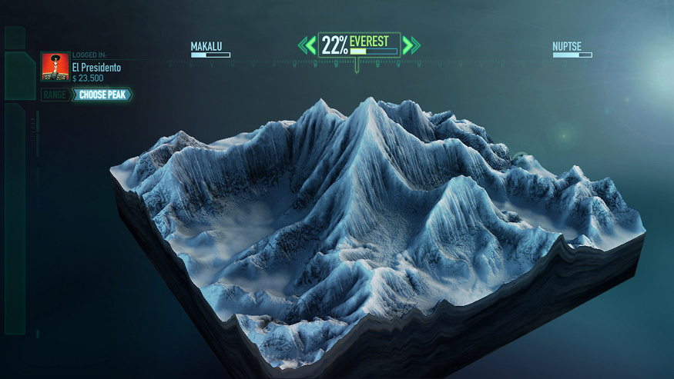
Satellite Maps Deliver More Realistic Gaming
Jet Propulsion Laboratory
Electronic Arts
Redwood City, CA
NASA Technology
NASA partnered with the Japanese government to develop the Advanced Spaceborne Thermal Emission and Reflection Radiometer (ASTER).
The technology allowed for detailed maps of land surface temperatures and elevations.
Technology Transfer
The ASTER map is the most complete global topographic map available to the public.
Video game company Electronic Arts was developing the latest title in a series of snowboarding simulations and used the data to construct courses based on the actual topography of famous mountains.
Benefits
The award-winning game, SSX, features 28 mountains from nine different ranges, the first time any of EA’s games has featured real-world terrain.
The background scenery throughout SSC also features accurate renderings of neighboring mountains and terrain.
Spinoff 2012
Consumer Goods

Slide 24
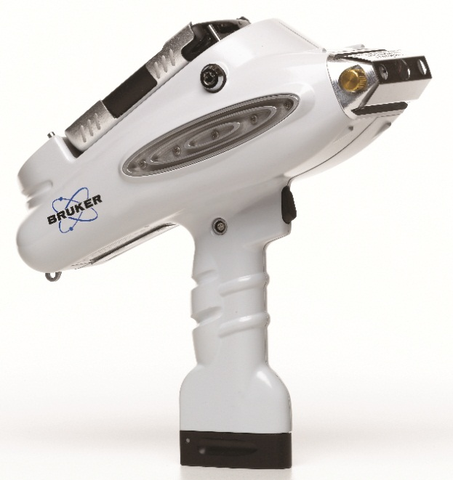
Elemental Scanning Devices Authenticate Works of Art
Marshall Space Flight Center
Bruker Elemental
Madison, WI
NASA Technology
X-ray fluorescence (XRF) scanners are used to detect the presence of elements, but conventional ones cannot detect the lighter elements, including aluminum, frequently used by NASA.
The problem is that lighter elements give off weaker x-rays that cannot be registered on the scanners.
Technology Transfer
A partnership between NASA and KeyMaster Inc. (later acquired by Bruker) solved the problem by developing scanners incorporated with vacuum chambers, which prevented x-rays from dissipating into the air.
Joint patents were issued, and NASA benefited from the technology while the company launched its Tracer III-SD and Tracer III-V models.
Benefits
Museums benefit from the scanners, which can authenticate paintings and artifacts by comparing pigments and mediums to verified originals.
The technology can save people and institutions from spending millions of dollars on forgeries.
Consumer products like food and medicine are also tested for safety using the technology.
Spinoff 2012
Consumer Goods

Slide 25
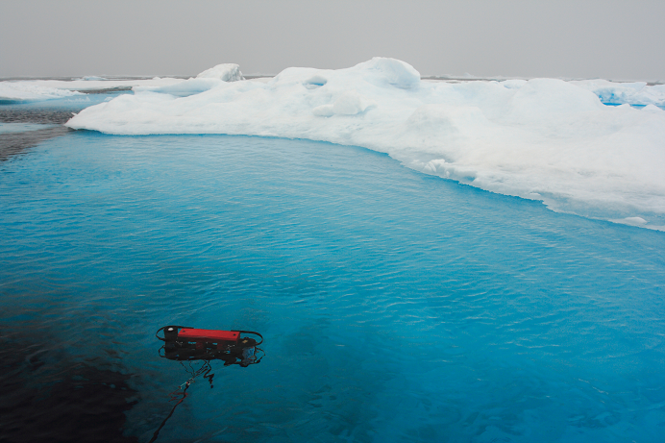
Microradiometers Reveal Ocean Health, Climate Change
Goddard Space Flight Center
Biospherical Instruments Inc.
San Diego, CA
NASA Technology
Ocean color can indicate the quantities and distribution of phytoplankton—microscopic plants whose wellbeing is critical to the sea’s health.
NASA wanted to improve on its ocean color satellites so that important changes in the sea could be studied and validated.
Technology Transfer
Through Small Business Innovation Research (SBIR) funding, Biospherical Instruments developed cost-effective “microradiometers,” small narrow tubes with sensors that collect data underwater.
Sensors can collect a range of information, including temperature and light measurements, that can enrich understanding of the world’s diverse ocean ecosystems.
Benefits
Because of its NASA work, Biospherical Instruments has sold the technology to researchers from many countries and has procured $2 million in contracts.
In partnership with Ames Research Center, the company has recently adapted its microradiometers to fly in aircraft and conduct atmospheric research.
Spinoff 2012
Energy and Environment

Slide 26
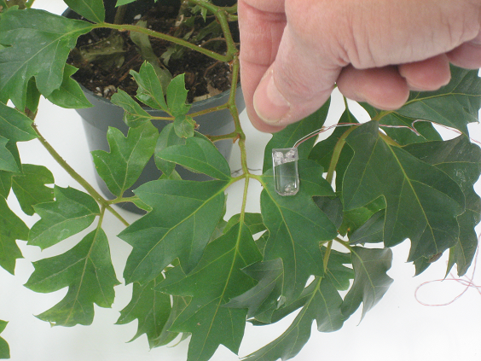
Sensors Enable Plants to Text Message Farmers
Marshall Space Flight Center
AgriHouse
Berthoud, CO
NASA Technology
Astronauts living in space for extended periods of time, like those on deep-space missions, will need to grow their own food.
As resources in space are severely limited and costly, systems that maximize efficiency will make long-term space flight possible.
Technology Transfer
AgriHouse partnered with BioServe Space Technologies, recipient of Small Business Innovation Research (SBIR) funding, to develop sensors that use electrical pulses to determine when a plant loses its rigidity to the point where it needs water.
In a laboratory test, the new system decreased water usage by between 25 and 45 percent.
Benefits
The technology will allow farmers in the water-scarce West to conserve their resources.
While current users are researchers, MBA students are working on business models to expand the product’s reach in the market.
AgriHouse sees a future where farmers can receive text messages on their plants’ health.
Spinoff 2012
Energy and Environment

Slide 27
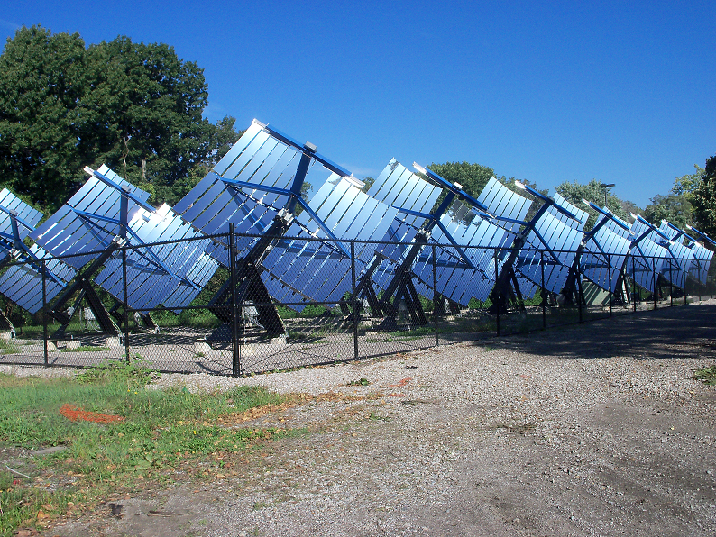
Efficient Cells Cut the Cost of Solar Power
Glenn Research Center
GreenField Solar Inc.
Oberlin, OH
NASA Technology
Solar power has great potential for increased use both on Earth and in space.
Glenn has taken interest in research that creates cheaper, more efficient photovoltaic (PV) chips to harness the sun’s energy.
Technology Transfer
Through a Space Act Agreement, a former Glenn scientist worked with NASA to develop the StarGen system, a technology where sunlight is reflected by powerful mirrors onto small PV chips.
The StarGen system provides 200 times more power than conventional panels for a given amount of silicon.
Benefits
The diminutive PV chips require less silicon, making them cheaper to produce than conventional panels.
Excess thermal energy can be used to heat office buildings and greenhouses.
The company employs 30 workers and expects to hire more as it expands globally.
Spinoff 2012
Energy and Environment

Slide 28
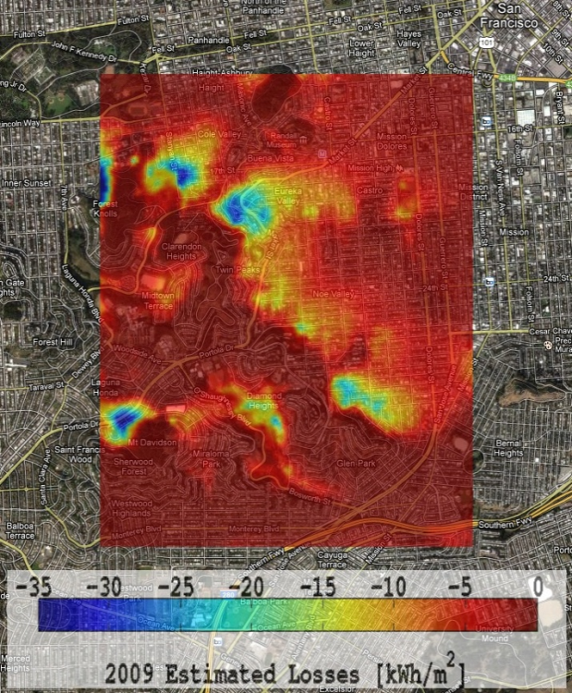
Shuttle Topography Data Inform Solar Power Analysis
Jet Propulsion Laboratory
Locus Energy LLC
New York, NY
NASA Technology
JPL partnered with the National Geospatial-Intelligence Agency (NGA) to put together the first near-global elevation map of the Earth.
Such research is useful in determining—through mapping out areas that lie in the shades of hills, for example—prime areas for installing solar panels.
Technology Transfer
Locus Energy LCC uses the elevation map data, which now lies in the public domain, to help its customers plan for and predict solar production throughout a given area.
The information is used in conjunction with NASA’s geostationary operational environmental satellite system (GOES).
Benefits
The company’s Virtual Irradiance package estimates solar irradiance without using physical sensors, which can be cost-prohibitive for firms.
Locus’ data can either provide long-term placement strategies for solar installation or estimate short-term, real-time power estimates using its weather forecasting system.
Spinoff 2012
Energy and Environment

Slide 29
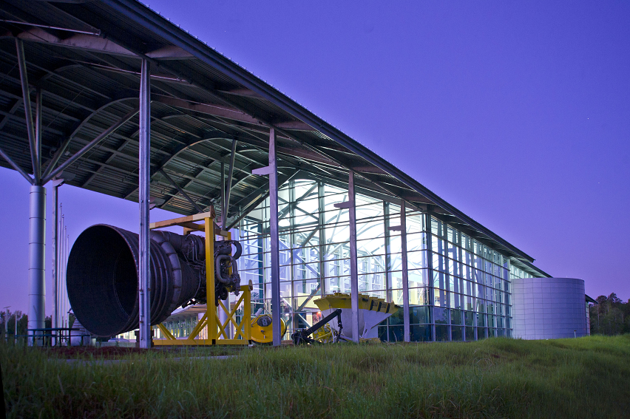
Photocatalytic Solutions Create Self-Cleaning Surfaces
Stennis Space Center
PURETi Inc.
New York, NY
NASA Technology
NASA scientists were looking toward technology that could purify water and eliminate harmful substances on spacecraft during missions.
Photocatalysis is a process whereby light energizes a mineral that then breaks down organic matter, including harmful chemicals.
Technology Transfer
Through a Dual Use Technology partnership with NASA, PURETi was able to prove the worth of its titanium dioxide-based photocatalyst, which is set to liquid and, therefore, easy to apply to surfaces.
The cost-sharing collaboration allowed PURETi’s products to meet both NASA and commercial needs.
The company won the Popular Science Green Tech 2011 Innovative Product of the Year Award.
Benefits
On building facades, the photocatalytic coating, through its cleansing properties, reduces maintenance by more than 50 percent.
Indoors, the technology eliminates odors and creates hospital-grade air quality.
Studies underway to understand clean air’s benefit on cattle may expand the product’s use.
Spinoff 2012
Energy and Environment

Slide 30
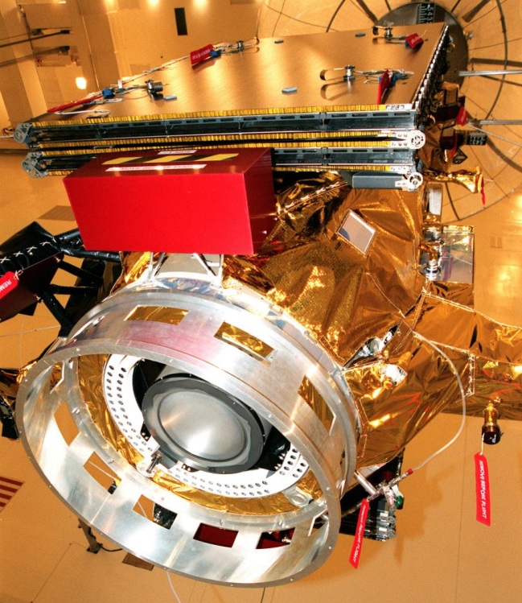
Concentrators Enhance Solar Power Systems
Glenn Research Center
Entech Solar Inc.
Fort Worth, TX
NASA Technology
Chemical rocket propulsion, the conventional method of powering spacecraft, is costly and bulky.
Launched in 1998, Deep Space 1 was the first spacecraft to use solar electric propulsion, a more cost-effective approach that allows for a more slimly built system.
Technology Transfer
With Small Business Innovation Research (SBIR) funding from Glenn, EnTech Solar adapted its solar concentrator technology for use on Deep Space 1.
Working with the Department of Defense, a more lightweight version called the Stretched Lens Array (SLA) was also developed.
In 2012 the technology won an R&D 100 Award.
Benefits
Entech’s commercial product, the SolarVolt generates energy in places with constant direct sunlight.
Commercial applications include utility-scale power plants, distributed energy for smart grids, communications systems, and government and military power systems.
Spinoff 2012
Energy and Environment

Slide 31
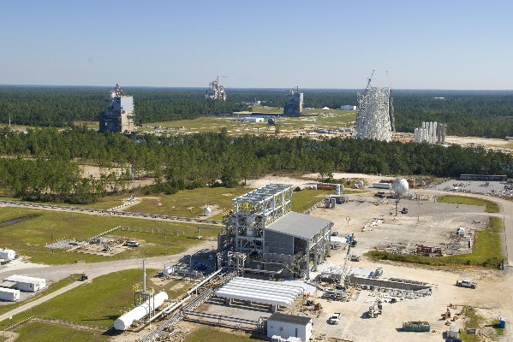
Innovative Coatings Potentially Lower Facility Maintenance Costs
Stennis Space Center
Nanocepts Inc.
Lexington, KY
NASA Technology
Scientists were looking toward technology that could purify water and eliminate harmful substances on spacecraft during missions.
Photocatalysis is a process whereby light energizes a mineral that then breaks down organic matter, including harmful chemicals.
Technology Transfer
Through a Dual Use Technology partnership with NASA, Nanocepts was able to prove the worth of its titanium dioxide-derived photocatalyst coating, which is water-based and easy to apply to surfaces.
At Stennis, a number of buildings benefit from the coating, which eliminates the buildup of grime and reduce the Center’s maintenance costs.
Benefits
In hospitals, Nanocepts’ products kill 99.99 percent of microbes, including MRSA and E. coli, thus reducing the chance of life-threatening infections for patients.
In new buildings, the solution can break down Volatile Organic Compounds (VOCs), such as formaldehyde, which can be emitted from fresh paint, carpets, and building materials.
Spinoff 2012
Energy and Environment

Slide 32
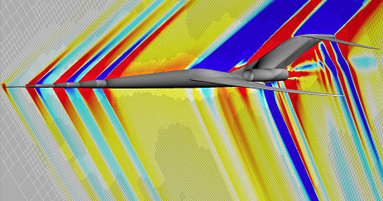
Simulation Packages Expand Aircraft Design Options
Ames Research Center
Desktop Aeronautics
Palo Alto, CA
NASA Technology
When designing safer, more fuel-efficient, or faster aircraft, computational fluid dynamics (CFD) can predict the flow of fluids and gasses around a vehicle and its effects on performance.
NASA developed Cart3D, a software that provides a streamlined, accurate analysis of vehicle designs.
Technology Transfer
Through Small Business Innovation Research (SBIR) funding, Desktop Aeronautics developed a plugin to make the technology more applicable for general use.
Desktop Aeronautics received a license to sell the Cart3D program, which was further enhanced with a graphic interface and additional computing abilities.
Benefits
Simulations generated by Cart3D help to design subsonic aircraft, space planes, spacecraft, and high speed commercial jets.
The program’s key feature is the automated generation of the mesh, or grid, for analyzing designs, which takes seconds rather than months or years when done by hand.
Spinoff 2012
Information Technology

Slide 33
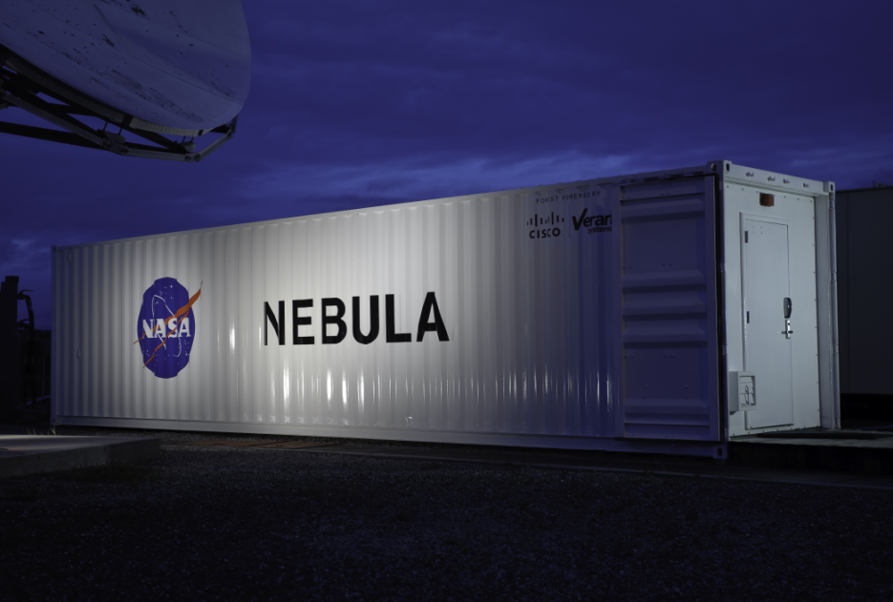
Web Solutions Inspire Cloud Computing Software
Ames Research Center
Rackspace Inc.
San Antonio, TX
NASA Technology
NASA wanted to develop an infrastructure service to connect all of the agency’s websites.
The solution was to develop a cloud computer service, which allows a person to login to a system and access any number of computers, devices, or services from it.
Technology Transfer
NASA and Rackspace, which runs the second largest public cloud in the world, shared common goals and decided to collaborate to build the system, which became known as OpenStack.
OpenStack was created without any proprietary code and has been released as open source software, free for use and modification by anyone.
Benefits
The technology is generating hundreds of millions in revenue; Rackspace alone currently takes in $150 million a year.
Hundreds of jobs have been created by companies using this open source system, which has spun off into its own nonprofit organization.
Spinoff 2012
Information Technology

Slide 34
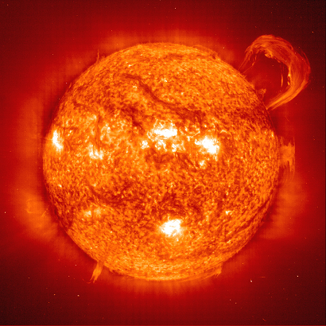
Behavior Prediction Tools Strengthen Nanoelectronics
Marshall Space Flight Center
CFD Research Corporation (CFDRC)
Huntsville, AL
NASA Technology
In space, extreme temperatures and erratic bursts of radiation can damage electronics systems within satellites, spacecraft, and robotics.
The smaller the electronics system, the more severe the damage, so with modern equipment precise testing is crucial to mission success.
Technology Transfer
With Small Business Research Innovation (SBIR) funding, CFDRC developed its NanoTCAD software, which predicts the effects of extreme temperatures and radiation on equipment.
The NanoTCAD was used to evaluate key technologies for the Ice, Cloud, and Land Elevation Satellite-2 (ICESat-2), scheduled for launch in 2016.
Benefits
The product allows prototypes to be tested early in the design phase, thereby reducing costs and testing time.
NanoTCAD has generated $2 million in revenue for the company, created new jobs, and led to partnerships with other defense and industrial customers.
Spinoff 2012
Information Technology

Slide 35
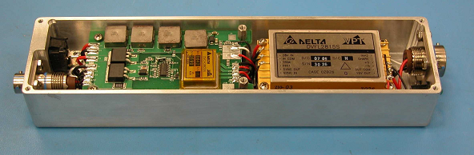
Power Converters Secure Electronics in Harsh Environments
Johnson Space Center
VPT Inc.
Blacksburg, VA
NASA Technology
In the vast reaches of space, radiation can wreak havoc on power converters, which send the necessary energy to electronic equipment.
NASA wanted to develop technology that would protect power converters from failing and causing catastrophic damage.
Technology Transfer
Johnson awarded VPT with Small Business Innovation Research (SBIR) funding to create DC-DC power converters that could stand up to radiation exposure.
The resulting converters received a major certification from the Defense Logistics Agency (DLA), which oversees military specifications.
Benefits
In addition to radiation resistance, the converters can withstand rapid temperature changes and extreme g-force acceleration.
Boeing, Raytheon, Lockheed Martin, and the US Air Force now use the converters, and the uptick in sales has spawned four new jobs and the creation of a space product division at the firm.
Spinoff 2012
Information Technology

Slide 36
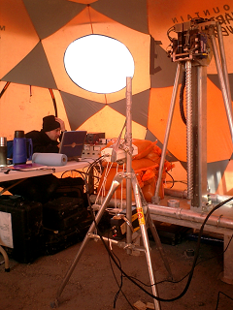
Diagnostics Tools Identify Faults Prior to Failure
Goddard Space Flight Center
Impact Technologies LLC
Rochester, NY
NASA Technology
Operating complex machinery and electronics in space requires software that can monitor their health and functionality from afar.
NASA developed the Hybrid Diagnostic Engine (HyDE) to observe a device’s performance through data-transmitting sensors.
Technology Transfer
To enable this technology for use on earth, Goddard awarded a Small Business Innovation Research (SBIR) contract to Impact Technologies.
The company integrated the software into its own product, which is used in modeling and simulation.
Goddard now uses the technology to monitor its geothermal heating and cooling system.
Benefits
The software not only detects potential faults in existing systems; it can craft solutions during the design phase of nearly any product, saving time and money.
New applications are being developed in the wind turbine and helicopter diagnostics markets.
Spinoff 2012
Information Technology

Slide 37
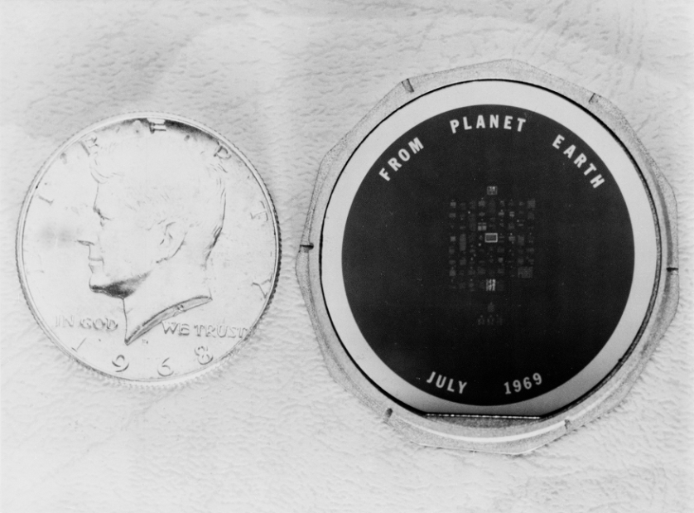
Archiving Innovations Preserve Essential Historical Records
NASA Headquarters
NanoArk Corporation
Fairport, NY
NASA Technology
When Apollo 11 landed on the moon, among the many objects left was a silicon disc with messages of goodwill from 73 countries.
Semiconductor manufacturing techniques were used to etch the messages, each one sized down to occupy a space smaller than the head of a pin.
Technology Transfer
Forty years later, NanoArk Corporation used the technology, now in the public domain, to create their own patented document preservation technology.
The company’s Waferfiche technology employs a photolithographic process to inscribe data onto thin silicon discs, which can fit about 2,000 letter-sized images and remain intact for 500 years.
Benefits
The discs are impervious to water damage, important considering moisture is the leading culprit in destroyed documents.
The only required technology needed to view the etched information is a magnifying glass.
NanoArk has experienced a five-fold increase in revenue between 2010 and 2011.
Spinoff 2012
Information Technology

Slide 38
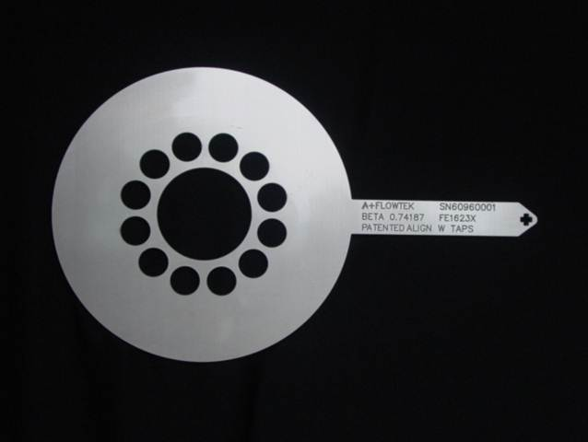
Meter Designs Reduce Operation Costs for Industry
Marshall Space Flight Center
APlus-QMC LLC
Humble, TX
NASA Technology
During routine ground testing of a shuttle engine, the measuring device for liquid oxygen failed, resulting in a fire that burned the test stand beyond repair.
Scientists were looking for a more reliable way of measuring flow rates, which evaluate performance, reliability, and safety.
Technology Transfer
Through Small Business Innovation Research (SBIR) funding, Quality Monitoring and Control (QMC) developed the balanced flow meter (BFM).
In 2007 the technology was designated Marshall Space Flight Center Invention of the year; in 2010 it won the Federal Laboratory Consortium National Excellence in Technology Transfer award.
Benefits
QMC founded Aplus-QMC to commercialize the technology, which produces flow measurement accuracies around 0.2 percent in very harsh environments and with no moving parts.
The product is now used at chemical plants, refineries, power plants, and pharmaceutical plants, and has spurred 100 new jobs.
Spinoff 2012
Industrial Productivity

Slide 39
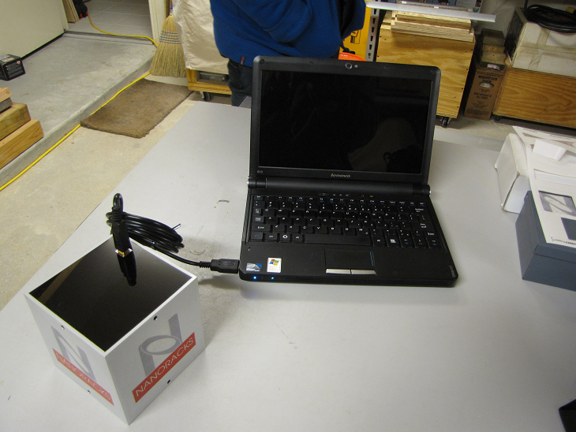
Commercial Platforms Allow Affordable Space Research
NASA Headquarters
NanoRacks LLC
Houston, TX
NASA Technology
The International Space Station (ISS) is a marvel of science, and a valuable resource for microgravity-based scientific investigation and research.
In 2005 the NASA Authorization Act opened up an ISS compartment for utilization by other federal agencies as well as by the private sector.
Technology Transfer
NanoRacks LLC was created to take advantage of the opportunity and developed the NanoLab— standardized software that can be used by the public and private sectors to gather data onboard the ISS.
Nanolabs are four-inch cubes with USB ports for drawing power from the ISS and for transmitting near real-time data gathered from the experiment.
Benefits
Standardized software forestalls companies from having to develop their own expensive models.
High schools, universities, and companies have conducted studies on plant growth, pharmaceutical crystals, and nanomaterial.
Spinoff 2012
Industrial Productivity

Slide 40
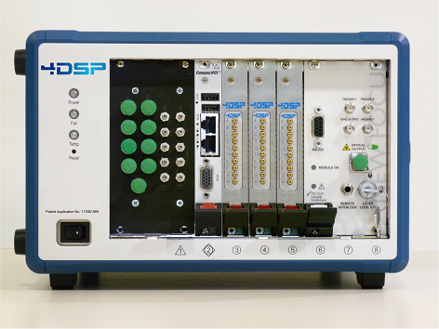
Fiber Optics Deliver Real-Time Structural Monitoring
Dryden Flight Research Center
4DSP LLC
Austin, TX
NASA Technology
Agency scientists were studying how plane wings were performing during flight and wanted to develop a more efficient sensor technology.
They created fiber optic sensors that were easier to apply to aircraft and delivered data quicker than before, but they wanted even faster feedback.
Technology Transfer
4DSP partnered with NASA to integrate its processing board with the agency’s fiber optic technology, creating a technology that can deliver a range of data in real-time speed.
Recognizing its broad applications, such as use in the oil industry to determine feasible sites or in the energy industry to improve wind turbine blades, NASA licensed the system to 4DSP.
Benefits
The company says the product delivers a 20-fold improvement in processing speeds over conventional sensor systems.
Because of the license, 4DSP’s customer base has grown four-fold, revenues for the company are up by 60 percent, and at least five jobs have been created.
Spinoff 2012
Industrial Productivity

Slide 41
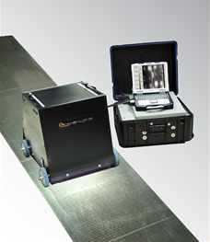
Camera Systems Rapidly Scan Large Structures
Langley Research Center
MISTRAS Group Inc.
Princeton Junction, NJ
NASA Technology
Aging aircraft are being kept in service longer than their intended lifespans, and NASA was looking for new technology to assess aircraft structural integrity.
NASA developed line scanning thermography (LST), whereby an infrared camera creates heat-based images that reveal areas of damage.
Technology Transfer
MISTRAS acquired ThermTech Services Inc., the company that had originally licensed the LST technology, and integrated LST into its business portfolio.
Defects in a structure are more easily discerned using thermography than with acoustic emission and ultrasonic tests, tools previously used by the company.
Benefits
Because of LST’s ability to cover a lot of area quickly, ships, boilers in power stations, and large equipment can be analyzed very quickly.
On aircraft the technology is able to spot structural failures before it’s too late, thereby eliminating the high prices and other losses associated with catastrophic failures.
Spinoff 2012
Industrial Productivity

Slide 42
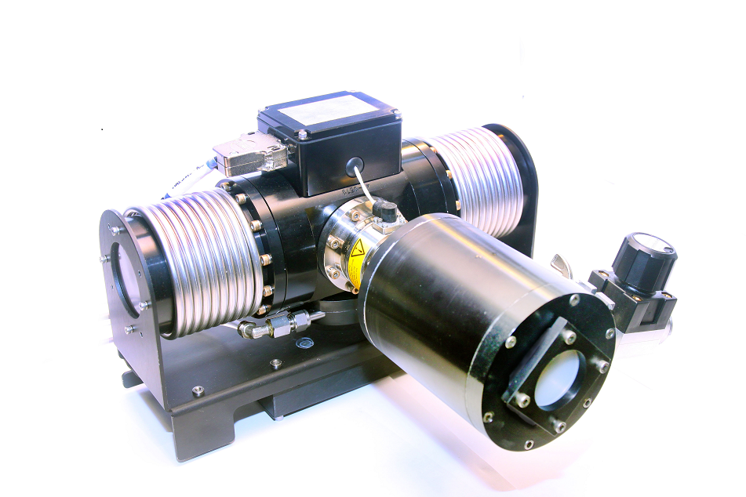
Terahertz Lasers Reveal Information for 3D Images
Kennedy Space Flight Center
LongWave Photonics LLC
Boston, MA
NASA Technology
Terahertz imaging, which is used in full-body scanners at the airport, is also used to detect any potential defects in spacecraft exteriors.
Evolving a terahertz 2D scanner to 3D functionality would allow scientists and engineers to better diagnose the size, depth, and location of defects.
Technology Transfer
Through Small Business Technology Transfer (STTR) funding, LongWave Photonics advanced the quantum cascade laser (QCL), which is capable of displaying objects within its spectrum range in 3D.
The STTR showed the technology to be powerful and proven effective for NASA's 3D scanning needs.
Benefits
The company has sold the technology to researchers working in government, academic, and industrial sectors.
One potential application is for examining the coatings of control-release pharmaceutical pills, whose efficacy can suffer if medication isn’t released in the correct time.
Spinoff 2012
Industrial Productivity

Slide 43
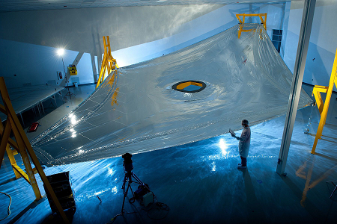
Thin Films Protect Electronics from Heat and Radiation
Langley Research Center
NeXolve Corporation
Huntsville, AL
NASA Technology
As part of NASA's efforts to create robust materials for space, the Agency researches polyimides, substances that are heat- and chemical-resistant.
A NASA researcher discovered nearly color-free polyimides, which proved especially stable in simulated space environments.
Technology Transfer
SRS Technologies worked with the researcher and Marshall Space Flight Center in validating the stability of Polyimide 1 and 2 in the extremes of space.
SRS was acquired by ManTech International, and then spun off into NeXolve Corporation, which is providing the five-layer protective sunshields for the James Webb Space Telescope.
Benefits
The company also sells its thin film products to Boeing, Lockheed Martin, and Northrop Grumman.
The technology is useful on flexible printed circuit boards, for coating electronic test hardware, and for hard disk drives.
Spinoff 2012
Industrial Productivity

Slide 44
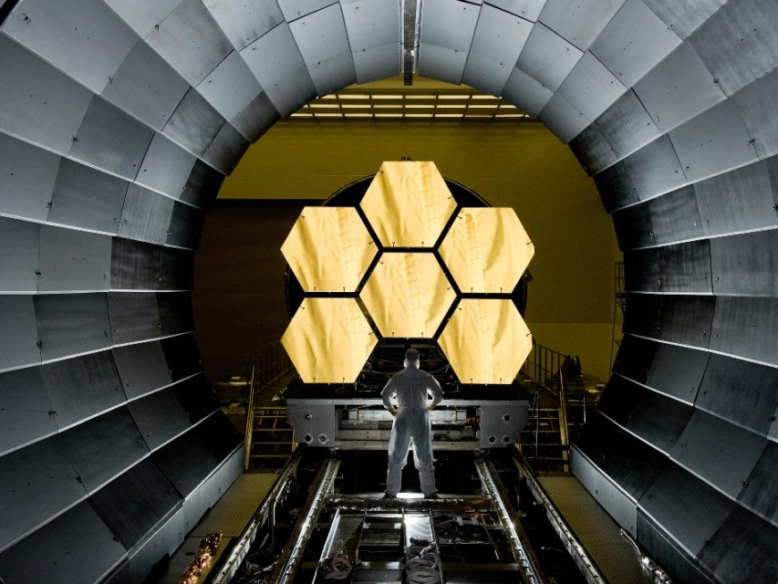
Interferometers Sharpen Measurements for Better Telescopes
Goddard Space Flight Center
4D Technology
Tucson, AZ
NASA Technology
To prepare for the James Webb Space Telescope’s launch into space in 2018, scientists use special chambers to test whether the instrument can handle the frigid temperatures and airlessness of space.
One issue was finding a device that could measure the mirrors in the volatile chamber environs.
Technology Transfer
The agency contracted with 4D Technology to create an interferometer able to test mirrors’ shape even with vibrational interference; it could also average out the effects of environmental noise.
The technology earned a prestigious award from R&D Magazine as one of the 100 most technologically significant products created in 2006.
Benefits
Dynamic interferometry can take measurements thousands of times faster than traditional interferometry and is used in labs and production environments with heavy vibration.
The company has sold hundreds of units, and has gone from a 4-person startup to over 30 employees.
Spinoff 2012
Industrial Productivity

Slide 45
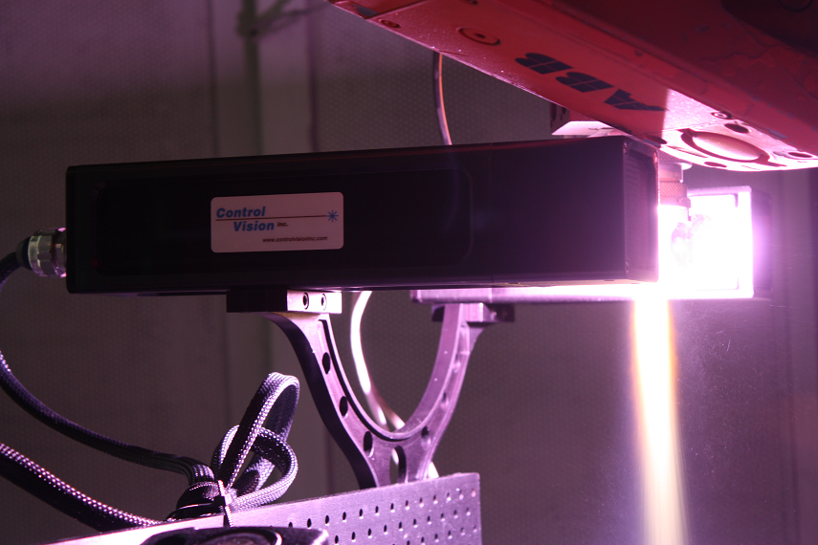
Vision Systems Illuminate Industrial Processes
Marshall Space Flight Center
Control Vision Inc.
Sahuarita, AZ
NASA Technology
During manufacturing processes such as arc welding and thermal coating, it’s difficult to see the process while it’s happening because of all the bright glare produced in the process.
Marshall was looking for a viewing technology that could cut through the glare.
Technology Transfer
Control Vision, through Small Business Innovation Research (SBIR) funding, developed video sensor systems that use specialized illumination to overcome process light.
The sensors can overcome light associated with laser, plasma spray, fiberglass spinning, and continuous casting processes.
Benefits
Three products have their origins in the company’s NASA work: the LaserStrobe system, SprayCam system, and the Pyrocam—all designed to overcome process light.
An important next step is using the technology to help 3D printing programs make adjustments during the manufacturing process.
Spinoff 2012
Industrial Productivity

