Slide 1
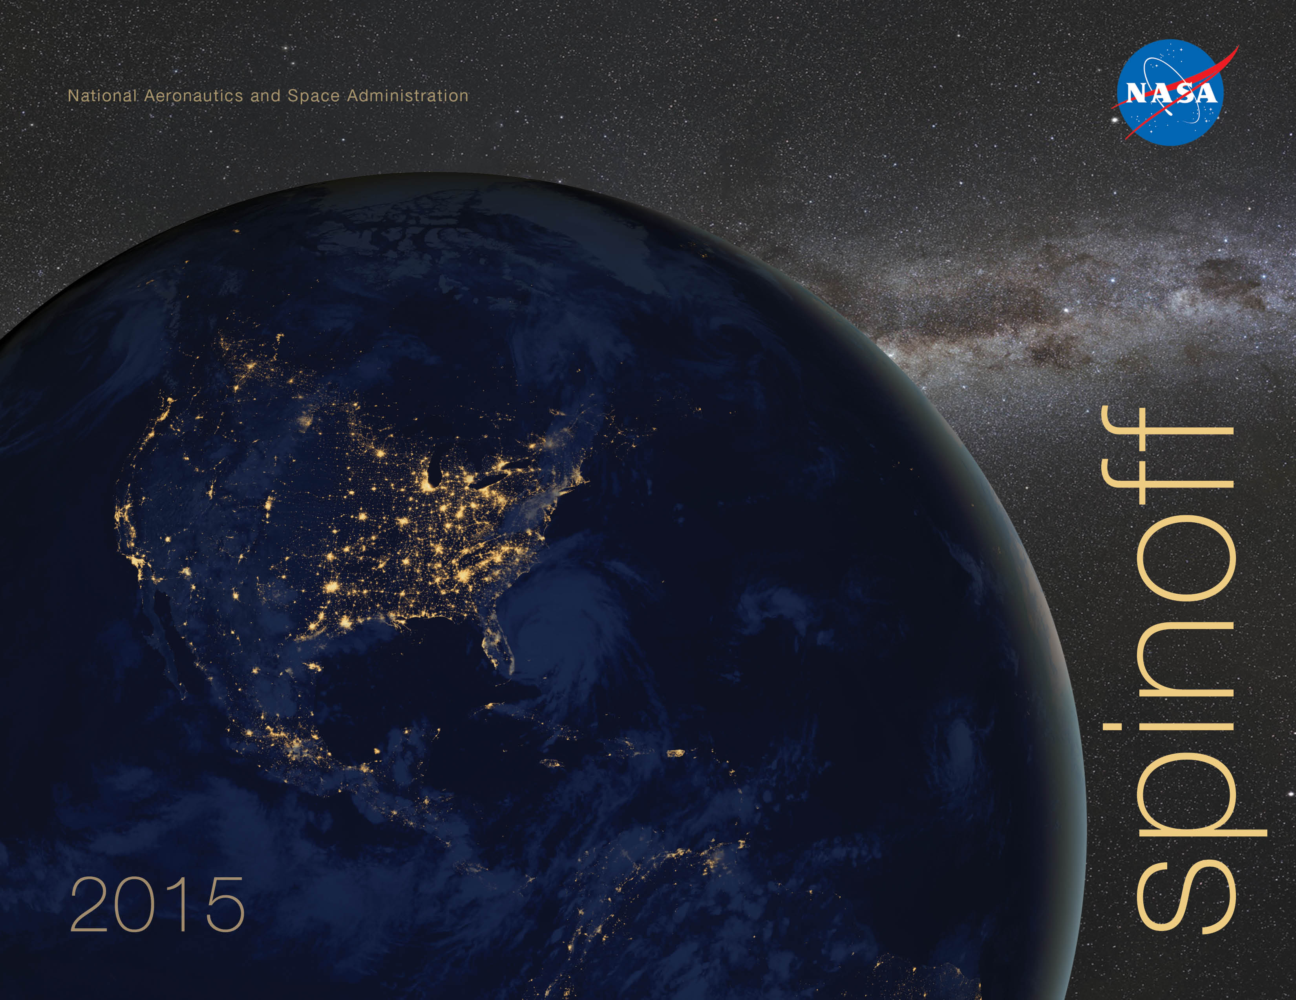

Slide 2
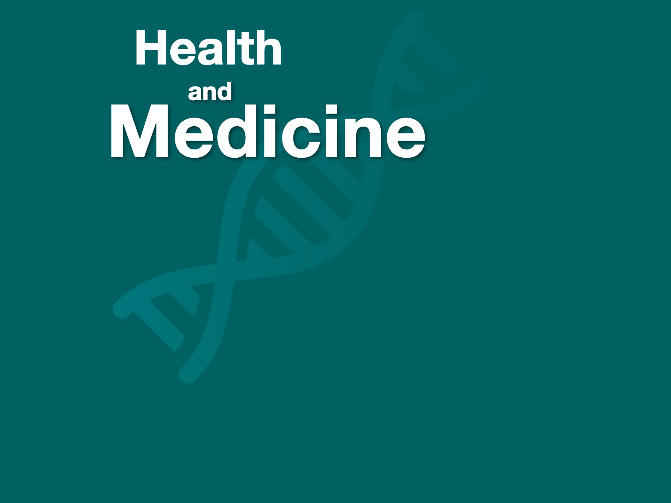

Slide 3
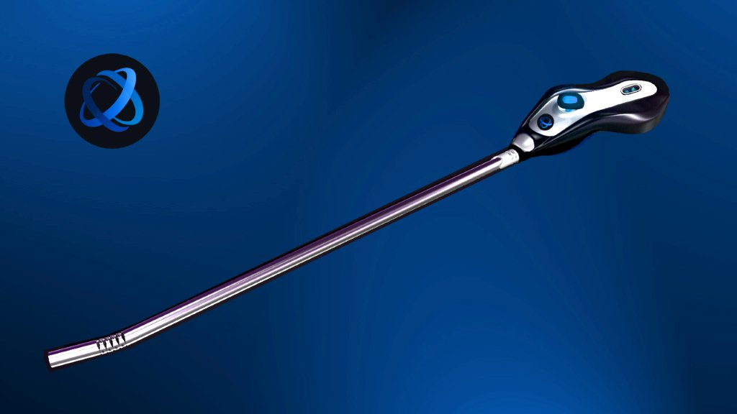
3D Endoscope to Boost Safety, Cut Cost of Surgery
Jet Propulsion Laboratory
Skull Base Institute
Los Angeles, California
NASA Technology
JPL engineers are experts at creating microsystems and imaging devices and have long-term interests in high-resolution 3D imagery
High-quality 3D images can be used for rover exploration, as well as the examination of faults in machinery
Technology Transfer
Neurosurgeon Hrayr Shahinian wanted to develop an endoscope for brain surgery that was capable of producing a 3D image
Shahinian entered a Space Act Agreement with JPL, resulting in the world’s first 3D endoscope suitable for brain surgery, which can also rotate 60 degrees in each direction
Benefits
Multi-Angle Rear-Viewing Endoscopic Tool (MARVEL) provides surgeons a 3D image in close quarters for brain surgery, allowing improved visibility and better understanding of an object’s proximity
MARVEL improves safety during operations, leading to reduced recovery time and lower costs
Spinoff 2015
Health and Medicine

Slide 4
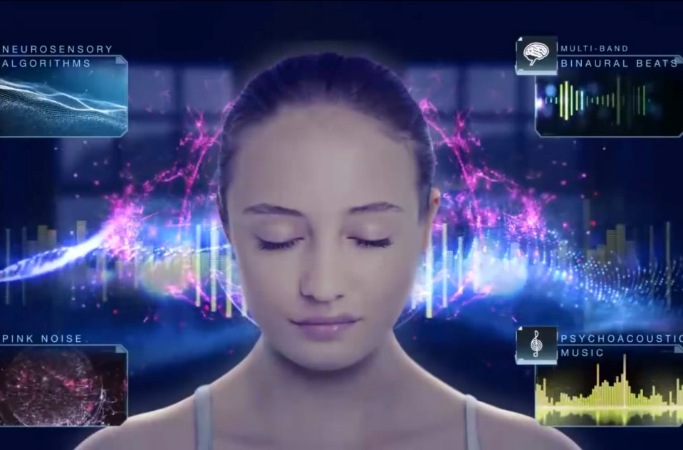
Audio App Brings a Better Night’s Sleep
Johnson Space Center
Sleep Genius
Park City, Utah
NASA Technology
Many astronauts aboard the International Space Station suffer from insomnia early in their mission
NASA’s National Space Biomedical Research Institute funded research at the State University of New York at Stony Brook examining the relationship between the body’s vestibular system and sleep
Technology Transfer
Seth Horowitz, one of the researchers, developed an algorithm that produces low-frequency, semi-periodic rumbling sounds that stimulate the vestibular system, inducing sleep
Horowitz combined his vestibular-inducing sound with pulses that synchronize the cortex, soothing sounds that lower heart and breathing rates, and classical music to help people sleep
Benefits
The Sleep Genius app is available on iOS and Android platforms
Within the first two years, the app was downloaded more than 400,000 times
Horowitz plans future research to examine whether app use results in deeper sleep
Spinoff 2015
Health and Medicine

Slide 5
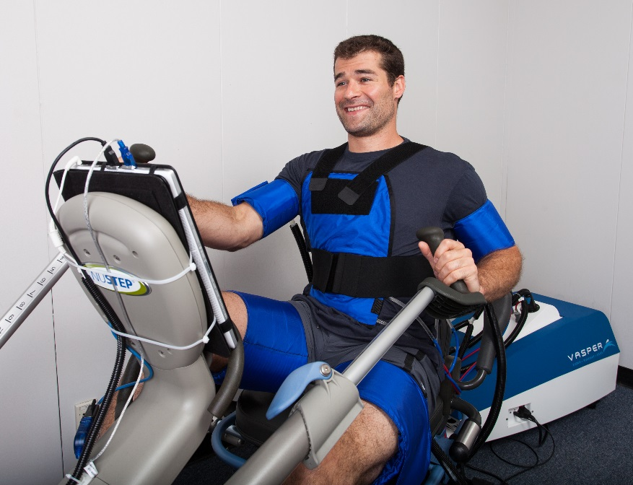
Liquid Cooling Technology Increases Exercise Efficiency
Ames Research Center
Vasper Systems
San Jose, California
NASA Technology
NASA’s spacesuits must create a tightly controlled microclimate for its astronauts
For the Apollo spacesuits, NASA adapted a design used by the British Royal Air Force, keeping astronauts cool by using a pump to cycle chilled liquid through tubes lining the suit
Technology Transfer
An engineer took the concept of chilled water tubing and combined it with compression to help athletes more efficiently perform anaerobic exercise
Adding compression to arm and leg muscles can trigger buildup of lactic acid, putting muscles in an anaerobic state faster
Using chilled cuffs at the same time reduces post-workout aches and fatigue
Benefits
Vasper’s exercise system uses compression and cooling cuffs on arms and thighs in addition to a cooling vest to keep users comfortable while building muscle
A 30-minute session on an elliptical machine produces results similar to workouts longer than an hour
Spinoff 2015
Health and Medicine

Slide 6
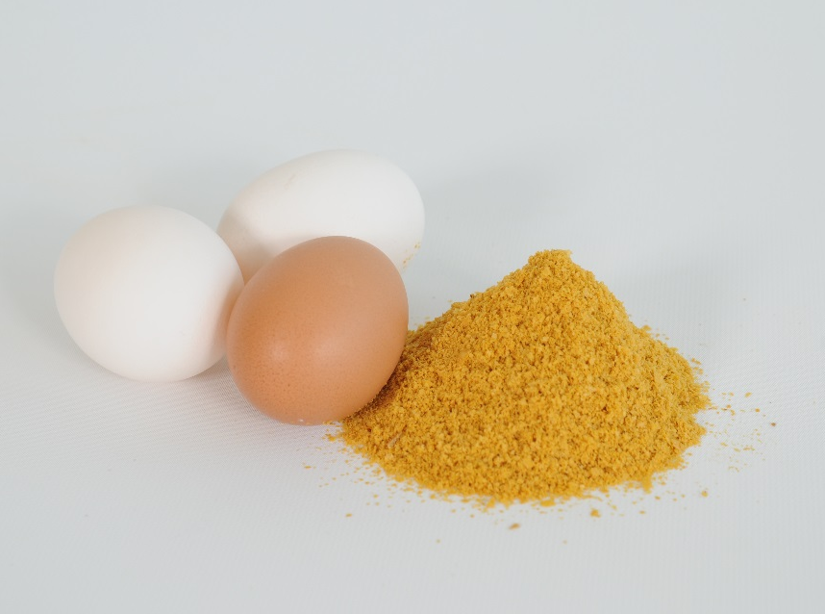
Algae-Derived Dietary Ingredients Nourish Animals
Ames Research Center
DSM Nutritional Products
Columbia, Maryland
NASA Technology
NASA-sponsored research led to the development of algae-based food ingredients, boosting the nutritional profile of infant formula and, later, dietary supplements
Some algae contain omega-3 fatty acids, important for neurological health
Technology Transfer
Scientists at Martek, now part of DSM, built on their NASA work to develop and commercialize algae that create DHA-rich oils
The resulting oils can be added to human nutritional supplements or animal feed, both for pets and for animals raised for human consumption
Beneficial fatty acids are bioavailable when digested
Benefits
DHAgold is used in chicken, animal, and aquaculture feed, resulting in DHA-enriched eggs and meat
DHA consumption is found to increase trainability in puppies, memory in older dogs
The algal source increases availability of omega-3 fatty acids without depleting fish populations
Spinoff 2015
Health and Medicine

Slide 7
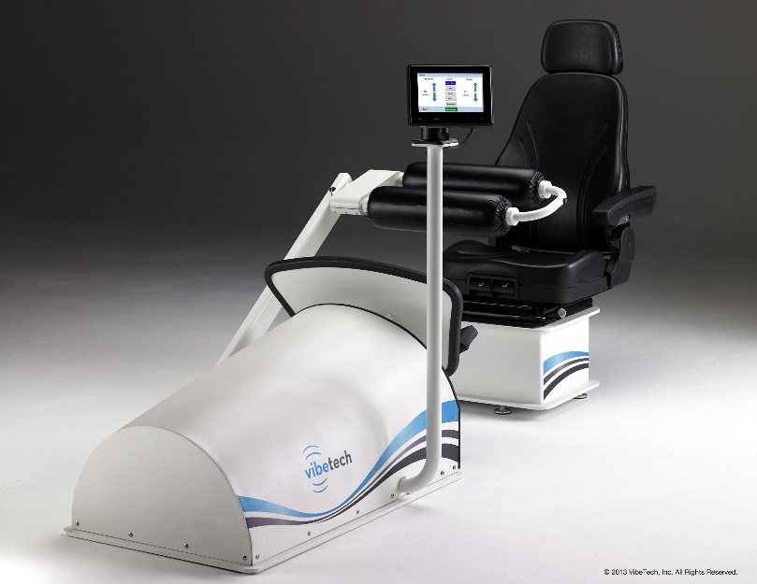
Space Grant Research Launches Rehabilitation Chair
NASA Headquarters
VibeTech
Sheboygan, Wisconsin
NASA Technology
Astronauts spend a surprising amount of time exercising while in space, partly to maintain bone density, as lack of gravity can cause loss of bone density 10 times faster than on Earth
Studies show that vibration can stimulate bone growth in animals
Technology Transfer
Through a grant from the National Space Grant College and Fellowship Program (implemented by NASA), engineering student Jeff Leismer developed a vibration-based system with astronauts in mind
Vibrations also simulate load-bearing exercise, eliciting muscle contractions and building muscle
Benefits
The VibeTech One rehabilitation chair uses vibration to mimic natural response to exercise, with or without individual exertion
Bodyweight loading simulates forces of standing and walking on the legs
Use of the chair helps mitigate muscle atrophy for athletes recovering from injury, surgery
Spinoff 2015
Health and Medicine

Slide 8
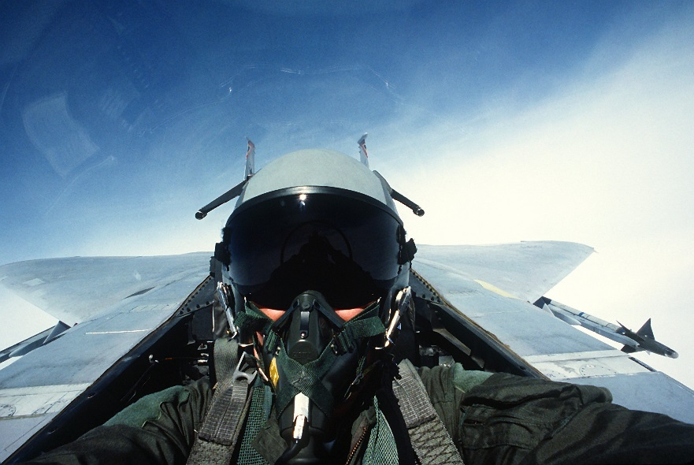
Vision Trainer Teaches Focusing Technique at Home
Ames Research Center
Zone-Trac
Seattle, Washington
NASA Technology
A NASA contract with Stanford University in the 1960s sought to develop a way to measure pilots’ ability to adapt vision to various distances
A NASA engineer working with the optometer built at Stanford found subjects could control their normally involuntary focus with the help of biofeedback
Technology Transfer
After reading the NASA and Stanford research, optometrist Joseph Trachtman thought biofeedback could correct nearsightedness
Instead, the optometer he designed in the 1980s won acclaim as a way to gain control over visual focus and achieve other benefits
Technological advances allowed Trachtman to miniaturize components of the system
Benefits
Zone-Trac, released in 2014, is the smaller, home version of the Accommotrac optometer
Many users report achieving a wider field of vision, intensified color perception, increased hand-eye coordination, and visual acuity
Device is used by pilots and professional sports teams
Spinoff 2015
Health and Medicine

Slide 9


Slide 10
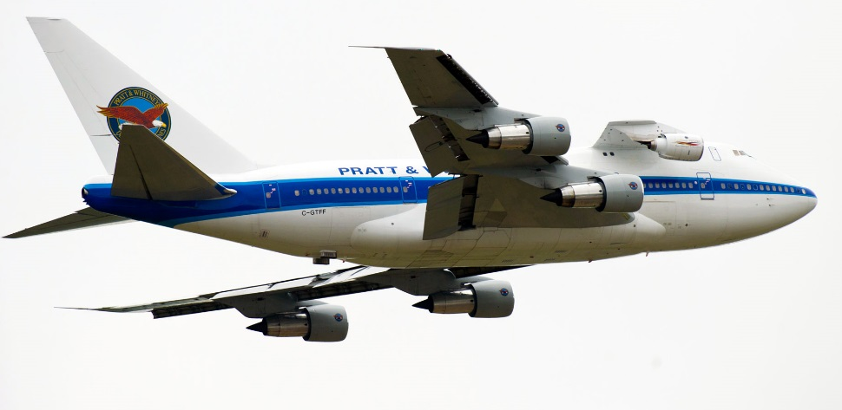
Aircraft Geared Architecture Reduces Fuel Cost and Noise
Glenn Research Center
Pratt & Whitney
East Hartford, Connecticut
NASA Technology
While spaceflight often steals the spotlight, NASA remains committed to air travel advancement
The Subsonic Fixed Wing Project aimed to help private industry improve fuel efficiency while reducing noise
Technology Transfer
Through a Space Act Agreement, Pratt & Whitney and NASA teamed up to develop and test more efficient turbofan engines
The partnership resulted in a gearbox that allows the fan and turbine to spin at different speeds on the same shaft for optimal efficiency
Benefits
PurePower Geared Turbofan (GTF) engines are 15 percent more fuel efficient, saving industry $1.5 million per aircraft annually
Noise footprint subsequently reduced by up to 75 percent
Pratt & Whitney remain involved with NASA’s Environmentally Responsible Aviation project
Spinoff 2015
Transportation

Slide 11
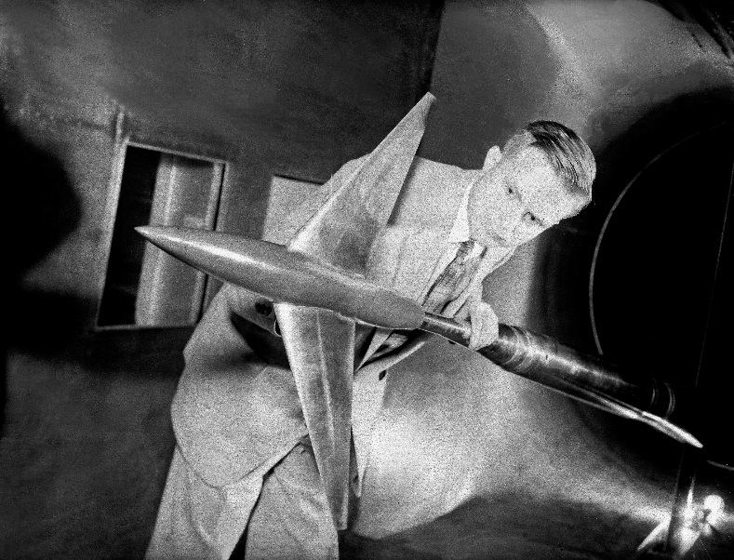
Ubiquitous Supercritical Wing Design Cuts Billions in Fuel Costs
Armstrong Flight Research Center
Boeing Commercial Airplanes
Renton, Washington
NASA Technology
In the 1960s, subsonic flights near the speed of sound were still inefficient because of drag created by standing shock waves
NASA engineer Richard Whitcomb designed a “supercritical” wing that diminished shock waves significantly
Technology Transfer
Results of NASA’s supercritical wing testing were released to industry in 1972
Since its introduction, the supercritical wing design has been incorporated into almost all commercial, business, and military planes around the world
Benefits
Whitcomb’s invention yields fuel efficiency gains at transonic and subsonic cruising speeds
It is estimated that the innovation has saved the industry roughly $2.4 billion in fuel annually, which also equates to large savings in carbon emissions
Spinoff 2015
Transportation

Slide 12
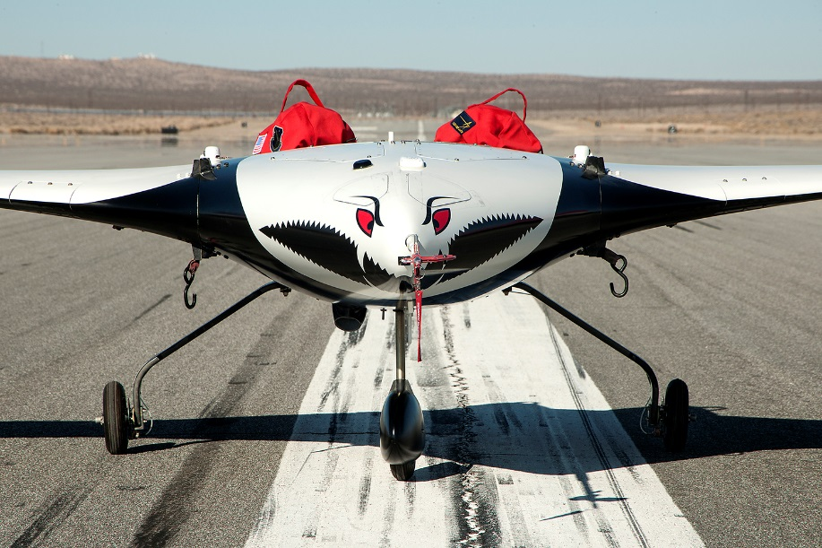
Flight Controller Software Protects Lightweight Flexible Aircraft
Armstrong Flight Research Center
MUSYN Inc.
Minneapolis, Minnesota
NASA Technology
Use of gain scheduling helps electronic controllers make split-second adjustments to aircraft in response to external forces
NASA advanced linear parameter-varying control theory to support gain scheduling for lightweight flexible aircraft susceptible to destructive flutter
Technology Transfer
MUSYN was among the first companies to build on Robust Control theory to create software to help design controllers for specific flight conditions in traditional aircraft.
Through Phase I and II SBIR contracts, MUSYN modified its software for new Linear Parameter-Varying Control theory in order adjust gain scheduling throughout the full duration of a flight
Benefits
Linear Parameter-Varying Controls Toolkit (LPVToolkit) was first made commercially available in 2014
Manufacturers designing lightweight aircraft and drones use the technology
There are also additional potential applications in farm and construction equipment
Spinoff 2015
Transportation

Slide 13
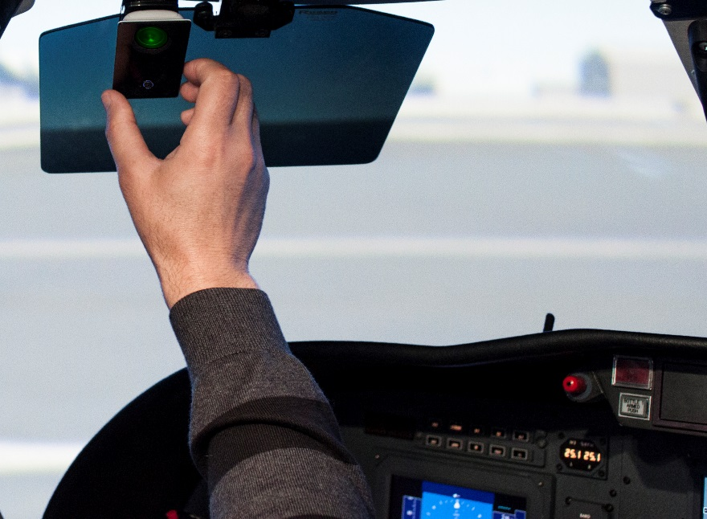
Cabin Pressure Monitors Notify Pilots to Save Lives
Kennedy Space Center
Aviation Technology Inc.
San Diego, California
NASA Technology
Loss of cabin pressure in aircraft can lead to incapacitation or death
A backup cabin pressure monitor can alert NASA personnel to a loss of pressure in training modules simulating lunar or Martian environments, or aboard the International Space Station
Technology Transfer
Stacy Pappas, founder and owner of Aviation Technology, obtained a license from Kennedy to create a new product from the NASA-designed cabin pressure monitor
The new product is based on earlier design, but with an improved circuit board and aesthetics, and it has the size and feel of a smartphone
Benefits
Alt Alert is smaller and lighter than most cell phones and has three mounting options
An alarm and LED light are used to alert pilots to a drop in cabin pressure, allowing sufficient time to take corrective action before loss of consciousness occurs
Spinoff 2015
Transportation

Slide 14
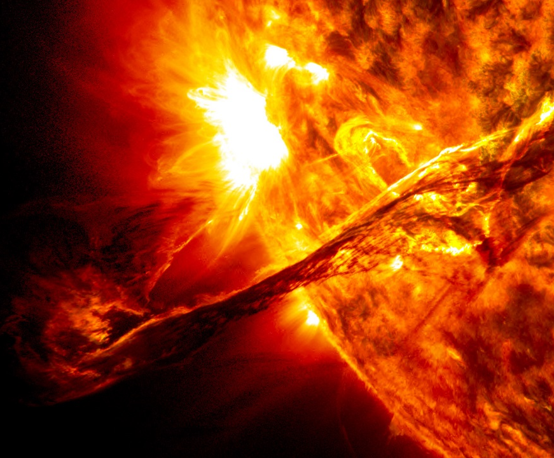
Ionospheric Mapping Software Ensures Pilots’ GPS Accuracy
Jet Propulsion Laboratory
NEC
Irving, Texas
NASA Technology
GPS technology is widely used to help navigate vehicles on land, sea, and air
IonoSTAGE and SuperTruth software are part of a suite created at JPL to enable the FAA’s Wide Area Augmentation System (WAAS), which provides pinpoint accuracy in aircraft GPS units
Technology Transfer
JPL’s software can correct lapses or delays that might occur due to ionospheric activity—i.e., space weather
WAAS is especially beneficial to smaller airports, which often can’t justify a $1 million instrument landing system, by making the same data available at a much lower cost
Benefits
IonoSTAGE and SuperTruth were licensed in 2013 by NEC
Aircraft using WAAS can safely fly at altitudes as low as 200 feet without visibility
Also allows pilots flying between small airports to fly most direct path, instead of relying on ground beacons
Spinoff 2015
Transportation

Slide 15
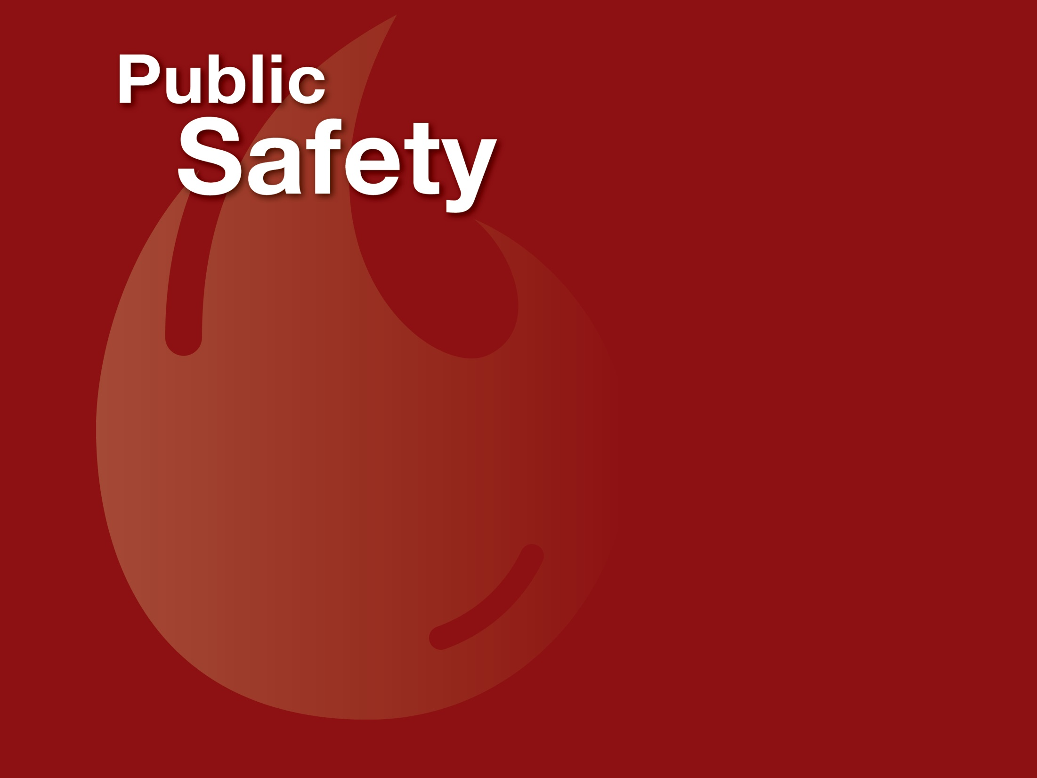

Slide 16
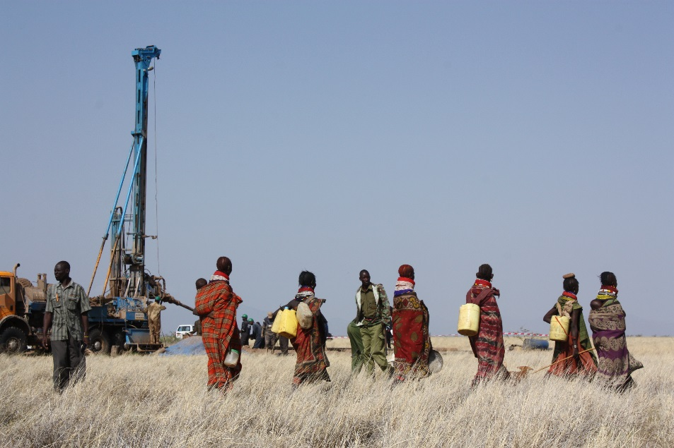
Water Mapping Technology Rebuilds Lives in Arid Regions
Goddard Space Flight Center
Radar Technologies International
New Braunfels, Texas
NASA Technology
NASA has mountains of Earth imaging data, including that of its Spaceborne Imaging Radar and from its Shuttle Radar Topography Mission (SRTM)
NASA also builds and launches the Landsat satellites that produce world-wide images in the visible, near-infrared, short-wave, and thermal bands
Technology Transfer
Using NASA data (among other data sources), Radar Technologies International founder Alain Gachet located a mother lode of gold in the Congo and went on to find diamonds, oil, and other resources
Incorporating Landsat and SRTM data, Gachet developed his WATEX System, capable of locating underground reservoirs of water
Benefits
The WATEX System is used to uncover water supplies in war-torn regions such as Sudan and Afghanistan
A subterranean deposit of 66 trillion gallons of water was discovered under drought-ravaged Turkana County, Kenya
New exploration seeks water deposits in Texas
Spinoff 2015
Public Safety

Slide 17
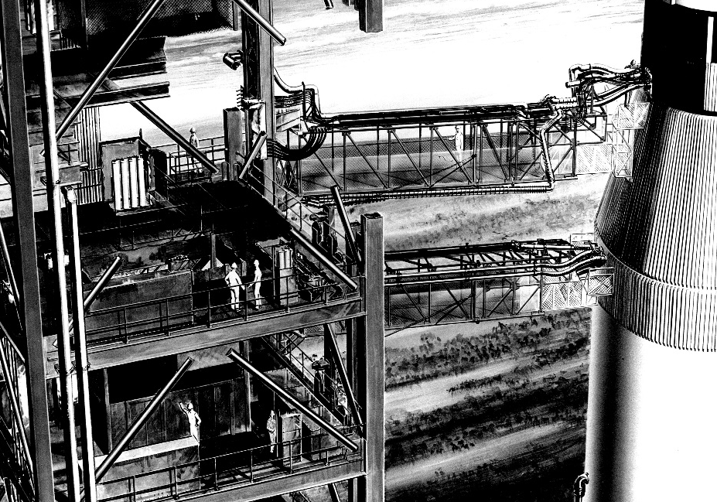
Shock Absorbers Save Structures and Lives during Earthquakes
Marshall Space Flight Center
Taylor Devices Inc.
North Tonawanda, New York
NASA Technology
NASA needed a way to pull back the swing arms that connected bundles of cords and tubes from a service tower to the rocket until just before launch, without damaging the arms
NASA also funded an investigation into running high-speed analogue computers on oil-based hydraulics
Technology Transfer
Taylor Devices created a series of dampers that use conventional shock absorption technology to control the swing arms
For a hydraulics-based computer, the company utilized the principles of fluidics science
The firm then developed fluidics-based dampers used for launches during shuttle program
Benefits
Taylor’s fluidic shock absorbers are now used to fortify structures in earthquake-prone areas such as San Francisco and Tokyo
Of the more than 550 buildings outfitted with Taylor Devices’ dampers in some of the world’s most seismically active regions, none has suffered even minor quake damage
Spinoff 2015
Public Safety

Slide 18
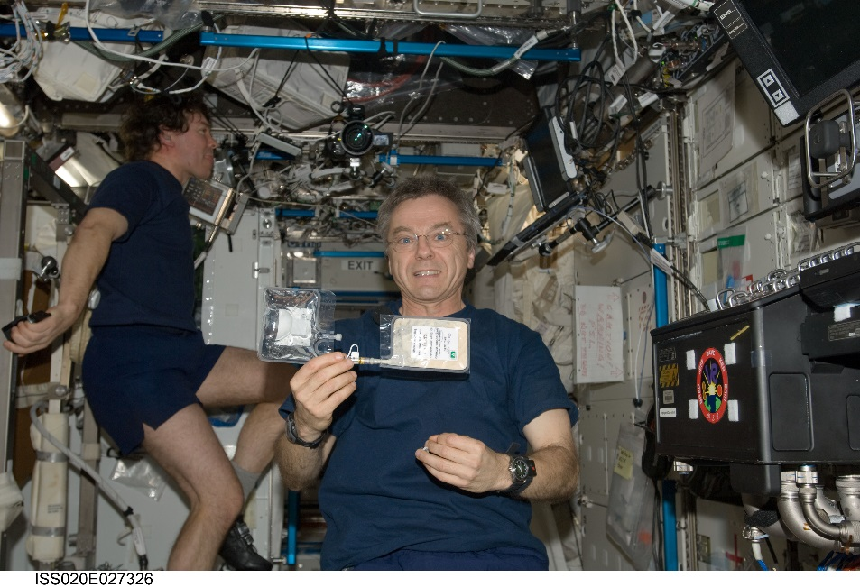
Software Facilitates Sharing of Water Quality Data Worldwide
Johnson Space Center
mWater
New York City, New York
NASA Technology
Every drop of water on the International Space Station is monitored, conserved, and reused
Engineers at Johnson created a simple, inexpensive, and accurate test for E. coli contamination without relying on the lab equipment used on Earth
Technology Transfer
An engineer who helped get this bag-based test flight certified later worked with his wife and another engineer to supply affordable kits that test water for E. coli and other contamination
The group also developed a smartphone app that instructs users on how to use the kits and can share the test results through its mapping software
Benefits
mWater’s kits and smartphone app can be used by residents of rural areas and developing countries to ensure safe drinking water
mWater received a grant from USAID to work with the Tanzanian government, providing kits and phones for in-country testing by public workers
Spinoff 2015
Public Safety

Slide 19
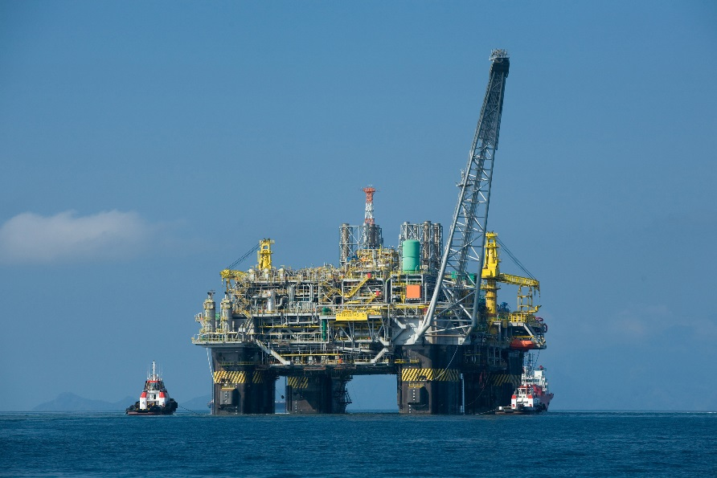
Underwater Adhesives Retrofit Pipelines with Advanced Sensors
Johnson Space Center
Astro Technology Inc. (ATI)
Houston, Texas
NASA Technology
NASA’s experience with extreme and dangerous environments has given it expertise applicable in many areas on Earth
In particular, many challenges faced by the oil and gas industry bear similarities to the kind of work done during extra-vehicular activities in space
Technology Transfer
Through a Space Act Agreement, NASA teamed up with ATI to design and test new sensors and adhesion methods for safety monitoring of subsea oil pipelines
An epoxy was chosen that would harden underwater, and NASA developed a new method for embedding fiber optic cables in the medium that protects sensors from the environment
Benefits
Trident Subsea Systems allows real-time monitoring of conditions that affect pipeline performance, stability, and safety
The system can help prevent clogged pipes, which cost many millions of dollars to fix, and can be retrofitted on older pipelines by divers or robots in just a few hours
Spinoff 2015
Public Safety

Slide 20
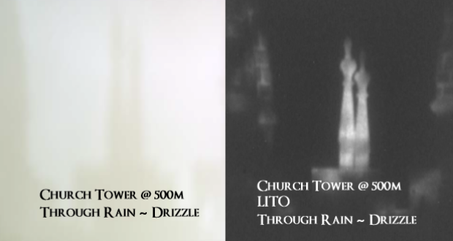
Laser Imaging Video Camera Sees through Fire, Fog, Smoke
Glenn Research Center,
Langley Research Center
Laser Imaging Through Obscurants (LITO) Technologies Inc.
Canton, Ohio
NASA Technology
Space and terrestrial aviation flights often can be delayed due to heavy rain, snow, or cloud cover
Similarly, first responders have difficulty fighting fires or finding injured people through smoke and flames
NASA has worked with the FAA to improve ability to fly in fog-covered airports, including San Francisco
Technology Transfer
Two entrepreneurs won an SBIR contract through Langley to develop hardware that bounces laser pulses off physical objects while blocking reflections from obscurants to create an image
A Space Act Agreement at Glenn allowed for development of a prototype security camera
Benefits
LITO’s security cameras could help airports maintain flight schedules through reduced visibility and inclement weather
Other applications include locating people trapped in structure fires, monitoring perimeters at fog-covered facilities and along borders, and helping ships navigate foggy harbors
Spinoff 2015
Public Safety

Slide 21
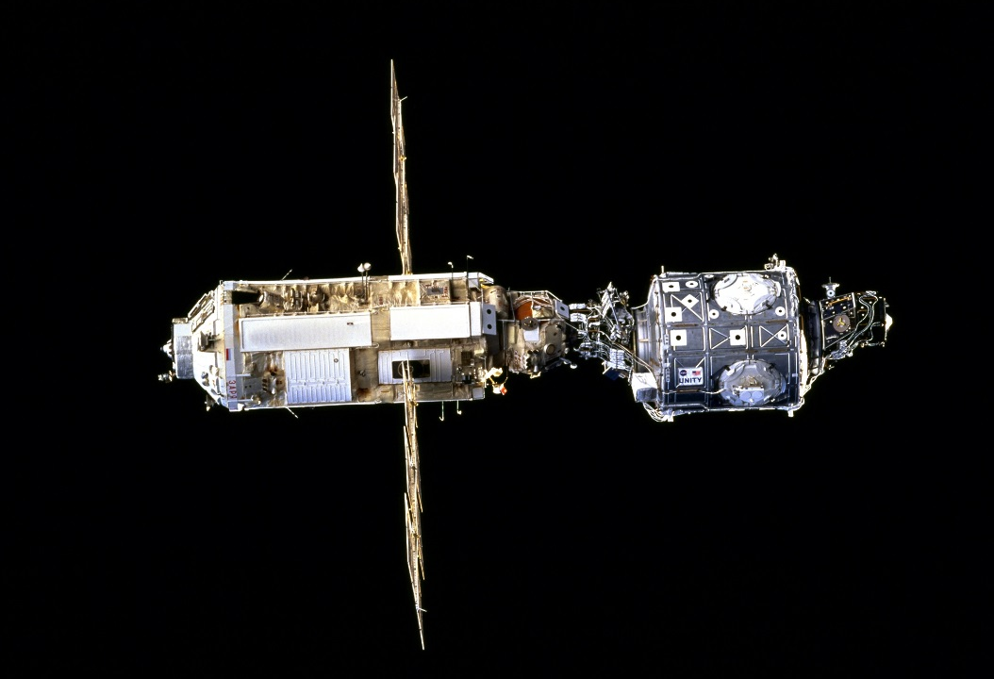
3D Lasers Increase Efficiency, Safety of Moving Machines
Johnson Space Center
Neptec Technologies Corporation
Houston, Texas
NASA Technology
Attaching modules to the International Space Station requires docking procedures that place objects within an inch and a degree of one another
Using standard cameras taking images 15 times per second, astronauts are able to determine the objects’ location in real time
Technology Transfer
Neptec, a NASA contractor, used its Laser Camera System to create a 3D image of the shuttle’s hull and another sensor to help ease docking maneuvers
The same technology is now being used to dock Cygnus (a commercial space resupply capsule) to the ISS
Benefits
Obscurant Penetrating Auto-Synchronous LiDAR (OPAL) 3D laser scanners help mining and gas companies operate machinery in dark surroundings
Real-time video feeds set OPAL apart from other similar devices on the market
Spinoff 2015
Public Safety

Slide 22


Slide 23
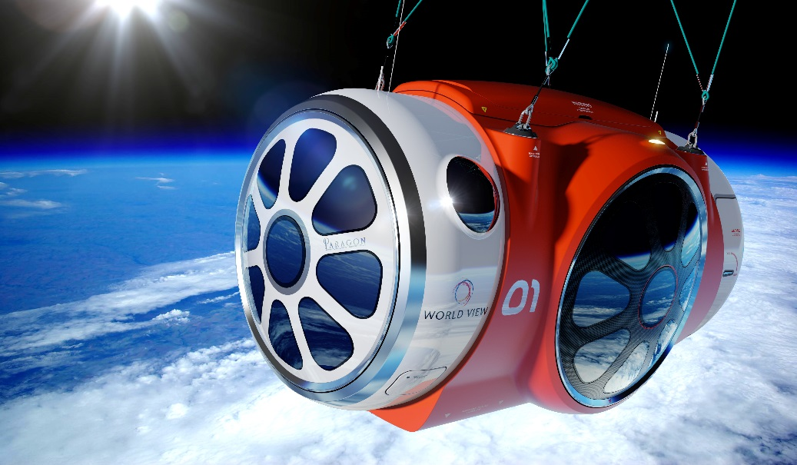
Air Revitalization System Enables Excursions to the Stratosphere
Johnson Space Center
World View Enterprises Inc.
Tucson, Arizona
NASA Technology
Astronauts need pressurized suits and clean air to survive in space
NASA’s space shuttles used several, separate components to scrub the air of impurities and excess metabolic substances, to circulate the air, and to control humidity and temperature
Technology Transfer
Under a Space Act Agreement, Paragon Space Development created a self-contained air scrubbing device that combined all these functions into a single module with only one moving part
Paragon created World View Enterprises to offer tours into low-Earth orbit, using a capsule that incorporates its air-revitalization system, as well as a radiator it also developed under a NASA contract
Benefits
World View capsule, capable of traveling to 100,000 feet above Earth, uses a pressurized cabin and air-revitalization system to enable all-day trips into near-space.
In addition to sight-seeing rides, the capsule can allow for microbiological experimentation in reduced atmosphere and celestial observation
Spinoff 2015
Consumer Goods

Slide 24
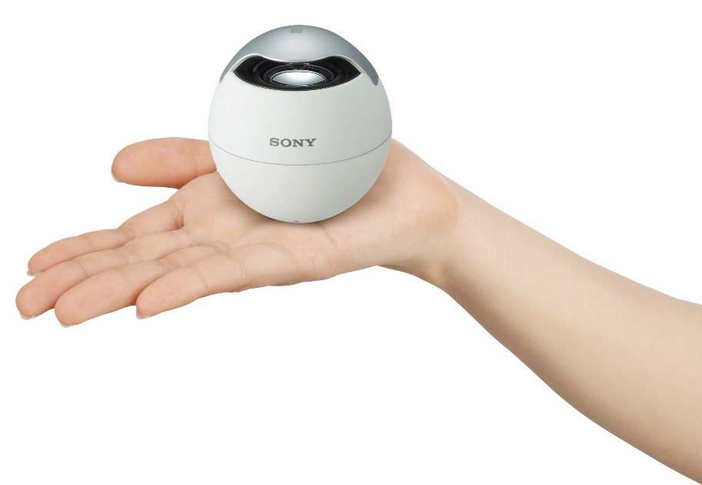
Magnetic Fluids Deliver Better Speaker Sound Quality
Glenn Research Center
Sony Corporation
New York City, New York
NASA Technology
NASA originally considered magnetizing fuel to pump it without gravity, later considering a similar concept for temperature control in shuttles
Two scientists with the contractor that explored that early work were intrigued by the potential of magnetized fluids, or ferrofluids
Technology Transfer
They licensed the technology from NASA, formed Ferrofluidics Corporation, and began using the technology for a variety of applications
Sony Corporation integrated ferrofluid in a line of speakers to produce a cleaner sound using a micron-deep pool of the fluid as a damper, which also decreases energy use by 35 percent
Benefits
Sony now sells slim speakers and Bluetooth wireless speakers that incorporate ferrofluids
Better-quality speakers have been installed in movie theaters, sound stages, and recording studios
The speakers are capable of louder volumes without distortion
Spinoff 2015
Consumer Goods

Slide 25
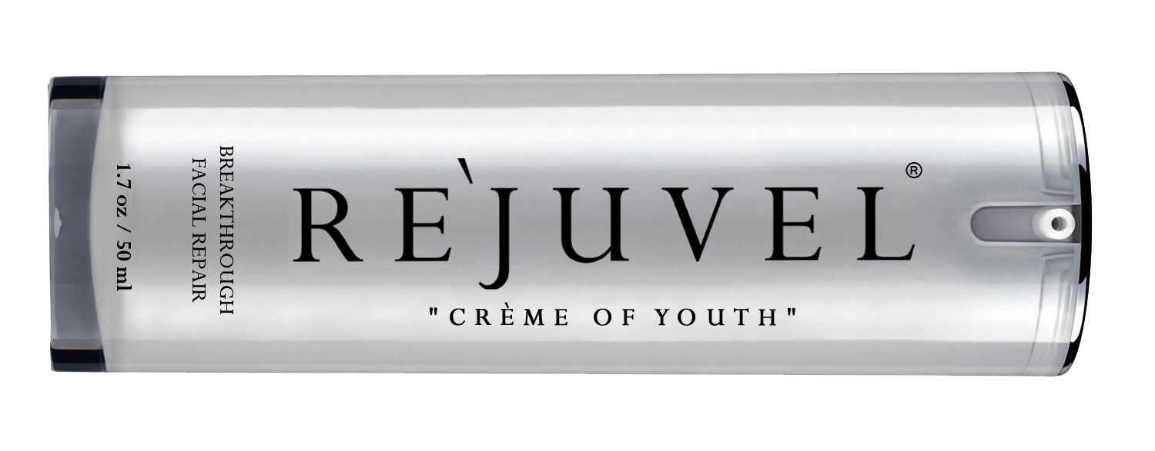
Bioreactor Yields Extracts for Skin Cream
Johnson Space Center
Renuèll Int’l Inc.
North Miami Beach, Florida
NASA Technology
A rotating wall vessel bioreactor created by NASA mimics weightlessness, allowing cell growth in three dimensions, the way they grow in the body
NASA researchers using the bioreactor produced molecules with regenerative properties, such as fibroblasts, which hold cells together
Technology Transfer
Technology Applications International obtained a license from NASA for the process of creating a fibroblast extract using the bioreactor
The company formed a subsidiary, Renuèll Int’l Inc., to market a facial skin repair cream infused with the fibroblast extract
Benefits
RE`JUVEL skin care cream stimulates cellular activity and rebuilds and tightens skin for a more youthful appearance
Tests conducted by the FDA found RE`JUVEL increased skin moisture by 76 percent and reduced wrinkles by 54 percent
Spinoff 2015
Consumer Goods

Slide 26
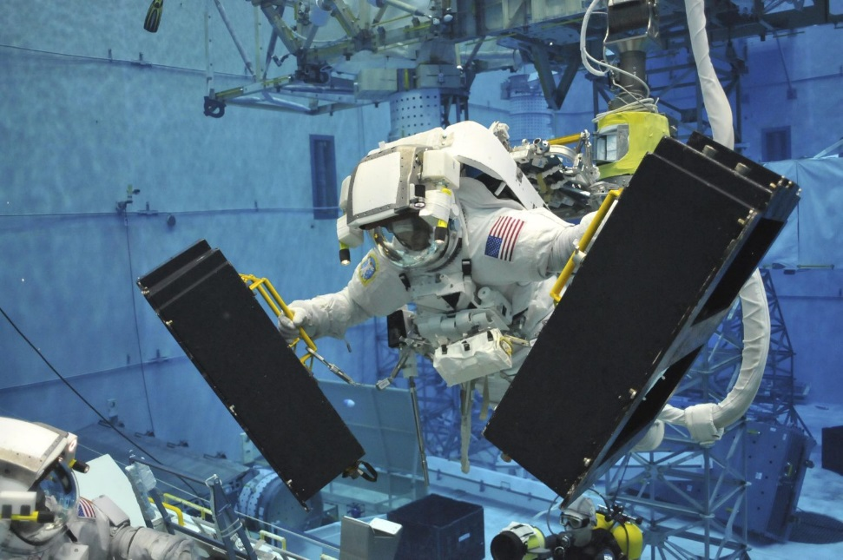
Private Astronaut Training Prepares Commercial Crews of Tomorrow
Johnson Space Center
Waypoint 2 Space
Houston, Texas
NASA Technology
As the space program has evolved, so too have the methods used to train astronauts for their journey
Astronauts receive instruction in land and water survival skills, orbital mechanics, payload deployment, and space physiology, among other training
Technology Transfer
Waypoint 2 Space employs former NASA personnel and contractors as trainers, including its director of programs, who trained astronauts for NASA
Company has also acquired at least two software programs from NASA through a General Public Release Software Usage Agreement
Waypoint 2 Space offers three levels of training for future space tourists and space aficionados
Benefits
The company is one of the first to receive a safety approval from the FAA’s Office of Commercial Space Transportation to offer commercial astronaut training
Training services could help meet the needs of commercial space companies and those sending payloads into space
Spinoff 2015
Consumer Goods

Slide 27
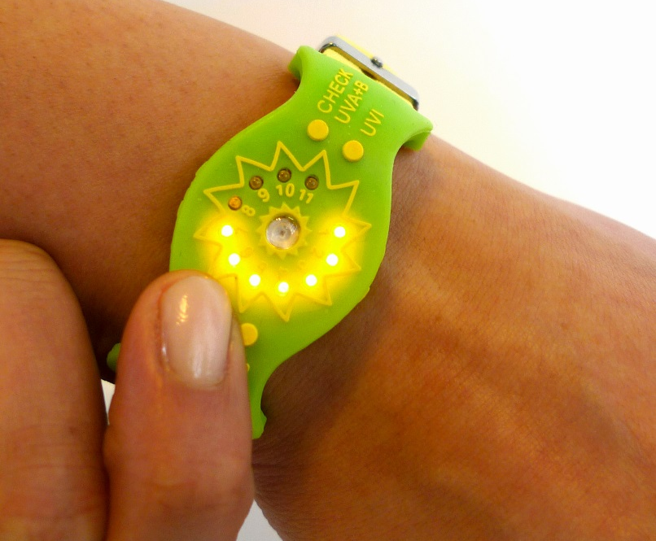
Activity Monitors Help Users Get Optimum Sun Exposure
Goddard Space Flight Center
Sensor Sensor LLC
College Park, Maryland
NASA Technology
To understand the sun’s impact on Earth, NASA started the Living with a Star program, including construction of the Solar Dynamics Observatory
Members of a team building the Extreme Ultraviolet Variability Experiment for the project looked into use of wide-bandgap semiconductors to detect UV light
Technology Transfer
Although they weren’t used on the observatory, compounds were identified that detected UV light
One of the NASA researchers used one such compound to create a detector that monitors the user’s exposure to UV light
Too much exposure to UV rays can trigger skin cancer; not enough can lead to vitamin D deficiency
Benefits
UVA+B SunFriend, a wearable UV exposure monitor, won the NASA Tech Briefs Create the Future Design Contest
The wearer selects his or her level of skin sensitivity, and the device flashes when the recommended daily dose of UV has been reached
Spinoff 2015
Consumer Goods

Slide 28
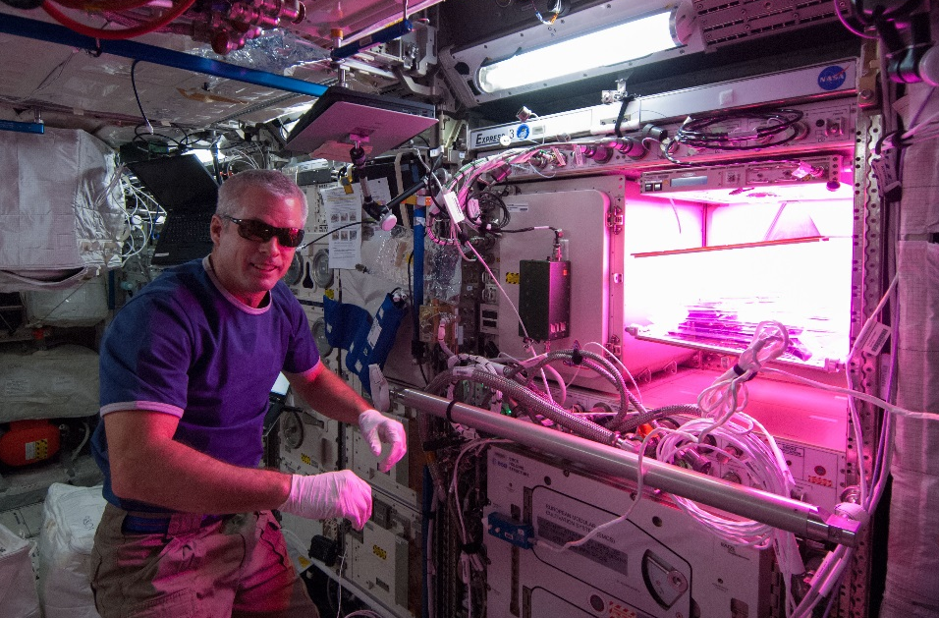
LEDs Illuminate Bulbs for Better Sleep, Wake Cycles
Kennedy Space Center
Lighting Science
Satellite Beach, Florida
NASA Technology
Lighting poses numerous challenges in space, such as limited durability of bulbs and the physiological effect they have on astronauts’ circadian rhythms
LEDs offer lightweight, long-lasting sources of light that can create specific colors and also be used to promote plant growth
Technology Transfer
The National Space Biomedical Research Program provided grants to institutions seeking solutions to health concerns in space
Certain colors of light were found to help astronauts fall asleep, while others were useful in keeping them alert
A team of scientists from Kennedy started a company specializing in beneficial-spectrum LEDs
Benefits
DefinityDigital LED bulbs promote sleep, wakefulness, or plant growth, and one helps prevent baby sea turtles from going inland
The bulbs have been adopted by hotel chains and resorts to help them save energy and promote relaxation and rest for customers
Spinoff 2015
Consumer Goods

Slide 29
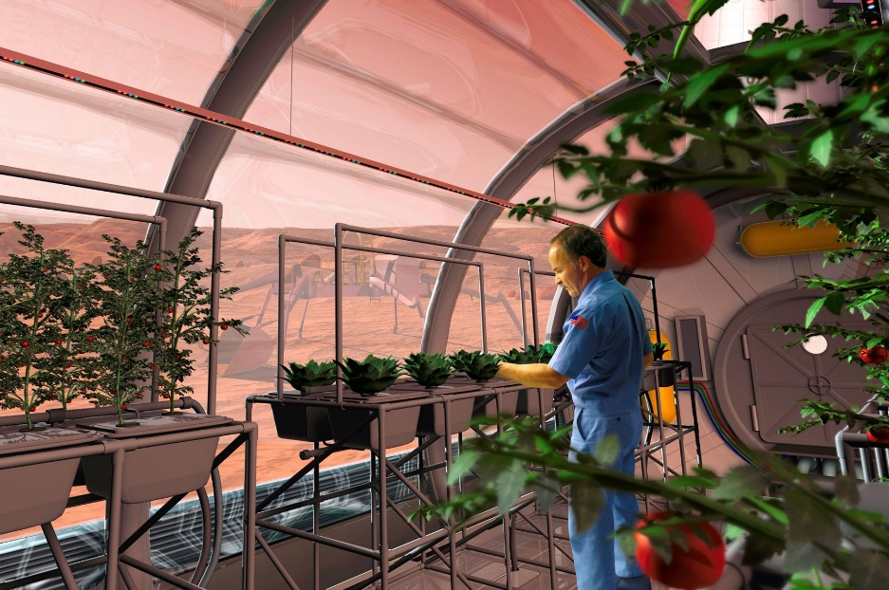
Charged Particles Kill Pathogens and Round Up Dust
Marshall Space Flight Center
Aerus Holdings
Dallas, Texas
NASA Technology
NASA wants astronauts to have the ability grow fresh fruits and vegetables in space or on Mars
A NASA-developed device scrubs the air of ethylene, a gas emitted by plants that speeds aging, turning it into trace amounts of carbon dioxide and water
Technology Transfer
The same process, first used on Space Shuttle Columbia in 1995, can also be used to kill pathogens
Building on that technology, Aerus created a device for HVAC systems to clean the air, as well as disinfect surfaces in a home or an office
Scrubbed air also removes dust and pollen and combats odor
Benefits
Air Scrubber Plus has been shown to reduce airborne MRSA by 99.8 percent and E. coli by 98.1 percent
Other research from the University of Chicago found that particles fall out of the air faster with the technology than by gravity alone
Spinoff 2015
Consumer Goods

Slide 30
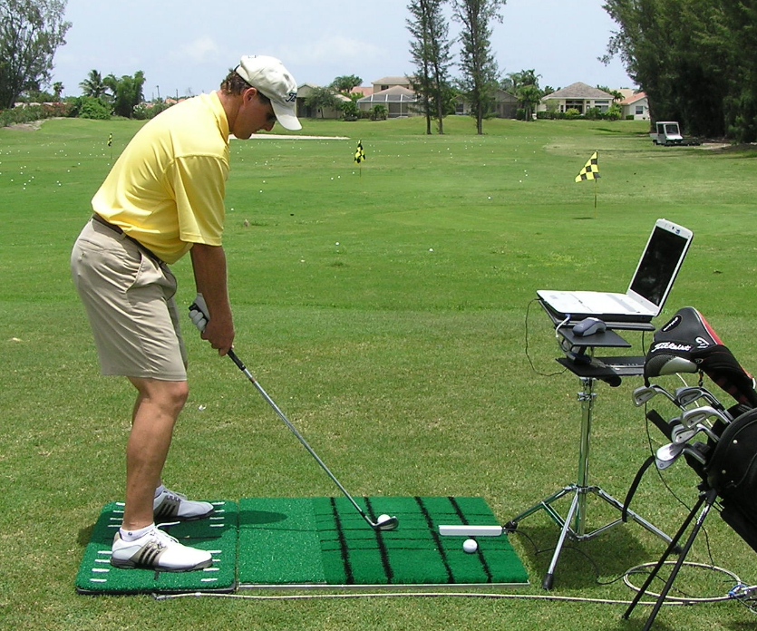
Balance Devices Train Golfers for a Consistent Swing
NASA Headquarters
Sports Therapy Inc.
West Palm Beach, Florida
NASA Technology
While astronauts can adjust rather quickly to a lack of gravity, reacclimation to Earth’s gravity takes time
A NASA-funded study used a device that alters the surface on which the user stands, as well as visual surroundings, in order to assess and train balance
Technology Transfer
The inventor later founded a company and offered devices to treat balance disorders
A physical therapist who started using the device to treat athletes found it could be adapted to improve a golfer’s swing
The two co-patented a modified version of the device
Benefits
Dynamic Balance System uses a shifting platform and computer to provide a real-time display of a user’s balance and center-of-gravity movement
Hundreds of units are in use in medical clinics, country clubs, and golf schools, including the PGA Center for Golf Performance and PGA Tour Academies
Spinoff 2015
Consumer Goods

Slide 31


Slide 32
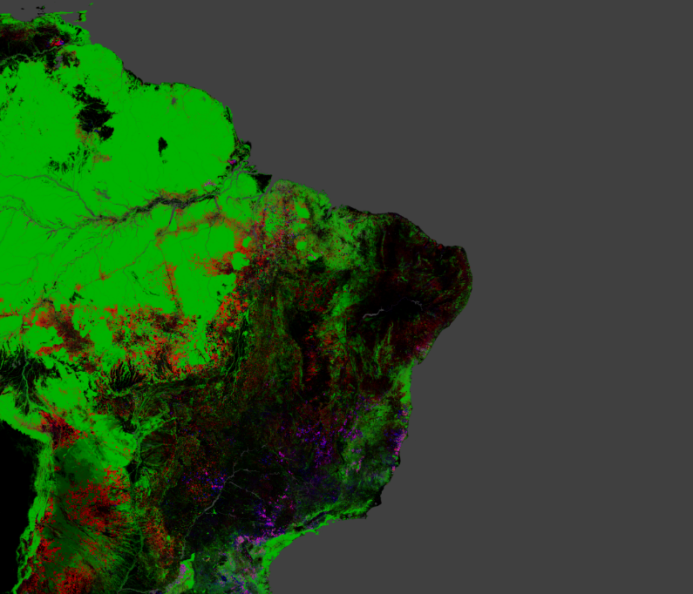
Landsat Imagery Enables Global Studies of Surface Trends
Goddard Space Flight Center
Google
Mountain View, California
NASA Technology
Landsat images of Earth, taken by NASA-built satellites, were originally used by the US Geological Survey to track changes to the landscape and research natural disaster assessments
Until 2008, the images were stored in a vault and sold for high prices
Technology Transfer
In 2008, Landsat images were made available to the public for free
By 2010, Google released Google Earth Engine, providing access to 40 years of Landsat images
Scientists now can track global trends over decades
Some are combining Landsat data with images from other satellites
Benefits
Google Earth Engine released Timelapse, allowing users to see animation of any land area on Earth from 1984-2012
First-ever global study of forest cover showing gains and losses in tree cover
Possible to predict disease outbreaks through ecological changes
Spinoff 2015
Energy and Environment

Slide 33
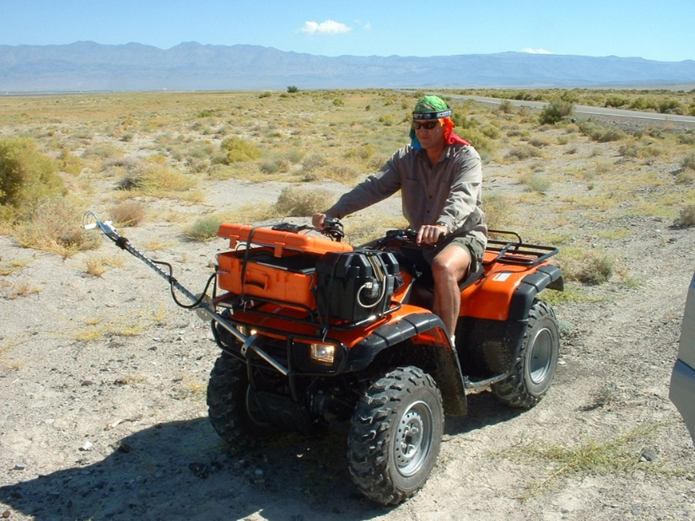
Ruggedized Spectrometers Are Built for Tough Jobs
Jet Propulsion Laboratory
Ocean Optics
Dunedin, Florida
NASA Technology
Curiosity contains a spectrometer capable of determining the elemental composition of a sample on Mars from up to 23 feet away
This information provides insight into the composition of Mars and whether it does or ever did sustain life.
Technology Transfer
Ocean Optics had developed the first miniaturized spectrometer prior to working with NASA on Curiosity
Spectrometers were reconfigured to withstand intense heat, cold, and radiation, as well as vibrations during launch
Optical input is optimized through the use of specialized mirrors
Benefits
Ocean Optics’ EMBED features electronics that are decoupled from the spectrometer detector to improve long-term wavelength stability
Optic mounting methods and temperature protections were improved based on NASA work
To date, more than 250,000 units have been sold
Spinoff 2015
Energy and Environment

Slide 34
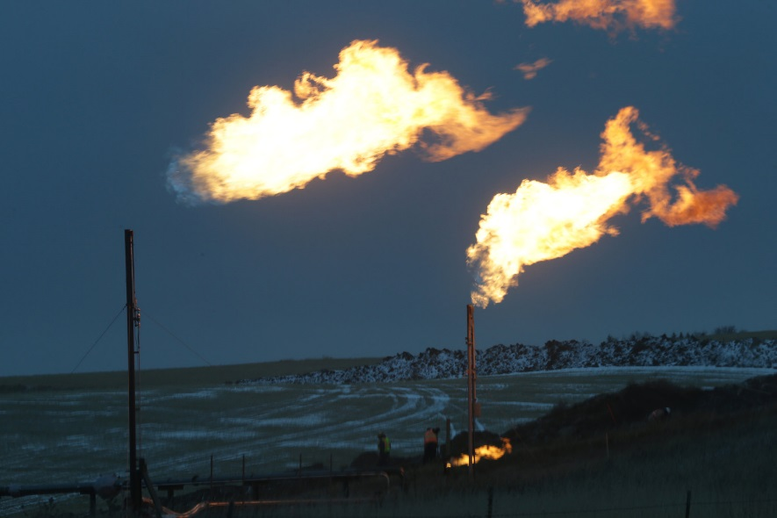
Gas Conversion Systems Reclaim Fuel for Industry
Johnson Space Center
Pioneer Energy Inc.
Lakewood, Colorado
NASA Technology
The ability to use Mars’ carbon dioxide-laden atmosphere to get oxygen for fuel and life support will be essential to future manned missions
The ability to make fuel rather than carry it lightens the required loads for launch
Technology Transfer
SBIR contracts funded work to recombine carbon, hydrogen and oxygen atoms into fuel and breathable air
Robert Zubrin, whose company worked on the project, devised a system to harness natural gases on Earth, and another to produce carbon dioxide for extracting oil from old wells, using similar processes
Benefits
Pioneer’s Mobile Alkane Gas Separator (MAGS) reduces wasteful gas flares by harnessing gases for use
Pioneer Energy Mobile CO₂ EOR Technology (PERT) creates hydrogen to power itself while creating carbon dioxide to obtain oil from old wells
Spinoff 2015
Energy and Environment

Slide 35
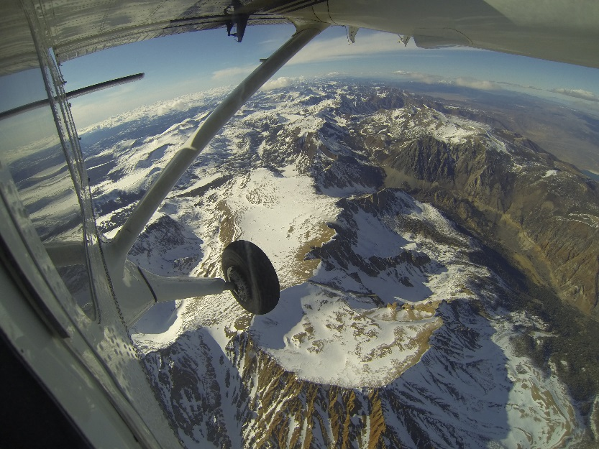
Remote Sensing Technologies Mitigate Drought
Ames Research Center
California Department of Water Resources
Fresno, California
NASA Technology
NASA satellites have been collecting data and images for decades, providing tools for tracking and dealing with drought conditions
The images also make it possible to survey fires, carbon cycles, and vegetation
Technology Transfer
Information from Landsat and other satellites, combined with evapotranspiration data, determine how much water is needed for crop irrigation at any given time
NASA and California Department of Water Resources initiated the Satellite Irrigation Management Support project, using Landsat and MODIS data to track coefficients for water needs
Benefits
Web and mobile prototypes are being tested by water managers throughout the state
The amount of water permitted for irrigation can be adjusted based on weather patterns or growing seasons to maximize efficiency
Technology can also be used to pinpoint fields with reduced productivity
Spinoff 2015
Energy and Environment

Slide 36
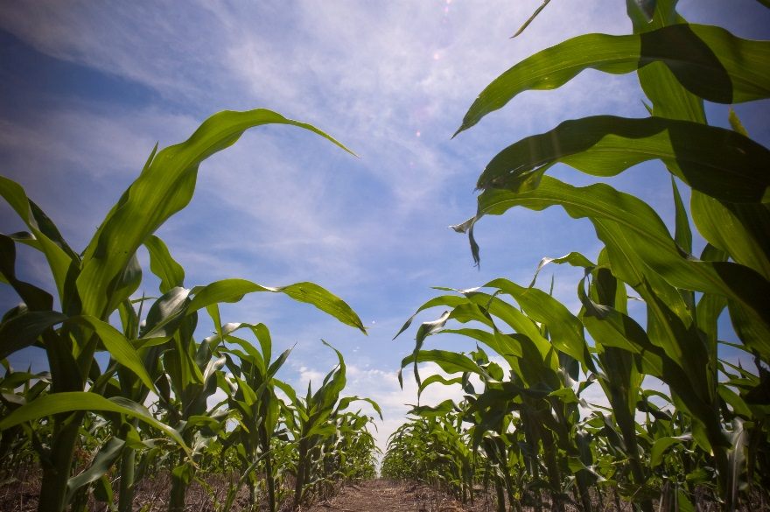
Satellite Data Inform Forecasts of Crop Growth
Stennis Space Center
Genscape Inc.
Louisville, Kentucky
NASA Technology
NASA and US Department of Agriculture have teamed up to advance technologies that can make farming more efficient and productive
The Ag 20/20 partnership led to new tools for monitoring plant health and better target applications of pesticides
Technology Transfer
Using MODIS data on how much solar radiation is reflected from a given location, researchers developed models to predict crop production
One of those researchers used what he had learned to help develop a software to predict corn yield
Genscape, a company that provides real-time data to energy markets, bought rights to the software and now offers it commercially
Benefits
LandViewer, a subscription-based software, provides daily updates on corn vegetation for predictions of crop production on national, state, and county scales
NASA data on vegetation vigor and nighttime surface temperature, gathered daily, allows for high-resolution information
Spinoff 2015
Energy and Environment

Slide 37
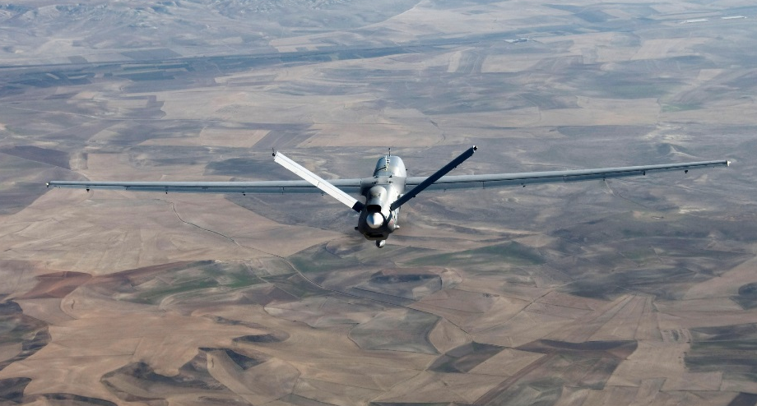
Probes Measure Gases for Environmental Research
Goddard Space Flight Center
Aeroprobe Corporation
Christianburg, Virginia
NASA Technology
NASA’s Orbiting Carbon Observatory-2 (OCO-2) is making the first space-based measurements of CO₂ in Earth’s atmosphere
OCO-2 can measure increasing CO₂ concentrations but cannot directly detect small variations
Technology Transfer
Aeroprobe, through an SBIR contract, worked to create an instrument that could be mounted on an aircraft to take CO₂ measurements
The tool measures concentration and speed of CO₂ and other airborne gases
It is also capable of correcting for aircraft movement during tests
Benefits
The Fast Response Atmospheric Turbulence (FRAT) probe was successfully tested by Virginia Tech for measuring gas contents, humidity, and other thermodynamic quantities
FRAT probes have been sold to research institutions and government; future uses could include environmental research and detecting leaks in natural gas lines
Spinoff 2015
Energy and Environment

Slide 38


Slide 39
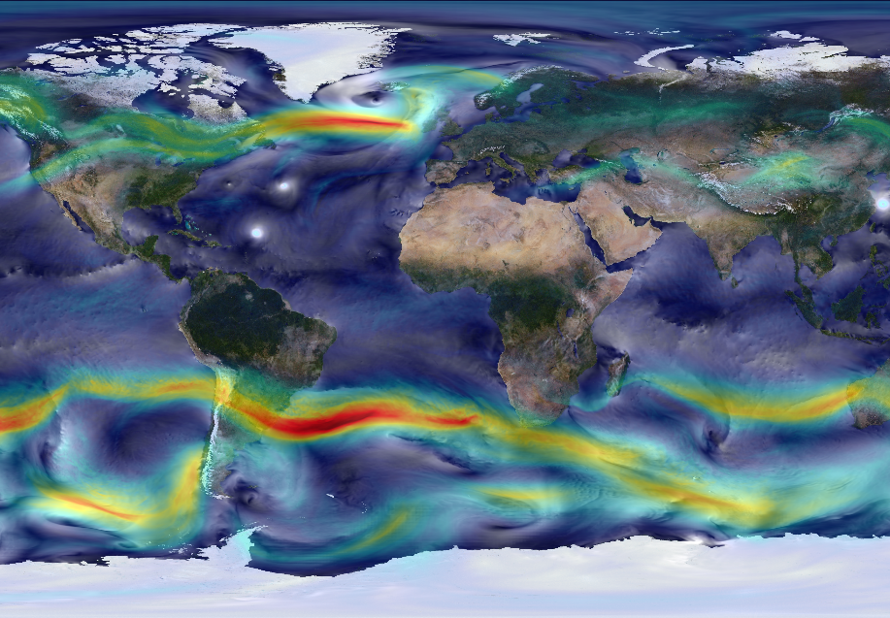
Cloud Computing Technologies Facilitate Earth Research
Ames Research Center,
Jet Propulsion Laboratory
Amazon.com
Seattle, Washington
NASA Technology
Landsat information led the way in providing tools for Earth science study
Terra and Aqua spacecraft track atmospherics, snow and ice cover, ocean life
It can be difficult to translate NASA data to outside systems
Technology Transfer
Cloud computing technology devised by Amazon.com can help researchers and commercial enterprises who need supercomputing capabilities and large amounts of data storage
Ames partnered with Amazon Web Services through a Space Act Agreement to provide storage for and share NASA data with scientists worldwide
Benefits
Three databases have been released by NASA and AWS so far, containing topographical, vegetative, and climate data
Users have the option of purchasing computing services from Amazon for performing analyses
The datasets have been optimized for Amazon’s servers, increasing ease of use
Spinoff 2015
Information Technology

Slide 40
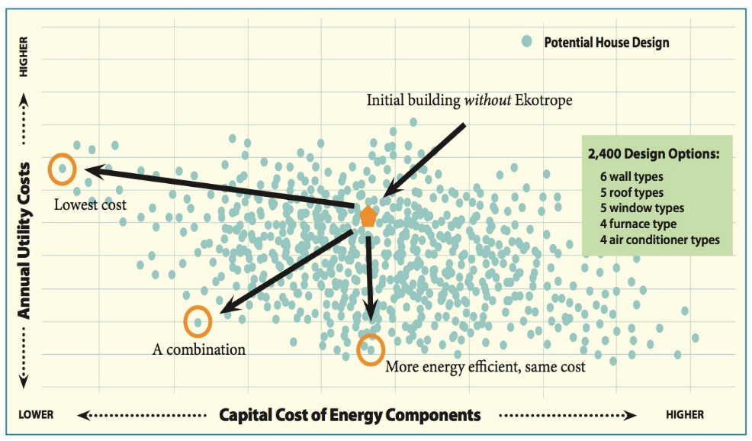
Software Cuts Homebuilding Costs, Increases Energy Efficiency
NASA Headquarters
Ekotrope
Cambridge, Massachusetts
NASA Technology
Landing on Mars will require new and innovative tools and instruments
Given the almost infinite combinations of possible technologies, NASA worked with MIT to create an algorithm-based evaluation tool to find best options
Technology Transfer
Using MIT’s algorithm, NASA has decided to further develop technologies in support of a liquid hydrogen fuel source and hydrogen boil-off control technology
The inventors created a similar algorithm for designing energy-efficient house construction plans
The program can determine what are the best design features to maximize efficiency, reduce costs
Benefits
Ekotrope analyzes interior and exterior dimensions, building materials, and orientation and combines with local weather data to make recommendations
A typical client can switch designs to one that is 40 percent more energy-efficient and saves up to $3,000 in construction costs
Spinoff 2015
Information Technology

Slide 41
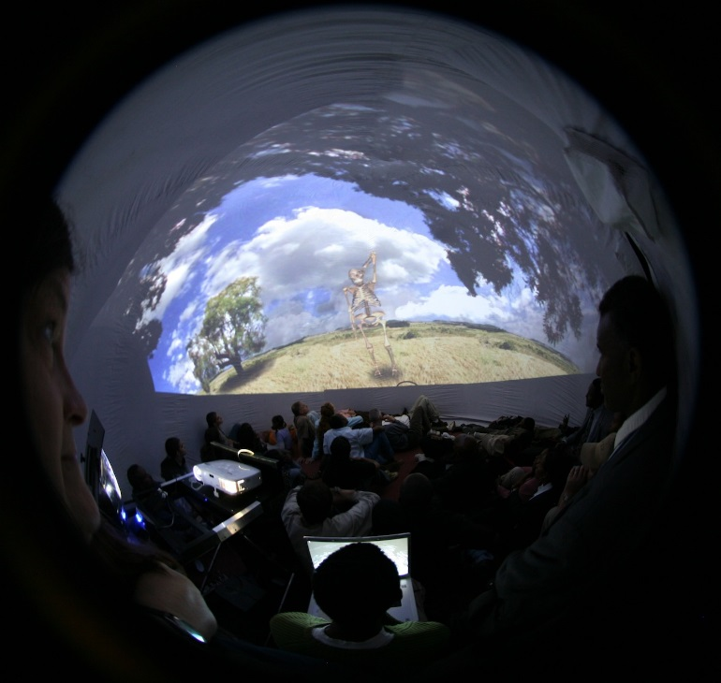
Portable Planetariums Teach Science
NASA Headquarters
Museums Teaching Planet Earth Inc. (MTPE)
Houston, Texas
NASA Technology
NASA has a trove of data and photos from space, but those treasures are not always easily accessible to the public
As the Internet grew in popularity, NASA wanted to find a way to use it to publicize more of its data
Technology Transfer
Responding to a call for proposals, Rice University and the Houston Museum of Natural Science created the world’s first Internet-accessible museum kiosk, with three informational programs
Funding and licenses from NASA led to the creation of the country’s first fully digital planetarium and first Earth science planetarium show focused on weather
Benefits
Discovery Dome, a portable planetarium, has been installed more than 200 times since 2005 in 33 different countries
The dome provides an immersive experience and is targeted especially at a young audience
New shows include images and videos taken from the International Space Station
Spinoff 2015
Information Technology

Slide 42
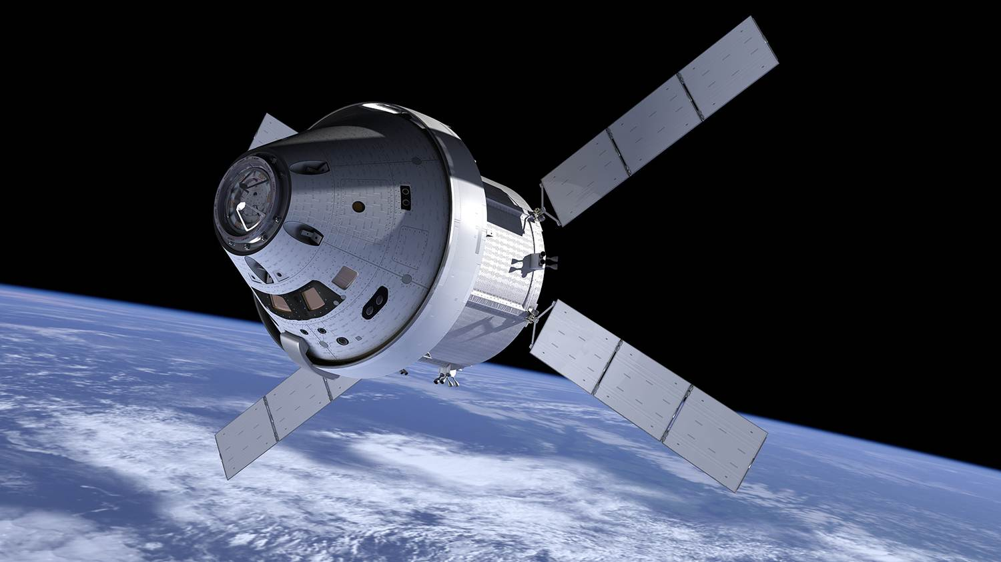
Schedule Analysis Software Saves Time for Project Planners
Marshall Space Flight Center
Vantage Systems Inc.
Lanham, Maryland
NASA Technology
At NASA, scheduling conflicts created logistical problems during major projects
Existing software was helpful, but time-consuming to use
Technology Transfer
Engineers created an add-on for Microsoft Project that greatly expanded scheduling capabilities
More than 200 companies, government agencies, and universities are now using the software
Program can produce a summary report, find performance issues or scheduling errors, and create a simplified summary for executive-level managers
Benefits
Schedule Test and Assessment (STAT) software helps create schedules based on relationships between tasks and identifies errors in logic
If a program falls too far behind a projected timeline, STAT recommends updates
Spinoff 2015
Information Technology

Slide 43
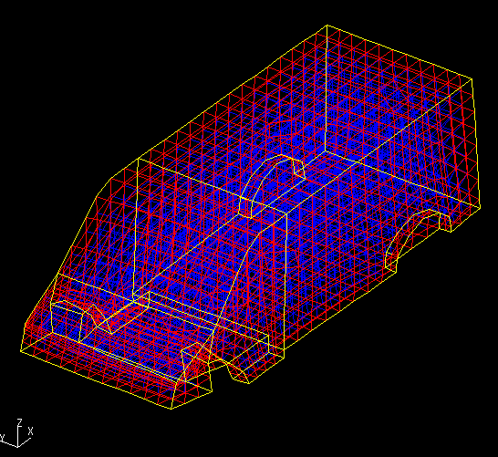
Sound Modeling Simplifies Vehicle Noise Management
Langley Research Center
Comet Technology Corporation (CTC)
Ann Arbor, Michigan
NASA Technology
Noise management and mitigation are important for NASA, as astronauts and payloads are exposed to loud noises and vibration during launch
Element and energy analysis can predict vibrations and sound in vehicle designs, but there were limits in existing methods
Technology Transfer
NASA awarded Phase I and II SBIR contracts to CTC for work on integrating finite element analysis and statistical energy analysis programs into a single model
New program provides a unified framework for analysis of both low- and high-frequency noise
Benefits
Comet EnFlow software is marketed to automobile and aircraft manufacturers, with interest from the consumer product industry and ship builders
NASA’s Nondestructive Evaluation Sciences Branch, at Langley, uses it to rapidly locate leaks in the International Space Station
Spinoff 2015
Information Technology

Slide 44


Slide 45
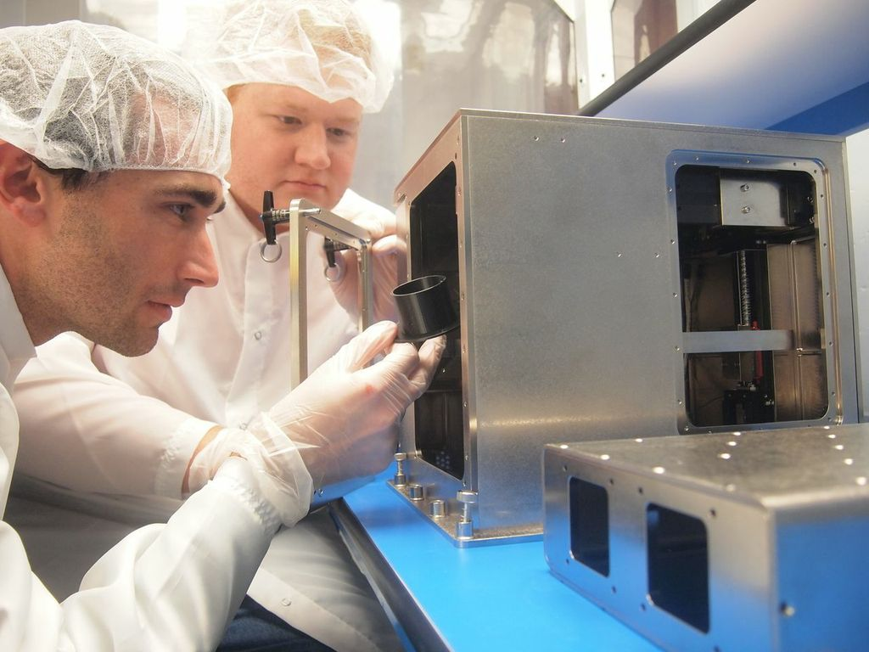
Custom 3D Printers Revolutionize Space Supply Chain
Marshall Space Flight Center
Made In Space
Moffett Field, California
NASA Technology
Until recently, astronauts had to fit everything needed for flight into a spacecraft, with space and weight capacity at a premium
The advent of 3D printing technology will allow many parts and supplies to be manufactured in space, changing the way NASA prepares for missions
Technology Transfer
Through SBIR contracts, Made In Space developed a 3D printer capable of working in microgravity that is being installed on the International Space Station
An estimated 30 percent of small parts and tools used on ISS could be printed in space; NASA has already emailed specifications for a wrench that was printed on the ISS
Benefits
Made In Space’s 3D printer allows astronauts to create or replace what they need while in space without waiting for another supply delivery
The printer will also serve a range of commercial interests, including the creation and deployment of nanosatellites from orbit
Spinoff 2015
Industrial Productivity

Slide 46
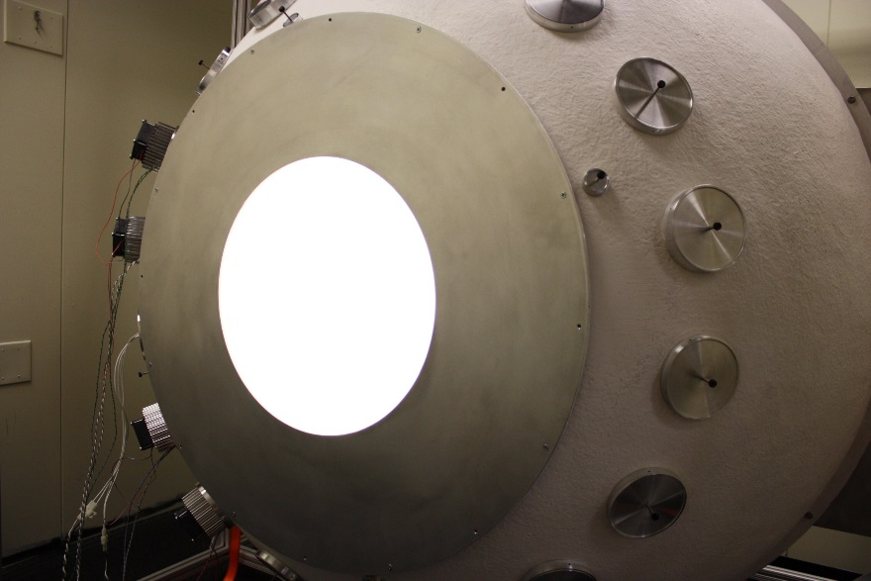
Improved Calibration Shows Images’ True Colors
Stennis Space Center
Innovative Imaging and Research Corporation (I2R)
Stennis Space Center, Mississippi
NASA Technology
Light-producing spheres (known as integrating spheres) are a tool used to calibrate cameras, but they are expensive to build and operate, and their bulbs degrade quickly
Properly calibrated cameras improve the color accuracy of images obtained from satellites
Technology Transfer
I2R has experimented with LEDs as a light source for integrating spheres; in addition to cost and durability benefits, LEDs can more accurately simulate sunlight in the calibration process
NASA and I2R entered into a dual-use agreement for the creation of integrating spheres using LEDs and alternative building materials, ultimately cutting their cost by 75 percent
Benefits
I2R’s integrating spheres improve the process of calibrating cameras and can even turn commercial off-the-shelf cameras into tools fit for science
NASA and I2R are using the spheres to calibrate cell phone cameras, as well as to design a new lighting system for the ISS
Spinoff 2015
Industrial Productivity

Slide 47
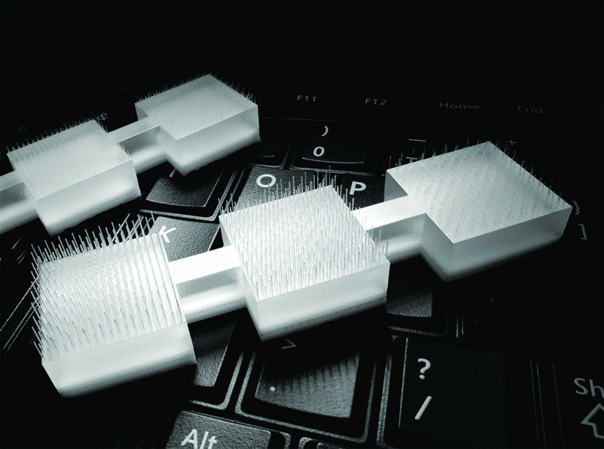
Micromachined Parts Advance Medicine, Astrophysics, and More
Marshall Space Flight Center
Potomac Photonics
Baltimore, Maryland
NASA Technology
NASA awarded two SBIR contracts to Potomac Photonics for research on using excimer lasers to micromachine diffractive lenses
SBIR contracts also funded the design of workstations that used AutoCAD software to automate micromachining
Technology Transfer
Technology resulting from SBIRs made the manufacture of not only diffractive lenses but all sorts of micromachined parts fast and affordable
Though workstations were eventually discontinued, the technology put the company on course to be a leader in the field of micromachined components
Benefits
Laser micromachining has caused company revenues to grow 50–75 percent
NASA remains a customer, for example, contracting Potomac to create laser markings to align telescopes on ASTRO-H
Other clients include Johns Hopkins and other hospitals
Spinoff 2015
Industrial Productivity

Slide 48
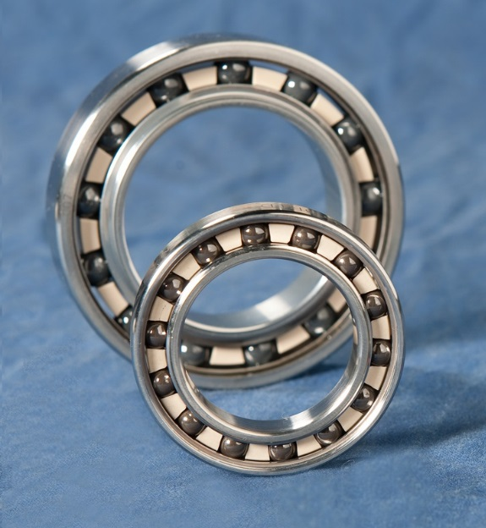
Metalworking Techniques Unlock a Unique Ability
Glenn Research Center
Abbott Ball Company
West Hartford, Connecticut
NASA Technology
Abbott Ball wanted to experiment with an overlooked titanium-nickel alloy (Nitinol 60) for ball bearings, as stainless steel bearings tend to corrode easily
Glenn has world-class facilities and personnel to test such metals for use in aerospace components
Technology Transfer
NASA engineers worked with Abbott Ball to manufacture Nitinol 60 bearings using powdered metallurgy, in which particles of materials are combined in powdered form and heated until they combine in a solid-state fashion
NASA and Abbott Ball co-own patents on their innovations in this process as it applies to Nitinol 60
Benefits
Nitinol 60 ball bearings have all the strength of those made with stainless steel but are essentially corrosion-proof
Aerospace clients make up most of product’s niche market
US Navy has granted two SBIR contracts for additional uses; medical uses being explored
Spinoff 2015
Industrial Productivity

Slide 49
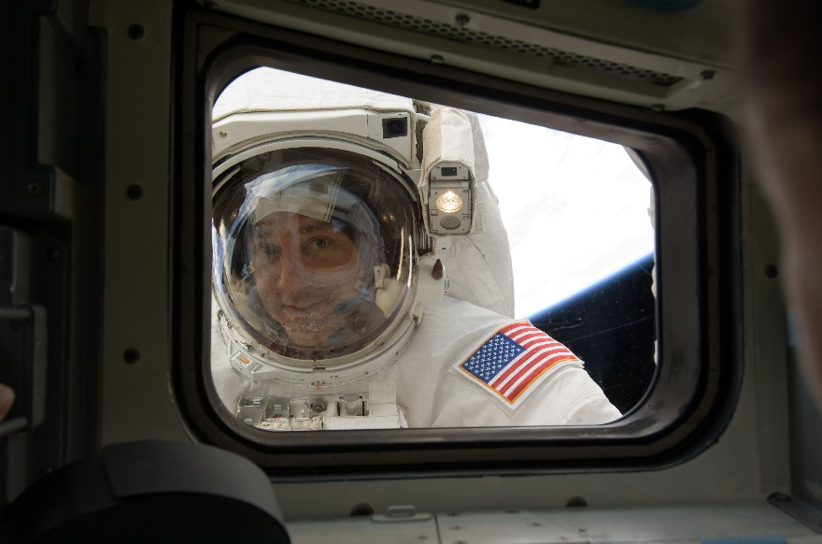
Low-Cost Sensors Deliver Nanometer-Accurate Measurements
Kennedy Space Center
Juntura Group
Winter Park, Florida
NASA Technology
The space shuttle windows required laborious inspections following each launch to ensure that even microscopic cracks and flaws were repaired
Using just a few widely available parts, a NASA engineer developed a new, low-cost sensor for the inspections
Technology Transfer
Kennedy’s Technology Transfer Office approached a local business school with a selected patent portfolio, looking for ideas for commercialization
A group of MBA students with engineering backgrounds took interest in the sensor, and after presenting their market research decided to execute a commercial license for it with the agency
Benefits
Juntura’s position sensor has a resolution of 10 nanometers—the thickness of a cell wall
The sensor has applications in 3D printers, laser holders, military technology, and robotics
Florida Institute of Technology is among the first purchasers, incorporating it in 3D printers used to produce human tissue
Spinoff 2015
Industrial Productivity

Slide 50
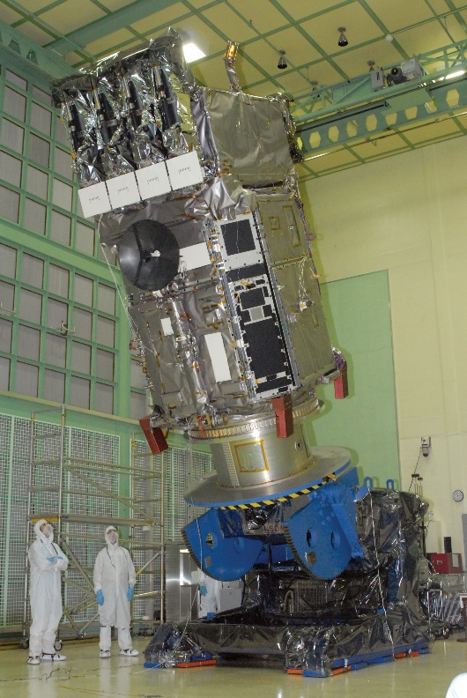
Electrical Monitoring Devices Save on Time and Cost
Goddard Space Flight Center
Micropac Industries Inc.
Garland, Texas
NASA Technology
NASA wanted to protect its investment in the technologically advanced Solar Dynamics Observatory from single-event upsets, which trip electrical fuses
The agency also wanted an alternative to electrical fuses to protect electronics without deactivation
Technology Transfer
The solution: a solid-state power controller which, unlike electrical fuses, can be switched back on remotely
NASA worked with Micropac to develop power controllers with silicon components and comparators resistant to up to 100 kilorads of radiation
Benefits
Micropac’s specially designed solid-state power controller (SSPC) is the first high-reliability spaceflight SSPC
It is immune to single-event upsets and is Underwriters Laboratories-certified for industrial sector, in any application where power control is required and remote control would be beneficial
Spinoff 2015
Industrial Productivity

Slide 51
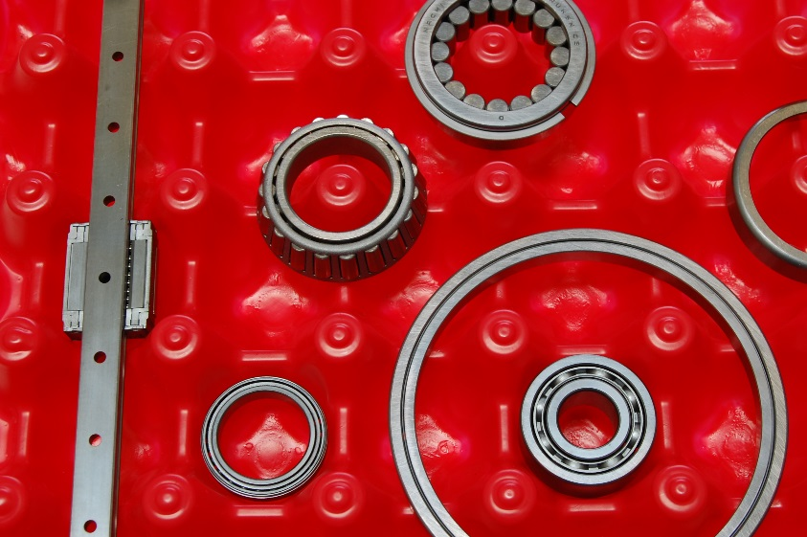
Dry Lubricant Smooths the Way for Space Travel, Industry
Jet Propulsion Laboratory
Applied Tungstenite Corporation
Temecula, California
NASA Technology
While much other NASA technology from early space missions is outdated, tungsten disulfide, invented for use on probes, remains useful
A dry lubricant, it can withstand loads in excess of 300,000 pounds per square inch
Technology Transfer
Impinging, or blasting the powder onto a surface at 700 mph, helps bond tungsten disulfide to a surface but is costly and labor-intensive
Most industries now use other lubricants, but impinging is still popular in aerospace applications
Applied Tungsteninte is the only company certified as using the original impinging process, invented by NASA, in a certified facility
Benefits
Impinged tungsten disulfide is used on government and commercial spacecraft parts, ranging from bearings and fasteners to gears and hydraulic connections
The company is currently in talks with Langley Research Center to engage in an SBIR contract to automate the impinging process, which is helpful for tiny parts
Spinoff 2015
Industrial Productivity

Slide 52
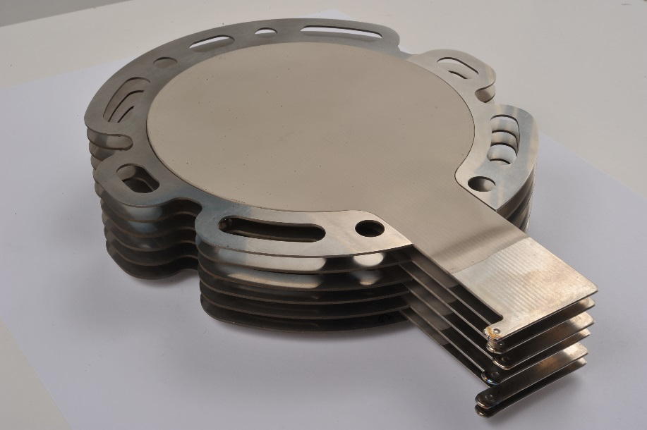
Compact Vapor Chamber Cools Critical Components
Glenn Research Center
Thermacore Inc.
Lancaster, Pennsylvania
NASA Technology
NASA has long been interested in alternatives to bulky alkaline batteries for its spacecraft
Improvements in proton exchange membrane (PEM) fuel cells have reinvigorated interest in them
Traditional liquid-pumping cooling systems for PEM cells, however, are also bulky
Technology Transfer
NASA needed a compact, passive thermal management system
Using Phase I and II SBIR contracts, Thermacore developed a water-based titanium vapor chamber, stronger and lighter than copper alternatives
Proprietary manufacturing technique reduces production costs by 90 percent
Benefits
The Thin Titanium-Vapor Chamber Therma-Base now provides passive thermal management to heat-generating electronics, including processors and amplifiers
Titanium and water don’t react, so there is no risk of producing gases that could damage the chamber
Spinoff 2015
Industrial Productivity

Slide 53
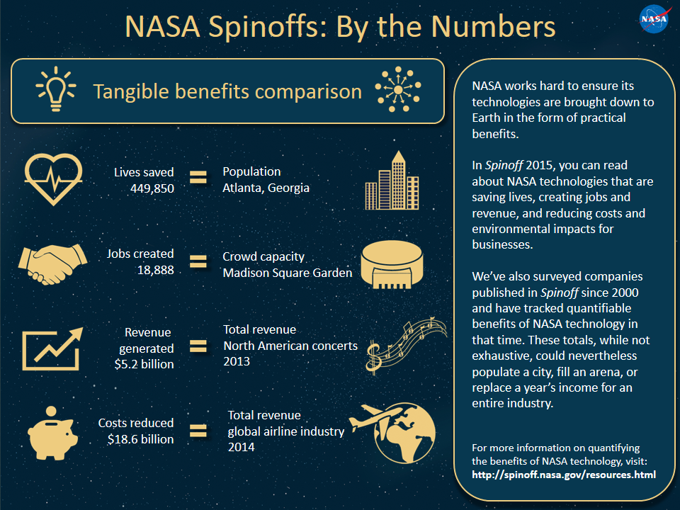

Slide 54
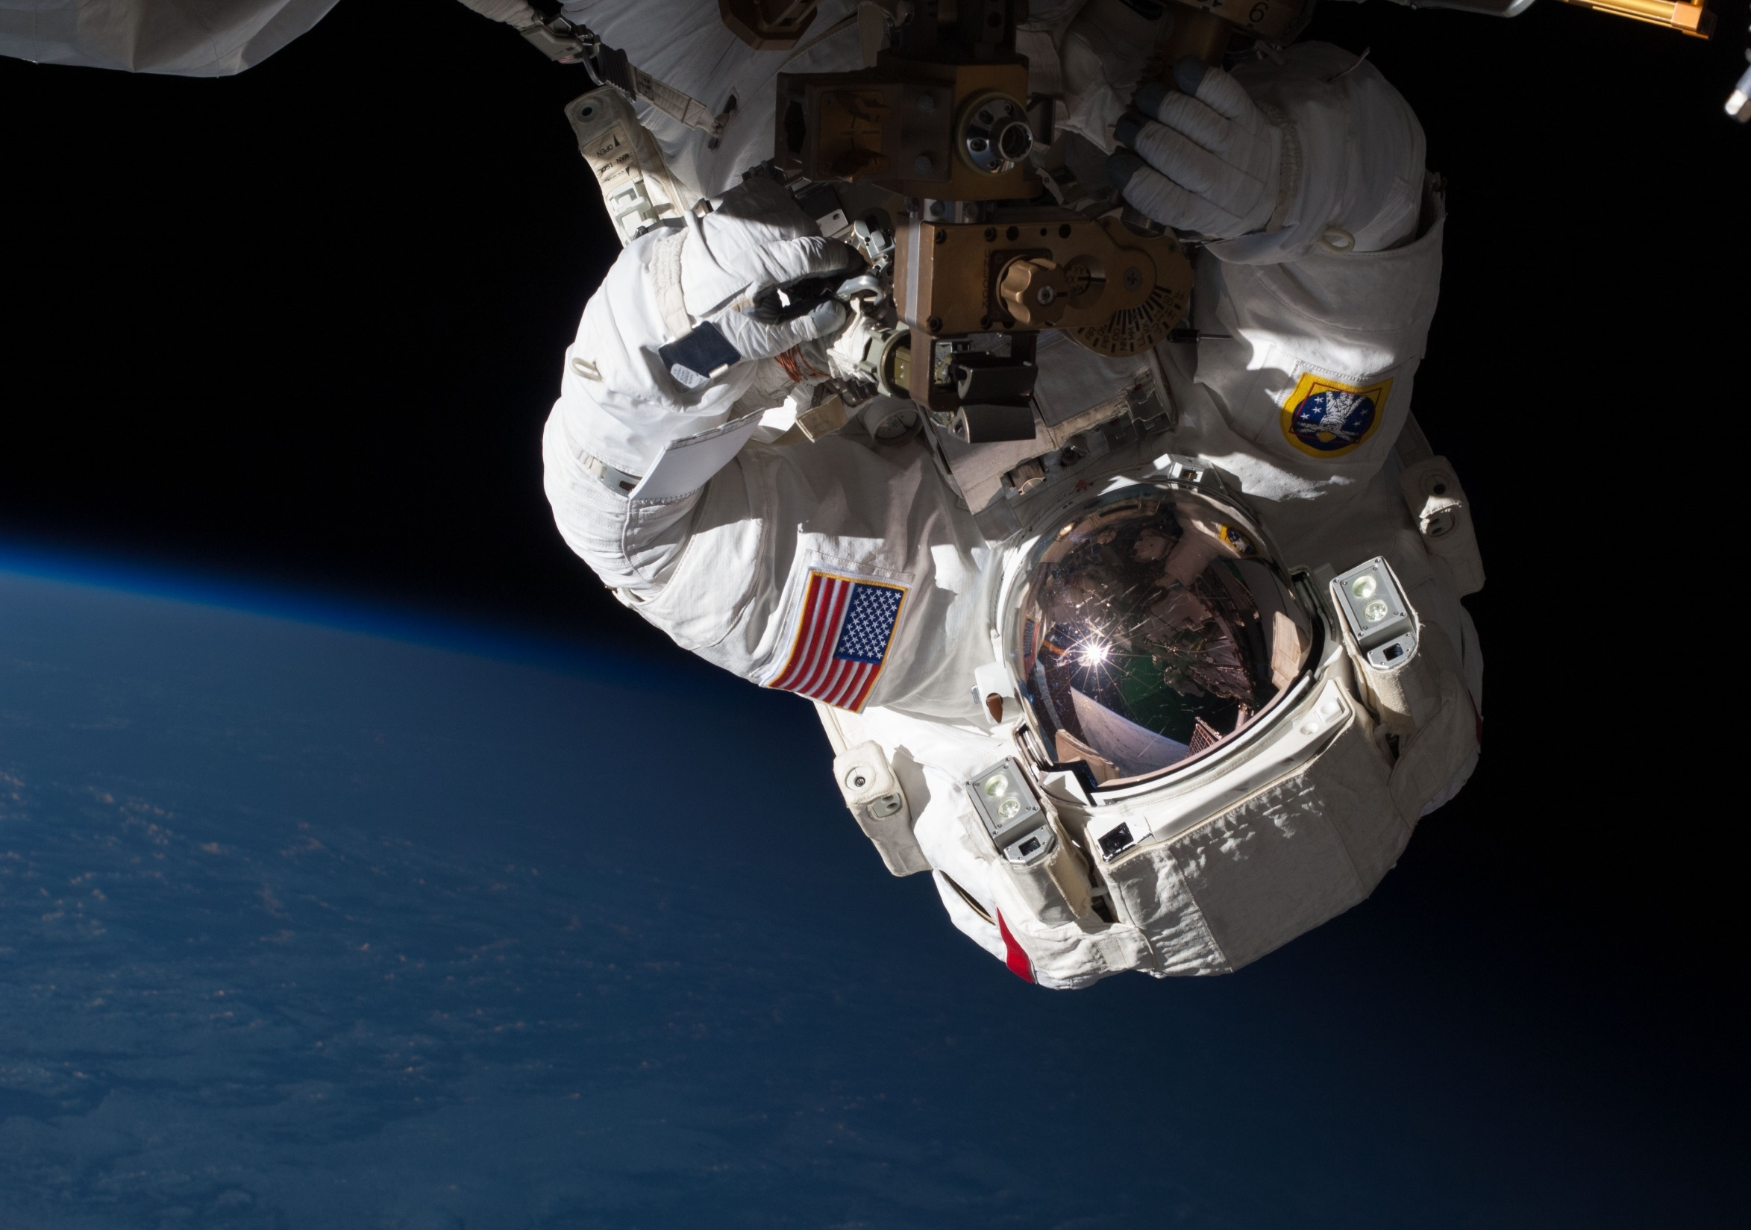
Visit the Spinoff website for more examples of NASA technology transfer: http://spinoff.nasa.gov

Slide 55
