Slide 1
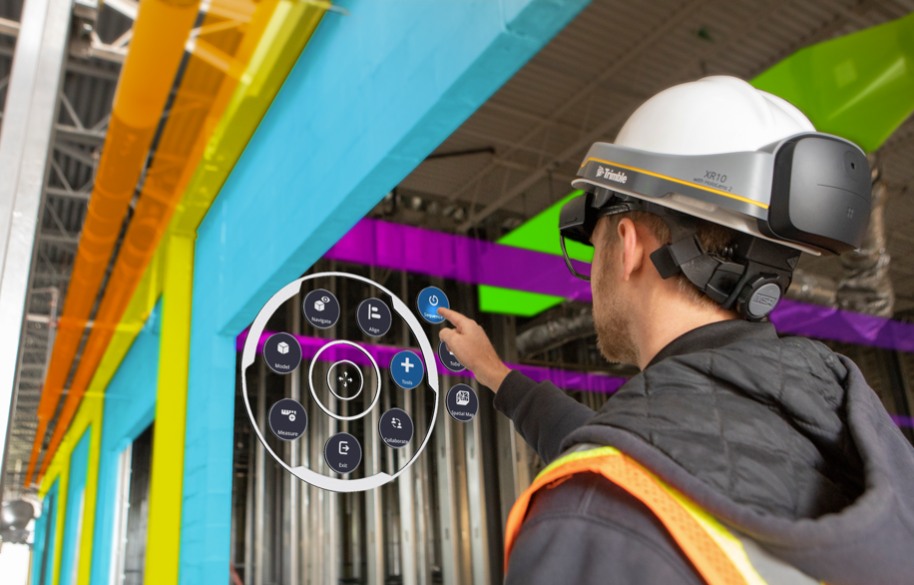
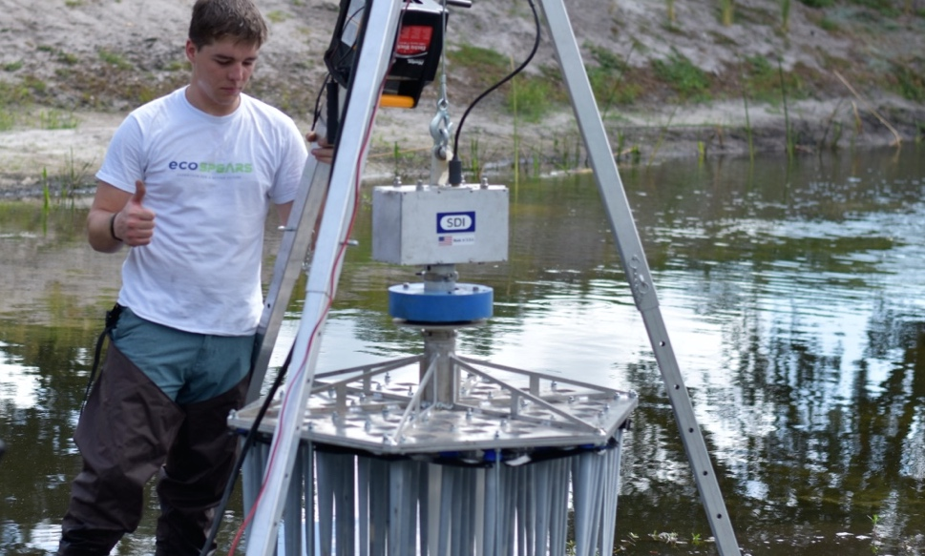
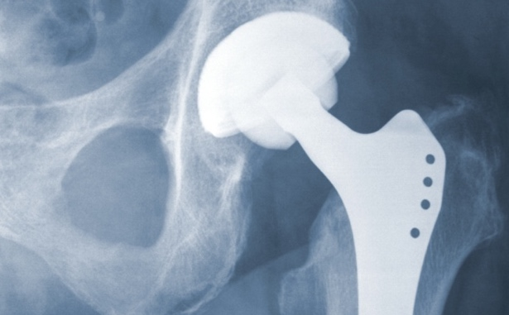
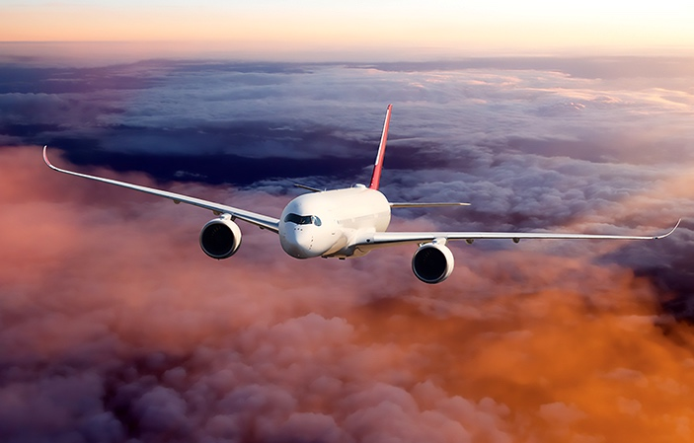
NASA has featured 2,000+ spinoff technologies improving life on Earth
Everyone benefits:
Students
Construction Workers
Conservationists
Farmers
Doctors and Patients
Airplane Passengers
First Responders

Slide 2
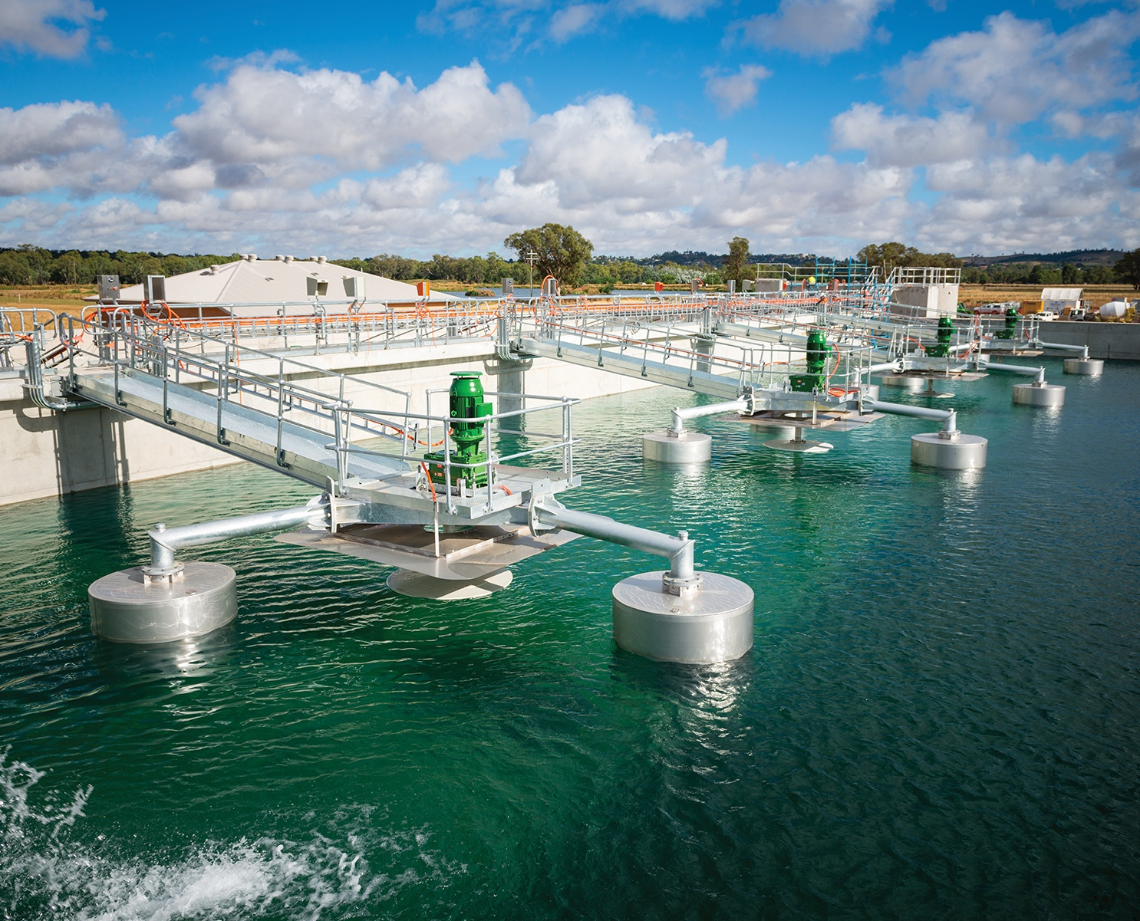
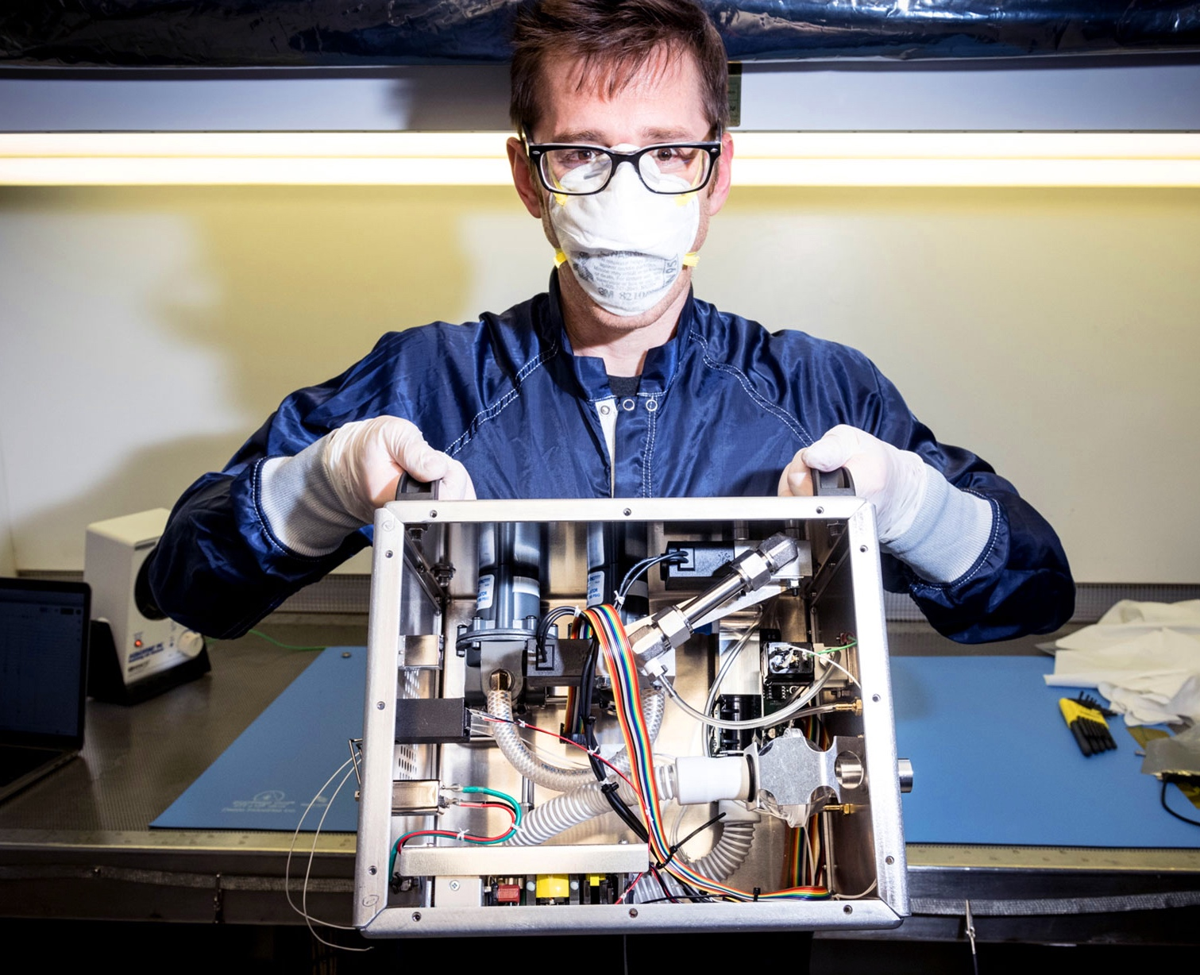
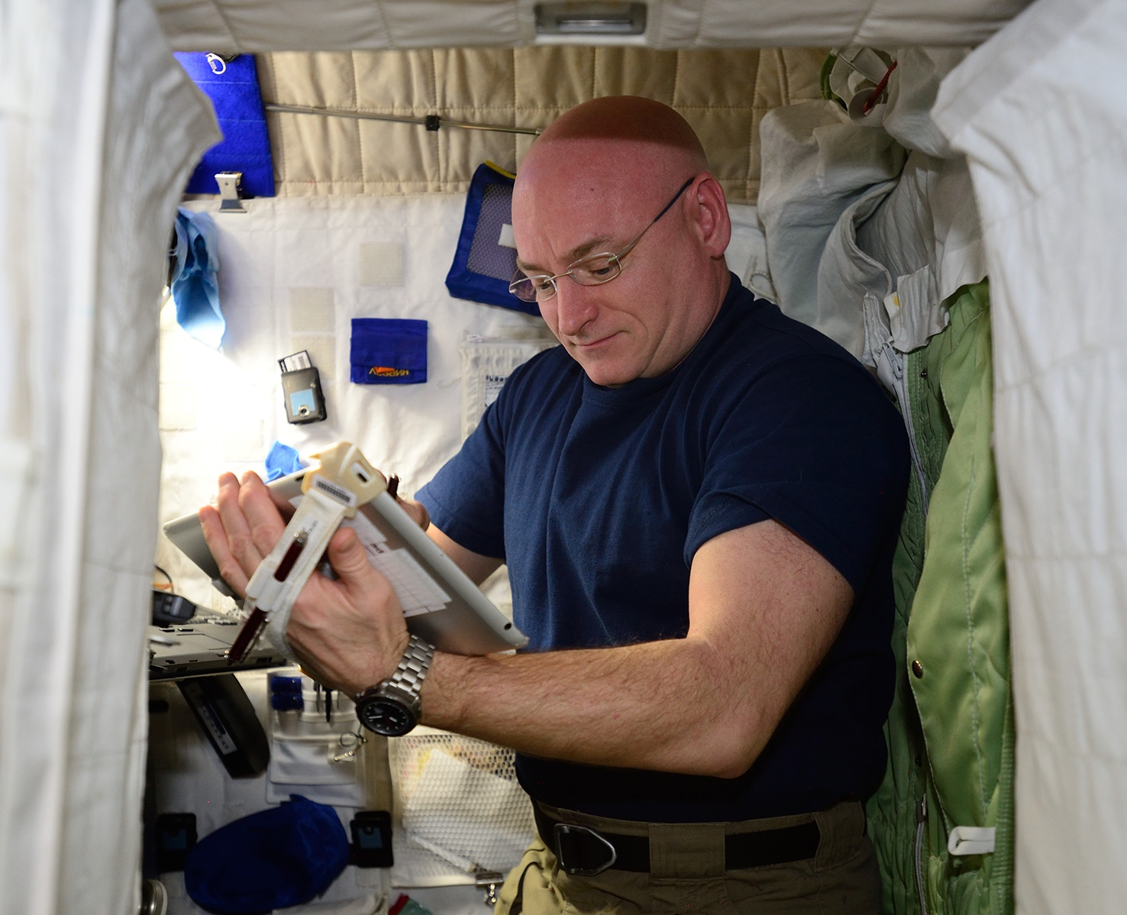
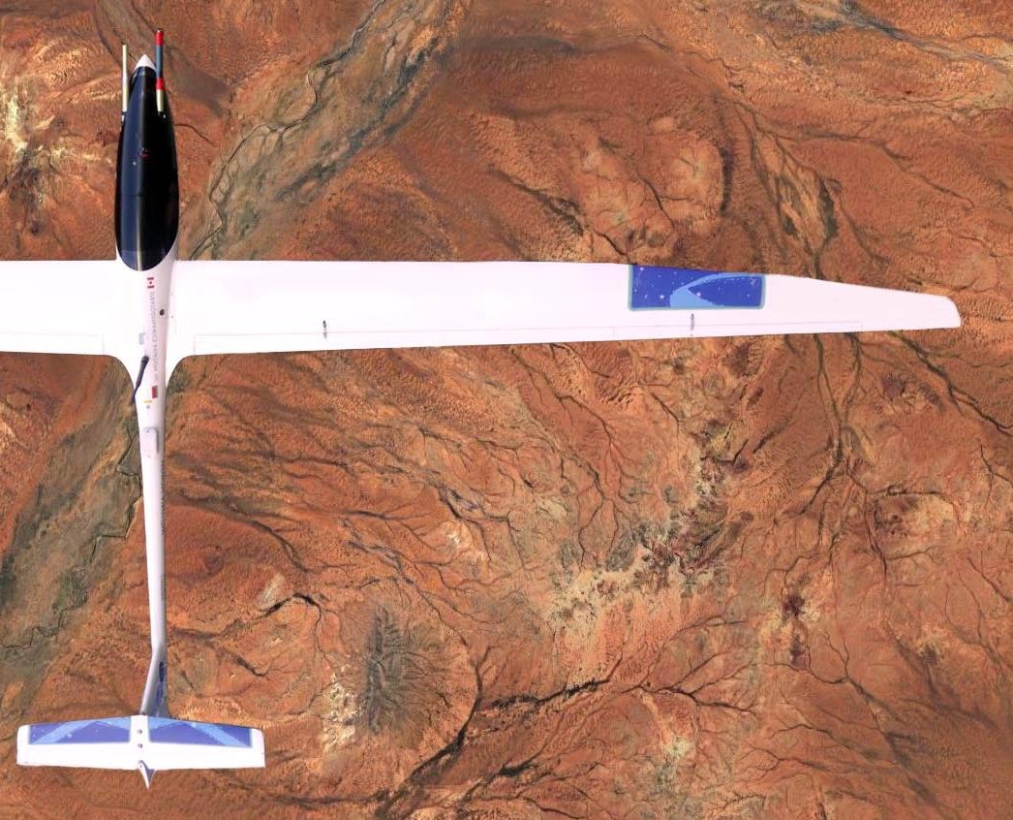
NASA spinoff technologies:
Save lives
Make the planet cleaner
Create jobs
Educate and entertain
Help small businesses
And more

